Slide 1
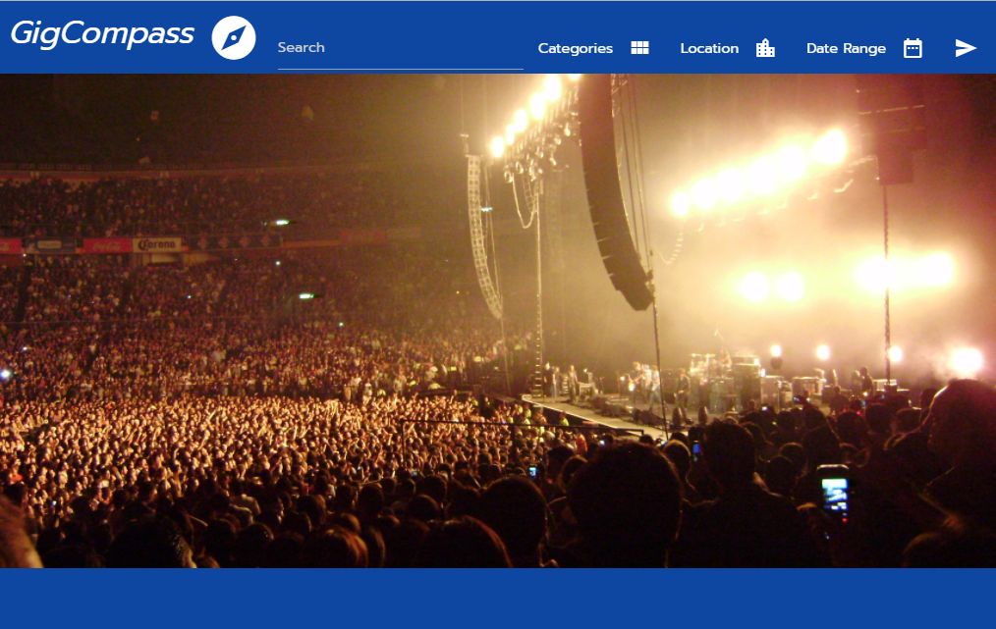

Gig Compass
Overall Concept
Motivation
Design Process
Technologies
Demo
Future Development
Implemented by: Lisa Zapson, John LaTona, Elisheva Elbaz

Slide 2


Overall Concept
Finds events in specified area and displays their locations on a map –powered by Ticketmaster and Google Maps APIs

Slide 3

Motivation
We all love music and thought it would be cool to develop an application to search for music in our area.

Slide 4

Design Process
We used a Bootstrap row-column grid layout to display the events and map side-by-side
We added materialize modals for the search dropdown-menus
Using local storage, application will apply the latest search parameters upon page loading
We designed it to show pages of 10 events each, with pagination bar
We designed the interactive map to display markers for all locations on the page
We added event pop-ups to show more information and to easily scroll through the different events

Slide 5

Design Process
We used a Bootstrap row-column grid layout to display the events and map side-by-side
We added materialize modals for the search dropdown-menus
Using local storage, application will apply the latest search parameters upon page loading
We designed it to show pages of 10 events each, with pagination bar
We designed the interactive map to display markers for all locations on the page
We added event pop-ups to show more information and to easily scroll through the different events

Slide 6

Technologies
APIs
Ticketmaster
GoogleMaps
CSS Libraries
Bootstrap
Materialize
Google Fonts
Javascript Libraries
jQuery
Moment.js
Data Persistence
Local Storage
Source Repository
GitHub
Issue Tracker
GitHub
Web Hosting
GitHub

Slide 7


Demo
Lisa – Search Bar
John – Ticketmaster Events and Google Map
Elisheva – Pagination and Mobile Responsiveness

Slide 8


Future Development
Store recent searches in session storage
Add Tool Tips
Add previous and next arrows for pagination
Add additional APIs for events other than Ticketmaster
Refactor code to reflect more mobile responsive styling consistency using classes

