Slide 1

Mini Project presentation
Real Estate Management System
Ambrose Tuscano 73
Elison Tuscano 74
Onish Dmello 79
Date of Presentation:
Under the guidance of: Mrs. Pradnya Pradhan
Department of Computer Engineering,
St. Francis Institute of Technology

Slide 2

Content
Introduction
Problem definition of the Application(Brief Description of Application)
System description
  Architecture or block diagram or Data Flow Diagram(Detail description of the functions implemented and used in the system)
Hardware & software requirements
User Interface Design (GUI snapshots)
Applications of the System
Conclusions
Literature Cited (book and web References)
Acknowledgements
Demo to be given for implementation
Real Estate Management System

Slide 3
Introduction
Online Realty Marketing allows user to store property, customer, seller, and staff details. It will allow users to update, search property details and use them whenever necessary. It will also be able to provide financial, sold properties, all staff, all contacts reports. Using this we can improve seller’s customer response rates, tune their plans and generate additional sales
Realty

Slide 4
Problem definition
This website is a online real estate management through which individual agents or buyer can maintain their property document keeping and managing property registration and also access its information and manage all the adding, updating, deleting the as and some of its tasks .The Admin user can inform their agents for regarding to property and update the information regarding property and cancellation of property or changing buyer choice. The system is very useful for the companies or builders that can post and edit their properties and their personal info and admin can monitor records of all of them
Realty

Slide 5
System description
Our system saves time and money: Accurate upfront software requirements definition helps ensure your team works on the business problems that matter most.
Reduce rework: Early validation and agreement by stakeholder’s means development and quality teams spend less time on rework.
Improve requirement accuracy: Industry-unique collaborative storyboarding improves accuracy by promoting effective communication.
Realty

Slide 6
Hardware & software requirements
  Hardware Interfaces
Any processor after Pentium 4.
Any version of Windows XP or later.
  Software Interfaces
Any Version of browser after Mozilla Firefox 4.0, Internet Explorer 6.0
Adobe Flash Player 10.0
Languages used are HTML, CSS, PHP, BOOTSTRAP
Xampp /Apache Server
Realty

Slide 7
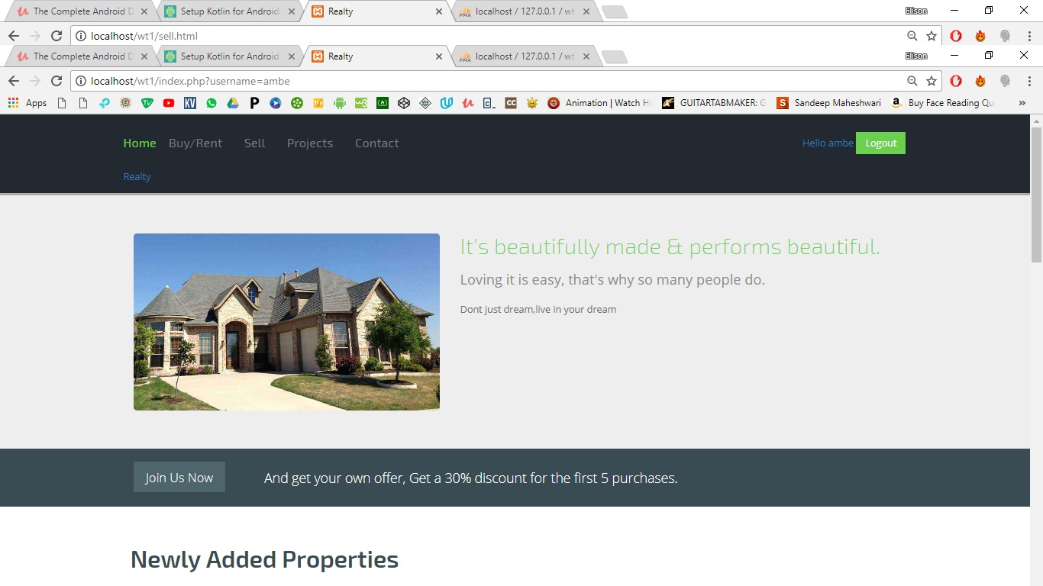
User Interface Design
The website will contain buttons with sign up and login option for both buyer and seller. Once signed up by user he can login and access his profile. In same way customer can signed up and then login to buy or rent as per his wish.
Realty

Slide 8
Applications of the System
Online Realty Marketing allows user to store property, customer, seller, and staff details. It will allow users to update, search property details and use them whenever necessary. It will also be able to provide financial, sold properties, all staff, all contacts reports. Using this we can improve seller’s customer response rates, tune their plans and generate additional sales. There would be features like login, registration, searching properties, browsing properties, etc. User can also post their properties for sale. Due to this system there is no need to visit various places in search of property. All this information can be accessible at one place
Realty

Slide 9
Conclusions
The World Wide Web has spread across millions of household, so Internet has become the best platform for real estate marketing today. It is an online portal for buyer and seller who wants to invest in real estate business. Online Realty Marketing allows user to store property, customer, seller, and staff details. It will allow users to update, search property details and use them whenever necessary. It will also be able to provide financial, sold properties, all staff, all contacts reports. Using this we can improve seller’s customer response rates, tune their plans and generate additional sales
Realty

Slide 10
Literature Cited
https://www.w3schools.com
http://www.codepen.io/
http://freecodecamp.org
http://99acres.com
Realty

Slide 11
Acknowledgements
We are extremely grateful to our guide Ms. Pradnya Pradhan for providing us all support, encouragement, suggestions and guidance which made us complete our project on time.
We owe our profound gratitude to our honourable Head of Department Dr. Kavita Sonawane for her cooperation, constant encouragement and guided us all along the project.
I would not forget to heartily thank our Principal Dr. Sincy George for her unlisted encouragement and more over for her timely support and guidance.
Realty

Slide 12
Questions??
Thank You!

