Slide 1


Assignment #01: Finite Difference Method
MEC8211
Vérification et Validation en Modélisation Numérique
Instructor:
David Vidal
Student Name:
Elissa El Hajj 2189711
Mohamad Mobin Nurzad Liyasi 2141987
Fall 2022

Slide 2
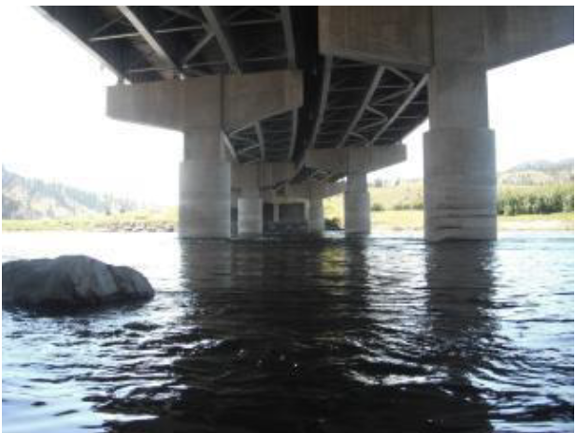
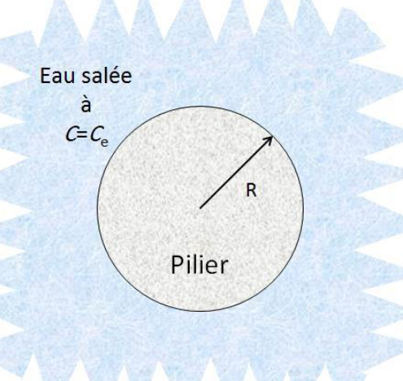
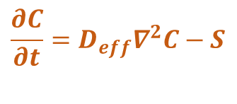
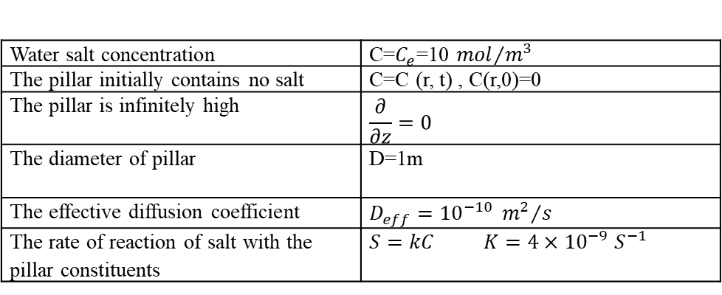
Physics of problem
The study of evolution of salt concentration inside the porous structure of a concrete pillar
The diffusion process in the concrete pillar is described by the second law of Fick:
$$\frac{∂C}{∂t}=D_{eff}∇^{2}C−S$$
Data we may need:
Water salt concentration | C=$C_{e}$=10 ${mol}/{m^{3}}$
The pillar initially contains no salt | C=C (r, t) , C(r,0)=0
The pillar is infinitely high | $$\frac{∂}{∂z}=0$$
The diameter of pillar | D=1m
The effective diffusion coefficient | $$D_{eff}={10}^{−10} {m^{2}}/s$$
The rate of reaction of salt with the pillar constituents | $S=kC$ $K=4×{10}^{−9}$ $S^{−1}$
Git hub Repository: https://github.com/elissa8/first_project

Slide 3
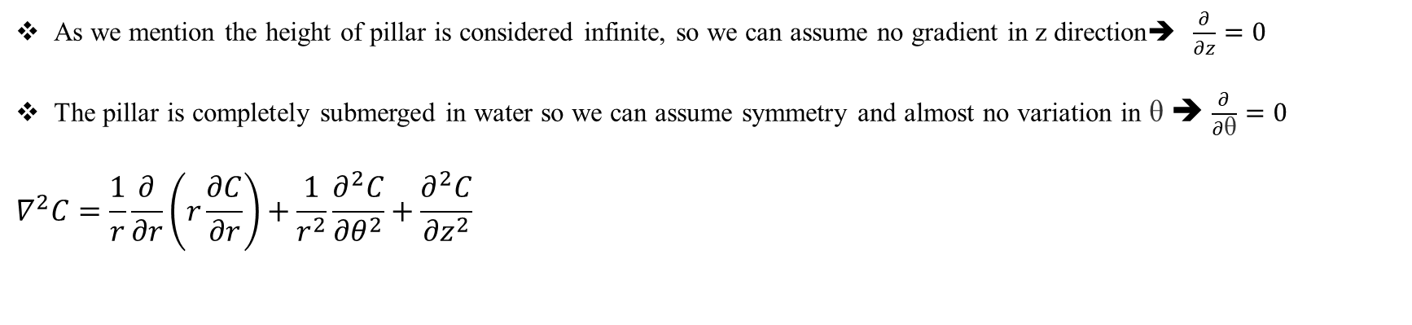
A. Simplify and stablish the problem
Type of equation
Most partial differential equations are of three basic types: elliptic, hyperbolic, and parabolic. Parabolic equations are often called diffusion equations as they describe the diffusion and convection of some substance. The dependent variable usually represents the density of the substance. These equations require initial conditions (what the initial concentration of the substance is) as well as boundary conditions (to specify, for instance, whether the substance can cross the boundary or not).
Dimensions
As we mention the height of pillar is considered infinite, so we can assume no gradient in z direction➔ $\frac{∂}{∂z}=0$
The pillar is completely submerged in water so we can assume symmetry and almost no variation in θ ➔ $\frac{∂}{∂\text{θ}}=0$
$$∇^{2}C=\frac{1}{r}\frac{∂}{∂r}\left(r\frac{∂C}{∂r}\right)+\frac{1}{r^{2}}\frac{∂^{2}C}{{∂θ}^{2}}+\frac{∂^{2}C}{{∂z}^{2}}$$
0
0

Slide 4
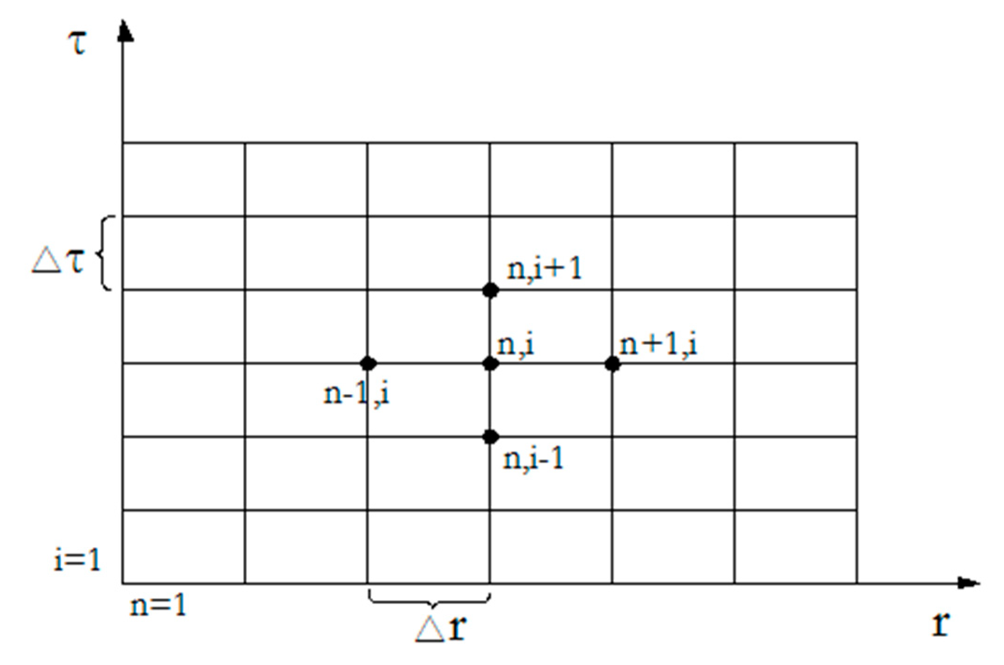
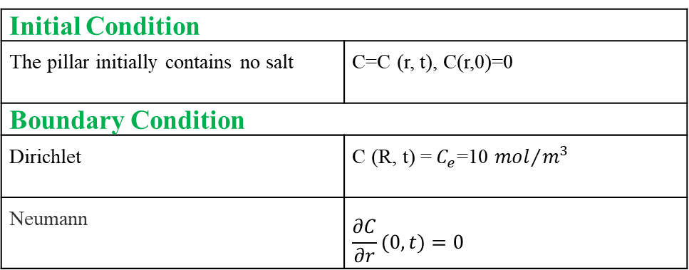
A. Simplify and stablish the problem
Discretized domain
Boundary and Initial condition
Initial Condition
The pillar initially contains no salt | C=C (r, t), C(r,0)=0
Boundary Condition
Dirichlet | C (R, t) = $C_{e}$=10 ${mol}/{m^{3}}$
Neumann | $$\frac{∂C}{∂r}(0,t)=0$$

Slide 5

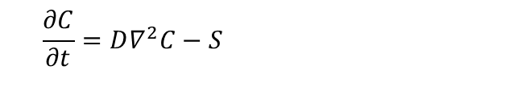
B. Discretization
Stability of discretization
Second law of Fick:
$$\frac{∂C}{∂t}=D∇^{2}C−S$$
We have: $\frac{∂C}{∂t}=D\frac{1}{r}\frac{∂}{∂r}\left(r\frac{∂C}{∂r}\right)−S$
Derivative of product: $\left[\frac{∂}{∂x}\left(f\left(x\right)g\left(x\right)\right)=f\left(x\right)\frac{∂}{∂x}\left(g\left(x\right)\right)+g(x)\frac{∂}{∂x}\left(f\left(x\right)\right)\right]$
$\frac{∂C}{∂t}=D\frac{1}{r}\left[\left(\frac{∂c}{∂r}\right)+\left(r\frac{∂^{2}c}{∂r^{2}}\right)\right]−S$ ➔ $\frac{∂C}{∂t}=D\left[\left(\frac{1}{r}\frac{∂c}{∂r}\right)+\left(\frac{∂^{2}c}{∂r^{2}}\right)\right]−S$
Forward approximation for first derivative, explicit forward (Euler) time stepping, Second order centered approximation for second derivative
$$\frac{C_{i}^{t+1}−C_{i}^{t}}{∆t}=D\left[\left(\frac{C_{i+1}^{t}−2C_{i}^{t}+C_{i−1}^{t}}{{∆x}^{2}}\right)+\left(\frac{1}{x}\frac{C_{i+1}^{t}−C_{i}^{t}}{∆x}\right)\right]−S$$

Slide 6
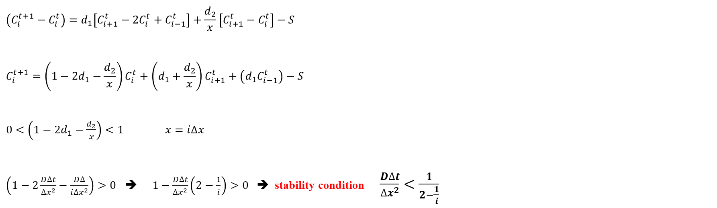
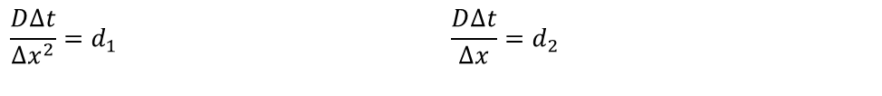

B. Discretization
$$\frac{C_{i}^{t+1}−C_{i}^{t}}{∆t}=D\left[\left(\frac{C_{i+1}^{t}−2C_{i}^{t}+C_{i−1}^{t}}{{∆x}^{2}}\right)+\left(\frac{1}{x}\frac{C_{i+1}^{t}−C_{i}^{t}}{∆x}\right)\right]−S$$
$$\frac{D∆t}{{∆x}^{2}}=d_{1}$$ | $$\frac{D∆t}{∆x}=d_{2}$$
$$\left(C_{i}^{t+1}−C_{i}^{t}\right)=d_{1}\left[C_{i+1}^{t}−2C_{i}^{t}+C_{i−1}^{t}\right]+\frac{d_{2}}{x}\left[C_{i+1}^{t}−C_{i}^{t}\right]−S$$
$$C_{i}^{t+1}=\left(1−2d_{1}−\frac{d_{2}}{x}\right)C_{i}^{t}+\left(d_{1}+\frac{d_{2}}{x}\right)C_{i+1}^{t}+\left(d_{1}C_{i−1}^{t}\right)−S$$
$0<\left(1−2d_{1}−\frac{d_{2}}{x}\right)<1$ $x=i∆x$
$\left(1−2\frac{D∆t}{{∆x}^{2}}−\frac{D∆}{{i∆x}^{2}}\right)>0$ ➔ $1−\frac{D∆t}{{∆x}^{2}}\left(2−\frac{1}{i}\right)>0$➔ stability condition $\frac{D∆t}{{∆x}^{2}}<\frac{1}{2−\frac{1}{i}}$
stability condition
$\frac{D∆t}{{∆x}^{2}}<\frac{1}{2−\frac{1}{i}}$

Slide 7
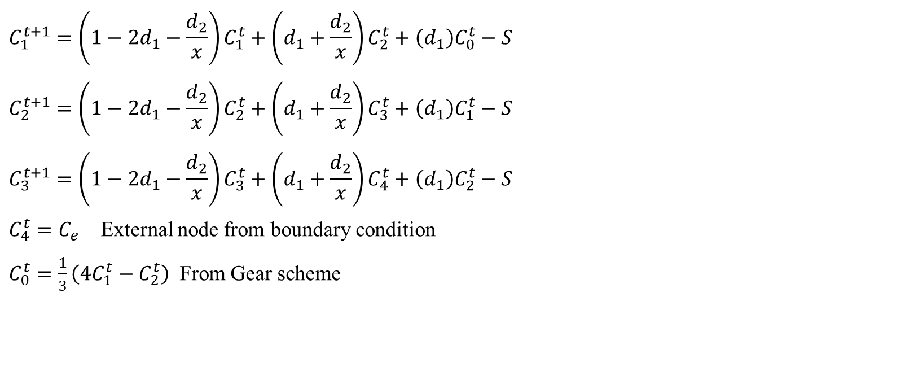
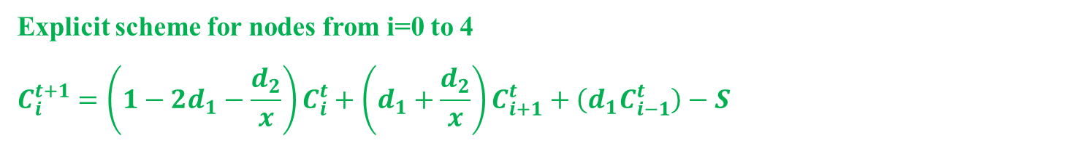
B. Discretization
Discretized equation obtained for each node.
Explicit scheme for nodes from i=0 to 4
$$C_{i}^{t+1}=\left(1−2d_{1}−\frac{d_{2}}{x}\right)C_{i}^{t}+\left(d_{1}+\frac{d_{2}}{x}\right)C_{i+1}^{t}+\left(d_{1}C_{i−1}^{t}\right)−S$$
$$C_{1}^{t+1}=\left(1−2d_{1}−\frac{d_{2}}{x}\right)C_{1}^{t}+\left(d_{1}+\frac{d_{2}}{x}\right)C_{2}^{t}+\left(d_{1}\right)C_{0}^{t}−S$$
$$C_{2}^{t+1}=\left(1−2d_{1}−\frac{d_{2}}{x}\right)C_{2}^{t}+\left(d_{1}+\frac{d_{2}}{x}\right)C_{3}^{t}+\left(d_{1}\right)C_{1}^{t}−S$$
$$C_{3}^{t+1}=\left(1−2d_{1}−\frac{d_{2}}{x}\right)C_{3}^{t}+\left(d_{1}+\frac{d_{2}}{x}\right)C_{4}^{t}+\left(d_{1}\right)C_{2}^{t}−S$$
$C_{4}^{t}=C_{e}$ External node from boundary condition
$C_{0}^{t}=\frac{1}{3}\left(4C_{1}^{t}−C_{2}^{t}\right)$ From Gear scheme

Slide 8
B. Discretization
Expected order of precision
2nd Order Centered FD scheme is used for the spatial second derivatives discretization and fist order forward scheme for spatial first order discretization.
1st Order Euler scheme is used for temporal discretization; therefore a 1st order convergence rate is expected from the theoretical point of view.
If we use Gear scheme, then near a 2nd order convergence rate is expected from the theoretical point of view. If we use a first order scheme for boundary, then 1st order convergence is expected

Slide 9
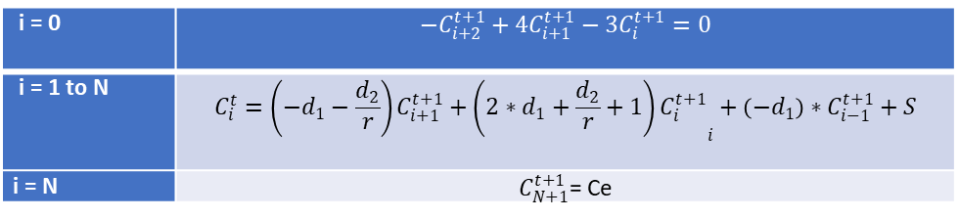
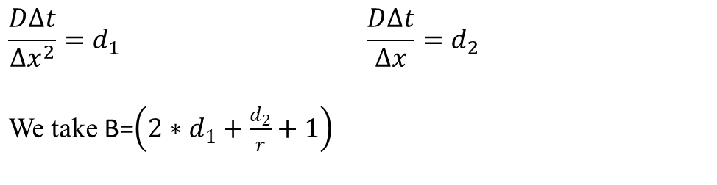
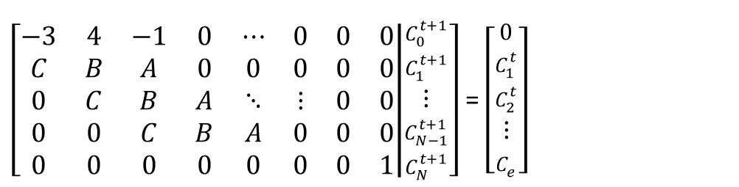
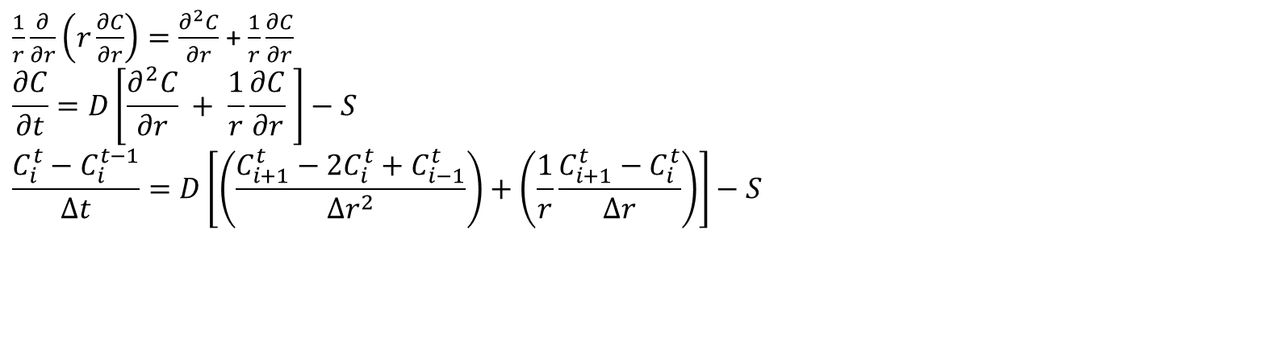

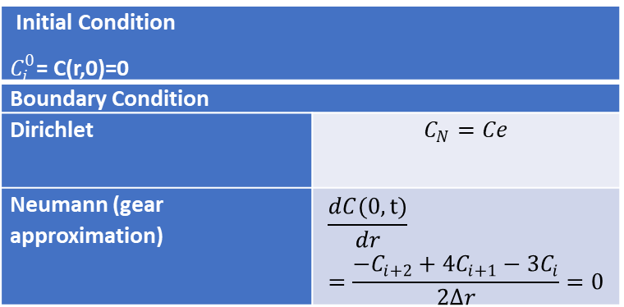
B/D. Discretization using Euler Implicit
$\frac{1}{r}\frac{∂}{∂r}\left(r\frac{∂C}{∂r}\right)=\frac{∂^{2}C}{∂r}$ + $\frac{1}{r}\frac{∂C}{∂r}$
$$\frac{∂C}{∂t}=D\left[\frac{∂^{2}C}{∂r} + \frac{1}{r}\frac{∂C}{∂r} \right]−S$$
$$\frac{C_{i}^{t}−C_{i}^{t−1}}{∆t}=D\left[\left(\frac{C_{i+1}^{t}−2C_{i}^{t}+C_{i−1}^{t}}{{∆r}^{2}}\right)+\left(\frac{1}{r}\frac{C_{i+1}^{t}−C_{i}^{t}}{∆r}\right)\right]−S$$
Initial Condition $C_{i}^{0}$= C(r,0)=0
Boundary Condition
Dirichlet | $$C_{N}=Ce$$
Neumann (gear approximation) | $$\frac{dC(0,t)}{dr}=\frac{−C_{i+2}+4C_{i+1}−{3C}_{i}}{2∆r}=0$$
$$\frac{D∆t}{{∆x}^{2}}=d_{1}$$ We take B=$\left(2∗d_{1}+\frac{d_{2}}{r}+1\right)$ | $$\frac{D∆t}{∆x}=d_{2}$$
A= $−d_{1}−\frac{d_{2}}{r}$
C= $−d_{1}$
$\left[\begin{matrix}−3 & 4 & −1 & 0 & ⋯ & 0 & 0 & 0 \\ C & B & A & 0 & 0 & 0 & 0 & 0 \\ 0 & C & B & A & ⋱ & ⋮ & 0 & 0 \\ 0 & 0 & C & B & A & 0 & 0 & 0 \\ 0 & 0 & 0 & 0 & 0 & 0 & 0 & 1\end{matrix} | \begin{aligned}C_{0}^{t+1} \\ C_{1}^{t+1} \\ ⋮ \\ C_{N−1}^{t+1} \\ C_{N}^{t+1}\end{aligned}\right]$ = $\left[\begin{matrix}0 \\ C_{1}^{t} \\ C_{2}^{t} \\ ⋮ \\ C_{e}\end{matrix}\right]$
i = 0 | $$−C_{i+2}^{t+1}+4C_{i+1}^{t+1}−3C_{i}^{t+1}=0$$
i = 1 to N | $$C_{i}^{t}=\left(−d_{1}−\frac{d_{2}}{r}\right)C_{i+1}^{t+1}+{\left(2∗d_{1}+\frac{d_{2}}{r}+1\right)C_{i}^{t+1}}_{i}+\left(−d_{1}\right)∗C_{i−1}^{t+1}+S$$
i = N | $C_{N+1}^{t+1}$= Ce

Slide 10
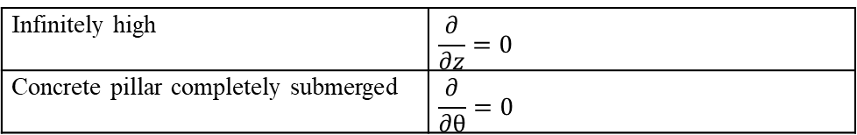
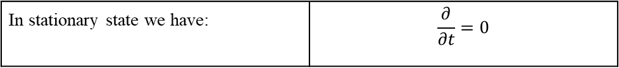
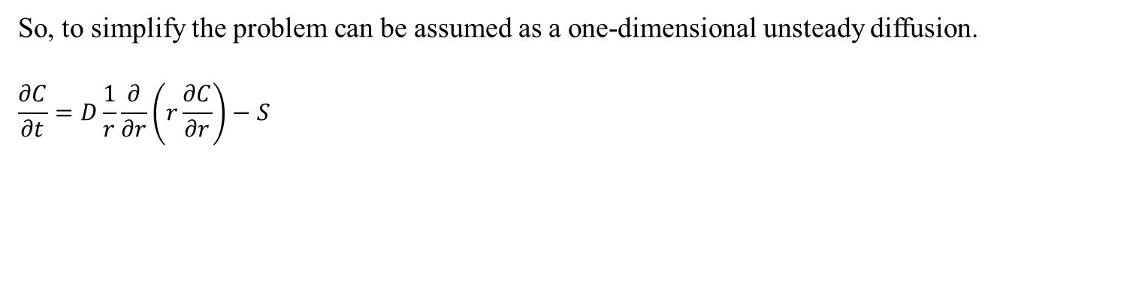
C. Analytical Steady State Solution
First, we begin with Fick’s Law $\frac{∂C}{∂t}=D∇^{2}C−S$
In cylindrical coordinate we have $∇^{2}f=\frac{1}{r}\frac{∂}{∂r}\left(r\frac{∂f}{∂r}\right)+\frac{1}{r^{2}}\frac{∂^{2}f}{{∂θ}^{2}}+\frac{∂^{2}f}{{∂z}^{2}}$
As mentioned in the description of problem:
Infinitely high | $$\frac{∂}{∂z}=0$$
Concrete pillar completely submerged | $$\frac{∂}{∂θ}=0$$
So, to simplify the problem can be assumed as a one-dimensional unsteady diffusion.
$$\frac{∂C}{∂t}=D\frac{1}{r}\frac{∂}{∂r}\left(r\frac{∂C}{∂r}\right)−S$$
In stationary state we have: | $$\frac{∂}{∂t}=0$$

Slide 11
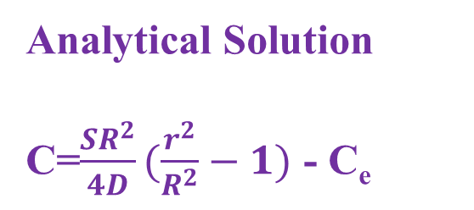

C. Analytical Steady State Solution
$\frac{∂C}{∂t}=D\frac{1}{r}\frac{∂}{∂r}\left(r\frac{∂C}{∂r}\right)−S$ ➔ 0$=D\frac{1}{r}\frac{∂}{∂r}\left(r\frac{∂C}{∂r}\right)−S$➔ $\frac{1}{r}\frac{∂}{∂r}\left(r\frac{∂C}{∂r}\right)=\frac{S}{D}➔$
$\frac{∂}{∂r}\left(r\frac{∂C}{∂r}\right)=\frac{Sr}{D}$ ➔$\left(r\frac{∂C}{∂r}\right)=\frac{Sr^{2}}{2D}+k$➔ $\frac{∂C}{∂r}$=$\frac{Sr}{2D}+A$➔ [$\frac{∂C}{∂r}$(0, t) =0] So A=0
$C=\frac{Sr^{2}}{4D}+B$➔[C (R, t) =C_{e}] ➔ C=$\frac{SR^{2}}{4D}(\frac{r^{2}}{R^{2}}−1)$ - C_{e}
0
∫
Analytical Solution
C=$\frac{SR^{2}}{4D}(\frac{r^{2}}{R^{2}}−1)$ - C_{e}

Slide 12
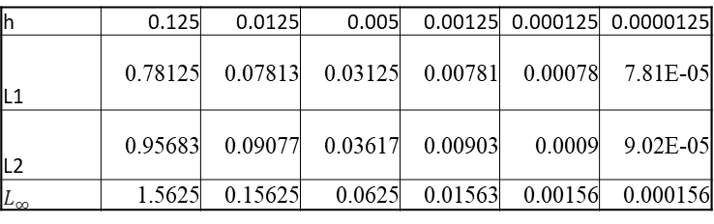
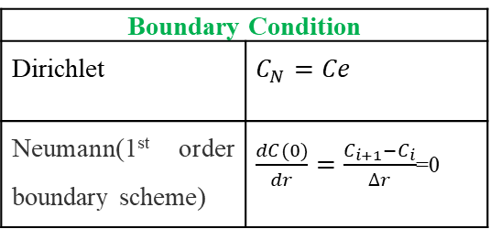

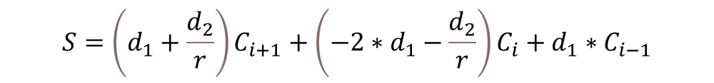
E. Steady State forward Approximation
$S=D\left[\left(\frac{C_{i+1}−2C_{i}+C_{i−1}}{{∆r}^{2}}\right)+\left(\frac{1}{r}\frac{C_{i+1}−C_{i}}{∆r}\right)\right]$ and $\frac{D}{{∆r}^{2}}=d_{1}$ and $\frac{D}{∆r}=d_{2}$
Using MATLAB, we find the value of C for 6 different meshes: N=[4 40 100 400 4000 40000]
Then we compare the numerical solution with the analytical solution. We also find $L_{1},L_{2} and L_{∞}$:
$$S=\left(d_{1}+\frac{d_{2}}{r}\right)C_{i+1}+{\left(−2∗d_{1}−\frac{d_{2}}{r}\right)C}_{i}+d_{1}∗C_{i−1}$$
Boundary Condition
Dirichlet | $$C_{N}=Ce$$
Neumann(1st order boundary scheme) | $\frac{dC(0)}{dr}=\frac{C_{i+1}−C_{i}}{∆r}$=0
h | 0.125 | 0.0125 | 0.005 | 0.00125 | 0.000125 | 0.0000125
L1 | 0.78125 | 0.07813 | 0.03125 | 0.00781 | 0.00078 | 7.81E-05
L2 | 0.95683 | 0.09077 | 0.03617 | 0.00903 | 0.0009 | 9.02E-05
$$L_{∞}$$ | 1.5625 | 0.15625 | 0.0625 | 0.01563 | 0.00156 | 0.000156

Slide 13
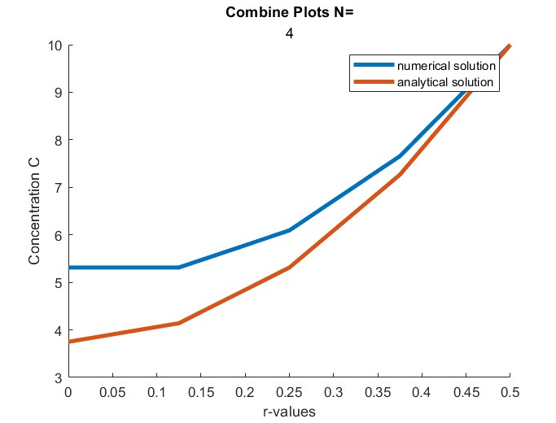
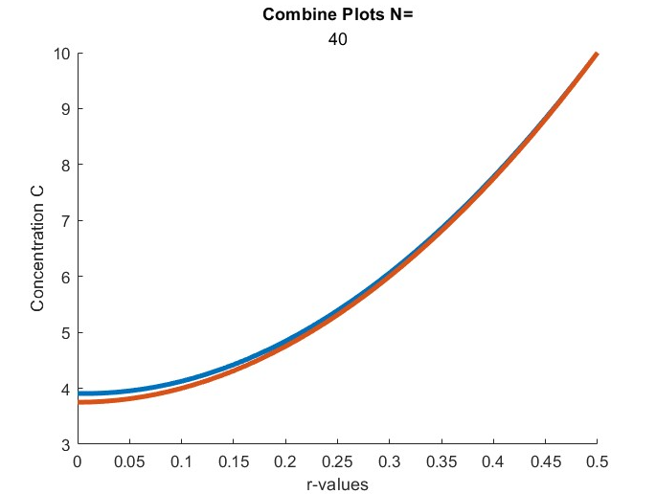
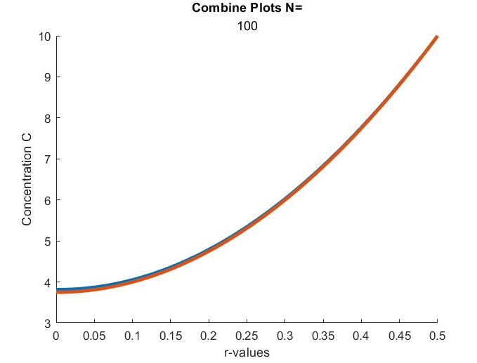
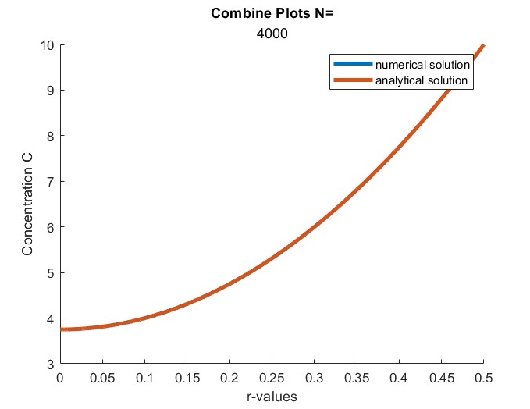
E. Steady State forward Approximation
The numerical and analytical curves are almost similar for N>4000.
However, after drawing the log L vs log h plot, we notice that the error is high if h not small enough.
As we have first order approximation for the first derivative and used first order for boundary condition, the error is order of one as you see in the plots

Slide 14
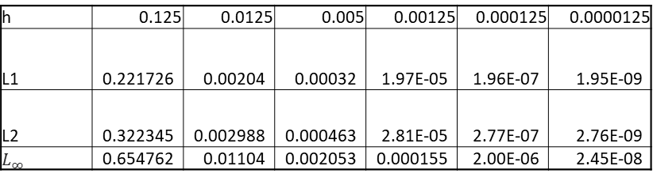
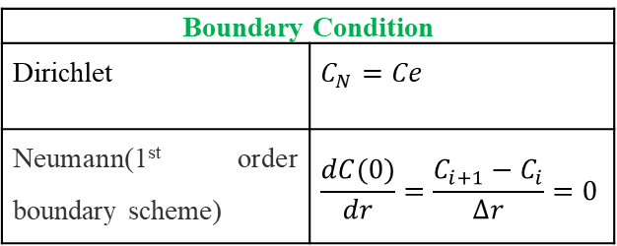

F. Steady State Central Approximation
$S=D\left[\left(\frac{C_{i+1}−2C_{i}+C_{i−1}}{{∆r}^{2}}\right)+\left(\frac{1}{r}\frac{C_{i+1}−C_{i}}{∆r}\right)\right]$ and $\frac{D}{{∆r}^{2}}=d_{1}$ and $\frac{D}{2∆r}=d_{2}$
$$S=\left(d_{1}+\frac{d_{2}}{r}\right)C_{i+1}+{\left(−2∗d_{1}\right)C}_{i}+\left(d_{1}−\frac{d_{2}}{r}\right)∗C_{i−1}$$
Using MATLAB, we find the value of C for 6 different meshes: N=[4 40 100 400 4000 40000]
Then we compare the numerical solution with the analytical solution. We also find $L_{1},L_{2} and L_{∞}$:
Boundary Condition
Dirichlet | $$C_{N}=Ce$$
Neumann(1st order boundary scheme) | $$\frac{dC(0)}{dr}=\frac{C_{i+1}−C_{i}}{∆r}=0$$
h | 0.125 | 0.0125 | 0.005 | 0.00125 | 0.000125 | 0.0000125
L1 | 0.221726 | 0.00204 | 0.00032 | 1.97E-05 | 1.96E-07 | 1.95E-09
L2 | 0.322345 | 0.002988 | 0.000463 | 2.81E-05 | 2.77E-07 | 2.76E-09
$$L_{∞}$$ | 0.654762 | 0.01104 | 0.002053 | 0.000155 | 2.00E-06 | 2.45E-08

Slide 15
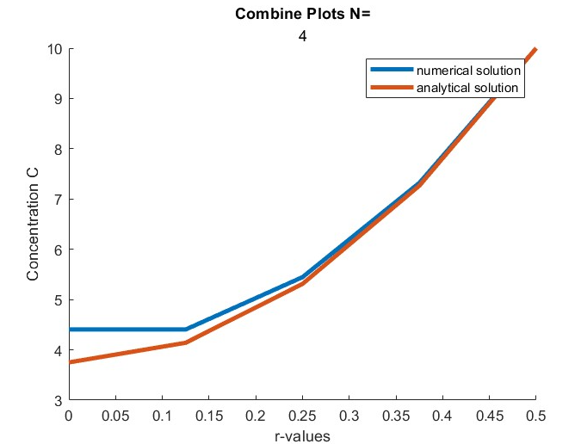
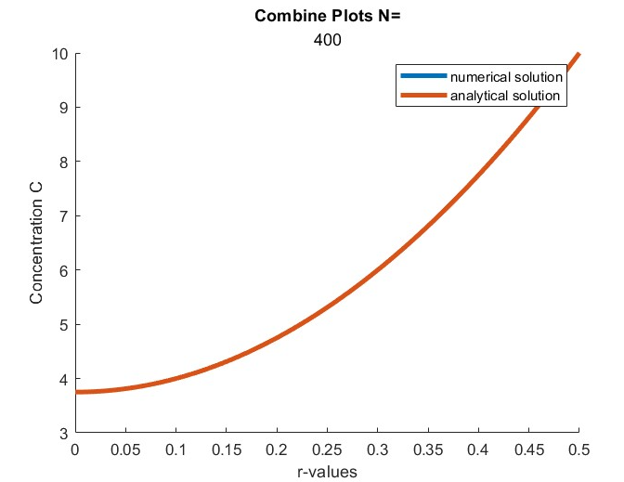
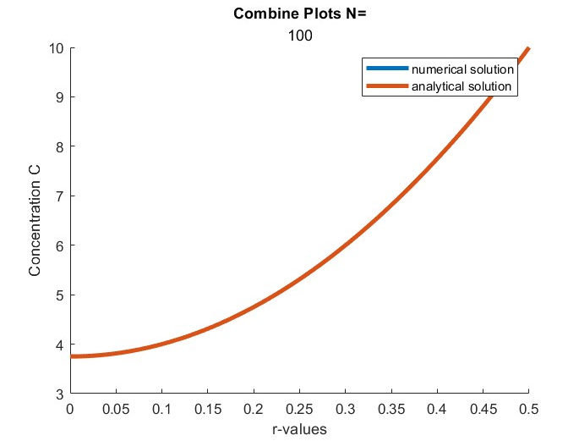
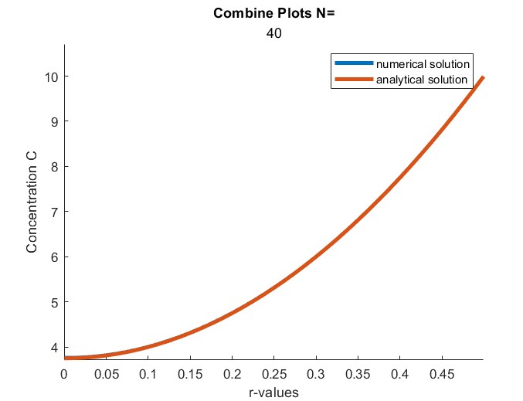
F. Steady State Central Approximation
Using Central Approximation, we notice the results are more accurate than using forward approximation. The convergent is applicable for higher h.

