Slide 1
Shin Cuff and Footplate

Slide 2
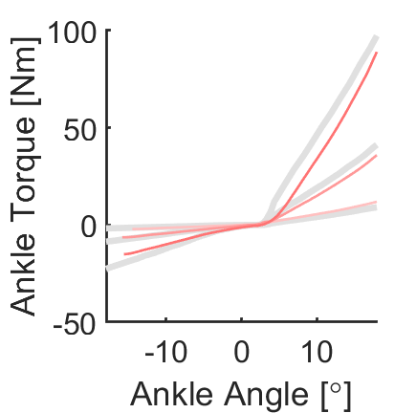
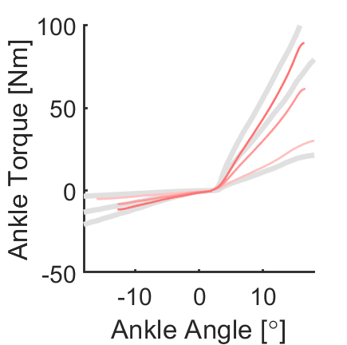
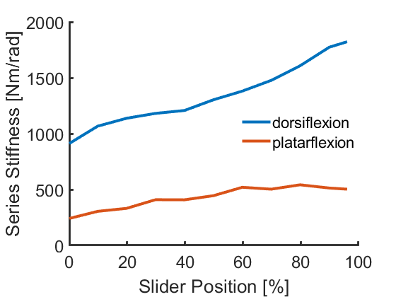
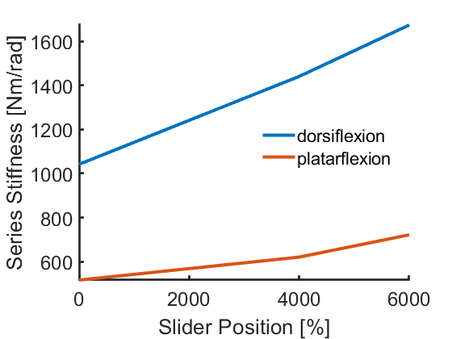
CAM 3 (Softest Cam)
[0-100]% intervals of 10%
18 degrees
CAM 1 (Stiffest Cam)
[0 10 40 60]%
15 degrees

Slide 3
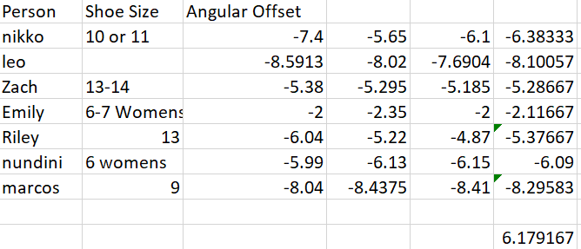
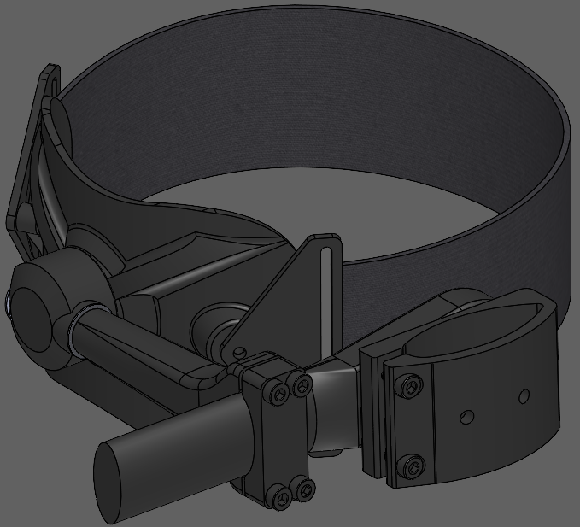
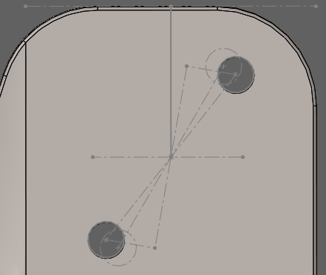
New: ~8.5deg adjustment (25 grams less)
Old: ~4.5 deg adjustment

Slide 4
Appendix

Slide 5
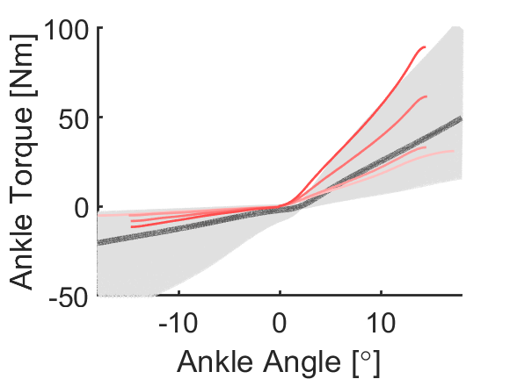
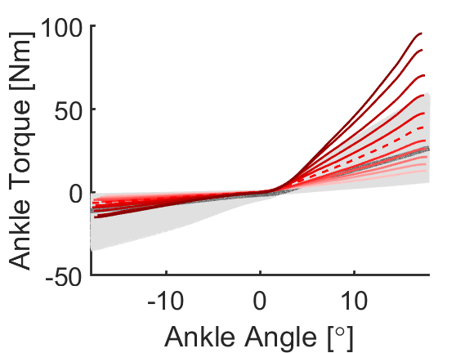
CAM 1 (Stiffest Cam)
[0 10 40 60]%
15 degrees
CAM 3 (Softest Cam)
[0-100]% intervals of 10%
18 degrees

Slide 6
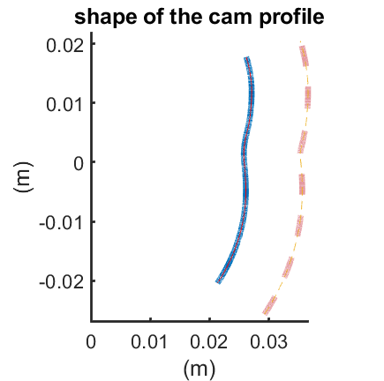
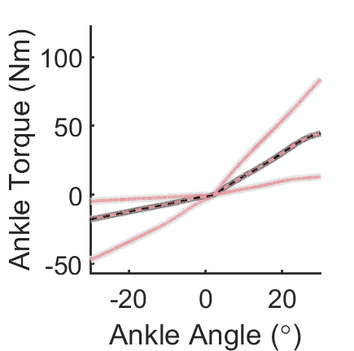
Math Correct

Slide 7
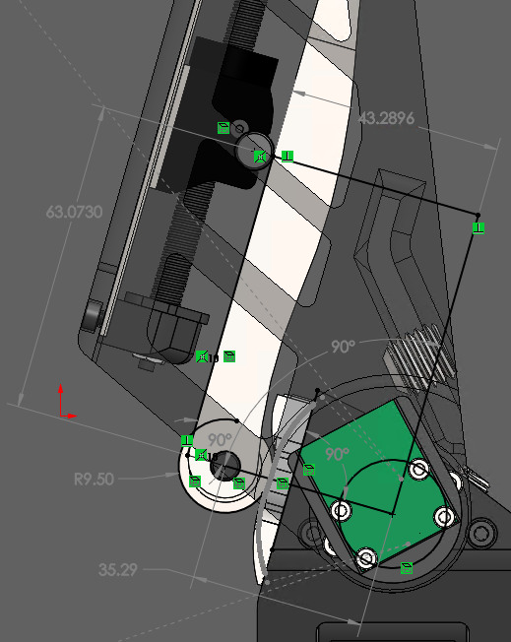
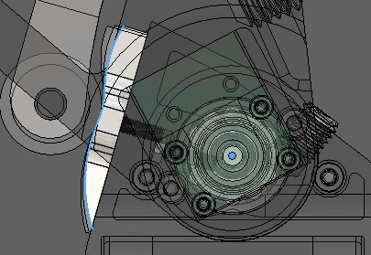
Parameters Correct
Position/Orientation Correct

