Slide 1
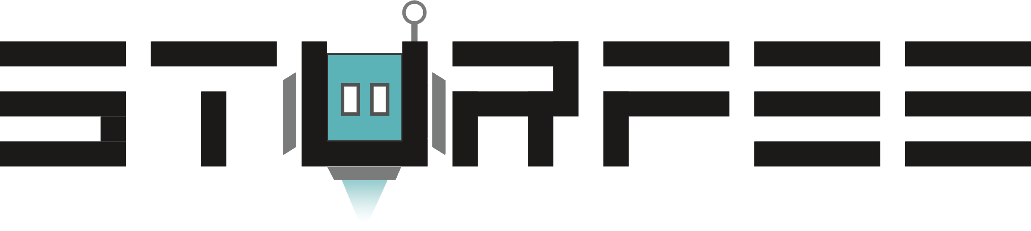
Market Research: Japan Telecom
May 4, 2021

Slide 2
Agenda
Market Share
Key Companies
Pricing Comparison
Smartphone Penetration

Slide 3
Introduction
This presentation was made with public sources available online which may be a few years out of date.
2. I did not use paid reports published from Market Research companies for these numerical numbers, trends, and graphs.
3. I’m still learning about the Telecom industry. I’m no expert!

Slide 4
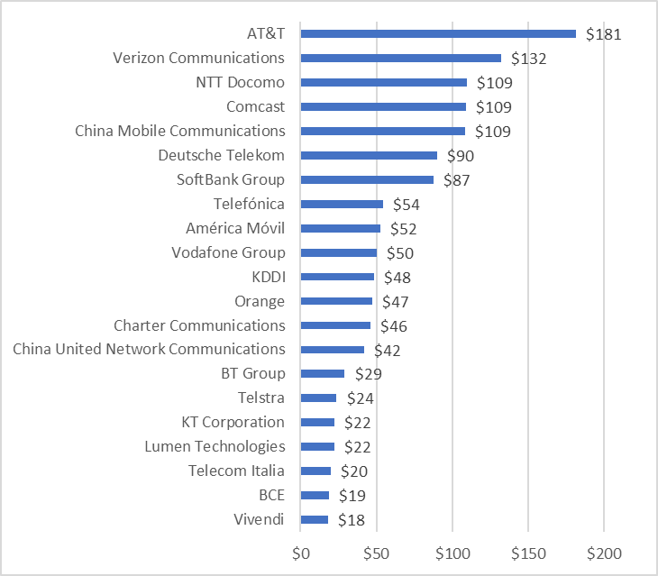
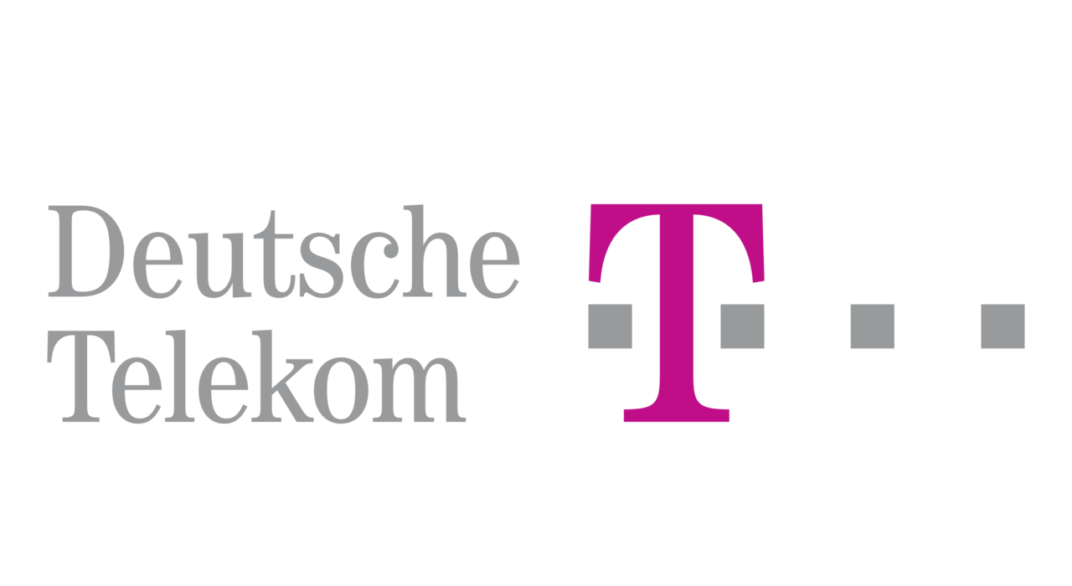

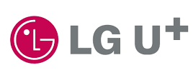
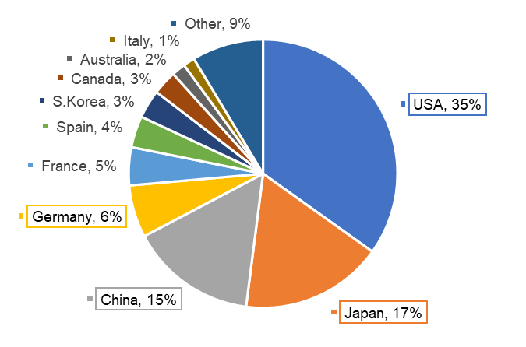
Global Telecom Market Share
Company with Highest Revenue ($B)
Global Telecom Revenue Market Share (%)
Outside top 20
*1Source: https://en.wikipedia.org/wiki/List_of_telephone_operating_companies

Slide 5
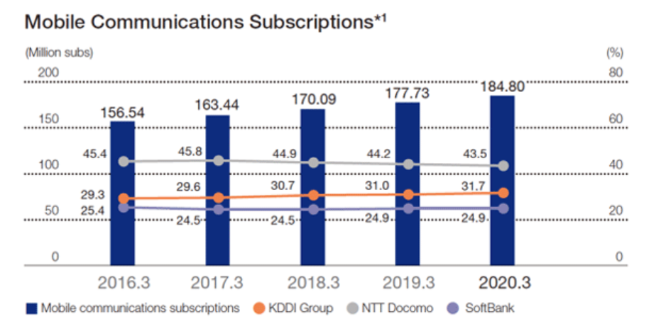
Japan Telecom Market Share
Japan Telecom Total Market
Cumulative Mobile Communication Subscriptions (2020.3)
Subscription: 184.80 million
YoY: + 4.0% YoY
AU by KDDI
Cumulative Mobile Communication Subscriptions (2020.3)
Subscriptions: 58.64 million
YoY: + 6.3% YoY
Share: 31.7%
(*behind NTT Docomo)
*1Source: https://www.kddi.com/english/corporate/ir/japanese-market-kddi/

Slide 6
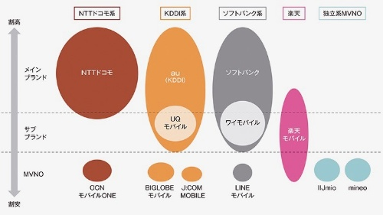
Key Companies in Japan
NTT Docomo
KDDI
Softbank
Rakuten
Ind. Brand
High Cost
3 Main Brands (MNO)
Mobile Network Operator
provider of wireless communications services that owns or controls all the elements necessary to sell and deliver services to an end user (infrastructure, service etc.)
Main Brand
NTT Docomo
AU by KDDI
SoftBank
Sub Brands
Subsidiary or second brand owned by the main brands. Targeted to customers who prefer flexible & lower cost options for cellular plans.
Sub Brands
UQ Mobile
Ymobile
Rakuten Mobile
Over 100+ MNVO
Mobile Virtual Network Operator
wireless communications services provider that does not own the wireless network infrastructure over which it provides services to its customers. Uses networks provided by the Big 3 providers.
MNVO
OCN MOBILE One
BIGLOBE MOBILE
J:COM MOBILE
LINE MOBILE
IIJmio
mineo
Low Cost
*1Source: https://xtech.nikkei.com/atcl/nxt/column/18/00001/04714/

Slide 7
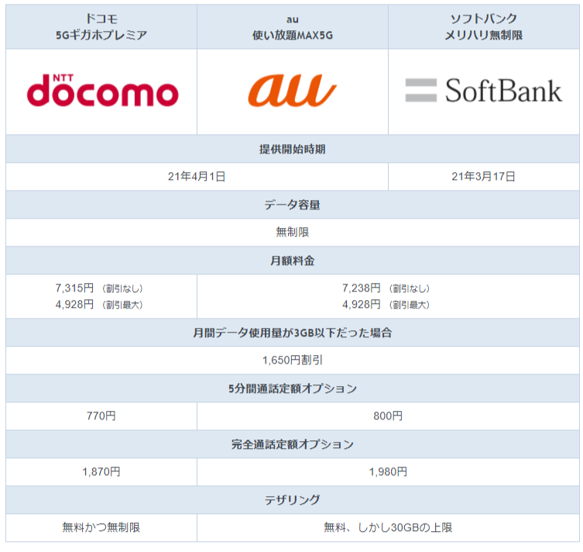
Sample Pricing Comparison
5G Giga Premier・Unlimited MAX5G Plan
Similarities
Differences
Unlimited Data
Tethering
Docomo: Free & Unlimited
KDD / Softbank: Free up until 30 GB
Similar Pricing
Maximum discount given
Not a limited-time offer but all-round discount.
Additional discount if data usage is below 3GB / Month
*1Source: https://selectra.jp/sim/guides/hikaku/carrier

Slide 8




AU by KDDI: Japanese folk tale setting
Softbank: Family Fight w/ Dog father and foreigner son.
UQ Mobile: Ramen slurping monster and three girls
Y!Mobile: Wealthy Family w/ Butler and Cat dancing

Slide 9
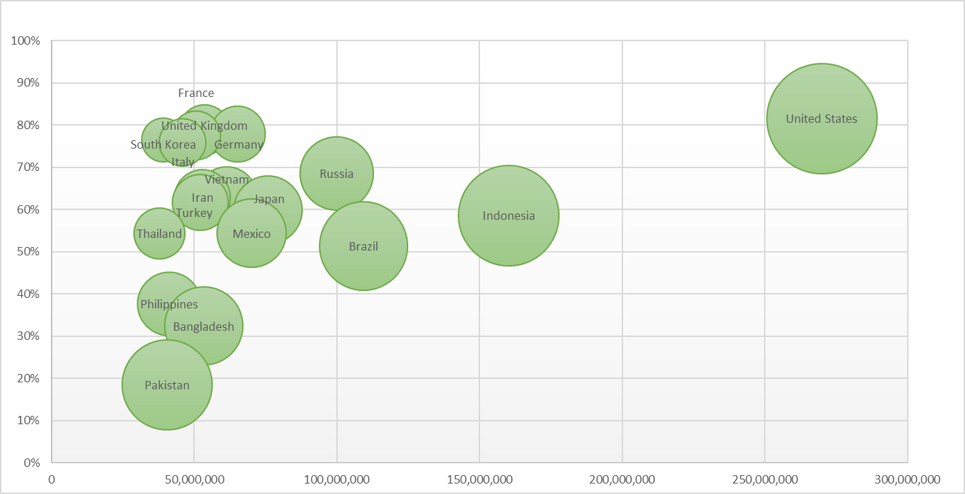
Global Smartphone Penetration
70%~100%
50%~70%
Smartphone Penetration Rate (%)
10%~50%
X: Smartphone Users
Y: Smartphone Penetration Rate
Z: Total Population
Smartphone Users
*1Source: https://newzoo.com/insights/rankings/top-countries-by-smartphone-penetration-and-users/

Slide 10
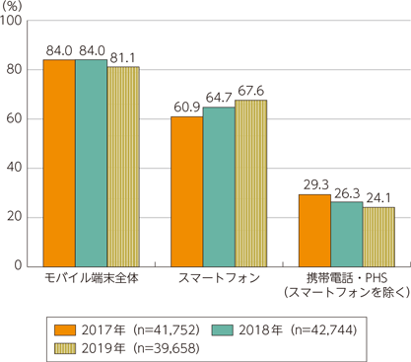
Japan Smartphone Penetration
Mobile device ownership (individual) (%)
2019 Smartphone Ownership & Market Penetration
(Data published by Ministry of Internal Affairs and Communication)
81.1% of people own some type of Mobile Device
67.6% of people own a Smartphone, and the percentage has increased every year since 2017
24.1% of people still own a portable handheld phone, although the percentage has decreased from 2017 to 2019.
Mobile Device Overall
Smartphone
Cell Phone / PHS
(Excludes Smartphones)
*1Source: https://www.soumu.go.jp/johotsusintokei/whitepaper/ja/r02/html/nd252110.html

Slide 11
Thank you!
Sturfee Inc.
1551 McCarthy Blvd #206
Milpitas, California 95035
www.sturfee.com | medium.com/sturfee | @sturfee

