Slide 1
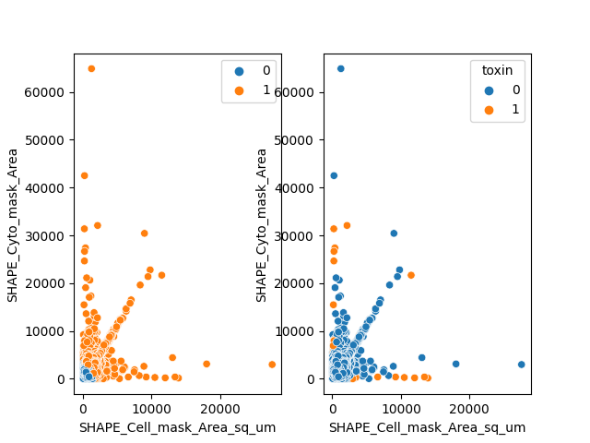
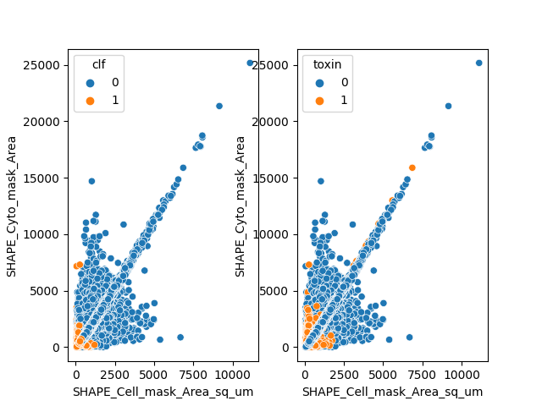
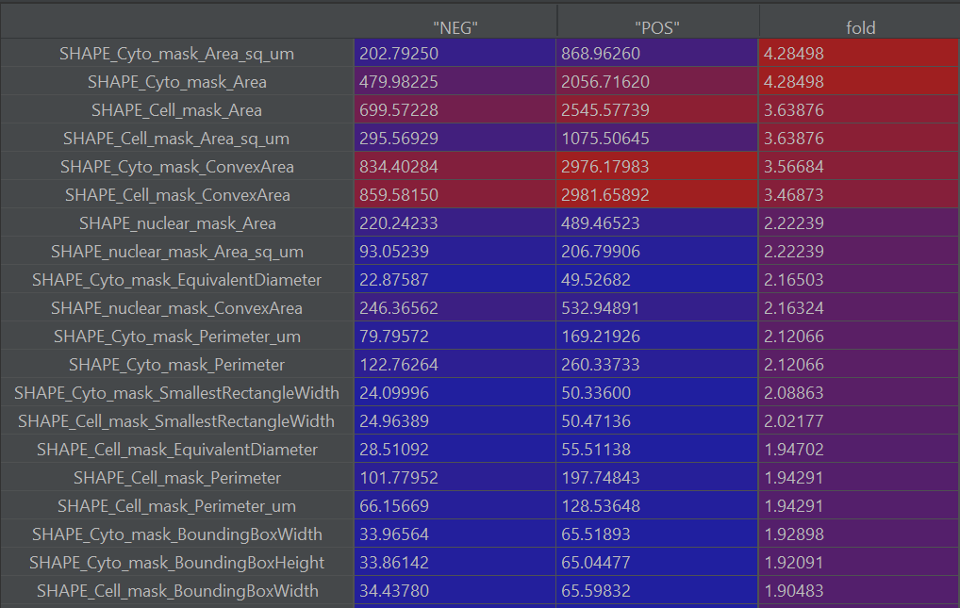
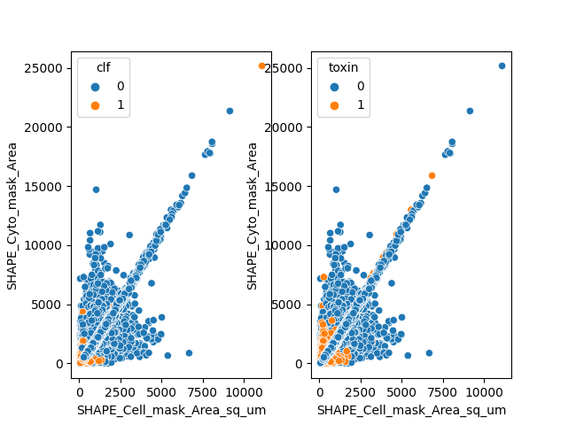
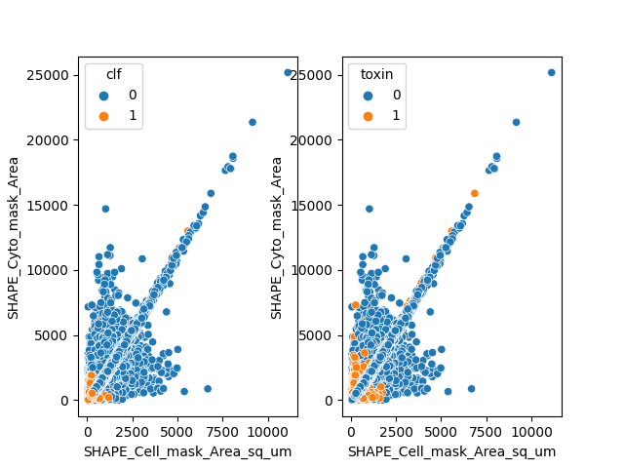
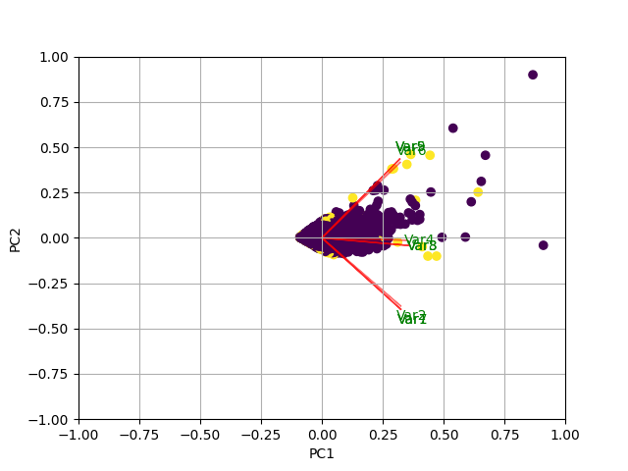
AI Coding Challenge - Elissa Tjahjono
Fig. 1 K-means clustering
Fig. 2 MLP
Healthy
Toxin-treated
Preliminary Analysis
Supervised ML
Fold difference of features
PCA
K-means clustering
Multilayer perceptron
Random forest
Gradient boosting
Cluster 1 : Cluster 2
55 : 45
Accuracy:
95.34% (training)
94.86% (testing)
Table 1 Driver features
Fig. 3 Random forest
Fig. 4 Gradient boosting
Features | Importance
SHAPE_nuclear_mask_Area | 0.03102
SHAPE_nuclear_mask_ConvexArea | 0.04337
SHAPE_Cell_mask_Area | 0.23404
SHAPE_Cell_mask_ConvexArea | 0.05228
SHAPE_Cyto_mask_Area | 0.11653
SHAPE_Cyto_mask_ConvexArea | 0.07801
SHAPE_nuclear_mask_Area_sq_um | 0.03106
SHAPE_Cell_mask_Area_sq_um | 0.26339
SHAPE_Cyto_mask_Area_sq_um | 0.15030
Accuracy:
96.15% (training)
94.39% (testing)
Accuracy:
96.21% (training)
94.61% (testing)

