Slide 1
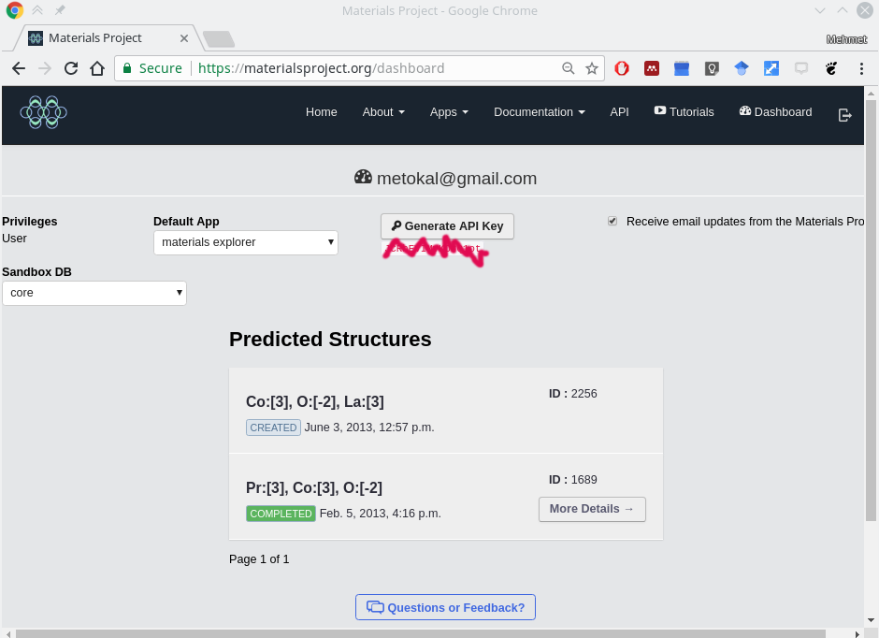
Materials Project API key is here

Slide 2
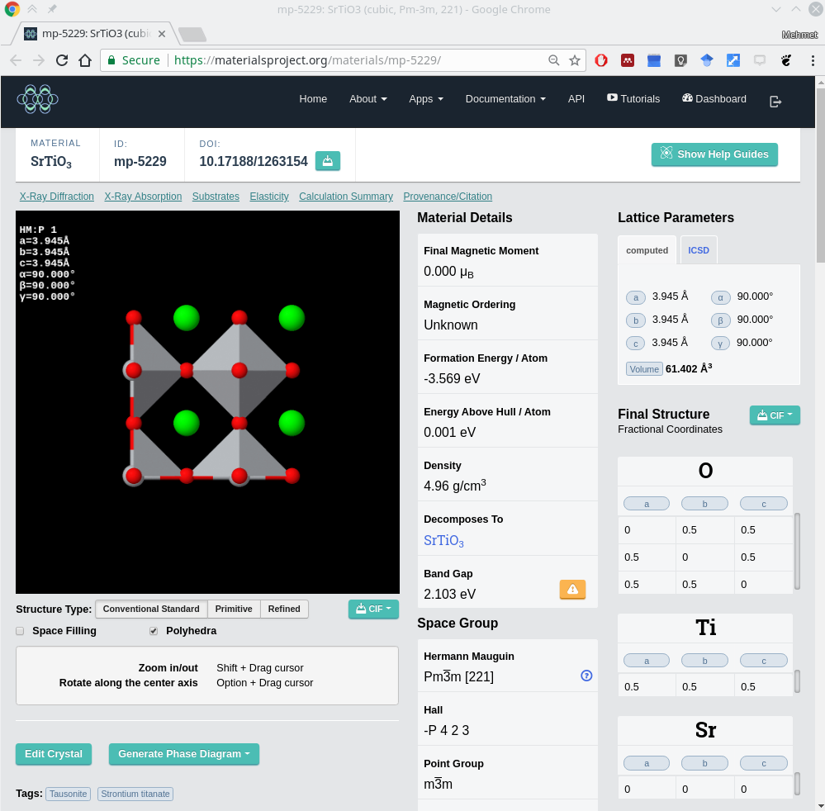
Materials Project ID (mpid) is here

