Slide 1
HWA Project
Eli Stribley

Slide 2
Intro – Where did I start?
Jira
Risk Assessment
Started with setting up an Epic, user stories and sprints in order to plan out the project.
The Risk Assessment allows you to pinpoint any issues you may have with the project and can discover how likely they are to cause an issue.
UML and ERD
These diagrams show the relationship between the database entities and the class relationships within Java.

Slide 3
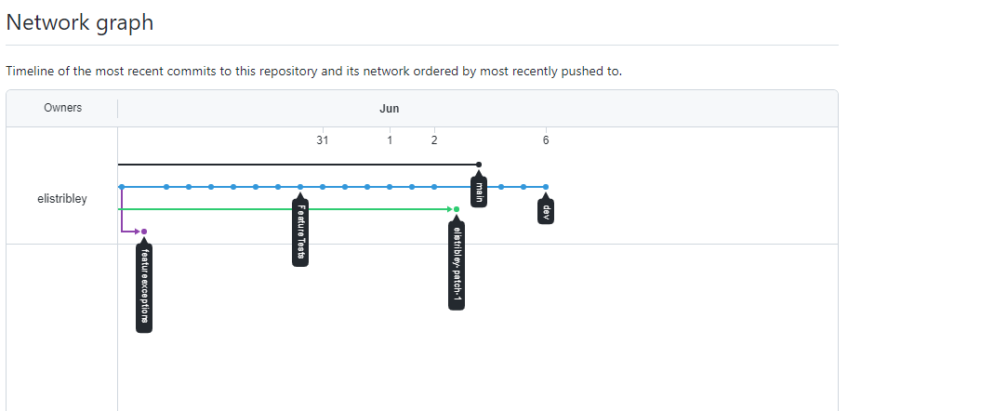
GitHub - Version Control
This is a network graph of my project however I used to feature branches rarely which is something I would like to improve on in the future.
I did the bulk of my coding of my dev branch, using feature test and exceptions to split up my code when I started a new section, next time I plan on having my front end in static folder from start so my front end is developed along with my backend.

Slide 4
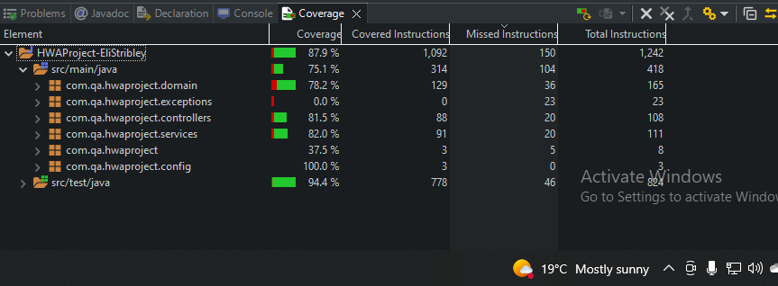
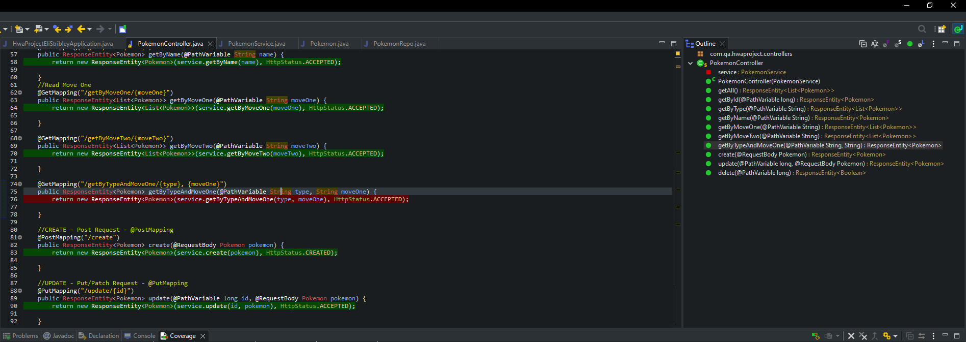
Testing
Testing was fairly simple, I nearly hit the target of 80% coverage however I failed to test the type and moveone mapping.

Slide 5
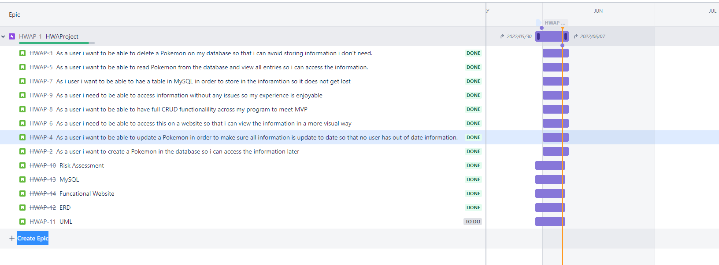
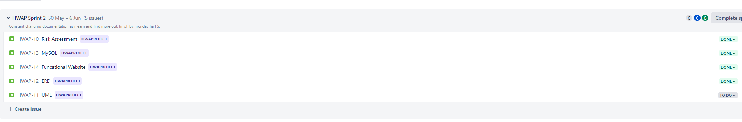
User Stories
All user stories are expanded except the ones that are for myself, as you can see the sprint starts 30/05/2022 and due to be finish 07/06/2022
Sprint 2 which is what I started with(don't ask how I managed that) seperates my documentation and code into multiply sprints, however in the future I want to full integrate myself with Jira and use it how it is intended to be at all times.

Slide 6
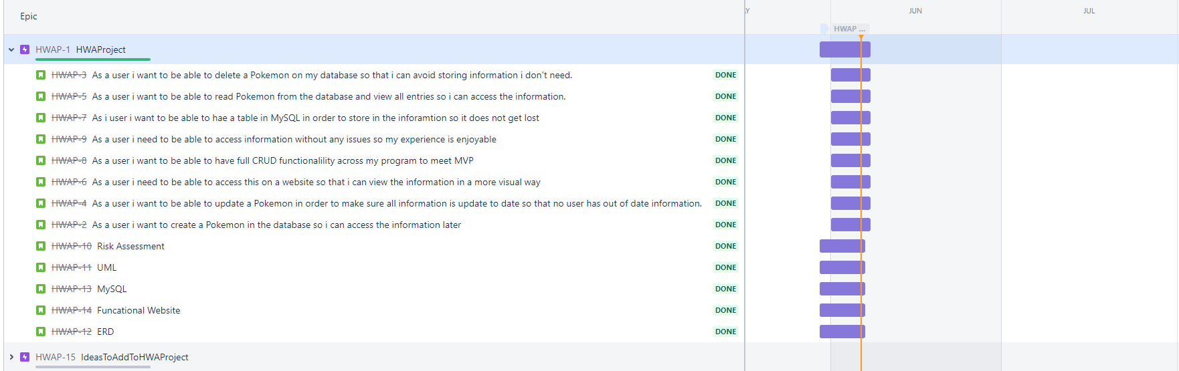
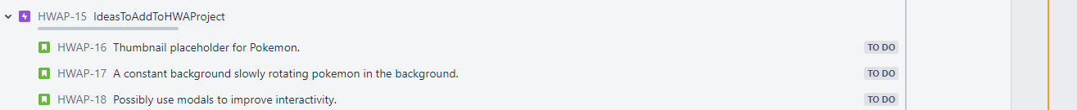
Sprint Review
Overall the project went well, sprint were completed on time and also found out more ideas I wanted to add in the future.
Some more advanced features on my second Epic to improve visual side of it.

Slide 7
Sprint Review 2)
What could have gone better?
I believe my test coverage could have been better along with my website, although I got the colour features down I wanted, still looked a little janky.
How to improve?
Rewatch videos to gain a better understanding of what I want before even planning, this way I can way up what's best to do.

Slide 8
Conclusion
Any questions?
If not, Thank you for listening!

