Slide 1

Security Concerns within the Internet of Things
Team Boulder:
Elita Danilyuk, Zachary Lowe & Tyson O’Leary

Slide 2
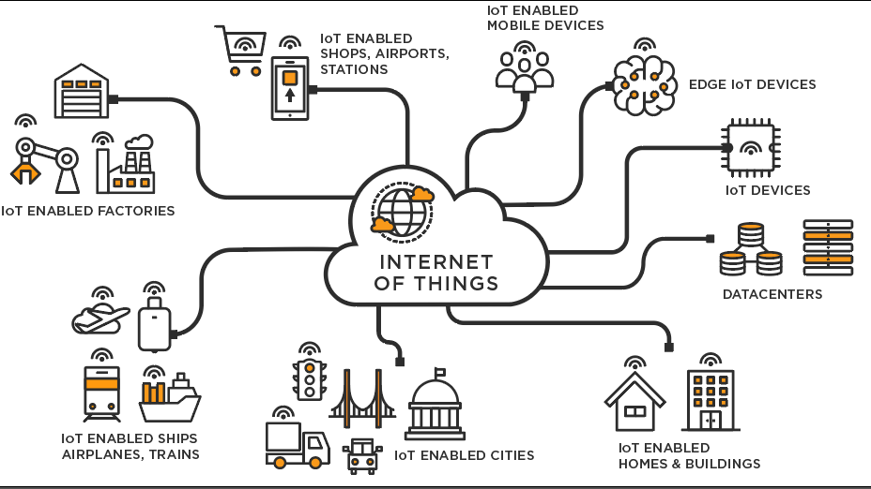
Introduction
IoT history
Security concerns
Current issues
Notes:
Elita
talk about history:
IoT can more broadly be defined as the interconnected network of various physical objects which are enabled to send and receive data
popularized by the idea of connecting home appliances to the internet
1999: Kevin Aston, executive director of the auto-id center at P&G, made the term the title of a presentation that linked the idea of RFID devices within P&G’s supply chain. In the same year, an author spoke about the principles of the IoT in his book When Things Start to Think
IoT has become a complex and intertwined web of network connections
IoT has transformed how people interact, live, and communicate with various devices
It has unified almost all devices within our grasp, which has led to a great deal of personal control, as well as an abundant amount of individual and group data which results in security concerns
data that is being collected is often closely related to private information and daily activities
This data has begun to increased relationships between the ‘digital’ and ‘real’ worlds causing security concerns as well as
Backdoor vulnerabilities, shadow devices, malware, and the absence of a widely adopted security standard are all examples of current areas of issue

Slide 3
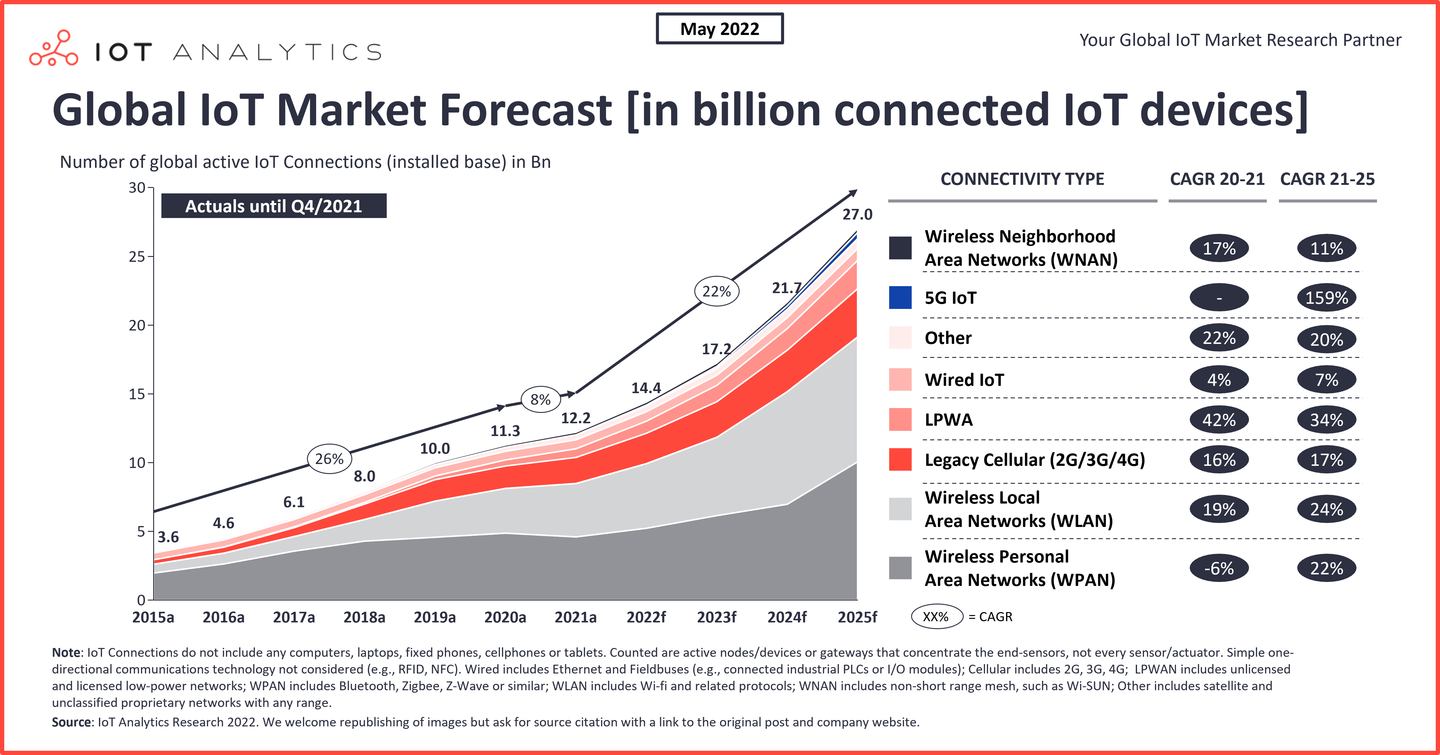
Current Issues
Potential for surveillance
Backdoor access
Malware
Large Attack Surface
Over 14 Billion Devices Currently
Lack of Universal Standards

Slide 4
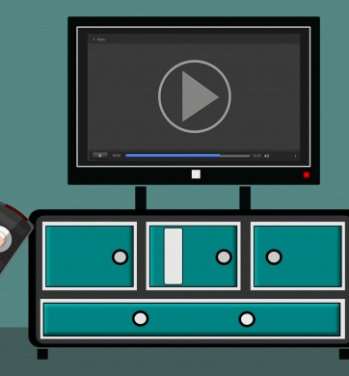
Device Concerns
Amazon Alexa
Skills can be developed by anyone
Amazon’s vetting process isn’t good enough
Smart TVs
Tracking user information
Targeted advertising
Notes:
Tyson
The Amazon Alexa is the classic example of a smart home device
The biggest worry that most have with it is that it is always listening, and it certainly is
Security issue comes from Alexa’s skills. Which are a way to add new commands and actions to Alexa
They can be developed by any third-party.
Amazon’s vetting process is not good enough, so many skills that make it through are dangerous.
For example, the backend of the skills can be changed after being approved
Smart TVs are in everyone’s home these days
Usually considered “smart” because they have apps, but they also track users now.
They use it for targeted advertising, but it can really be a privacy concern

Slide 5
Future of IoT Security
Improved Security Standard
Not all-encompassing. Localized to specific industries
Evolution of malware
More legislation
More research and adaptability to keep pace
Notes:
Tyson
More legislation: The IoT Cybersecurity Improvement Act
Imposes a minimum security standard for devices used by the government
incentivizes companies to improve the security of their devices.
More research: With the evolution of the IoT and its malware, more research is going to be required to keep pace
The industry is going to need to be adaptable to the big changes

Slide 6

Closing Thoughts
The
Future
Notes:
Elita
The unification of these devices has improved many parts of people’s lives, such as making mundane tasks automated.
Unifying these devices has come with a significant amount of security and privacy challenges
Although the situation of IoT security may seem very concerning, there is still hope
Today, standards are being developed on multiple fronts to attempt to unify the devices and their security
Legislation is being put in place to incentivize securing devices and ensuring privacy.
Research is also making an impact and effort to find better methods of securing IoT devices and the network that connects them
Standards are beginning to be put into place
Despite the challenges and uncertainty on the horizon, the future is looking bright for a secured Internet of Things.
- be sure to take time thanking the audience

