Slide 1
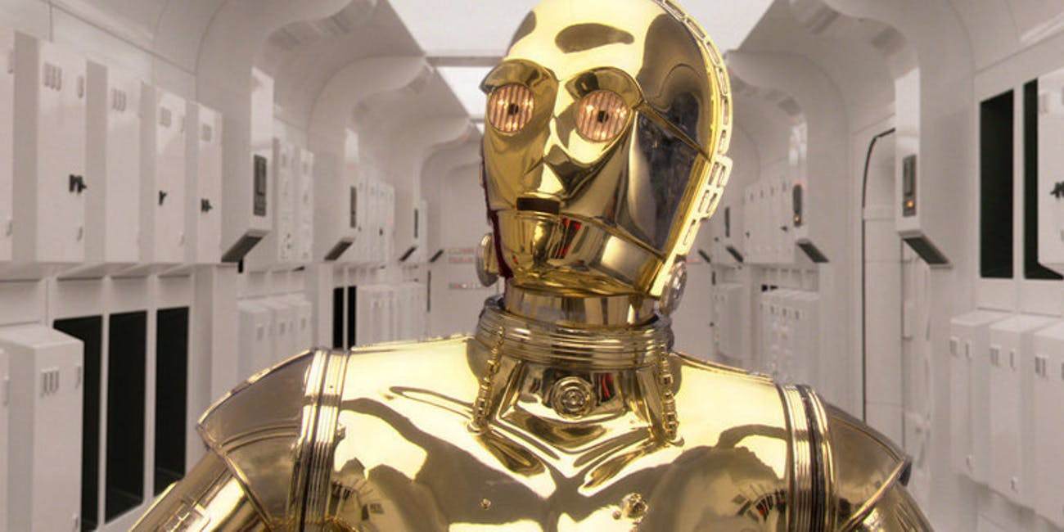

Design Workshop
Human-AI Interaction
Luigi De Russis, Alberto Monge Roffarello
Academic Year 2023/2024

Slide 2

Introducing the RUN app…
RUN is a (fictional) mobile app for helping people in their running activities
AI included!
screenshots from https://pair.withgoogle.com

Slide 3
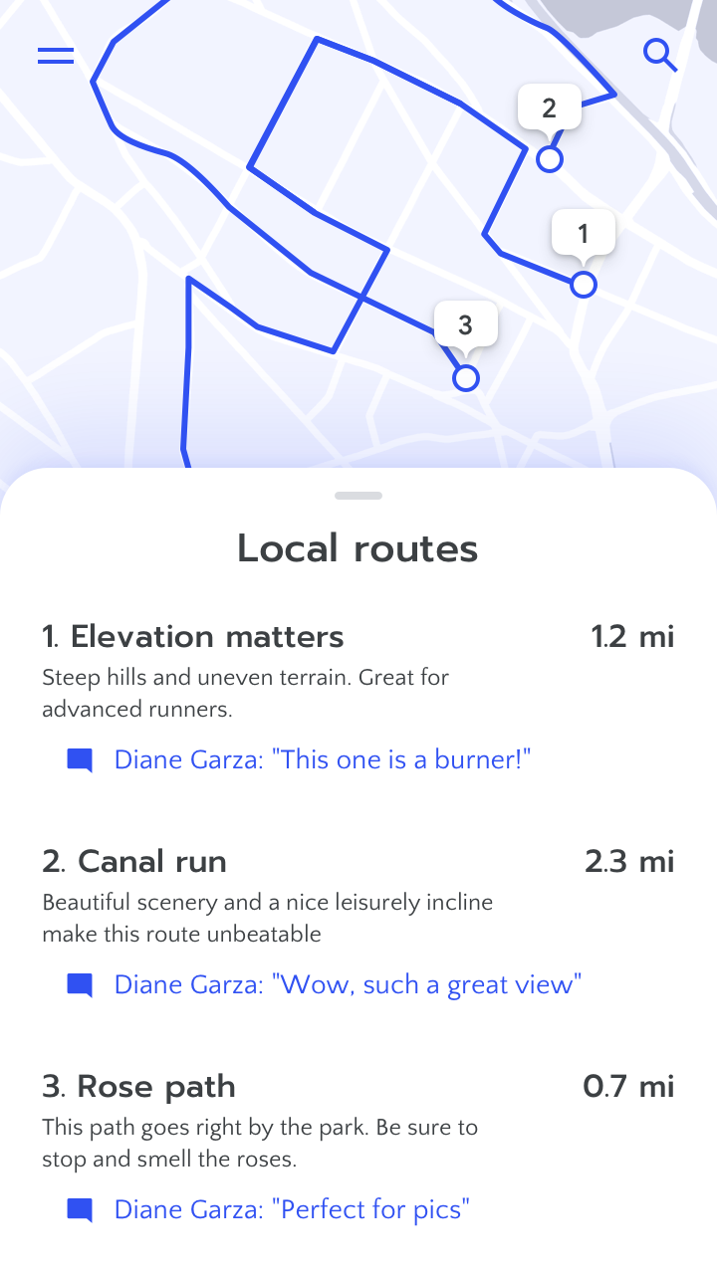
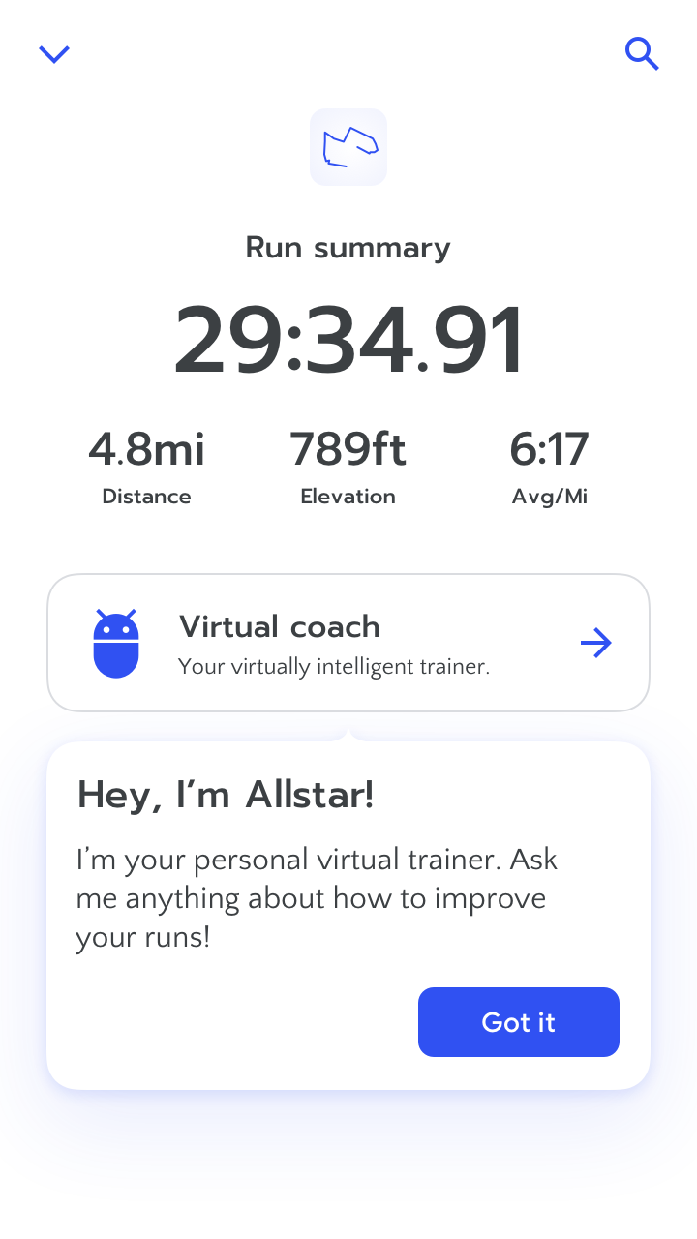
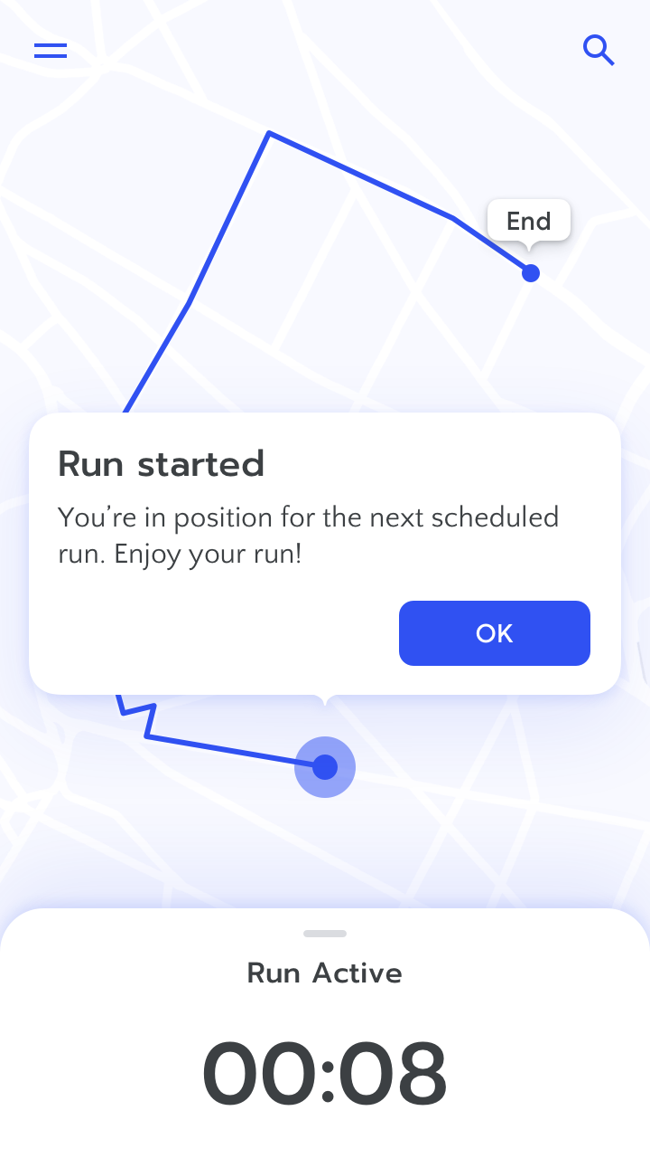
Three Main Features
Suggesting Routes
AI Coach (vocal, too)
Tracking Runs

Slide 4
Activity 1: Mental Models
The "Virtual coach" is there to help, to improve people's runs.
How might users think this works?
When might it work better?
When might it work more poorly?
Use the next 2 slides to answer, as a group

Slide 5
Activity 1: Mental Models
Who are the users you have in mind?
According to this group of users, how does the feature work?

Slide 6
Activity 1: Mental Models
According to this group of users, when it might work better?
…when it might work poorly? What can be changed in the app to compensate?

Slide 7
Activity 2: Errors and Failures
The "Run" app automatically start tracking a run once it detects contextual information.
What happens when the prediction is wrong?
How can the app recover from this?
Use the next 2 slides to answer, as a group

Slide 8
Activity 2: Errors and Failures
What is a way this feature could fail with low/no consequences?
What is a way this feature could fail with large negative consequences?

Slide 9
Activity 2: Errors and Failures
What technical and/or human methods may mitigate these failures/recover from them?

Slide 10
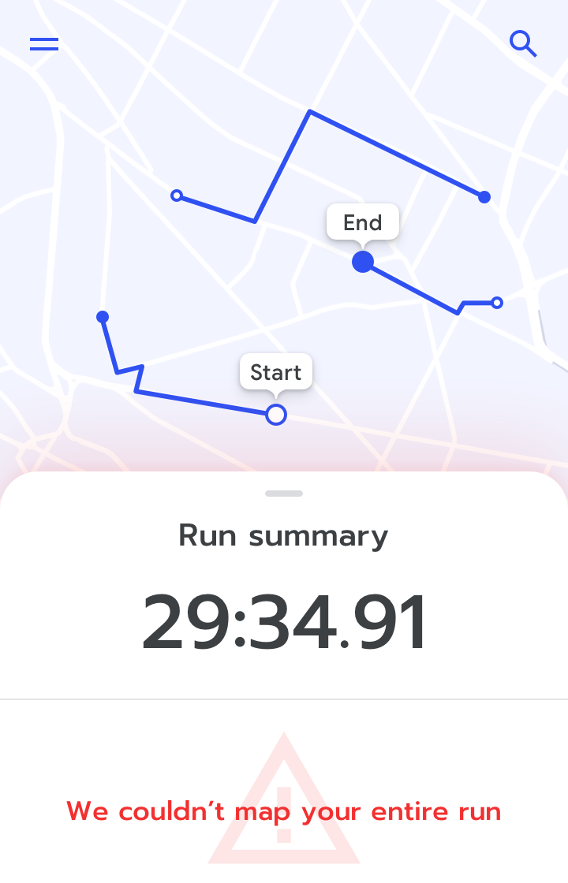
Activity 3: Errors and Failures
After a run, it may happen that the app is not able to track the entire path…
How can we change the app design to handle this case?
Use the next slide to answer, as a group

Slide 11
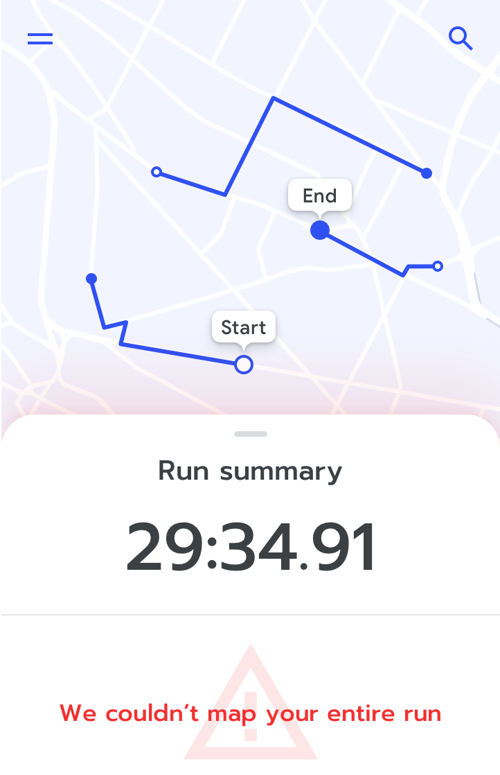
Activity 3: Errors and Failures
Original Design
Improved Design

Slide 12
Activity 4: Guidelines
Use the Guidelines for Human-AI Interaction on the previous three screenshots
https://www.microsoft.com/en-us/haxtoolkit/library/
How many "issues" are you able to identify?
How many guidelines is the app respecting?
Do you spot any other problems?
suggestion: the phone owner is not called Diane Garza
Use the next slides to answer, as a group

Slide 13
Activity 4: Guidelines
AI Design Guidelines | Violation/Everything ok? Where? [A Guideline may not apply]
G1 - Make clear what the system can do
G2 - Make clear how well the system can do what it can do
G3 - Time services based on context
G4 - Show contextually relevant information
G5 - Match relevant social norms

Slide 14
Activity 4: Guidelines
AI Design Guidelines | Violation/Everything ok? Where? [A Guideline may not apply]
G6 - Mitigate social biases
G7 - Support efficient invocation
G8 - Support efficient dismissal
G9 - Support efficient correction
G10 - Scope services when in doubt

Slide 15
Activity 4: Guidelines
AI Design Guidelines | Violation/Everything ok? Where? [A Guideline may not apply]
G11 - Make clear why the system did what it did
G12 - Remember recent interactions
G13 - Learn from user behavior
G14 - Update and adapt cautiously
G15 - Encourage granular feedback

Slide 16
Activity 4: Guidelines
AI Design Guidelines | Violation/Everything ok? Where? [A Guideline may not apply]
G16 - Convey the consequences of user actions
G17 - Provide global controls
G18 - Notify users about changes
NG - Other

Slide 17
Submission Instructions
One per team, choose a "submitter"
Convert the set of slides in PDF and name it as follows: Lastname_Firstname_ex2.pdf (example: Monge_Alberto_ex2.pdf)
Upload the resulting file to OwnCloud, at the following URL: https://baltea.polito.it/owncloud/index.php/s/UF4L9J1CtMp2fdD
By the end of the week (Feb 4, 2024)

