Slide 1
Intro study on lcc c compiler

Slide 2
Agenda
Intention
lcc overview & added features
* features & example demo
TODO list

Slide 3
Intention – from career point
> Language intermediate generation:
e.g. c, HW language (part of EDA field)
> IC vendor requires assember, c-like compiler, debugger:
e.g. silan microelectronics ltd
> Benefits of work:
e.g. reduce curve to understand gcc internals
understand & solve difficult debugging problems
etc

Slide 4
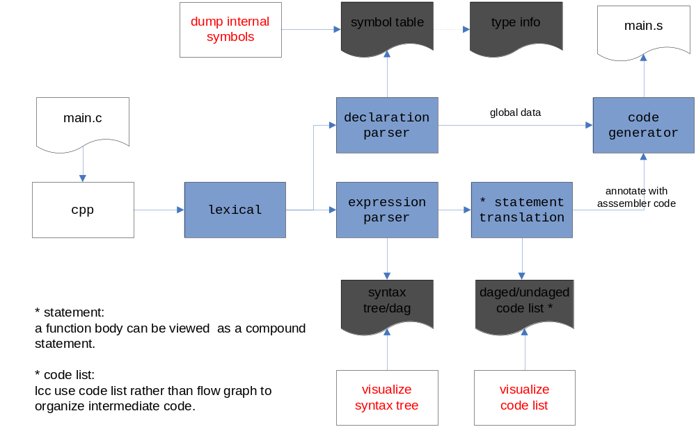
lcc overview
Notes:
doc elements filled with color gray are important lcc intermediate data.
rectangle elements in red font are features added to improve to understand lcc.
cpp (c preprocessor) is not a part of lcc.

Slide 5
Feature – symbol/symbol table
1 #define SIZE 10
2 int x;
3 extern int arr[SIZE];
4
5 void foo(int x, int a) {
6 int b;
7 b = a * arr[x];
8
9 if (b < 100) {
10 int a;
11 b = a * arr[x];
12 }
13 }
Here two kind of symbols occur, they are
constants: 10, 100
identifiers of global: x, arr, foo
PARAM: x, a
LOCAL scope: b
LOCAL+1 scope: a
List types:
int, int [10], void (int, int)
# run & view symbol report
export LCC_SYM_DUMP_ENABEL=true
lcc -c test.c

Slide 6
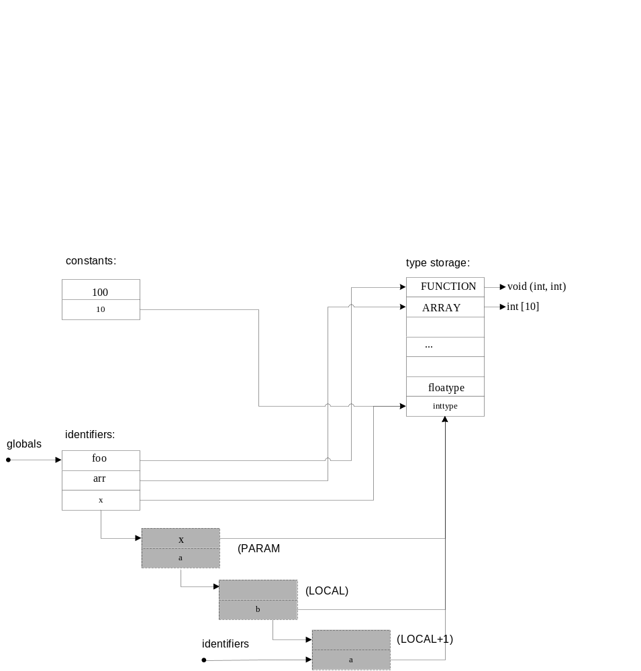
symbol table – how to organize
Note1:
Two symbol tables named after constants and identifiers.
In order to quick access to an identifier, ptr globals points to
global identifiers, ptr identifiers points to identifiers of
current scope.
e.g. identifiers points to scope of LOCAL+1
when parse code of line 10.
* lcc adds function parameters to identifiers table when parse
on a function definition.
Note2:
Identifiers is a hierarchical structure, each
of which contains a symbols table points to
a certain scope.

Slide 7
Feature – syntax tree for expression
1 int foo(int a, int b) {
2 return a + b; // simple arithmetic
3 }
4
5 int bar(int a, int b, int c)
6 {
7 return foo(foo(a,b), c); // nested function call
8 }
# run & view syntax tree/dag
# *.dot is a file that use dot language to define
# a diagraph, and generate .png format for display
export LCC_DAG_DUMP_ENABEL=true
lcc -c test.c
dot test_c_line2.dot –Tpng > test_c_line2.png
dot test_c_line6.dot –Tpng > test_c_line6.png

Slide 8
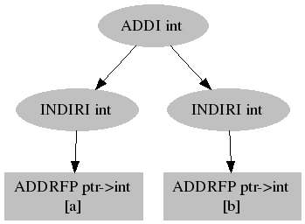
Syntax tree for expr – simple arithmetic
syntax tree for simple arithmetic: a + b
ADDI: integer add operation
INDIRI: indirect access to an integer value
ADDRFP: address of an parameter
[*]: enclosed is a symbol

Slide 9
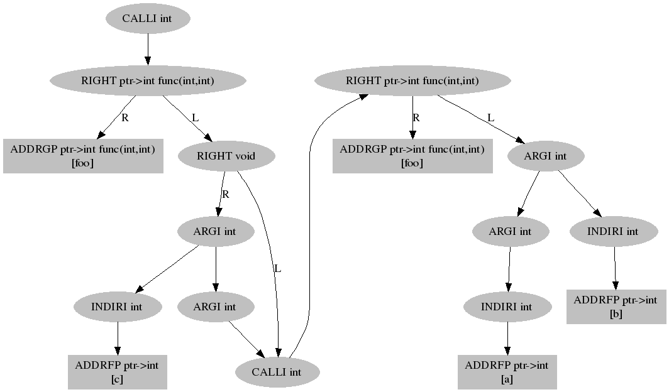
syntax tree for expr – nested call
CALLI: function call with integer returned
RIGHT: a binary operation with value of R side
ADDRGP: address of a global variable
L: left side of RIGHT operation
R: right side of RIGHT operation
ARGI: argument of an integer type

Slide 10
Feature – intermediate dump
int foo(int arr[], int size, int e) {
int i, int r = -1;
for(i = 0; i < size; ++i) { // loop
if (arr[i] == e) { // conditional branch
r = i;
break; // jump out of loop
}
}
return r;
}
# run & view intermediate code:
export LCC_CODE_LIST_DUMP_ENABLE=true
lcc -c test.c
dot find.dot –Tpng > find.png

Slide 11
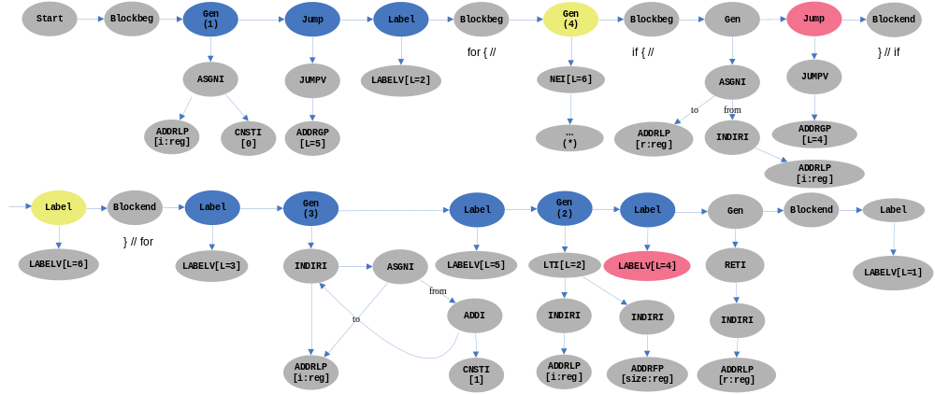
intermediate dump -- overview
ellipisis filled with color
blue: for-stmt structure of translation.
yellow: if-stmt structure of translation.
red: break-stmt of translation
The top nodes of the diagram list kind of code:
Blockbeg, Blockend, Gen, Jump, Label, etc.
Beneath that are generated forests of intermediate code.

Slide 12
intermediate dump -- explanation
A for-stmt has following form:
for(expr1; expr2; expr3)
stmt
Gen(1) : points to intermediate code of for’s
expr1, that is i = 0.
Gen(2) : points to intermediate code of for’s
expr2, that is i < size.
Gen(3) : points to intermediate code of for’s
expr3, that is i++.
Explanation on diagram node operations:
Blockbeg/Blockend: beginning or end of a block.
Jump/Label: alter control, Label specifies place to jump.
Gen: points to a forest which represents intermediate
codes of a basic block without altering control flow.
ADDRFP: address of a parameter.
ADDRLP: address of a local.
ADDRGP: address of a global.
address is of pointer type, that P means.
ADDRGP[L=5]: address of label 5
ADDRLP[i:reg] : address of local variable i;
however, i is a register.
JUMPV: jump to a label its child specifies.
LABELV: define a label.
they are treated as void type.
ASGNI: assignment operation of integer type.
INDIRI: indirect access on an integer value.
CNSTI[*]: constant integer of value *.
NEI: not equal comparison of two integers.
LTI: greater than comparison.
NEI[L=5], LTI[5] : jump to label 5 on condition.
Gen(4) : contrary part of if-stmt’s conditional.
its intermediate code is to show next.
Gen(3) is a dag, which will be undaged.
.
Blockbeg points to a set of local defined symbol.
Last Label in diagram specifies function exit.

Slide 13
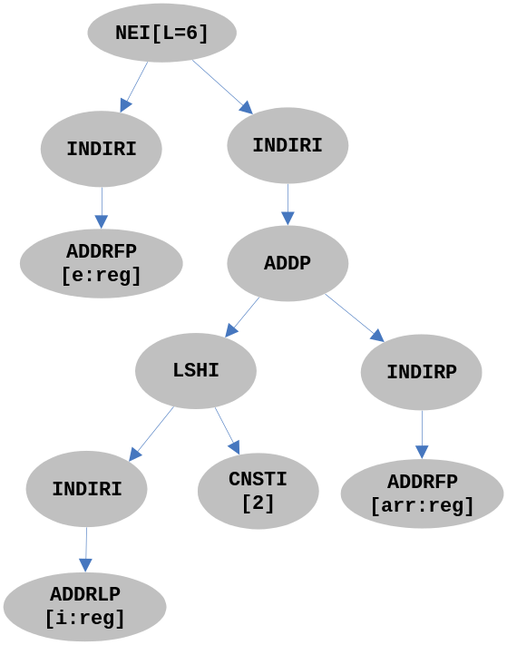
intermediate dump – subdiagraph
Sub-diagram continues from previous
diagram, which reflects intermediate code
of: arr[i] != e
NEI[L=6]: when operand in left is not equal to
operand in right, it jumps to LABEL(6)
ADDP: addition between an address and an
integer
LSHI: left shift operation on an integer
ADDRFP[arr:reg]: address of parameter arr,
which is a pointer type, and treated as
a register in lcc.

Slide 14
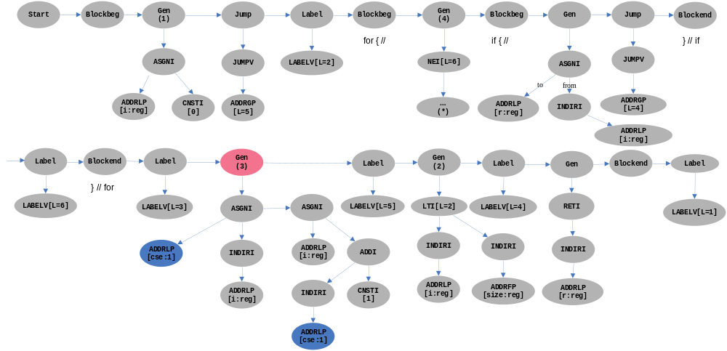
intermediate dump -- undag
ADDRLP[cse:1] : an address for storing result
of a common sub-expression.
1 is used for name the place it occurs.
Gen filled with color red is intermediate code after
undag(i.e, eliminating common sub-expressions).

Slide 15
TODO list
annotating assembler instructions on undaged code list
architect knowledge of a specific chip
debugger

Slide 16
Notes
Translating function statements to intermediate code simply operating on forest/trees, the
only to be notable is -- evaluation order on trees/forests that represents execution differ
from traversal order on trees which parser does.
从形式上看，翻译过程就是对树的一些操作。 但是树的各种节点所代表的不同意义、以及
异质特性，增加了lcc的实现困难、容易出错、也变得不好理解。
Think of the following problems:
struct storage, access on struct member, pass a struct as a parameter or return a struct.
implicit conversions in an expression, conversion arguments to function paramter type.
old-style and new-style in mix use: declaration, definition and function call.
parse declaration of an abstract function:
Optimize on jumps of switch-statement’s case branches.

