Slide 1




IDEA SUBMISSION
NITSHACKS 9.0
North-east India’s Most Premium Hackathon
PROBLEM STATEMENT TITLE
J.A.R.V.I.S.: Autonomous Incident Intelligence & Deterministic Causal RCA for Distributed Cloud Microservices
THEME
AIOps / Autonomous DevOps & Cloud Infrastructure Reliability
TEAM NAME (REGISTERED ON PORTAL)
uppu
Team Members: Kaustab Karmakar, Rajat Sharma
Live Interactive Prototype: https://frontend-three-alpha-90.vercel.app

Slide 2

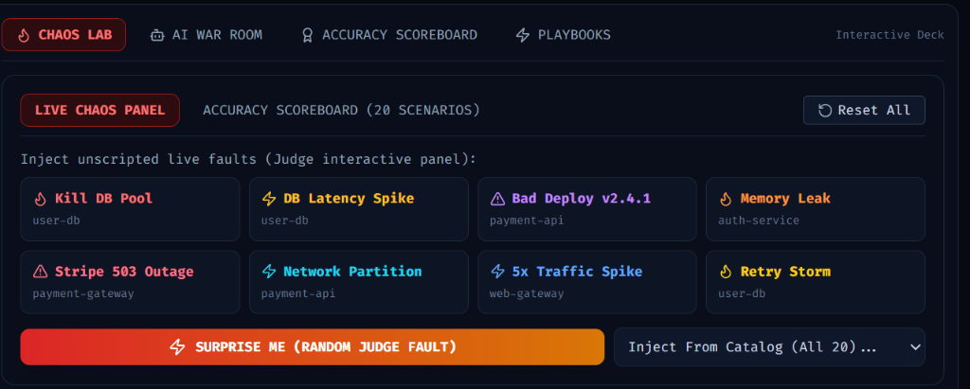
J.A.R.V.I.S. — Deterministic Causal Incident Intelligence
uppu
01 / PROPOSED SOLUTION
Proposed Solution
• Causal Graph Walk: Eliminates alert-arrival bias. Reconstructs directed topology to trace upstream root causes vs cascading victim alarms.
• Live Counterfactual Proof: Our signature breakthrough. Operators click 'Verify Fix' to heal the suspected service in the live simulator and mathematically verify 100% downstream error recovery.
• Calibrated Confidence & Honest Ambiguity: Refuses to hallucinate certainty when evidence is split (Scenario 17); triggers an explicit Ambiguous state with a targeted lowest-cost disambiguation query.
• Grounded AI War Room: Deterministic 6-feature causal engine computes the verdict; the LLM strictly serves as an interface bound to cite verified [EVT-xxx] evidence chips.
⚡ Live Chaos Injection Lab (Built & Deployed):
Judges can trigger unscripted live faults (Kill DB Pool, DB Latency Spike, Bad Deploy, Stripe Outage, or 'Surprise Me') and watch J.A.R.V.I.S. isolate the root cause in 1.8 seconds with complete causal telemetry.

Slide 3


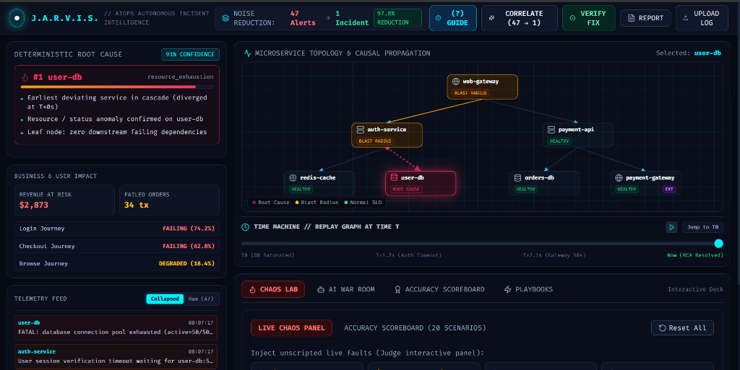
Architecture, Stack & Causal Pipeline
uppu
02 / BUILD PLAN
Technologies to be used
Methodology & implementation
• Backend & Analytics: Python 3.11+, FastAPI, WebSockets, NetworkX graph walks, scikit-learn, Drain3 online log pattern mining.
• Frontend HUD: React 18, Vite, Tailwind CSS, SVG Directed Vector Canvas (viewBox 800x250), Lucide Icons.
• Storage & Ingestion: SQLite (WAL mode), multi-source parsers (.log, .json, .csv) with regex PII masking, Prometheus/Grafana webhooks.
• Chaos Simulator: Asynchronous 6-microservice emulator with cascade propagation physics and live fault injection.
• Causal Pipeline: Ingestion → Anomaly Detection (MAD + EWMA) → Topological Correlation → 6-Feature Deterministic RCA → Counterfactual Proof.
• Performance Metrics: 1.8s MTTI | 97.8% Alert Storm Reduction | 20/20 Scenarios Pass.

Slide 4



Feasibility, Production Viability & Mitigations
uppu
03 / REALITY CHECK
Feasibility
Challenges & Risks
Mitigation
• Zero Heavy Infra: Runs as a single lightweight async runtime without requiring heavyweight Kafka, Zookeeper, or distributed DB clusters.
• 100% Offline Resilience: Engineered with 3-tier fallback (Hosted Cloud API → Local Ollama → Deterministic Template) to guarantee zero failure during live venue demonstrations.
• Non-Invasive Adoption: Directly ingests standard Syslog, JSON structured logs, and Prometheus webhooks without altering existing application source code.
• Victim-Alarms-First: Downstream caller services alarm first due to cascade delays, deceiving naive tools.
• LLM Hallucinations: Generative AI models independently hallucinate non-existent root causes under high diagnostic stress.
• Flapping Alert Storms: Repeated micro-outages trigger 40+ duplicate fragmented incidents, causing alert fatigue.
• Sparse Telemetry Gaps: Legacy microservices often lack complete OpenTelemetry trace coverage.
• Topological Leaf Priority: Walks reversed dependency graphs; prioritizes failing leaf nodes with zero downstream anomalous dependencies.
• Zero LLM in Causal Loop: Deterministic 6-feature causal scoring engine computes verdict; citations strictly verified.
• Stateful Debouncing: Requires sustained multi-window deviations while preserving true initial onset timestamps.
• Inferred Topology Mode: Automatically tags inferred call edges with low-confidence warnings rather than guessing.

Slide 5


Quantified Business Impact & Target Audience
uppu
04 / WHY IT MATTERS
Benefits (social, economic, environmental)
Target Audience
• 97.8% Alert Storm Collapse: Eliminates operator fatigue by collapsing 47 noisy cascading alarms into 1 actionable incident.
• 1.8s vs 45min MTTI: Slashes Mean Time to Identify from 45 minutes of frantic Slack triage down to sub-2 seconds.
• $84.50 / Failed Tx Revenue Shield: Maps blast radius to critical user journeys (Checkout, Login) and calculates exact real-time revenue at risk.
• Zero Burnout for On-Call: Automated playbooks with safety risk badges and dry-run commands empower junior engineers to remediate safely.
• SREs & DevOps Teams: Provides instant causal isolation in 1.8 seconds, eliminates 3 AM alert storms, and provides verified 1-click rollback playbooks.
• Incident Commanders & Leadership: Generates 1-click Executive Briefs translating raw technical telemetry into exact revenue impact and recovery timelines.
• Cloud-Native Enterprises & Fintech: Protects high-volume transaction architectures (e-commerce, banking) where 1 minute of downtime costs $10,000+.

Slide 6


Algorithmic Rigor, Benchmarks & References
uppu
05 / EVIDENCE
What backs up your idea?
Research
References
• RCAEval Benchmark Grounding: Evaluated against standardized microservice failure benchmarks (Online Boutique, Sock Shop, Train Ticket) covering 11 fault classes.
• MicroRCA Graph Walks: Implemented personalized PageRank on reversed directed call graphs to isolate upstream root causes from cascading victims.
• Drain3 Online Parsing: Fixed-depth tree log pattern mining achieving 99%+ template accuracy on high-cardinality cloud logs.
• BARO Baseline Metric Cross-Checking: Layered metric ranking combining robust MAD Z-scores with EWMA trend filtering.
• MicroRCA: 'Root Cause Analysis of Anomalies in Microservices through Graph Walks' — IEEE INFOCOM.
• Drain: 'An Online Log Parsing Approach with Fixed Depth Tree' — IEEE ICWS.
• Google SRE Book: 'Addressing Cascading Failures & Managing Incidents' — Betsy Beyer et al., O'Reilly Media.
• MITRE ATT&CK & CNCF: Microservice Observability & OpenTelemetry Standards.

