Slide 1
TXNRD1 and TXN1 Expression in SC RNA-Seq Data

Slide 2
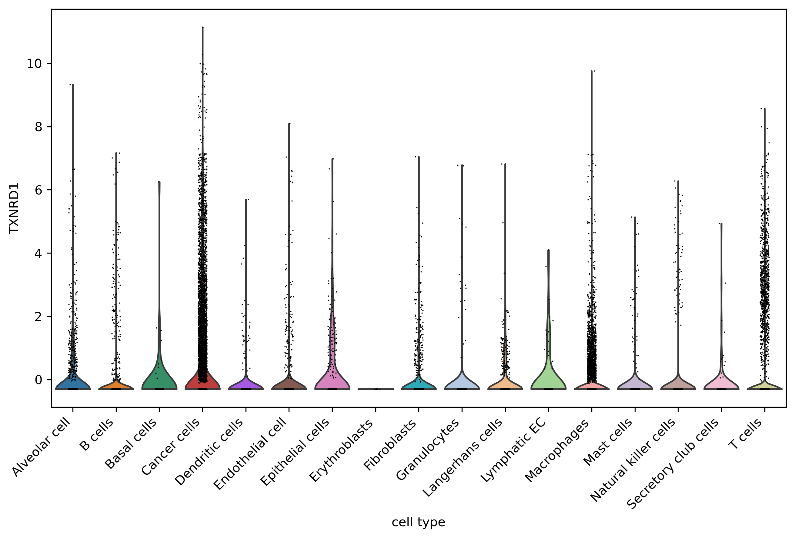
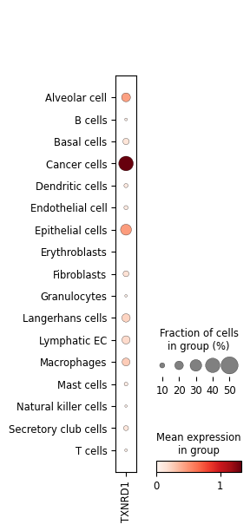
A
C
TXNRD1
B
D
Fig. 3. TrxR1 (also referred to by its gene name TXNRD1) is highly expressed in tumor cells, compared to immune cells and other cells in tumor microenvironment (TME). (A) Annotation landscape of TME-related cells in EMTAB6149. (B) UMAP visualization showing expression of TXN1 across all cell clusters. (C) Violin plot displaying the distribution of TXNRD1 expression across annotated cell types. Compared to all immune cells and other cells in the TME, TXNRD1 expression is higher in tumor cells. The p-values range from 0 to 1.50E-05, all showing significant differences. The Mann-Whitney test was used. (D) Dot plot showing expression of TXNRD1 in TME-related cells; size of dot represents the proportion of cells expressing TXNRD1 in each group, color intensity reflects mean expression level.

Slide 3
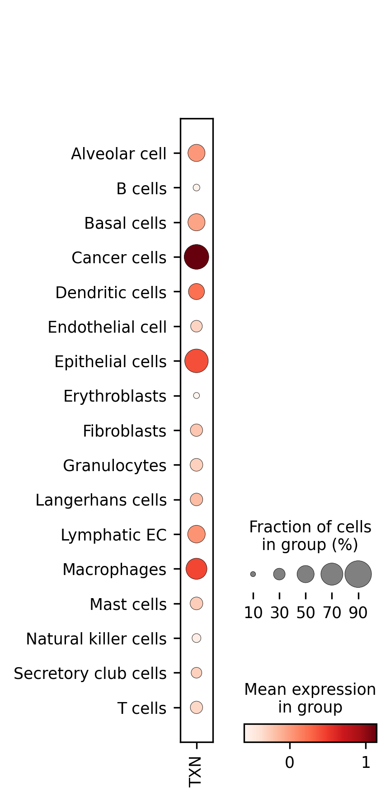
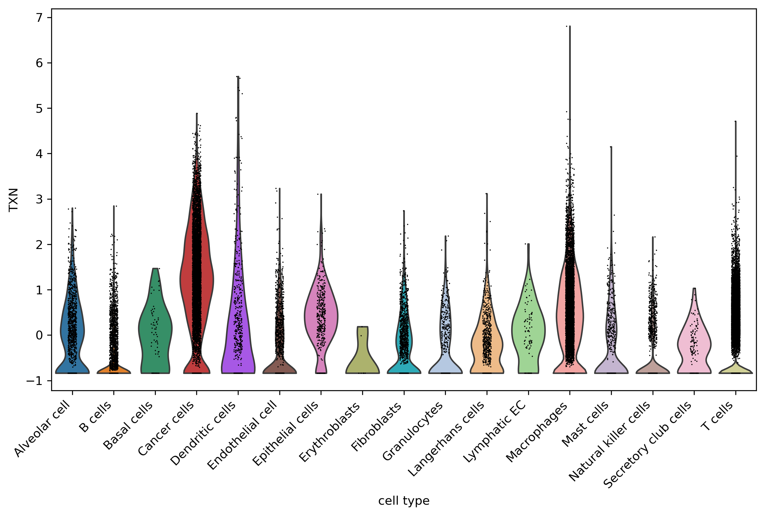
TXN1
A
D
D
C
B
Fig. 3. TXN1 is also highly expressed in tumor cells, compared to immune cells and other cells in tumor microenvironment (TME) (A) Annotation landscape of TME-related cells in EMTAB6149. (B) (B) UMAP visualization showing expression of TXN1 across all cell clusters. (C) Violin plot displaying the distribution of TXN1 expression across annotated cell types. Compared to all immune cells and other cells in the TME, TXN1 expression is higher in tumor cells. The p-values range from 0 to 4.63E-05, all showing significant differences. The Mann-Whitney test was used. (D) Dot plot showing expression of TXN1 in TME-related cells; dot size represents the proportion of cells expressing TXN1 in each group, color intensity reflects mean expression level.

Slide 4
Mann-Whitney U Results: Cancer Cells Tested Against each Individual Cell-type
Gene | Cell Type | Mean Expression | P-value
TXN | Alveolar cell | 0.02178731 | 7.51E-231
TXNRD1 | Alveolar cell | 0.05668504 | 9.75E-52
TXN | B cells | -0.5680182 | 0
TXNRD1 | B cells | -0.1999137 | 0
TXN | Basal cells | -0.0429482 | 1.07E-17
TXNRD1 | Basal cells | -0.0739251 | 1.07E-06
TXN | Cancer cells | 1.14403123
TXNRD1 | Cancer cells | 0.76943551
TXN | Dendritic cells | 0.23366412 | 1.28E-74
TXNRD1 | Dendritic cells | -0.1606986 | 6.09E-56
TXN | Endothelial cell | -0.3141414 | 0
TXNRD1 | Endothelial cell | -0.1269361 | 1.17E-129
TXN | Epithelial cells | 0.3981333 | 1.78E-44
TXNRD1 | Epithelial cells | 0.21015468 | 2.96E-09
TXN | Erythroblasts | -0.6056329 | 4.63E-05
TXNRD1 | Erythroblasts | -0.296353 | 0.01231587
TXN | Fibroblasts | -0.2319863 | 0
TXNRD1 | Fibroblasts | -0.0886914 | 8.00E-100
TXN | Granulocytes | -0.2969546 | 7.37E-139
TXNRD1 | Granulocytes | -0.1599695 | 5.55E-53
TXN | Langerhans cells | -0.1756357 | 3.98E-176
TXNRD1 | Langerhans cells | -0.0614119 | 2.18E-37
TXN | Lymphatic EC | 0.03759374 | 4.11E-20
TXNRD1 | Lymphatic EC | 0.05527802 | 1.50E-05
TXN | Macrophages | 0.43757788 | 0
TXNRD1 | Macrophages | -0.0634541 | 7.85E-274
TXN | Mast cells | -0.2718704 | 6.85E-166
TXNRD1 | Mast cells | -0.1326994 | 1.01E-58
TXN | Natural killer cells | -0.5296411 | 0
TXNRD1 | Natural killer cells | -0.1544407 | 1.51E-175
TXN | Secretory club cells | -0.2951416 | 6.99E-44
TXNRD1 | Secretory club cells | -0.1535355 | 7.89E-14
TXN | T cells | -0.3370381 | 0
TXNRD1 | T cells | -0.1571247 | 0

