Slide 1
SC RNA-seq Gene Expression E-MTAB-6149:
UMAPs, Violin Plots, Dotplots

Slide 2
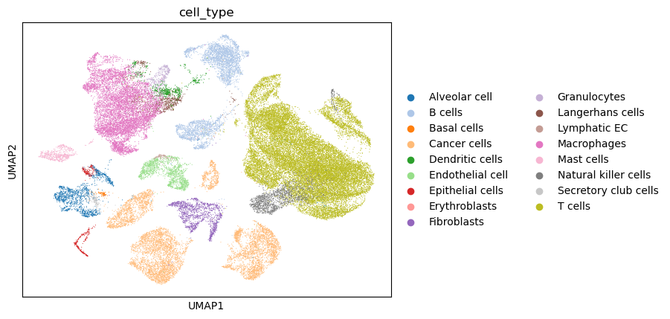
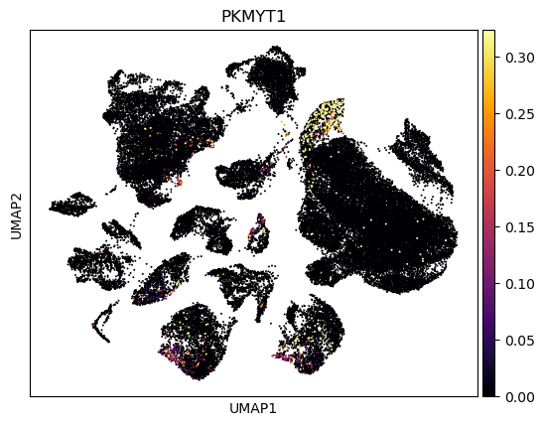
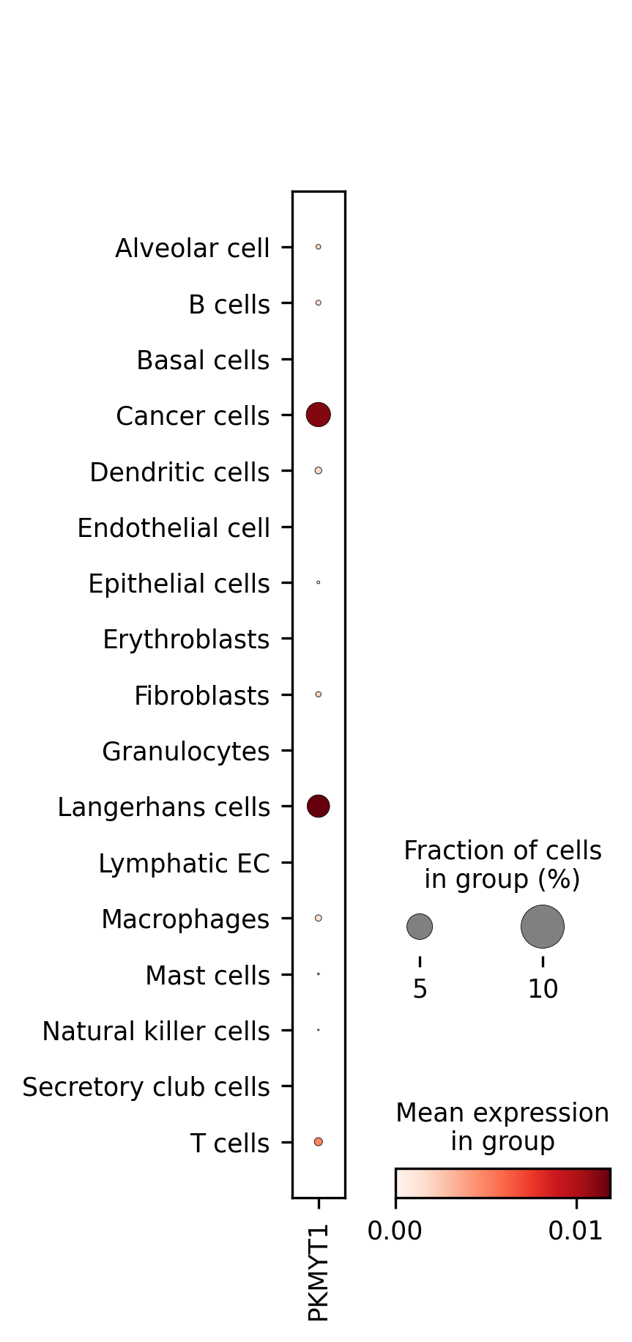
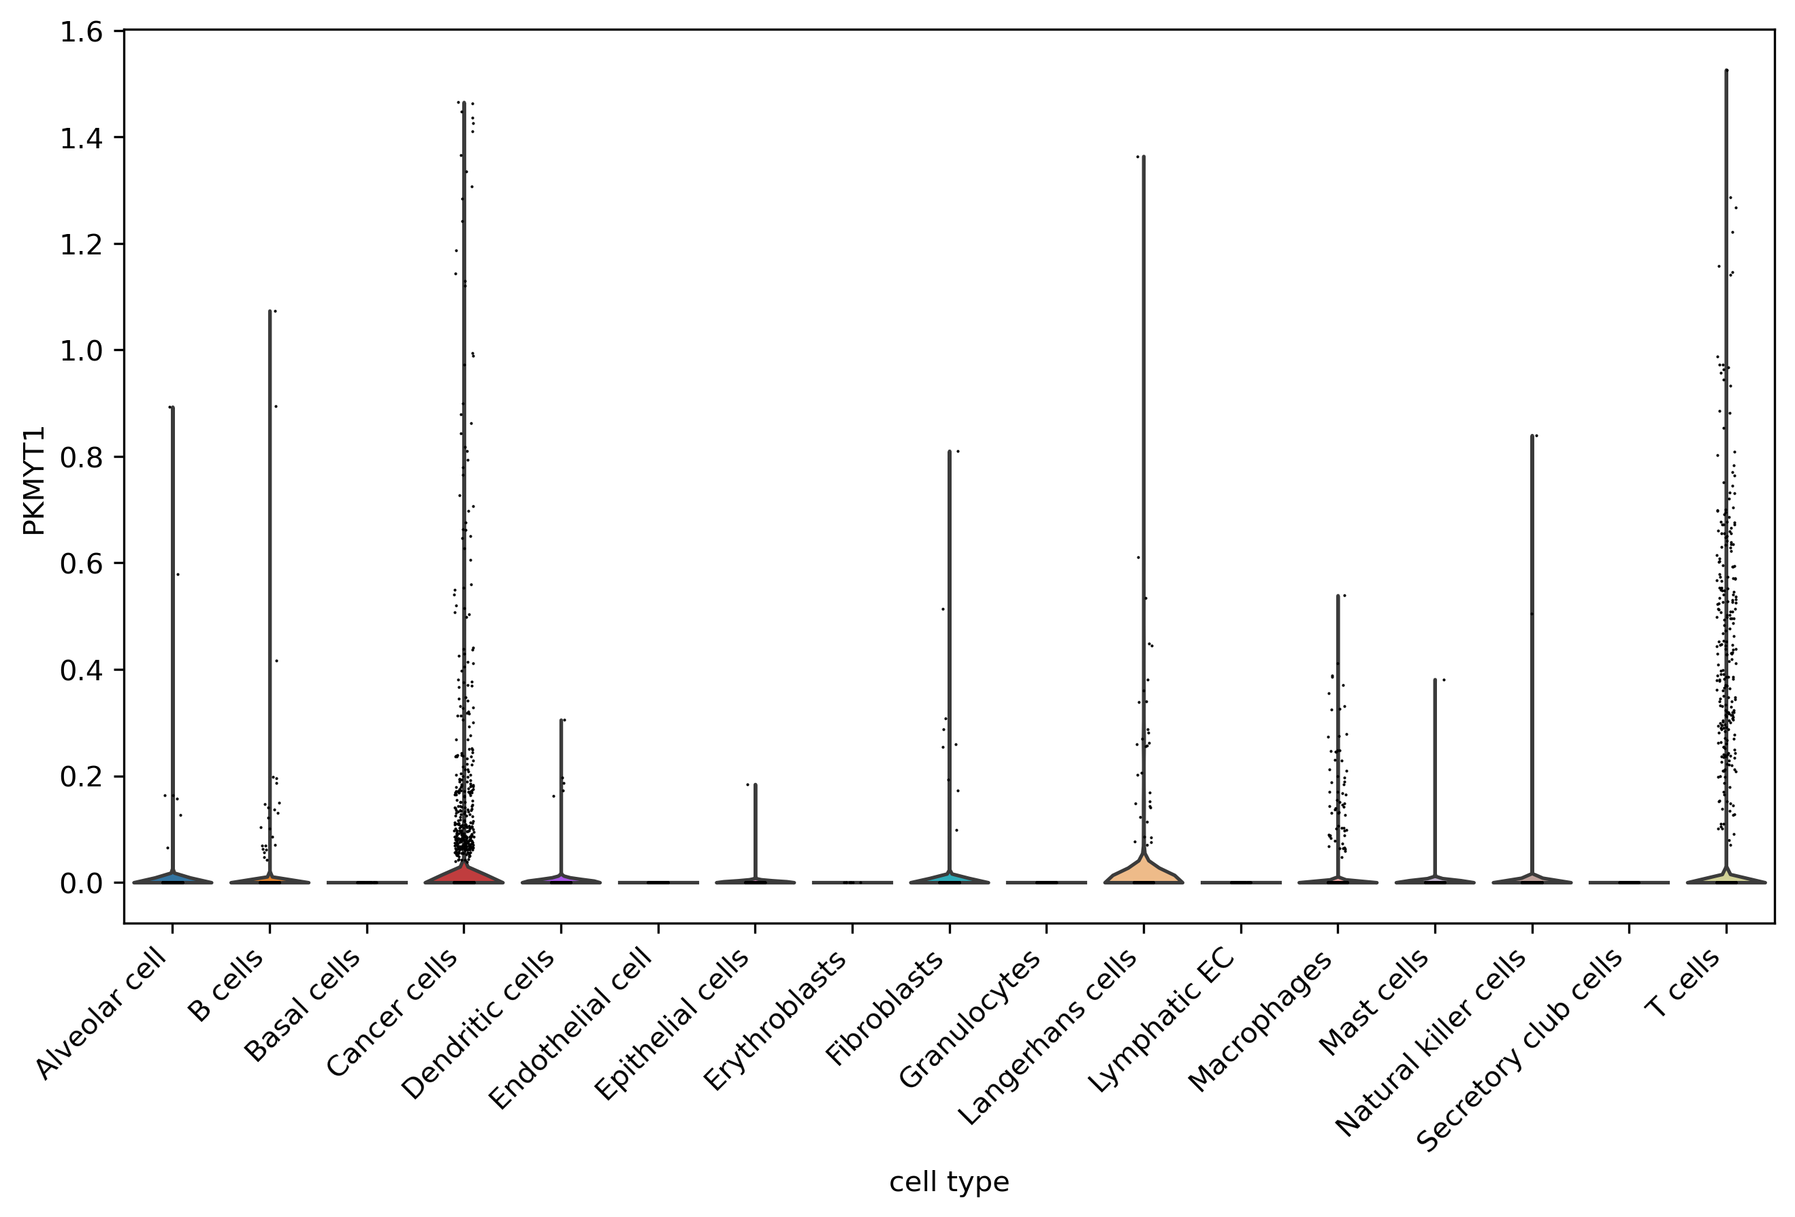
Fig. A
PKMYT1
UMAP of cell-types
UMAP for PKMYT1 expression
Violin plot showing distribution of expression across cell types
Dotplot showing mean expression per cell-type and fraction of cells within the cell-type expressing PKMYT1
PKMYT1 is most highly expressed in the cancer and Langerhans cells. P-values for Mannwhitney test for cancer vs each cell-type found in attached csv
Fig. B
Fig.D
Fig. C

Slide 3
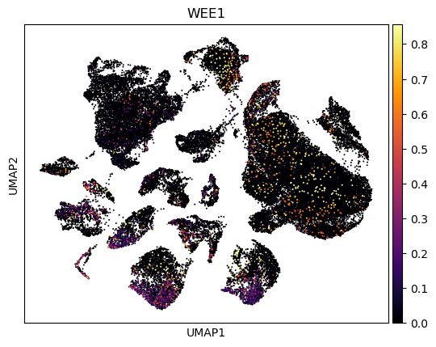
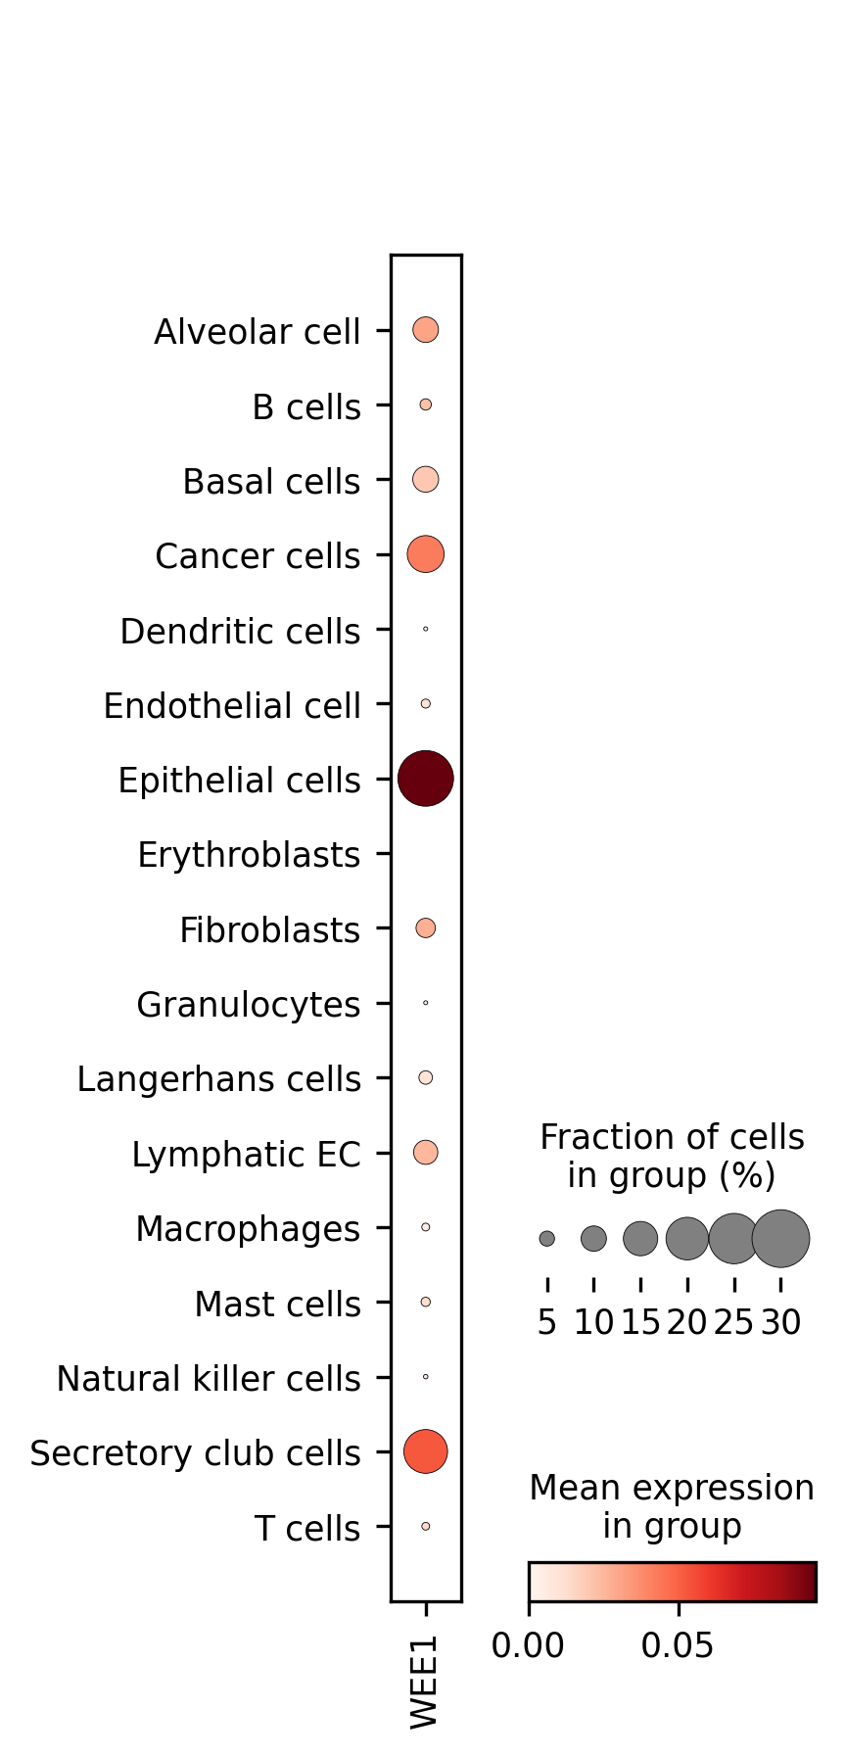
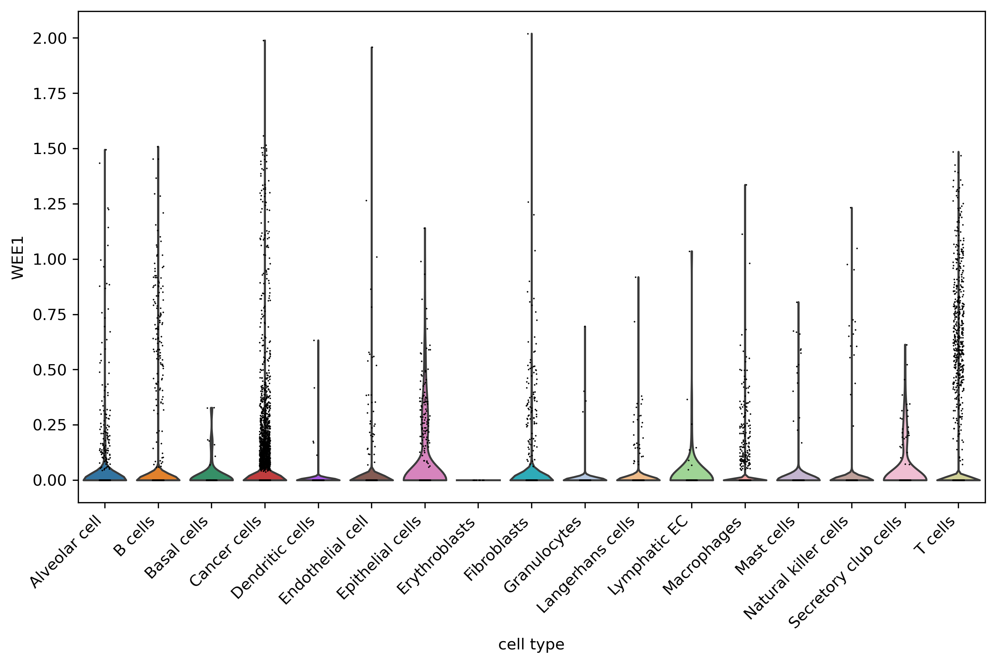
WEE1
UMAP of cell-types
UMAP for PKMYT1 expression
Violin plot showing distribution of expression across cell types
Dotplot showing mean expression per cell-type and fraction of cells within the cell-type expressing PKMYT1
PKMYT1 is highly expressed in a variety of cell-types. P-values for Mannwhitney test for cancer vs each cell-type found in attached csv.

Slide 4
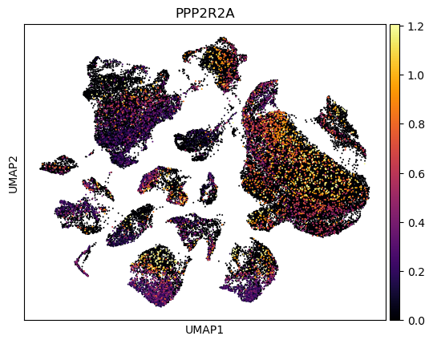
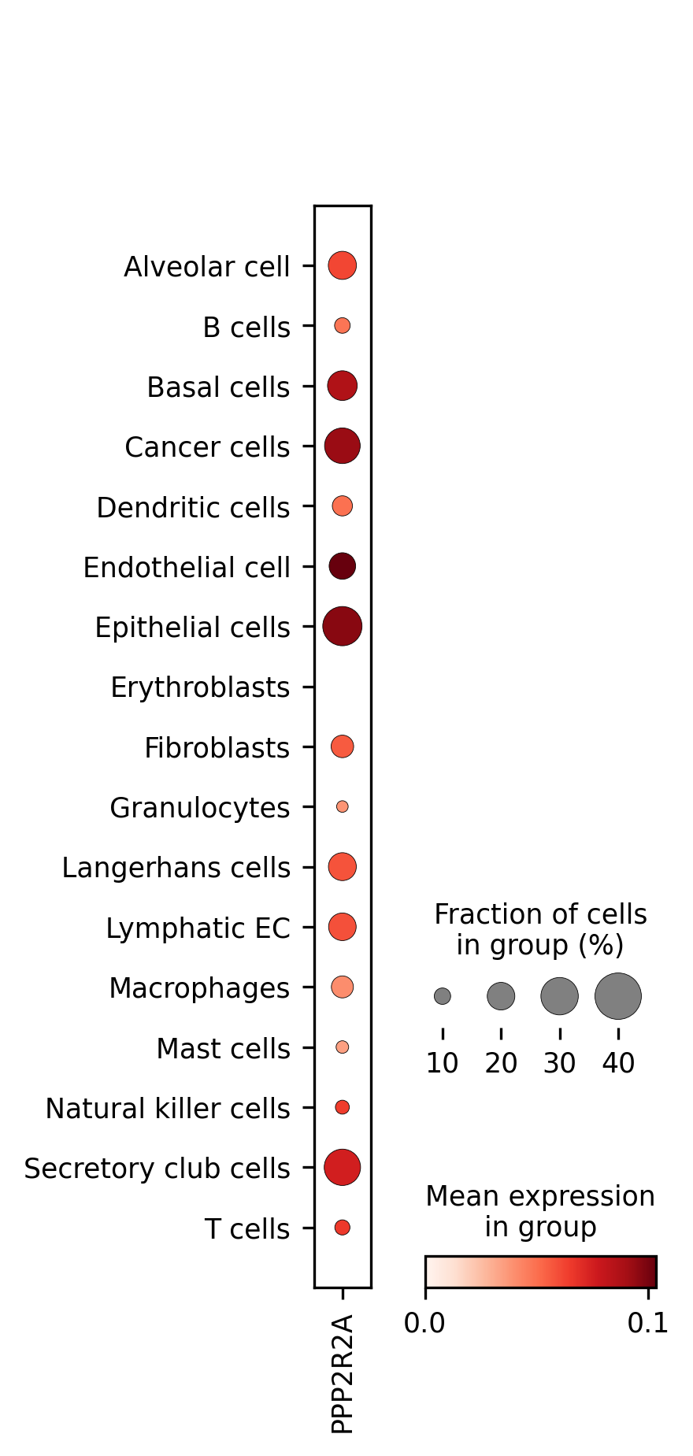
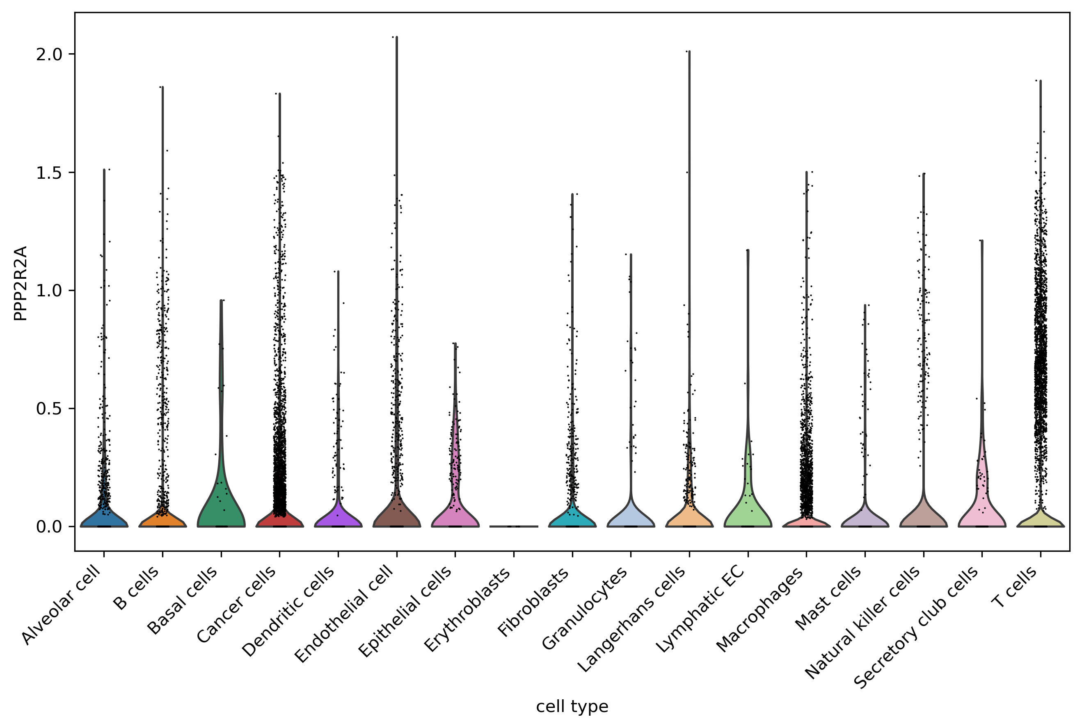
PPP2R2A
UMAP of cell-types
UMAP for PKMYT1 expression
Violin plot showing distribution of expression across cell types
Dotplot showing mean expression per cell-type and fraction of cells within the cell-type expressing PKMYT1
PKMYT1 is highly expressed in a variety of cell-types. P-values for Mannwhitney test for cancer vs each cell-type found in attached csv.

