Slide 1

Prepared by Group 3
Group Project
Work and Stress
06 February 2025

Slide 2


Team Members
Chris Dobbin
Ellen Liu
Pratishtha Theeng
Sarah Burnap
Jordan Dreyer
Member
Member
Member
Member
Member

Slide 3
Introduction
Work-related stress is physical and emotional strain experienced by individuals due to pressures and challenges in the workplace, such as heavy workloads, tight deadlines, job insecurity, and lack of support, which can negatively impact their health and job performance.

Slide 4

Analysis Objectives
Exploring the impact of Work-related Stress
Investigating how stress in the workplace affects employees` well-being, productivity, and overall job satisfaction
Understanding the Sources of Work Stress
Analyzing key stressors, such as workload, company size, and work-life balance, and their correlation with performance and mental health

Slide 5

Key Factors Influencing Corporate Workplace Stress
Point I
Lorem……..
Point III:
lorem
Point II
lorem

Slide 6
Exploring Gender Biasness
50.70% of Non-binary experiences gender biasness at workplace
50% of Female experiences gender biasness at workplace
50.40% of Male experiences gender biasness at workplace

Slide 7
Gender VS Stress Analysis
Stress Level were categorized into three different type based on the rating:
Lowest : 0 - 4
Moderate : 5 - 7
Highest : 8 -10

Slide 8
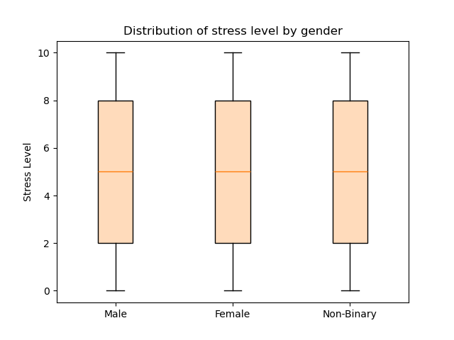
Stress level distribution by gender
This box plot visualizes the distribution of the stress level experienced by male, female, and non-binary individuals.
The box plot clearly shows a uniform distribution of the stress levels for each of the genders, which signals the possibility of the data being synthetic.

Slide 9
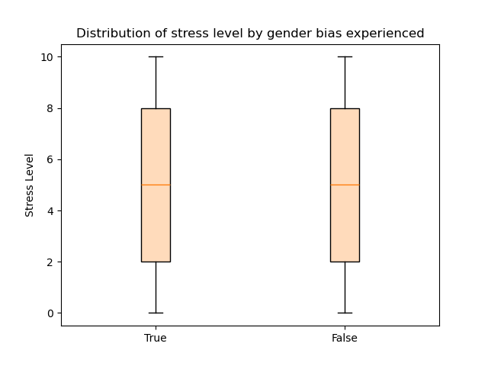
Distribution of stress level by gender bias experience
This box plot visualizes distribution of stress level experienced by individuals who have indicated they have experienced gender bias and those who indicated they have not experienced gender bias.
The box plot also visualizes a uniform distribution of the stress level by each group

Slide 10
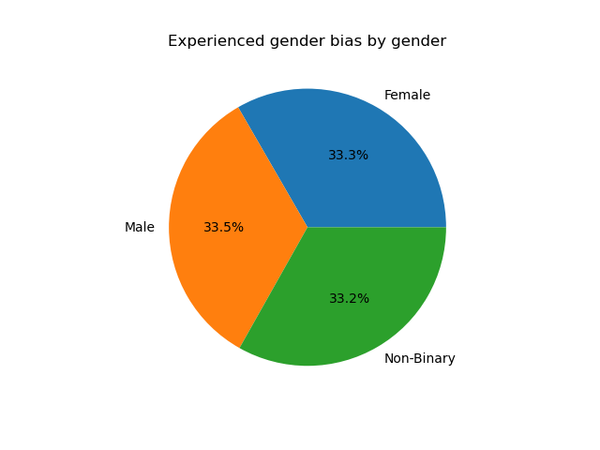
Proportion of individuals who have experienced gender bias by gender
This pie chart visualizes the percentage distribution of each gender among individuals who reported they have experienced gender bias.
According to this pie chart, individuals who identify as male make up a slightly higher proportion of those who reported they have experienced gender bias.

Slide 11
Familial Support and Stress
Familial Support have played significant impact on underlying the stress level

Slide 12
Impact of team size in Work place stress
Stress Level were categorized into three different type based on the rating:
Lowest : 0 - 4
Moderate : 5 - 7
Highest : 8 -10

Slide 13
Correlation between physical activity and stress
Write descritipin

Slide 14
Work Model contribution to stress
Stress Level were categorized into three different type based on the rating:
Lowest : 0 - 4
Medium : 5 - 7
Highest : 8 -10

Slide 15
Conclusion
CONCLUSION

Slide 16
Thank you

