Slide 1
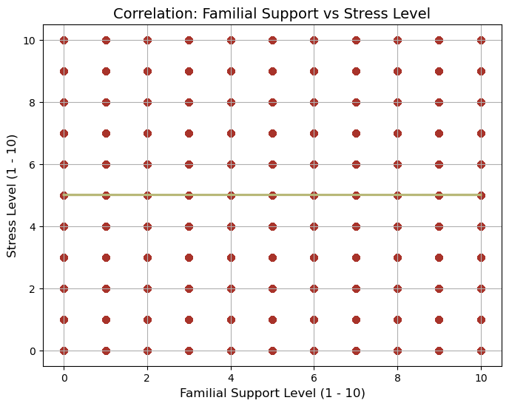
Familial Support and Stress
There is no correlation, if any, with this data set that there was an impact of Familial support on stress levels.
The data set was far too even, and there was little variance at all for this data sample.

Slide 2
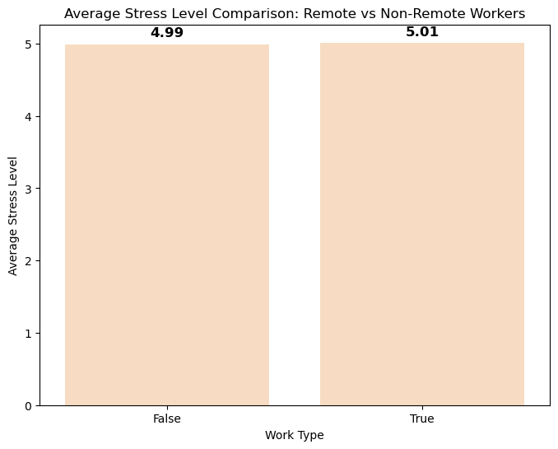
Remote work and Stress
There is no correlation, if any, with this data set that there was an impact of remote work on stress levels.
This finding also correlates with the previous findings that were inconclusive.

