Slide 1
F1 Fan Analytics Database
Eliud Hadgu & Nathan Delgado

Slide 2
Problem & Purpose
The Problem
F1 data is scattered across many websites
Most sites show only basic results and current standings
Deeper questions require multiple searches, like how two teammates compare or how a driver performs at a specific circuit
Our Solution
A relational database that stores F1 drivers, teams, circuits, races, seasons, sponsors, and engine suppliers in one place
Tracks changes over time, such as driver transfers, sponsorships, and engine deals
Who It's For
Fans and analysts who want to explore and compare historical race data
Administrators who keep the data accurate and up to date

Slide 3
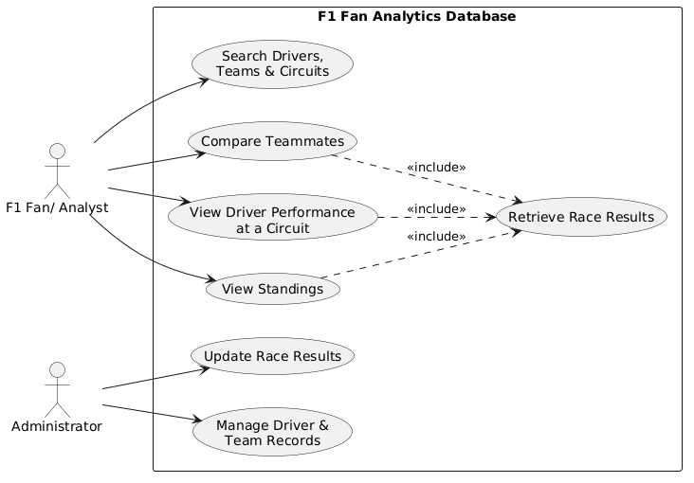
Use Case Diagram
The primary use case modeled in this system is allowing F1 fans and analysts to search and analyze Formula 1 racing data. Users can:
search for drivers, teams, and circuits,
compare teammates across seasons,
view driver performance at specific circuits,
and access championship standings.
These functions retrieve race results from the database to display relevant statistics, including finishing positions, points earned, and team performance.

Slide 4
Use Case Diagram
The system also includes an Administrator responsible for maintaining accurate and updated information.
Administrators can update race results and manage driver and team records, ensuring the database remains reliable.
Overall, the system provides a structured way to explore historical F1 data, compare performance, and track racing statistics across multiple seasons.

Slide 5
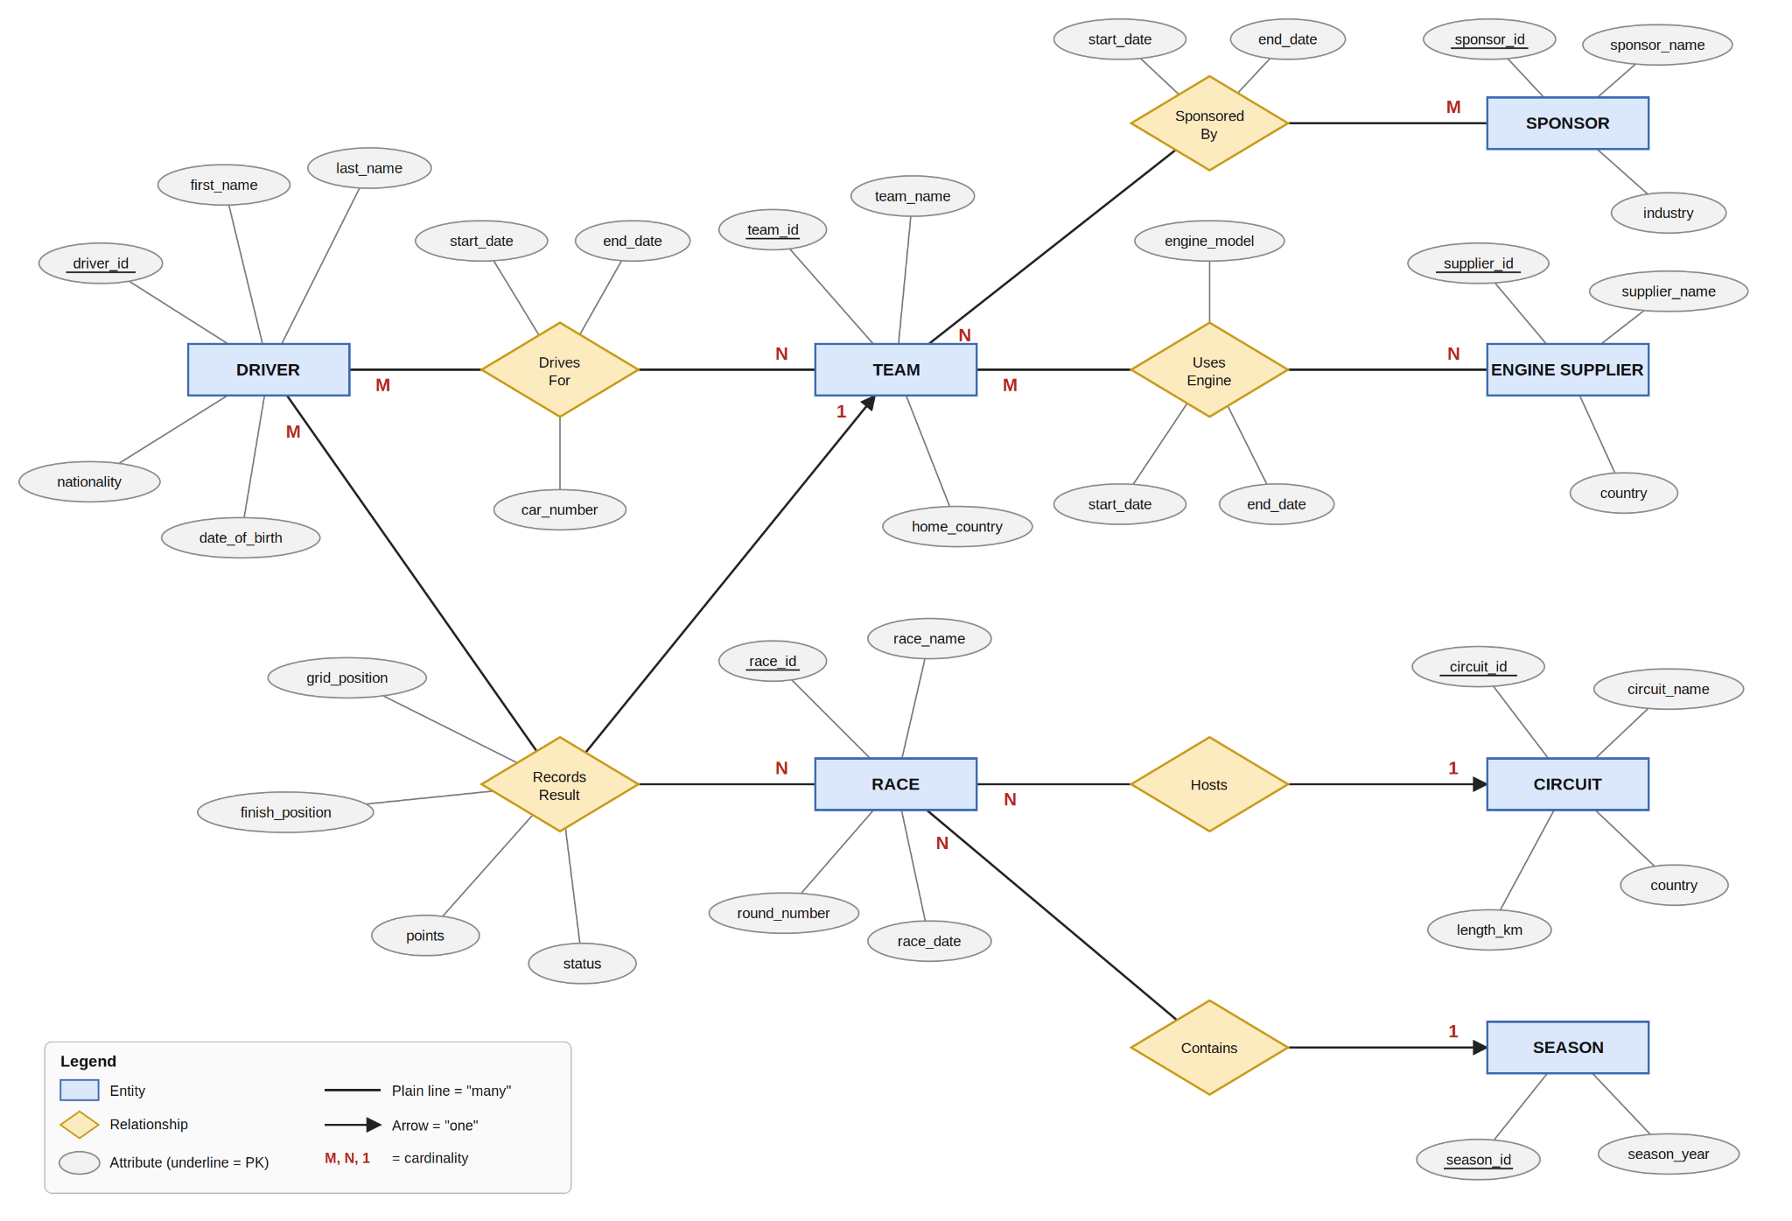
E/R Diagram

Slide 6
E/R Diagram
The database consists of 7 entities:
Driver, Team, Circuit, Race, Season, Sponsor, and Engine Supplier
They are connected through 6 relationships:
Drives For (many-to-many between Drivers and Teams),
Sponsored By (many-to-many between Teams and Sponsor),
Uses Engine (many-to-many between Teams and Engine Suppliers),
Records Result (between Drivers, Teams, and Races),
Hosts (one-to-many between Circuits and Races),
Contains (one-to-many between Seasons and Races).

Slide 7
Schema Overview: Entities
Entity | Primary Key | Key Attributes | What it represents
Driver | driver_id | first_name, last_name, nationality, date_of_birth | A person who races in F1
Team | team_id | team_name, home_country | A constructor that enters cars
Circuit | circuit_id | circuit_name, country, length_km | A track where races are held
Season | season_id | season_year | One year of the championship
Race | race_id | race_name, round_number, race_date | One Grand Prix (links to a Circuit and a Season)
Sponsor | sponsor_id | sponsor_name, industry | A company that funds a team
Engine_Supplier | supplier_id | supplier_name, country | A manufacturer that provides engines

Slide 8
Schema Overview: Relationships
Relationship table | Connects | Type | Extra attributes
Drives_For | Driver and Team | many-to-many | start_date, end_date, car_number
Sponsored_By | Sponsor and Team | many-to-many | start_date, end_date
Uses_Engine | Team and Engine_Supplier | many-to-many | start_date, end_date, engine_model
Records_Result | Driver, Race, and Team | many-to-many | grid_position, finish_position, points, status

Slide 9
Relational Schemas
Driver
CREATE TABLE Driver (
driver_id INTEGER PRIMARY KEY,
first_name VARCHAR(50) NOT NULL,
last_name VARCHAR(50) NOT NULL,
nationality VARCHAR(50),
date_of_birth DATE
);
Team
CREATE TABLE Team (
team_id INTEGER PRIMARY KEY,
team_name VARCHAR(100) NOT NULL,
home_country VARCHAR(50)
);
Race
CREATE TABLE Race (
race_id INTEGER PRIMARY KEY,
race_name VARCHAR(100) NOT NULL,
round_number INTEGER,
race_date DATE,
circuit_id INTEGER NOT NULL,
season_id INTEGER NOT NULL,
FOREIGN KEY (circuit_id) REFERENCES Circuit(circuit_id),
FOREIGN KEY (season_id) REFERENCES Season(season_id)
);

Slide 10
Relational Schemas
Sponsor
CREATE TABLE Sponsor (
sponsor_id INTEGER PRIMARY KEY,
sponsor_name VARCHAR(100) NOT NULL,
industry VARCHAR(50)
);
Engine Supplier
CREATE TABLE Engine_Supplier (
supplier_id INTEGER PRIMARY KEY,
supplier_name VARCHAR(100) NOT NULL,
country VARCHAR(50),
);
Circuit
CREATE TABLE Circuit (
circuit_id INTEGER PRIMARY KEY,
circuit_name VARCHAR(100) NOT NULL,
country VARCHAR(50),
length_km DECIMAL(5,3)
);

