Slide 1
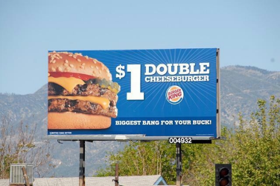
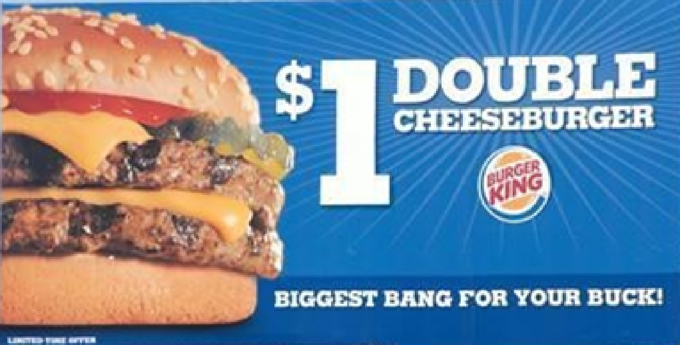
Spreadsheet
Sales Order
IBS
Client/PlannerView
InboundOrders
MFG Order
InDesign Data
InDesign
A spreadsheet with order information comes into our system from a customer the following takes place.
Header column formatted and matched to our script.
Data is reviewed and prepared.
Orders are separated based on our standards.
Standard orders are submitted.
The Inbound process will create a sale order, mfg order, and provide indesign with attributes to create the artwork using the templates that have been created for the customer.
Once the customer has approved the art it is produced and delivered for their use.

