Slide 1

Lessonly Concept Video
Created by

Slide 2
Problem & Solution Overview
Problem: Teachers do not have a quick and easy way to share resources and help each other in the classroom. They struggle to create tests, homeworks, worksheets, and lesson plans but when they try to collaborate and work together, it just gets confusing and things get lost.
Proposed Solution: Lessonly! The online teacher’s lounge where teachers can share teaching resources as well as getting feedback. This will provide a quick and easy way for teachers to share exams or lesson plans when they need it, or just store them safely in an easily accessible location. We also wanted to support creative lesson plans by teachers that don’t always use technology.

Slide 3
Tasks
Task 1 (Simple)
→ Experienced “genius” Stanford section leader Chris has noticed his students responding overwhelmingly positively to his Karel lesson plan and performing strongly as a result and wants to keep a record of his effective lesson plan for teaching Karel and make it accessible to others.
Task 2 (Complex)
→ Inexperienced and distraught Berkeley section leader Peach is struggling to relay the basic Karel concepts to her students and wants to find an effective lesson plan on short notice for this topic that her students will understand.
Task 3 (Moderate)
→ Experienced “genius” section leader Chris has been teaching the same lesson for years and feels like there might be ways to make it better and wants to understand if it works in other classrooms and to know how best to improve it.

Slide 4
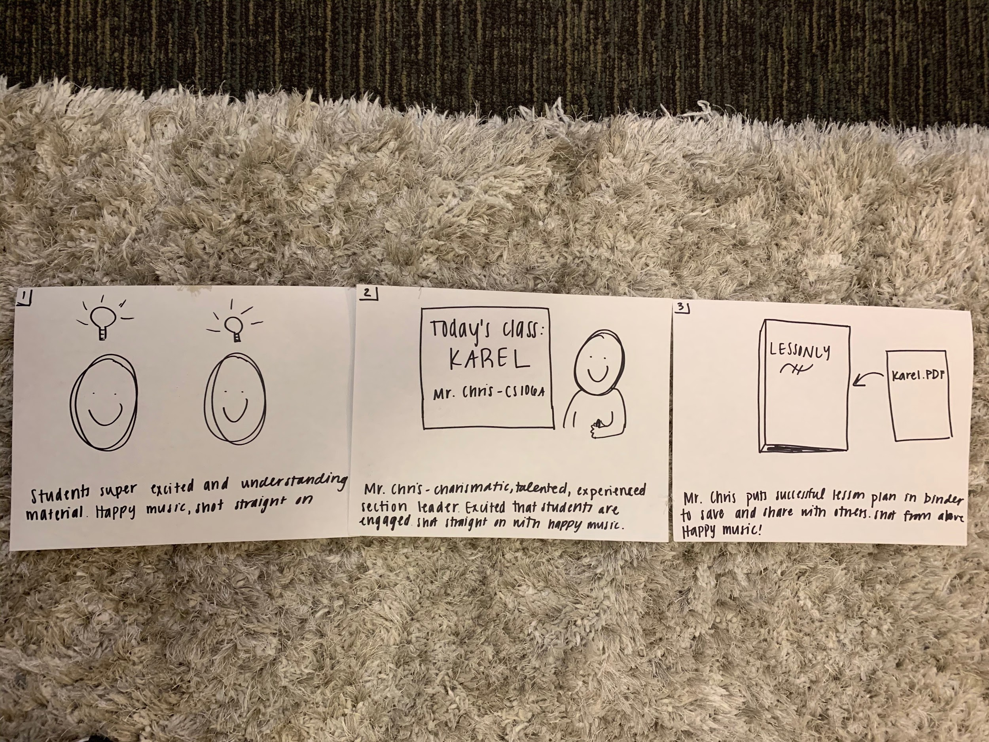
Storyboard Part 1
This storyboard corresponds to our first task, where we see students excited and learning new material in class. We then turn to Mr. Chris at the front of the class, where we see him teaching Karel and his happy reaction to seeing the students understanding the lesson. Lastly, we have the frame with Mr. Chris putting his Karel lesson plan into Lessonly.

Slide 5
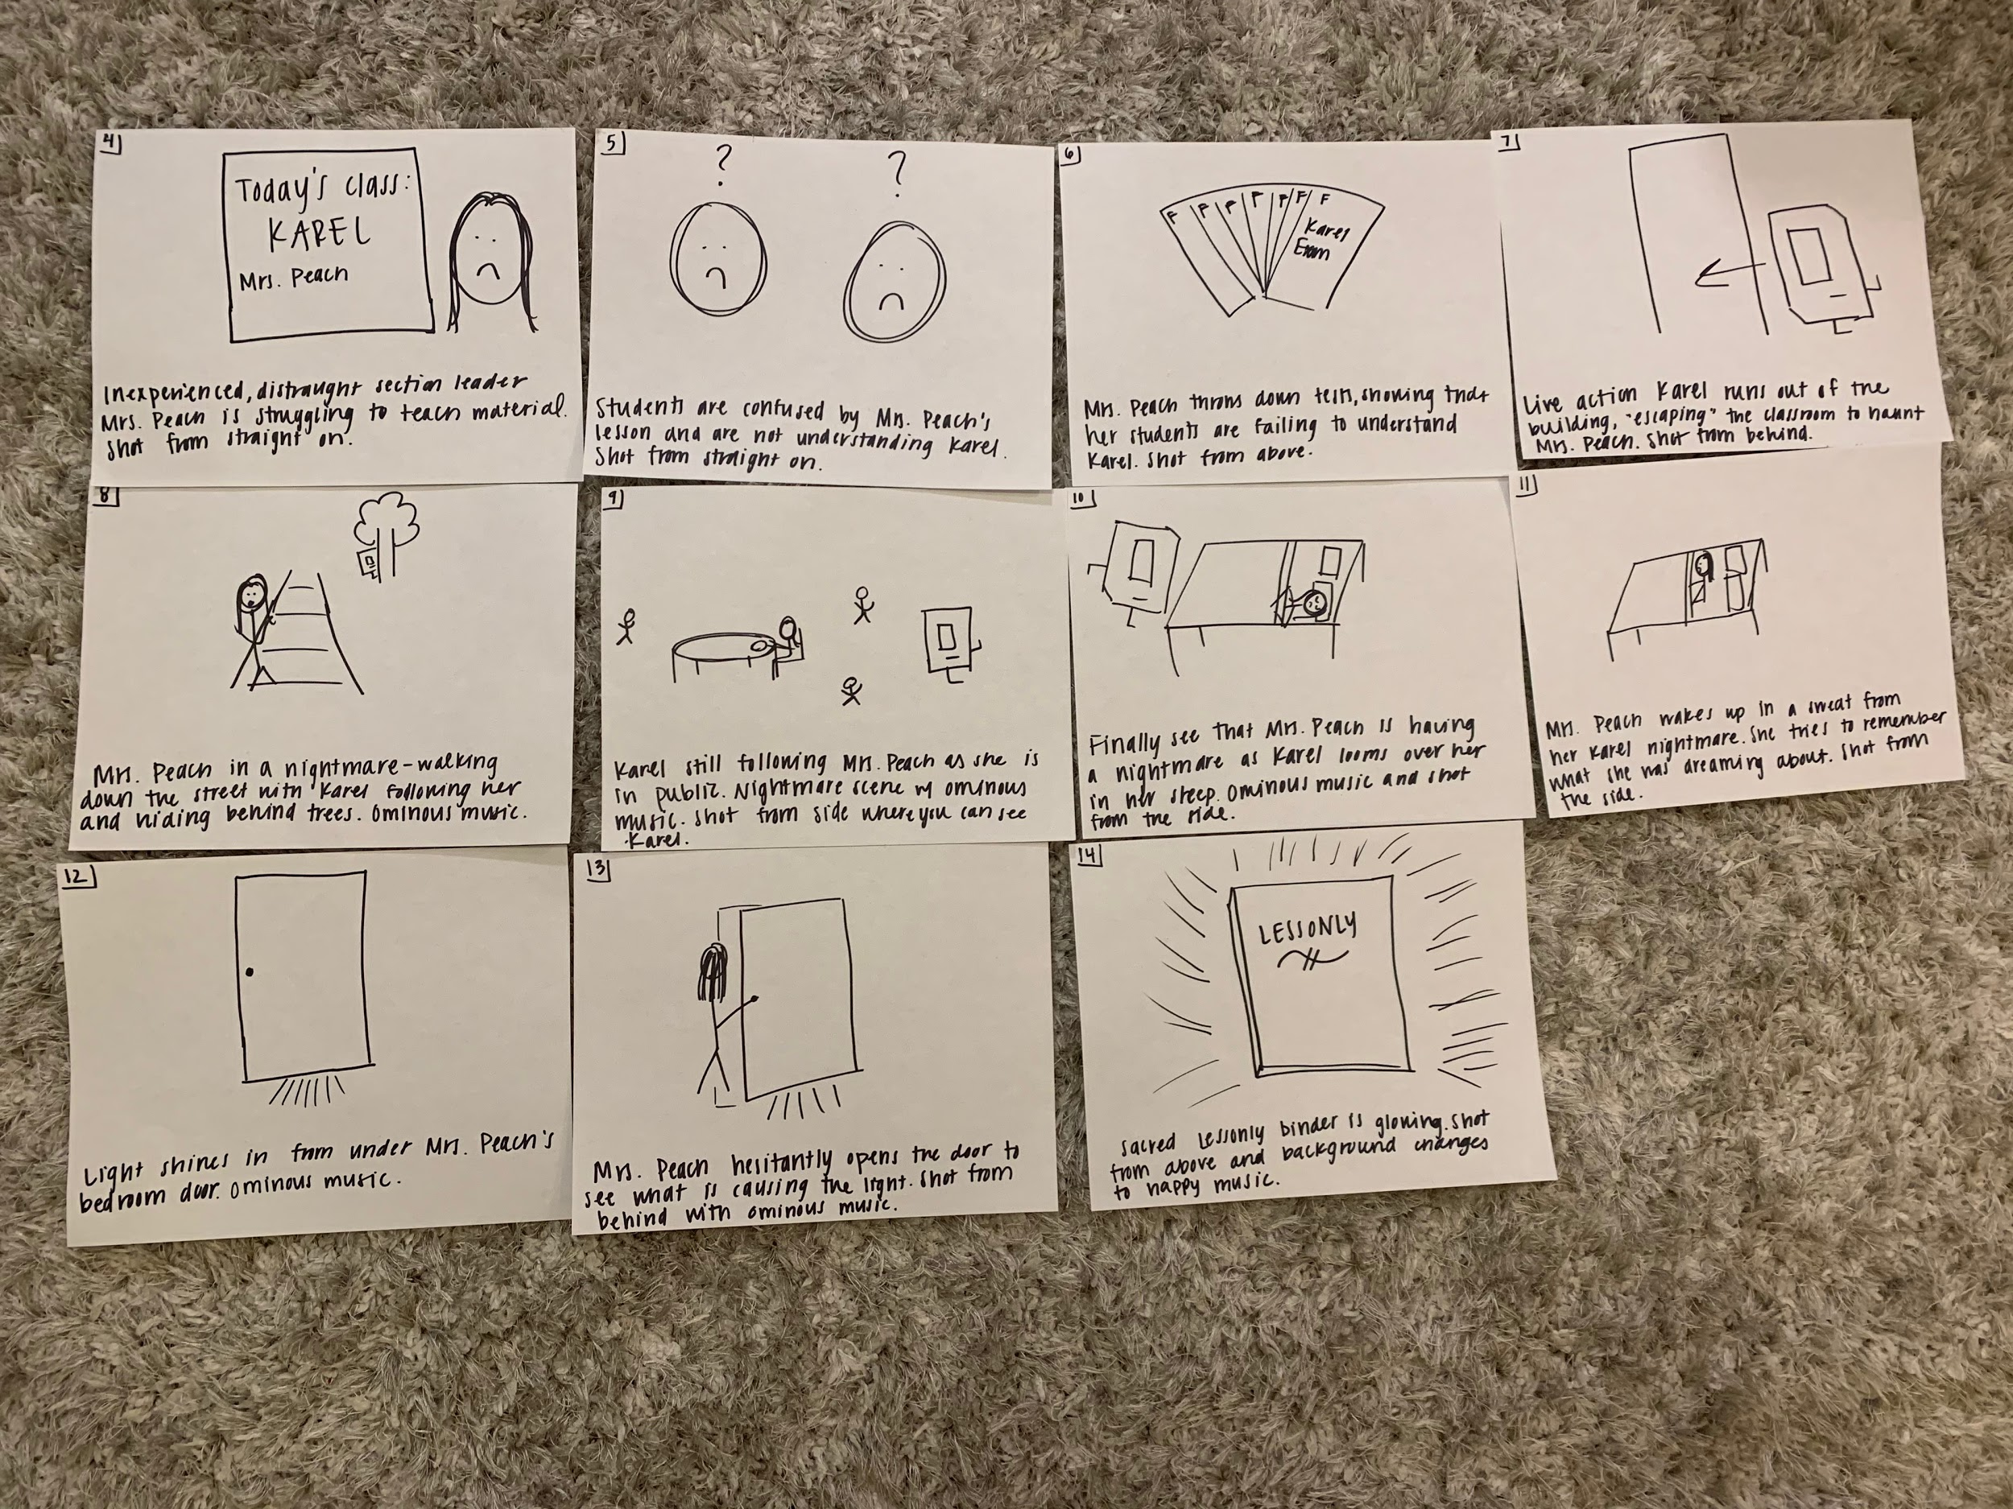
Storyboard Part 2
This storyboard corresponds to our second task. We first Mrs. Peach trying to teach Karel and looking frustrated and sad as we also see the students struggling to understand the material. This is explained more by all of the Karel exams having poor grades. Later, we see Mrs. Peach walking outside being followed by Karel (in a dream) to show how Mrs. Peach is struggling with Karel. Mrs. Peach then wakes up from her dream scared but then discovers Lessonly from behind her door.

Slide 6
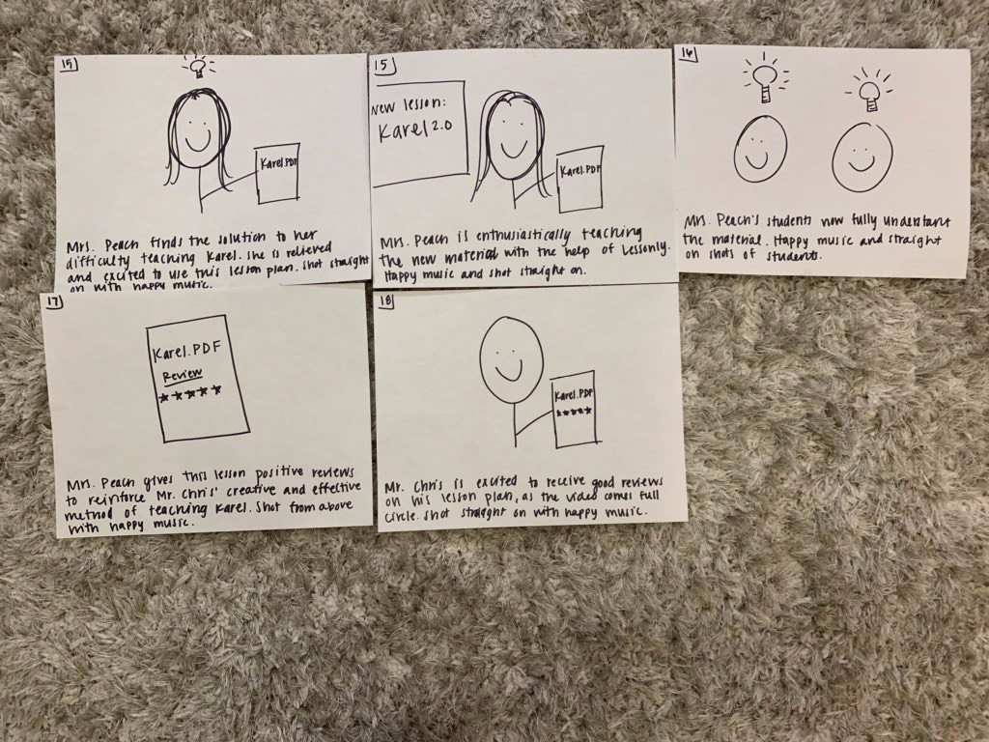
Storyboard Part 3
This storyboard corresponds to our third task, in which Mrs. Peach has found the new Karel Lesson Plan using Lessonly. We then we see her teaching the class with her new lesson plan (Karel 2.0) and then show the students as they can understand the material now. Finally, we have Mrs. Peach liking the lesson plan on Lessonly and Mr. Chris seeing that someone used and approved his lesson plan for Karel.

