Slide 1
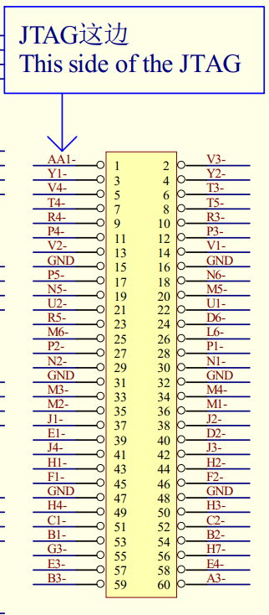
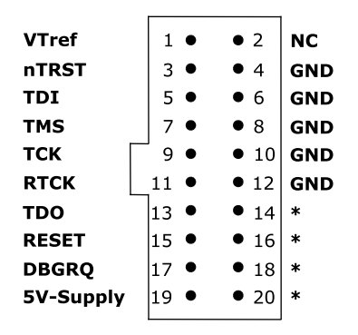
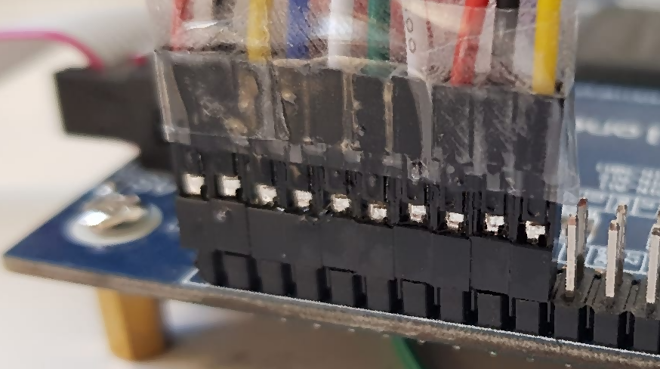
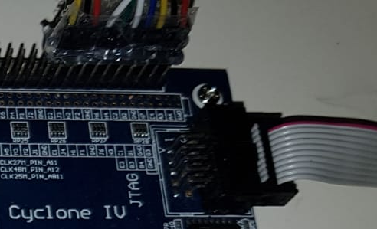
Connecting E115 to
ARM JTAG 20-pin Header
VTref A3 (RED1)
nTRST E4 (BLACK1)
TDI H7 (YELLOW1)
TMS B2 (BLUE)
TCK C2 (WHITE1)
RTCK H3 (GREEN)
TDO F2 (RED2)
RESET H2 (BLACK2)
DBGRQ J3 (YELLOW2)
JTAG pins are on the outer row, near the USB Blaster connection

