Slide 1

Parameterizing R Markdown Reports
β
λ
Φ
σ
λ
α
σ
ε
Φ
Elizabeth Mauer, MS
Research Biostatistician III, Weill Cornell Medicine
@LIZ_MAUER

Slide 2
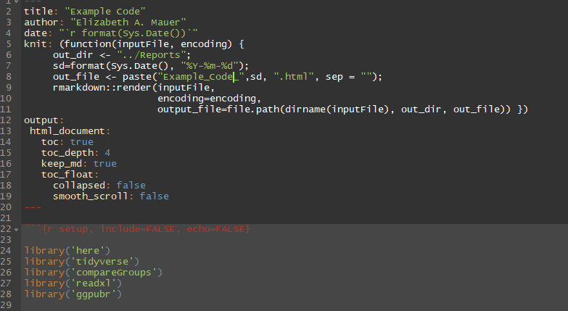
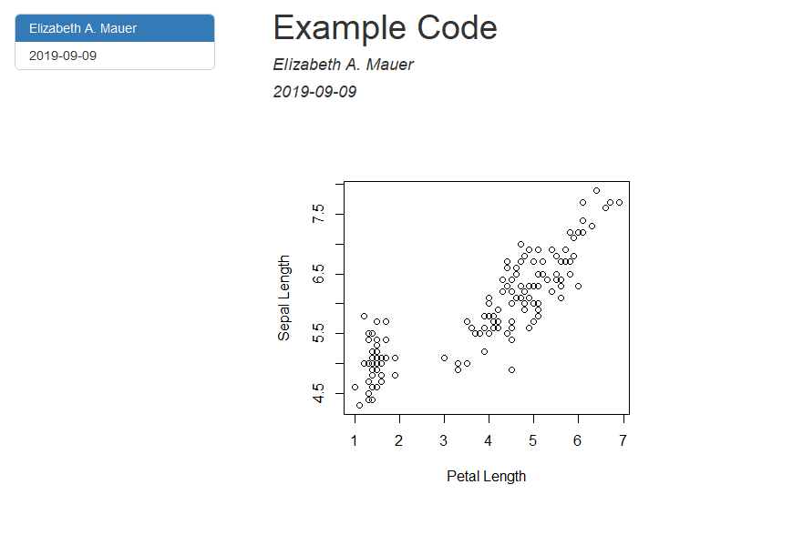

Motivation
SOURCE CODE
R Markdown Report
Investigator
DATA

Slide 3
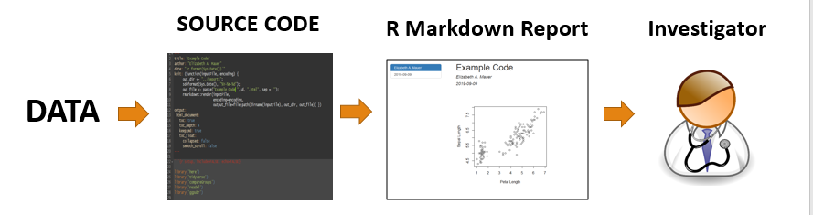
Motivation

Slide 4
Motivation
Feedback from investigator often results in requests for the same analyses under different circumstances/conditions
Different audiences need to see different things (ex. not necessary for physician to see code or details of analyses)

Slide 5
Typical Solution
Changes to source code
Copying source code for
different reports
Takes Time
Prone to Manual Mistakes
Threats to reproducibility

Slide 6

Parameterized Solution
R Markdown parameters allow you to keep the same source code while allowing you to render separate reports under different conditions.
Essentially, parameters allow you to create ‘templatized’ reports

Slide 7
Applications
Different selections of data (ex. year ranges, different diagnoses)
Different assumptions
Changing the behavior of knitr
Different audiences
λ
σ
β
α

Slide 8
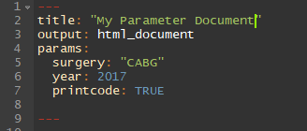
Implementation of Parameters
Parameters are incorporated into the YAML section of the R Markdown document in the ‘params:’ field.

Slide 9
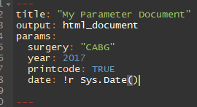
Implementation of Parameters
R types that can be parsed by yaml::yaml.load() can be included as parameters (character, numeric, integer, logical)
R objects can be included with ‘!r’ before the R expression

Slide 10
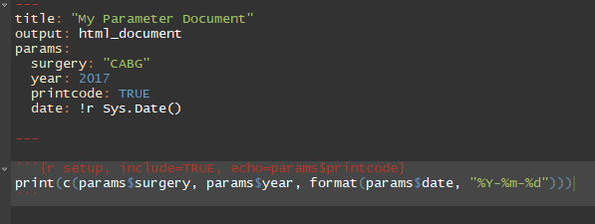
Implementation of Parameters
Parameters are specified in the YAML and can be accessed in the source code with ‘params$’

Slide 11


Knitting with Parameters
Using the ‘Knit’ button in Rstudio
Using ‘rmarkdown::render()’

Slide 12
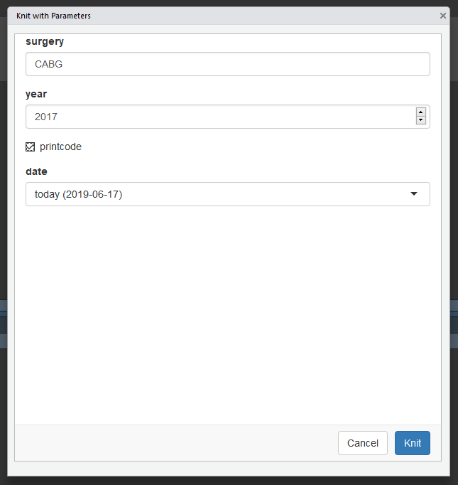
Knitting with Parameters
Using an interactive UI for
input of parameter values

Slide 13
The UI
The graphical user interface is based on Shiny. It's used to interactively select inputs for the report.
Can be accessed by:
'Knit' dropdown > 'Knit with Parameters' or
rmarkdown::render("My_Parameter_Document.Rmd", params="ask")

Slide 14
Parameter Attributes
What if we wished to constrain 'year' to a certain range, or we wished to display discrete options for 'surgery'?

Slide 15
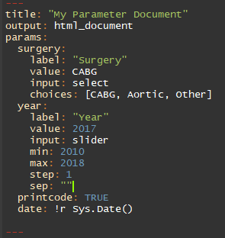
Parameter Attributes
Inputs for parameters can
be controlled by additional
arguments in the YAML.

Slide 16
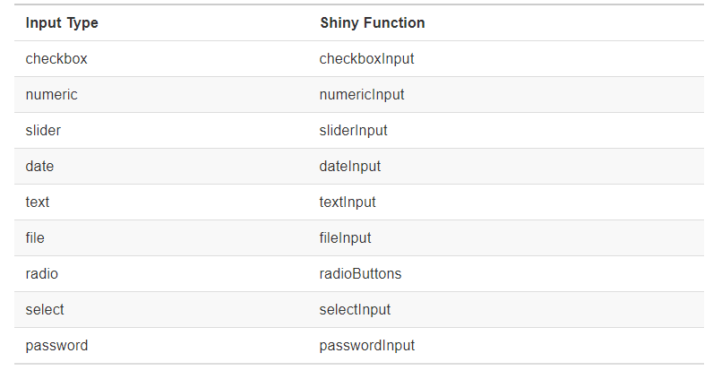
Parameter Attributes
Different inputs currently supported:

Slide 17
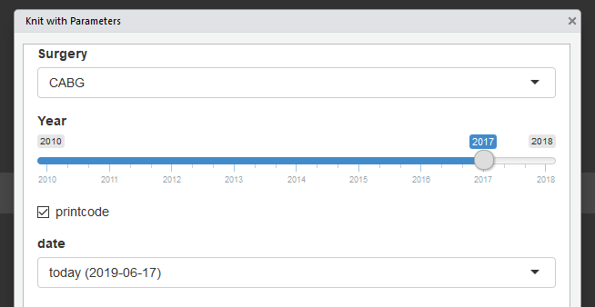
Parameter Attributes
The graphical UI
has the ability to
provide different
features for input
selections such as
sliders, check boxes,
text boxes.

Slide 18
Additional Resources
https://bookdown.org/yihui/rmarkdown/parameterized-reports.html
https://docs.rstudio.com/connect/user/param-rmarkdown.html

Slide 19
Thank You!

