Slide 1

Ai Engineering 2025
An overview

Slide 2

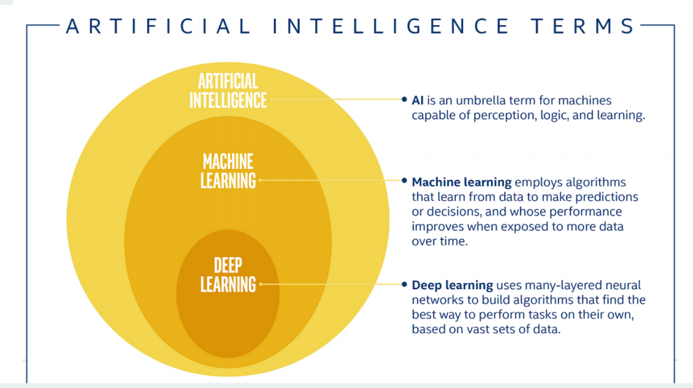
SOME DEFINITIONS
Modern
AI
Data Squad | Intro to AI

Slide 3
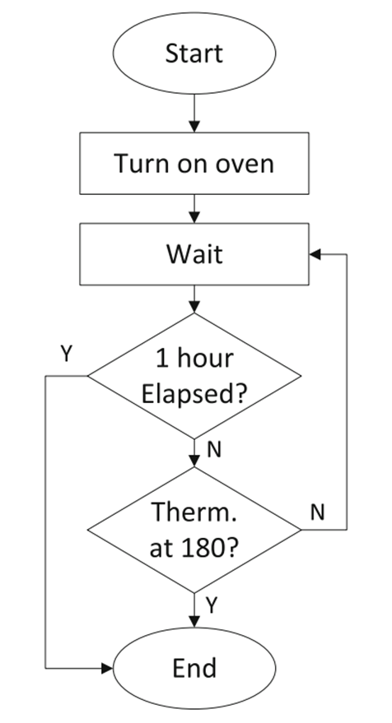
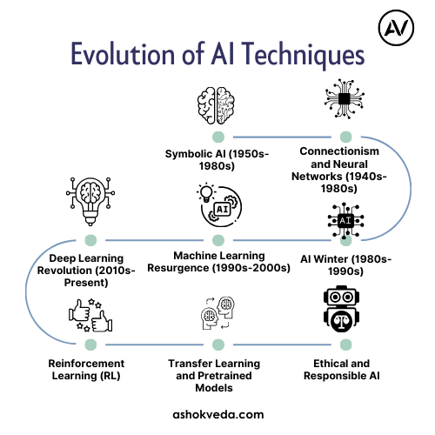
AI IS NOT NEW
THEN WHY IS IT FAMOUS NOW?
Data Squad | Intro to AI

Slide 4
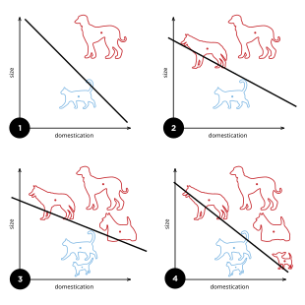
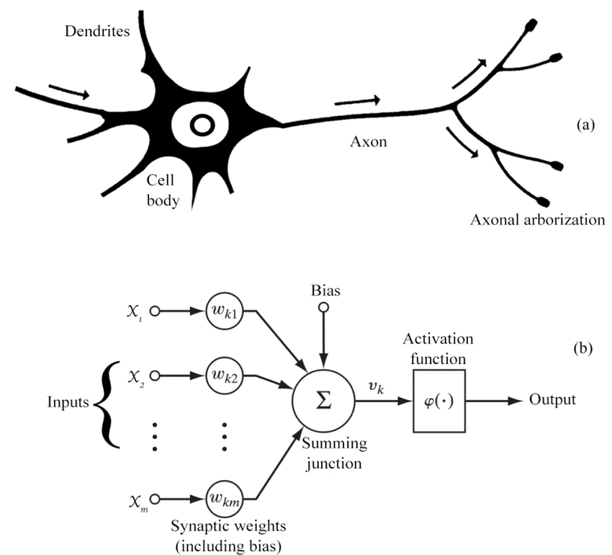
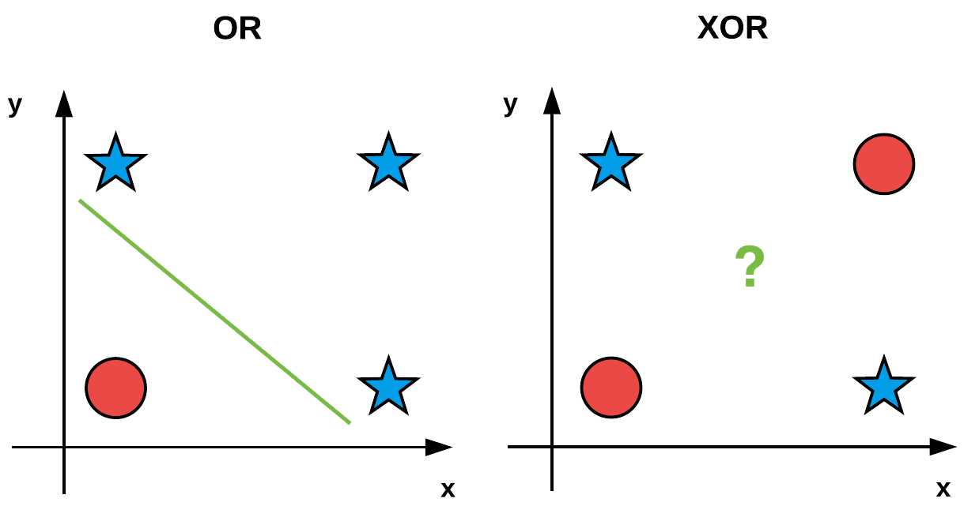
AI IS NOT NEW
THEN WHY IS IT FAMOUS NOW?
Data Squad | Intro to AI

Slide 5
AI IS NOT NEW
THEN WHY IS IT FAMOUS NOW?
Statistical Learning Theory
- being right according to reason
-> being right ‘on average’
- SVM Computational Power
Data Squad | Intro to AI

Slide 6
AI IS NOT NEW
THEN WHY IS IT FAMOUS NOW?
AlexNet winning ImageNet - proved deep CNNs superior for computer vision
GPU computing making training feasible
Large labeled datasets becoming available
Data Squad | Intro to AI

Slide 7
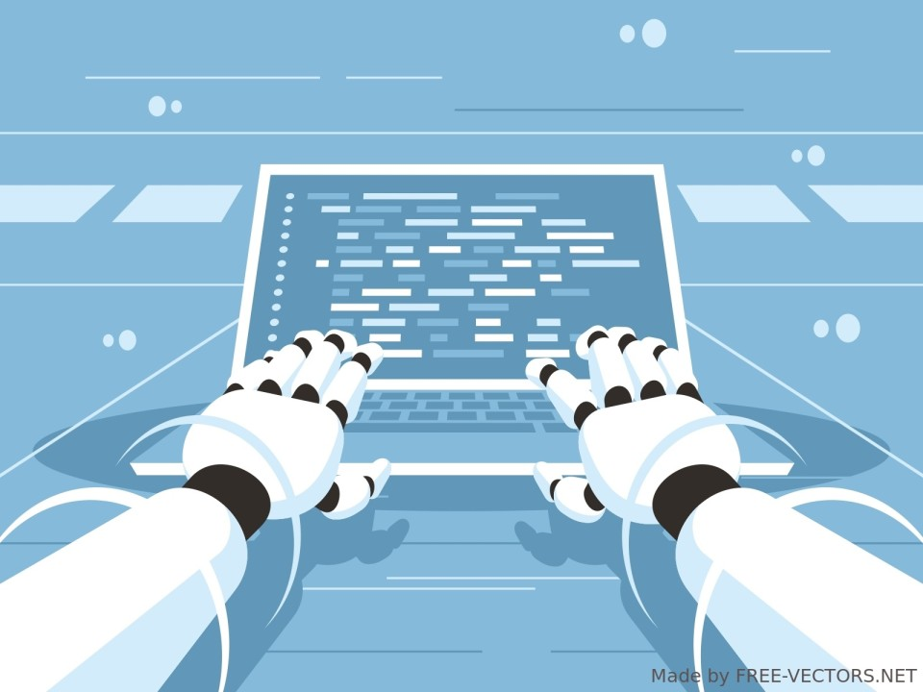
AI IS NOT NEW
THEN WHY IS IT FAMOUS NOW?
Data Squad | Intro to AI

Slide 8
AI IS NOT NEW
THEN WHY IS IT FAMOUS NOW?
Computational power
+
Algorithmic Innovations
=
Finally, we can do AI “properly”
Data Squad | Intro to AI

Slide 9
What we are going to teach you
Python, Bash & Git
How to work with data
Computer Vision and CNN
NLP and transformers
OpenAI API and chatbots
RAG
Langchain
Agents
Intro to ML/AI deployment and MLOps

Slide 10
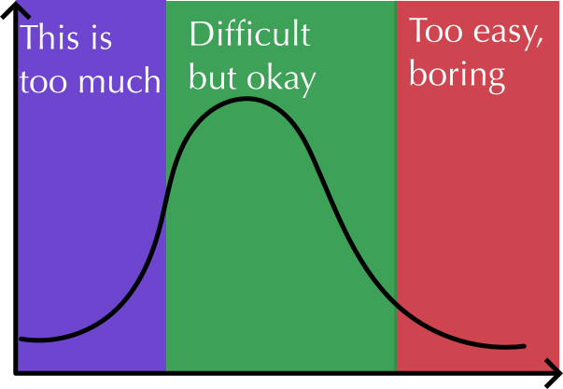
Easy = f(time doing similar things)
Python, Bash & Git
How to work with data
Computer Vision and CNN
NLP and transformers
Ask questions. Ask for help!
Ask for extra
challenge

Slide 11
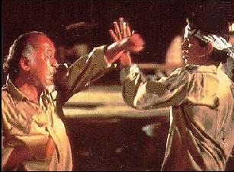
Bash: Command line tools
In your terminal

Slide 12
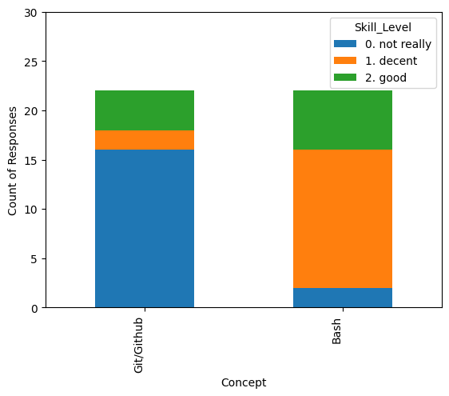
Git and Bash

