Slide 1

Predicting Durham County Department of Public Health Inspection Scores
Temilola Famakinwa
Email: tefamakinwa@gmail.com
LinkedIn: https://www.linkedin.com/in/famakinwatemilola/

Slide 2

The Problem
Incorrect implementation of hygiene procedures at food services establishments leads to:
Brand risk for the establishments.¹
Risk to public health and safety for consumers.²
How can we help establishments understand where and how to improve in their hygiene procedures?
https://www.fastcompany.com/91137429/addressing-brand-damage-and-legal-risk-in-food-safety-issues
https://www.cdc.gov/foodborne-outbreaks/index.html

Slide 3

Approach
Determine the most frequent health department violations in Durham county.
Predict health department inspection scores
Find opportunities for improvement for the 5 worst performing food service establishments.

Slide 4
Data Sources and Their Uses
Link/Name of File | Source | Description
Food-inspection-violations_1.json | Data World | Food health inspection violation data up until 2/21/20217
Restaurant-and-services_3.json | Data World | Restaurant information as a list
Food-health-inspections_3.csv | Kaggle | Restaurant and violation information
Durham_County_Boundary.shp | Durham, NC Open Data Portal | Durham County GIS Boundary
Food-inspection-violations_1: To learn about the types of inspection violations.
Restaurants-and-services_3 and Durham_County_Bounday: To map out the location of restaurants in Durham county
Food-health-inspections_3: To model inspection scores.

Slide 5
EDA Findings

Slide 6
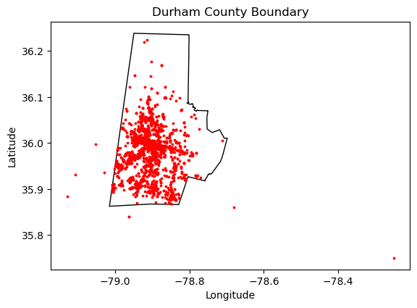

Restaurant Locations
Establishments are concentrated toward the center and lower parts of Durham county (close to Durham city).
Additional questions: is there is a difference in number of restaurant visits per year between restaurants on the outskirts of the county, and those in the center?

Slide 7
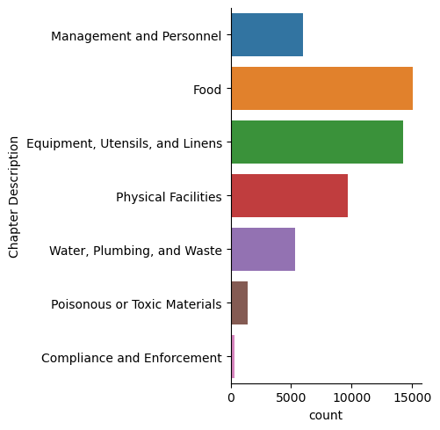


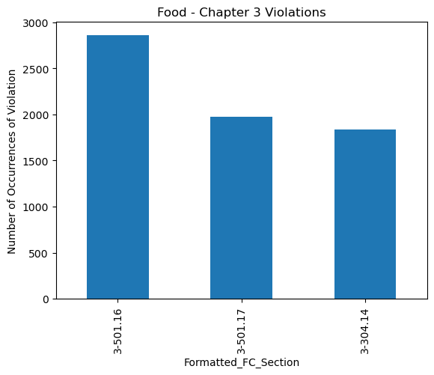
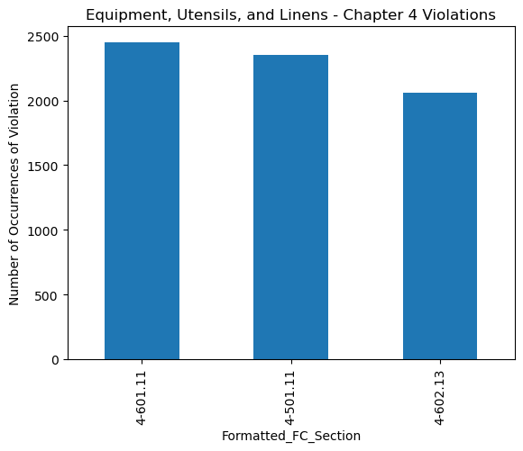
General Food Code Violations
Violations related to ‘Time/Temperature Control for Safety Food, Hot and Cold Holding’ and 'Equipment, Food-Contact Surfaces, NonfoodContact Surfaces, and Utensils.’ occurred most frequently in each chapter.

Slide 8
Modeling

Slide 9
Modeling Plan
Feature Engineering
Features > 5% null values were dropped
Non-pertinent feature dropped
Comments (stop words, tokenization, lemmatization, TFIDFVectorizer )
StandardScaler
Supervised Learning: Regression*
Predict Inspection Scores
Support Vector Regression (SVR)
RandomForest Regression (RFR)
XGBoost Regression (XGBR)
Model Parameter Tuning
RandomizedSearch CV
Bayes Optimization
5-Fold Cross Validation
*See appendix for model hyperparameters

Slide 10
Model Performance
Hyper tuning Output – RandomizedSearchCV
Hyper tuning Output – Bayes Optimization
Model | Best R-Squared Value | Best hyperparameters | Optimization Time (min)
SVR | 0.92 | 'kernel': 'rbf' | 10.16
 |  | 'epsilon': 1
 |  | 'C': 100
RFR | 0.90 | 'n_estimators': 50 | 0.31
 |  | 'max_leaf_nodes': 9
 |  | 'max_features': 'sqrt'
 |  | 'max_depth': 9
XGBR | 0.99 | 'subsample': 0.5 | 2.46
 |  | 'min_child_weight': 1
 |  | 'max_depth': 3
 |  | 'learning_rate': 0.5
Model | Best R-Squared Value | Best hyperparameters | Optimization Time (min)
SVR | 0.92 | 'epsilon’: 0.01 | 15.5
 |  | 'C’: 69.7
RFR | 0.90 | 'n_estimators’: 53 | 0.5
 |  | 'max_leaf_nodes': 9
 |  | 'max_depth': 9
XGBR | 0.99 | 'subsample': 0.77 | 3.8
 |  | 'min_child_weight’: 1.6
 |  | 'max_depth’: 8.0
 |  | 'learning_rate': 0.05
Categorical and numerical hyperparameters were used in RandomizedSearchCV while only numerical parameters were used in Bayes Optimization.

Slide 11
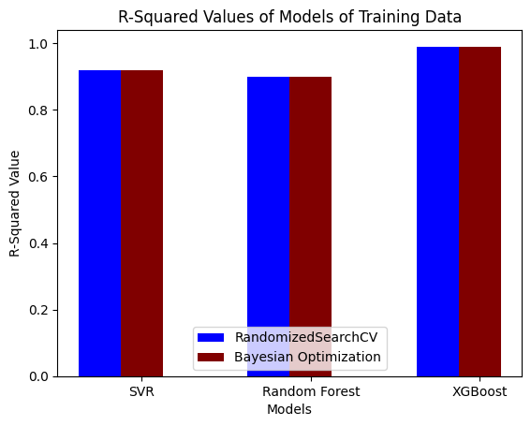
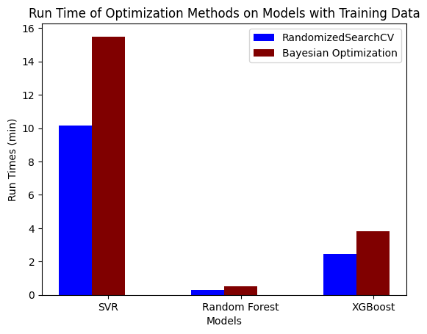
Model Scores and Run Time
XGBoost Regression resulted in the best model score. R-squared = 0.99).
R-squared value for each model was the same using the RandomizedSearchCV or Bayes Optimization.
Bayes Optimization had a longer run time than RandomizedSearchCV

Slide 12
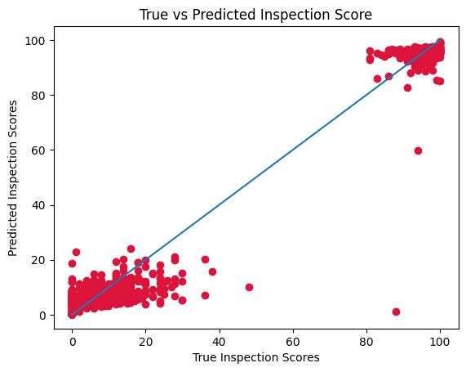
Model Performance on Test Data
XGBoost Regression along with its hyperparameters were used to predict scores on test data. R-squared value was 0.99.
Majority of recorded inspection scores are at the extremes of the score range.
The error between true scores and test scores is greatest in score range between 20 – 80, possibly due to lack of data.

Slide 13
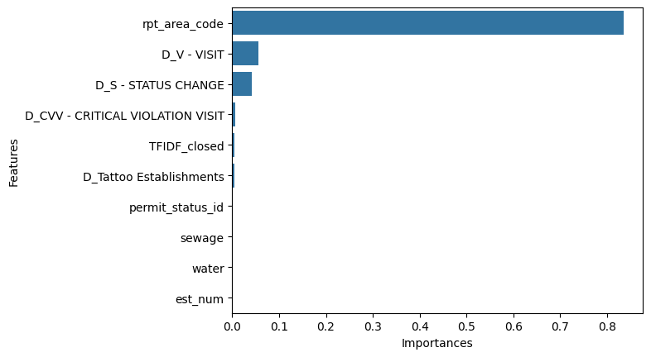
Model Features of Importance
The feature with the highest importance score was rpt_area_code description. Additional work should be done to understand what it corresponds to
The reason for inspection visit were also important features.

Slide 14
Business Recommendations
Companies who provide food safety and hygiene services for food service establishments should focus on training on time and temperature control for food safety and maintenance of equipment, food contact surfaces and nonfood contact surfaces.
Companies who offer services to food establishments should explore opportunities for automating time and temperature control of foods and maintenance of equipment, food contact surfaces, and nonfood contact surfaces through hardware and software solutions.
Further investment should be made in data analytics and modelling to understand:
if there are systemic factors that drive infractions in certain customers, markets or geographical locations or if the infractions are one-offs for infractions under the ‘time and temperature control’ and ‘equipment, food contact surfaces and nonfood contact surface’ categories.
what drives certain inspection scores in a geographical location. An example of a question to ask to determine what drives inspection scores is “what does the rpt_area_code truly represent? a specific inspector, a socio-economic group?” and so on.

Slide 15
Future Modeling Recommendations
Before moving forward other steps in EDA or modelling, understand the distribution of values for the target variable.
Reach out to the Durham County Health Department to understand
The extreme values in inspection scores
The meaning behind the rpt_area_code
Work to understand if the extreme values in inspection scores are unique to this data set or if this can be seen in data sets in other counties and states. When I have visited restaurants in various cities in the US I have seen that they display high inspection score ratings (> 90 or A grades), so it would b good to understand if this is a norm across states.
Explore using Principal Component Analysis (PCA) to reduce the dimensionality of the predictive features instead of relying on contextual knowledge to drop features.
Build on text manipulation methods used for the inspection comments by using sentence similarity to understand ‘closeness’ between comments from establishments, then see if there is an underlying pattern (e.g. method of operation, location, etc.) in establishments which are clustered together.

Slide 16
Future Modeling Recommendations
Investigate the use of vectors from flag embedding instead of TFIDF Vectorizer as features for modelling.
Use output from PCA, sentence similarity of flag embedding to perform a clustering analysis on establishments to see if there is an underlying factor among establishments that makes them cluster.
Incorporate categorical hyperparameters in the hyperparameter tuning step for XGBoost Regression and evaluate whether that changes the recommended best parameters.
Apply the XGBoost Regression model to another data set with similar features (e.g. if another county in NC records inspection data in a similar format, how successful will the model be in predicting the inspection scores for that county?)
Group the observations from Food-inspection-violations_1 and Restaurant-and-services_3 on the type of establishment and check if the two data frames can be joined on establishment type. Determine if a working model could be built on this need aggregated data frame.

Slide 17
Appendix

Slide 18
Model Hyperparameters
Support Vector Regression Hyperparameters
Hyperparameter | Values
Kernel | ‘Poly’, ‘rbf’
Epsilon | 0.001, 0.1, 1
C | 1, 50, 100
Random Forest Regression Hyperparameters
Hyperparameter | Values
n_estimators | 50, 100, 150
max_features | 'sqrt', 'log2'
max_depth | 3, 6, 9
max_leaf_nodes | 3, 6, 9
XGBoost Regression Hyperparameters
Hyperparameter | Values
max_depth | 3, 6, 9
min_child_weight | 1, 5, 10
subsample | 0.5, 0.7, 0.9
learning_rate | 0.05, 0.5, 1

