Slide 1

pricing AND investment strategy
Big Mountain Resort

Slide 2
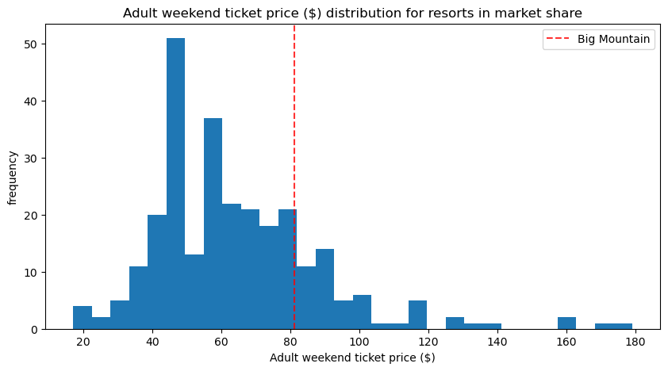
Problem statement
Big Mountain’s pricing strategy has been to charge a premium above market average. There is a suspicion that Big Mountain is not capitalizing on its facilities as much as it could in the US market.
Problem Statement: What facilities should be 1) invested in such that ticket price can be set at a value which delivers 5% increase in annual revenue or 2) decommissioned to deliver 5% decrease in annual operating costs within 12 months of implementation?
Scope of analysis was the US market.
Facility information from 330 resorts across US market was used for analysis.

Slide 3
Recommendation and key findings
A random forest regression model had the best performance.
No patterns were found in pricing based on resorts’ state.
The model suggests current facilities at Big Mountain could support a $10.09 increase in ticket price.
It estimates Big Mountain could increase annual revenue by $1.6M by increasing vertical drop by 150 feet, adding a new run and associated chairlift to the new summit.
We recommend Big Mountain trials this scenario after considering pros and cons of implementation.
Future work should investigate
Facility and pricing changes in prior years to understand gap in pricing from current to predicted.
Facility-specific operating costs and visitor traffic for model refinement.
Development of an app for on-going scenario modeling.

Slide 4
Modeling results and analysis training Data summary
Data from 330 resorts in the US were pre-processed and used in the analysis.
Adult weekend ticket price was chosen as the target feature because it had the least missing values (when compared to adult weekday prices).
In Montana, weekend and weekday prices are the same.
The resort data was split into training (70%) and test (30%) data.
Big Mountain data was not included in the training data for the model.
Missing values for each feature in the training data were imputed as median of the feature.

Slide 5
Modeling results and analysis metrics for evaluation of model performance
Modeling metrics included:
Coefficient of determination (R²) – Amount of variance explained by model for ticket prices.
Values close to 1 are better
Mean Absolute Error (MAE) – The average of absolute errors in ticket prices
Smaller values are better
Mean Squared Error (MSE) –The average of the square of errors in ticket prices
Smaller values are good
Cross validation was used in combination with metrics to measure performance
Model 1 – Use mean of training set to predict weekend prices for test set
MAE = $18.9
Model 2 – Use linear regression model to predict weekend prices for test set
MAE = $10.6
Model3 – Use random forest model to predict weekend prices for test set
MAE = $9.2
The random forest regression model had the lowest MAE and best performance

Slide 6
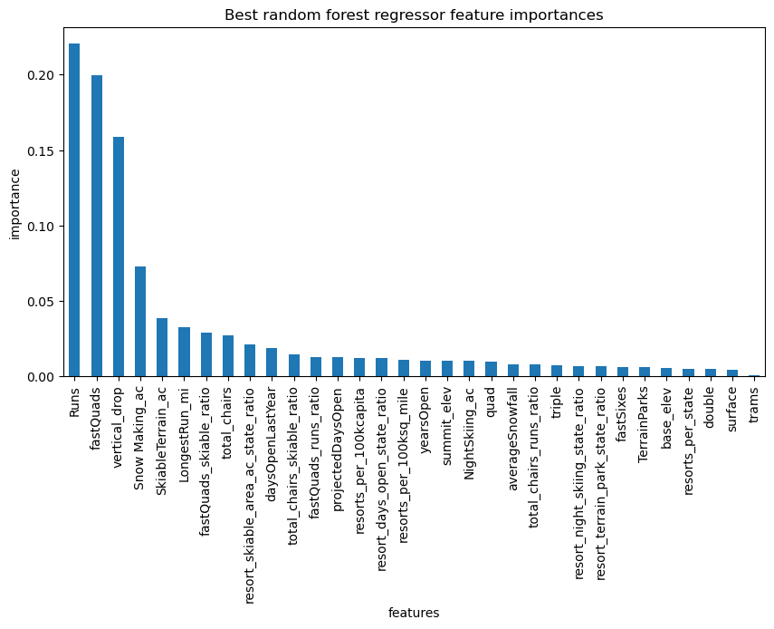
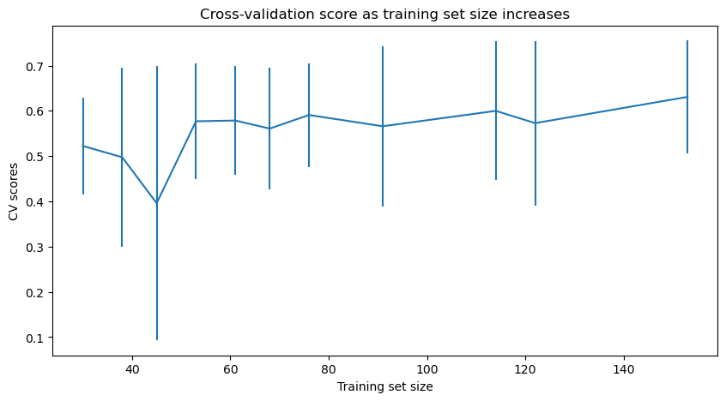
Modeling results and analysis Model performance and selection
Cross validation score shows model performance levels off beyond a training data set size of ~50. The training set size in this study is >50.
The 5 most important features for random forest regression are runs, fast quads, vertical drop, snow making , and skiable terrain.
Based on the importance of these features, the following scenarios were explored:
1 – Permanently close up to 10 runs.
2 – Increase vertical drop by 150 feet, add a run and chairlift.
3 – Same as two and increase snow making coverage
4 – Increase longest run by 0.2 miles and increase snow making coverage by 4 acres.

Slide 7
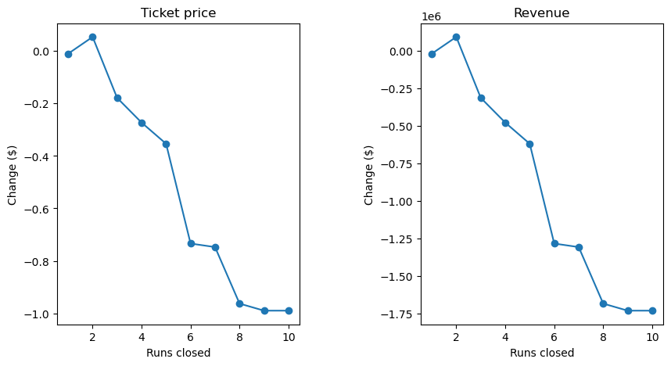
Modeling results and analysis metrics for evaluation of model performance
The random forest model suggests Big Mountain’s current facilities can support a $10.09 increase in ticket price.
Scenario 1 – Close up to 10 runs
Closure of 1 -2 run makes no significant difference in revenue; closure of > 3 may cause significant decrease in revenue.
Scenario 2 – Increase vertical drop by 150 feet, add a run and chairlift.
Increases ticket price by $0.92 -> Increases revenue by $1.6M
Scenario 3 – Same as two with increased snow making coverage
Same impact as scenario two except incures cost for extra snow making coverage.
Scenario 4 – Increase longest run by 0.2 miles and increase snow making coverage by 4 acres.
No impact to cost.

Slide 8
conclusion
Big Mountain may have an opportunity to increase revenue by $1.6M by pursuing scenario 2
We recommend the company test scenarios 1 and 2 to confirm if there is an opportunity to increase revenue and/or reduce cost.
Historical records of facility and pricing changes should be explored to understand the gap in current and predicted ticket price.
Facility-specific visitor traffic and operating costs should be used to refine the model.
An app may be created for business analysts to explore more scenarios to optimize operating income.

