Slide 1

App Design
Elizabeta Budini
Student ID: 19147099
Birmingham City University
Date: 02/03/2020

Slide 2




Introduction and features
The aim is to design a Prototype FilmTourist App for the Android and iOS platforms (cross-platform).
This app is designed to make film lovers visit locations portrayed within a specific movie and discover locations near him.
The app User Analysis is based on the review of 2 articles: Connell, 2012 and Rittichainuwat, 2015 (see optional slide)
The locations will be shown on a map based on user location | Get all the filming locations for a selected movie, bookmark them and ask for a verified badge when he visits the place in real life. | Verified badges, movies and locations can be shared with friends using social medias (eg. Instagram stories) | (Optional) Send notification when the user is close to a filming location bookmarked. Remember the user to ask for a badge!

Slide 3
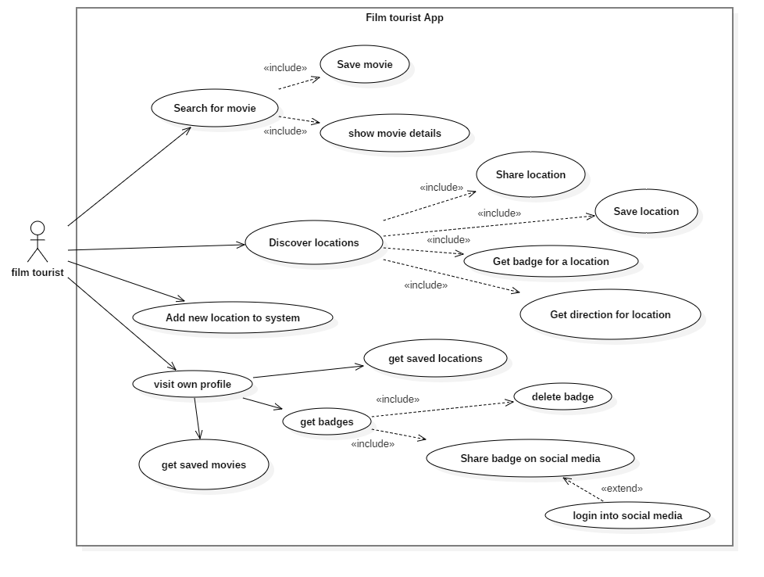
Use-case diagram

Slide 4
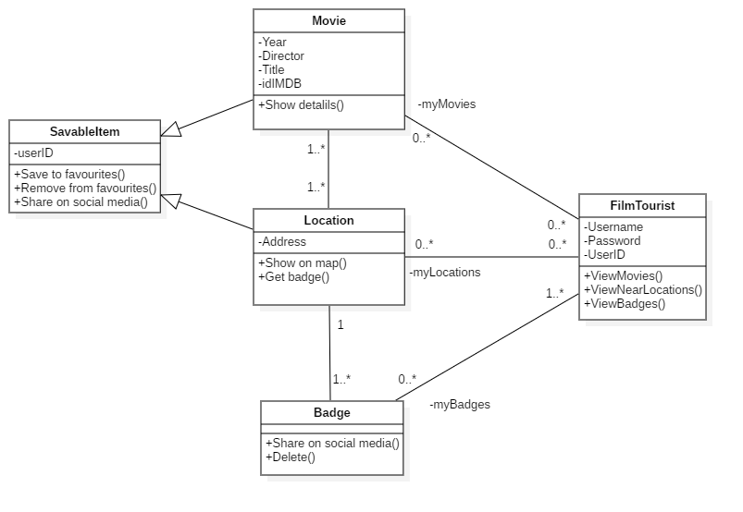
Class diagram

Slide 5
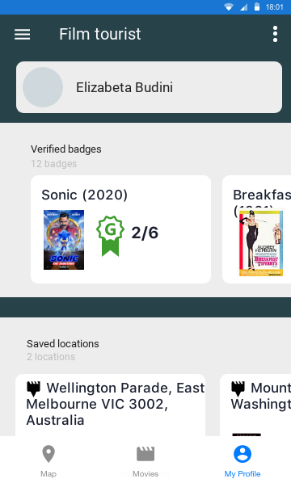
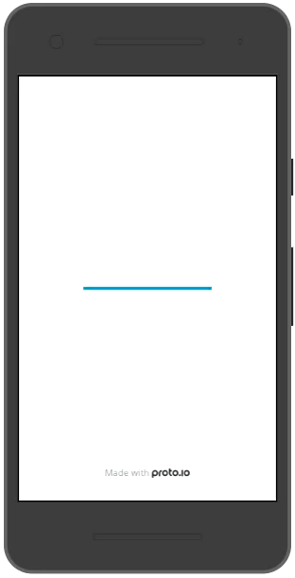
UI Design
Video demo:
https://youtu.be/AoP2ey-hSfo

Slide 6



Data Management
Data Source(s):
  Merge data from the myApiFilms (proprietary) web service and Amazon IMDB dataset to create own Movie database (see extra slide for code)
IMDB list of IDs
www.myapifilms.com/
Database with movies and locations

Slide 7
Data Management
Will use the MyApiFilms to get Movie locations and data:
  Example Request URL – search for a movie by IMDB ID (e.g. tt1877830): https://www.myapifilms.com/imdb/idIMDB?idIMDB=tt1877830
  Example Response in JSON:
"title": "The Batman",
"year": "2021",
"releaseDate": "20210625",
"idIMDB": "tt1877830",
"urlIMDB": "https://www.imdb.com/title/tt1877830",
"filmingLocations": [
{
"location": "Warner Bros. Studios Leavesden, Watford, England, UK"
},
{
"location": "Necropolis Cemetery, Glasgow, Scotland, UK"
},
{
"location": "Cardington Studios, Bedford, England, UK"
},
{
"location": "Liverpool, England, UK"
}
]

Slide 8
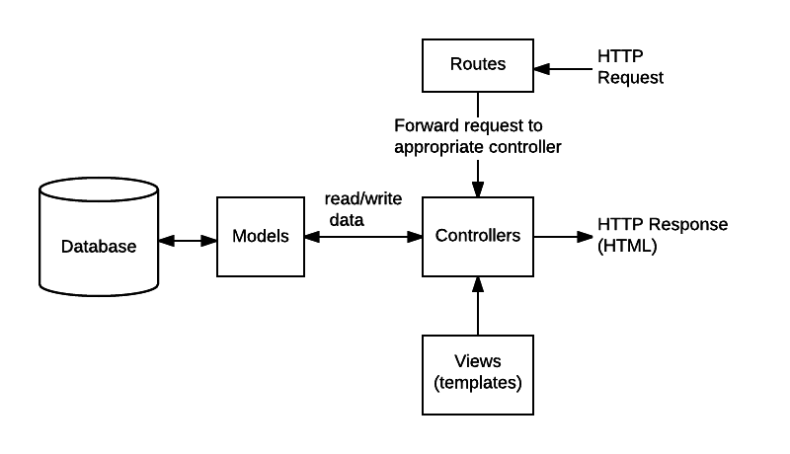
Build Specific API
/myAPI/movies/:filmID
  Get informations and locations for a movie
/myAPI/filmlocations/:location
  Get filming locations near a given location
/myAPI/badge/verify/:userPos&filmloc
  Verifiy the user location to give a new badge

Slide 9
Data persistence
Using Realm for managing Movie data
  It’s fast, can be combined with server-side databases.
  Good choice when dealing with large data.
  Dynamic with the way it encrypts data. It uses different encryption mechanism for different mobile platform.
  E.g.:
  Realm.write(() => {
  Realm.create('Post', {title: title, content: content, timestamp: timestamp});
  });
Using Redux for application state managing
Using AsyncStorage for simple and small data. For example, the data that the app will need to login the user, like session id and/or user id.
  E.g.:
  const userId = '8ba790f3-5acd-4a08-bc6a-97a36c124f29';
  const saveUserId = async userId => {
  try {
  await AsyncStorage.setItem('userId', userId);
  } catch (error) {
  // Error retrieving data
  console.log(error.message);
  }

Slide 10
Frameworks
LOCATION: Will use React Native GeoLocation framework to verify badges and show nearest filming locations
  E.g.:
    geolocation.getCurrentPosition(geo_success, [geo_error], [geo_options]);
LOG-IN: Might use Google Firebase for authentication
  E.g. see: https://medium.com/fullstack-with-react-native-aws-serverless-and/google-sign-in-for-react-native-android-7d43df78c082
WEB VIEW: use React Native Web View to display IMDB trailers
  E.g.:
    render() { return ( <WebView source={{uri: ‘https://www.imdb.com/video/vi117320885'}} style={{marginTop: 20}} /> ); }
SOCIAL NETWORK: post badge to Instagram Stories
  E.g. see: https://developers.facebook.com/docs/instagram/sharing-to-stories/

Slide 11
Target Platform features
Access camera to attach picture to a verified badge. Will use Flutter for doing this.
  E.g.
    await _initializeControllerFuture;
    final path = join((await getTemporaryDirectory()).path,
    '${DateTime.now()}.png',
    ); await _controller.takePicture(path);
Access battery level to disable some functionalities when battery is low. https://www.npmjs.com/package/react-native-battery. (optional feature)
Use Firebase Cloud Messaging (FCM), it provides a reliable and battery-efficient connection between our server and the devices that allows to deliver and receive messages and notifications on iOS, Android, and the web at no cost. (optional feature)

Slide 12
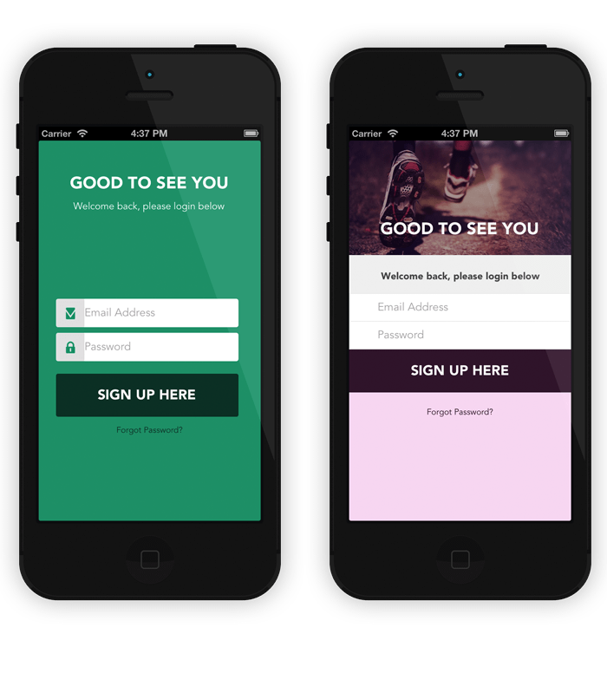


App Architecture
  Implement the Singleton design pattern for the connection to the database
  Implement the Command design pattern for API calls, to separate the objects calling an API service from the objects which are telling them when to call the API service.
Main interactions:
Authentication
Own server
Cloud messaging (optional)
local DB
myapifilms.com/

Slide 13
Conclusion and Perceived Challenges
A challenge would be trying to select only precise locations, for example ‘Liverpool, England’ is too general instead ‘Trevi Fountain, Rome, Italy’ is a specific place.
Map marker clustering should be implemented if too many locations need to be shown.
May implement the possibility for the user to add new locations and contribute to the database

Slide 14
Extra slides (show only if required)
Merge data from the myApiFilms (proprietary) web service and Amazon IMDB dataset to create own Movie database
C:\mongodb\bin>mongoimport -d myfilmdb -c filmIDs --type tsv --file data-movieIDs.tsv --fields "idIMDB
2020-02-17T13:22:31.119+0000 connected to: mongodb://localhost/
2020-02-17T13:22:34.119+0000 [######..................] myfilmdb.filmIDs 1.62MB/5.74MB (28.2%)
2020-02-17T13:22:37.120+0000 [##############..........] myfilmdb.filmIDs 3.37MB/5.74MB (58.7%)
2020-02-17T13:22:40.119+0000 [#####################...] myfilmdb.filmIDs 5.10MB/5.74MB (88.9%)
2020-02-17T13:22:41.240+0000 [########################] myfilmdb.filmIDs 5.74MB/5.74MB (100.0%)
2020-02-17T13:22:41.241+0000 544015 document(s) imported successfully. 0 document(s) failed to import.

Slide 15
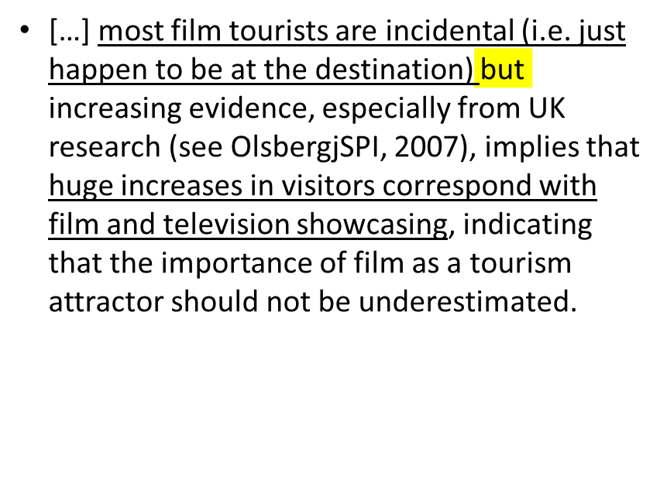
UX user Analysis
Connell, J., 2012. Film tourism – Evolution, progress and prospects. Tourism Management 33, 1007–1029. https://doi.org/10.1016/j.tourman.2012.02.008
Rittichainuwat, B., Rattanaphinanchai, S., 2015. Applying a mixed method of quantitative and qualitative design in explaining the travel motivation of film tourists in visiting a film-shooting destination. Tourism Management 46, 136–147. https://doi.org/10.1016/j.tourman.2014.06.005
Out of 1852 samples, the numbers of specific film tourists (10.5%) and general film tourists (19.5%) are less than serendipitous tourists (70%) - their presence in a film destination is unrelated to the film. Motivations based on social interaction and novelty;

Slide 16
