Slide 1

UK road traffic prediction
Elizabeta Budini
Student ID: 19147099
Module: Advance Data Science - CMP7161
Birmingham City University
Date: 12/05/2020

Slide 2
Table of contents:
Abstract
Dataset description
Problem to be addressed
Pre-processing, cleaning, visualization
Models description
Results
Conclusion and future work

Slide 3
1. Abstract
This study will analyse a traffic dataset from the UK government to predict the level of traffic on roads. The control of traffic has many benefits both for the government and for citizens: it can forecast traffic jams and help on building solutions against pollution.

Slide 4
2. Dataset description
The dataset is been published by the Department for Transport (UK) and can be found here: https://data.gov.uk/dataset/208c0e7b-353f-4e2d-8b7a-1a7118467acc/gb-road-traffic-counts
It contains traffic level (in vehicle miles travelled*) for different vehicle types, roads and regions from 1993 to 2018.
14 columns and 1580 observations
*VMT: Combination of number of vehicles in a road and travelled distance

Slide 5
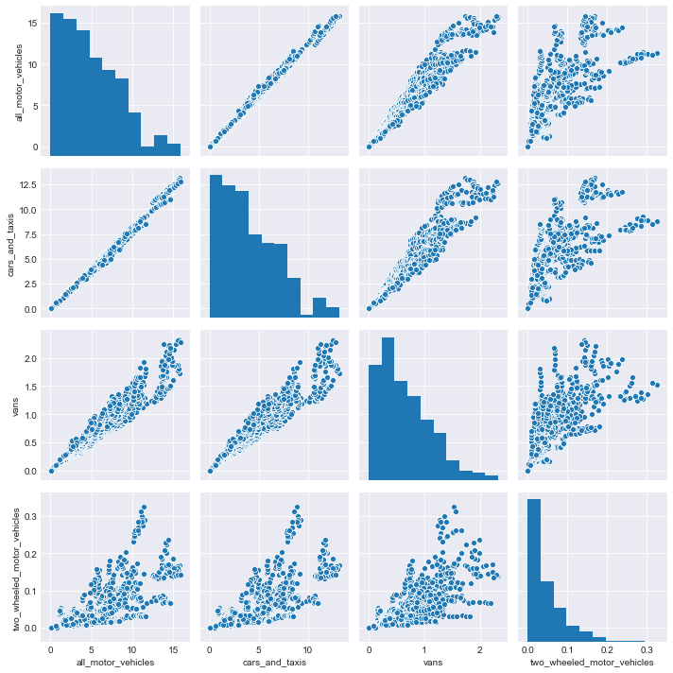
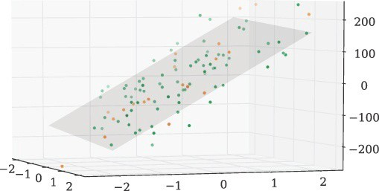
3. Problem to be addressed
Find a suitable ML model to predict traffic volume for all vehicle types (in billion vehicle miles) based on different features such as year, region, road category, link length, etc.
Different techniques will be used (Linear regression, SVR, Random forest regressor)

Slide 6
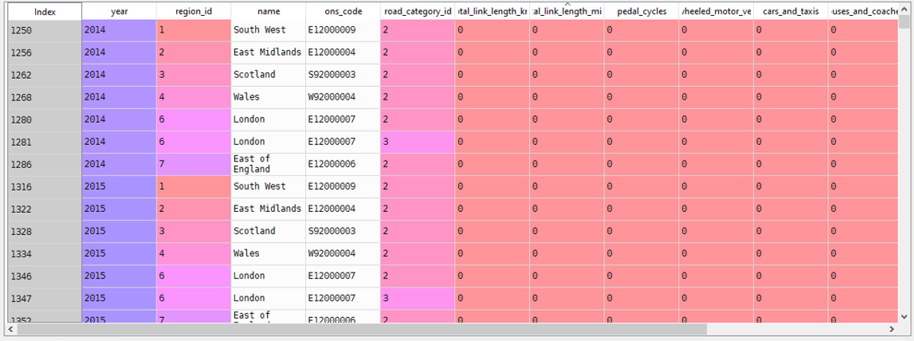
4. Pre-processing, cleaning, visualization
There are no missing values but some road have 0 as length value
Region name is a categorical feature that should be encoded, but it has the same information as region id column.

Slide 7
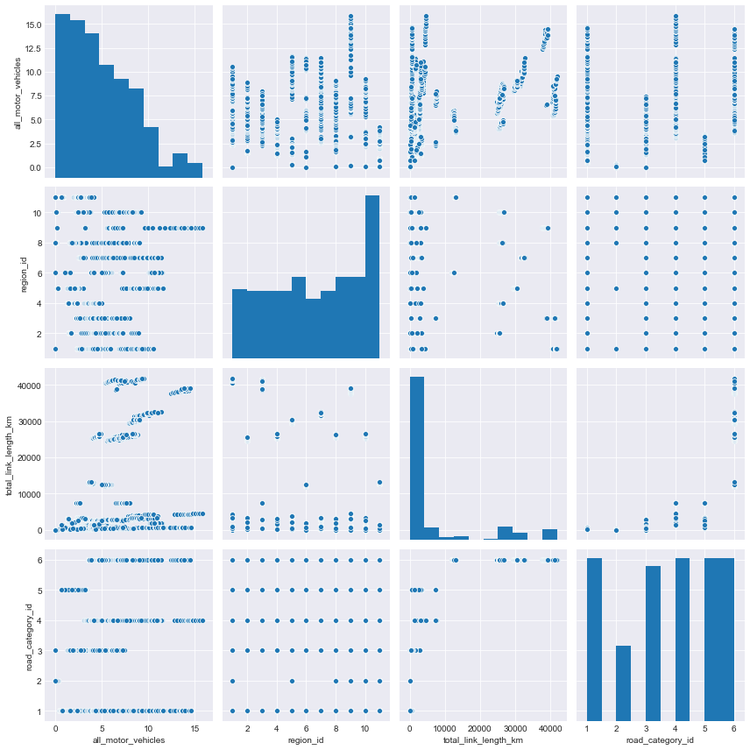
4. Pre-processing, cleaning, visualization
Summarize data statistical info using describe()
Visualize data to analyse the distribution of the features and relationships between them

Slide 8
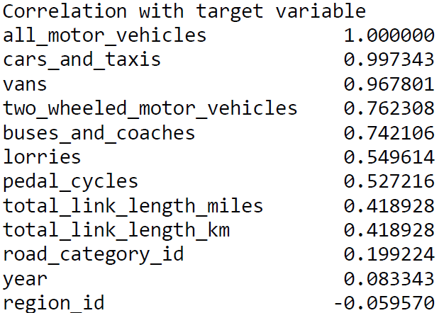
5. Models description (Linear Regression)
Approach 1: apply Linear Regression with linearly correlated features to predict all_vehicles
Approach 2: apply Linear Regression with all features to predict all_vehicles – use RANSAC

Slide 9
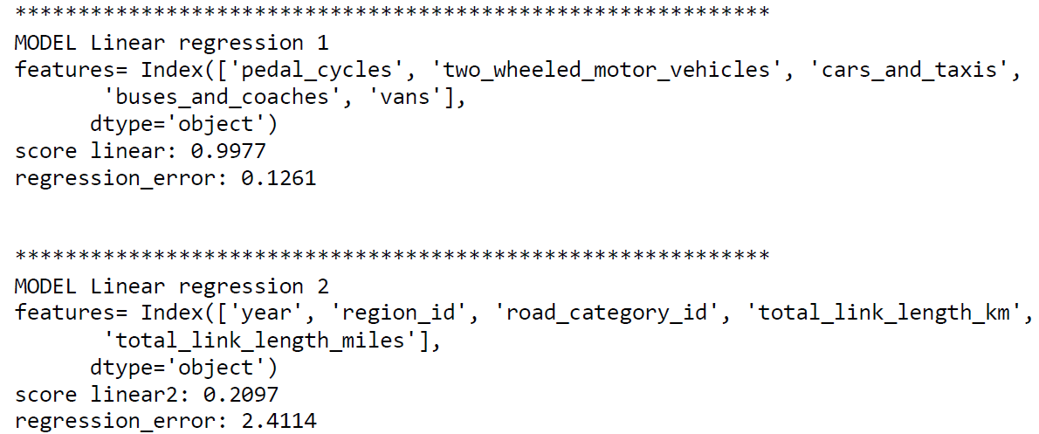
5. Models description (Linear Regression)
The r2 score when considering as input linearly correlated variables (different vehicle types) is higher (99%) than the same approach with other features (20%)

Slide 10
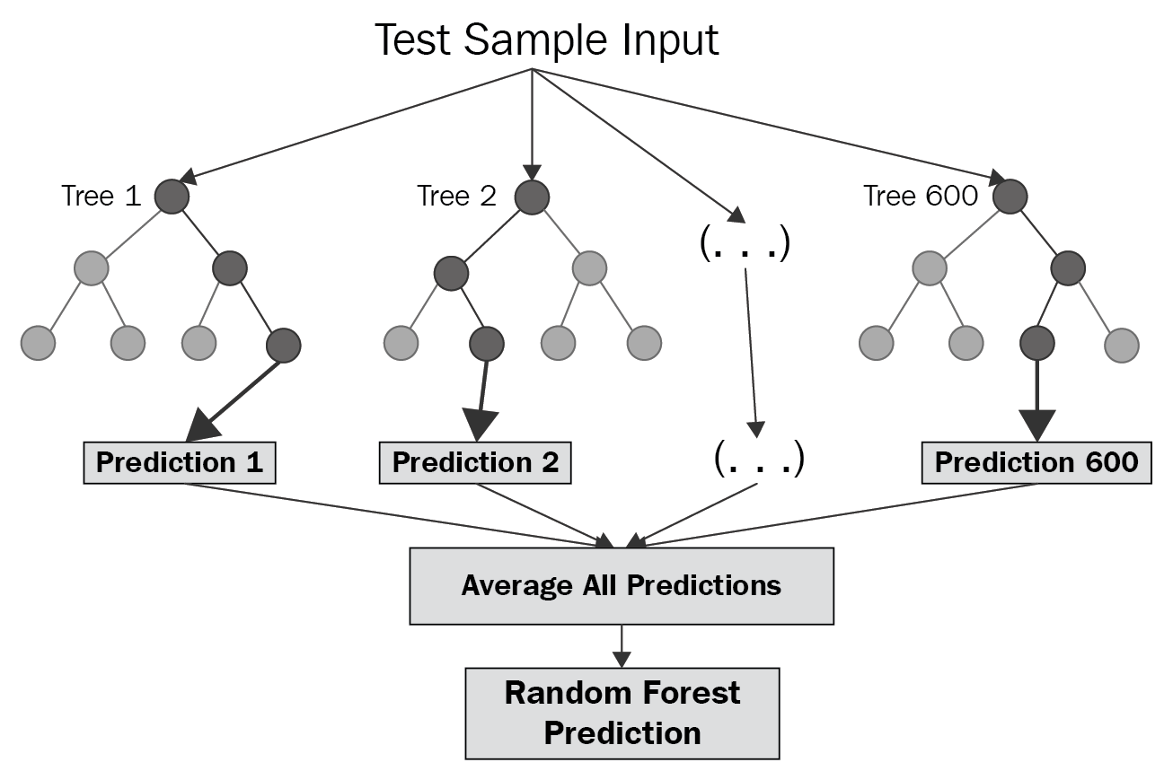
5. Models description (Random Forest regression)
Approach 1: Random forest with non-linear input features (test-train and cross-validation) and model tuning
Approach 2: Create synthetic features to improve accuracy

Slide 11
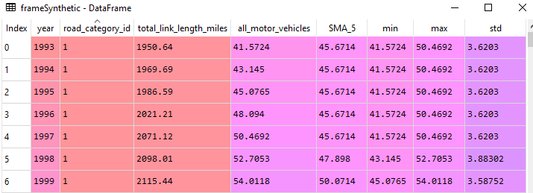
5. Models description (Random Forest regression)
Use GridSearchCV, RandomizedGridSearch and Bayesian optimization to tune model hyperparameters
Create synthetic features to improve accuracy

Slide 12
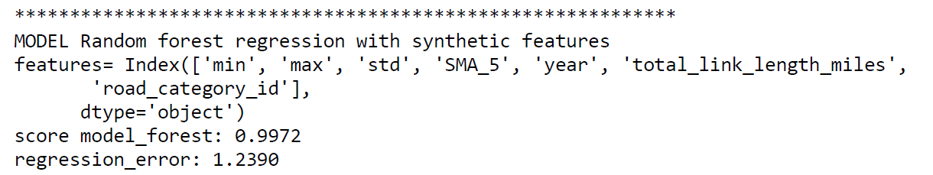
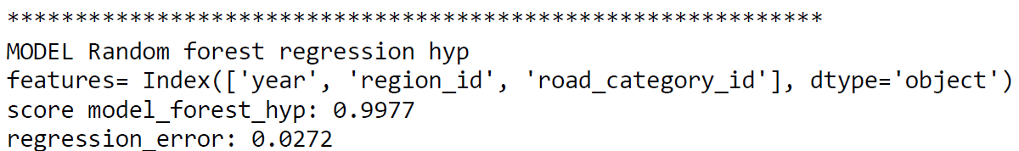
5. Models description (Random forest Regression)
The r2 score when considering model tuning is higher.
Overall random forest has a high accuracy score with non-linear related features (99%)

Slide 13
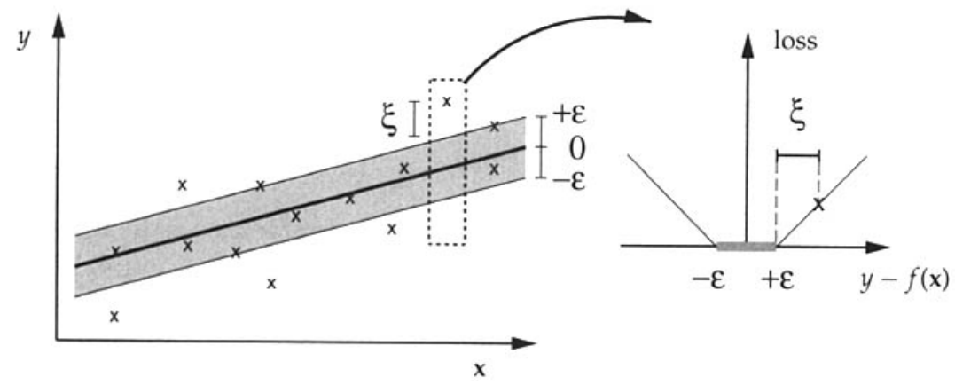
5. Models description (Support Vector Regression)
Approach 1: apply SVR with GridSearchCV tuning

Slide 14
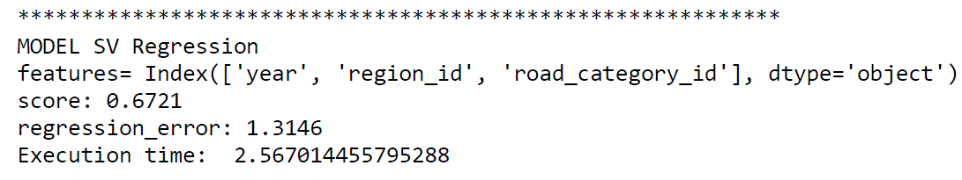
5. Models description (Support Vector Regression)
GridSearchCV tuning makes SVR model too complex, to reduce execution time only one hyperparameter is tuned
SVR accuracy score is around 67%

Slide 15
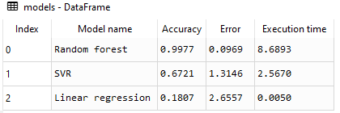
6. Results
Mean absolute error, r2 score and execution time are compared to evaluate the best approach for each model proposed
Linear regression is very efficient but not the best to model non-linear features.
Random forest with model tuning achieves an excellent score in modelling non-linear features with a good execution time.

Slide 16
7. Conclusion and future work
By comparing all the approaches analysed in this study, Random forest regression is recommended for modelling traffic data.
Future work could include a Bayesian optimization for random forest instead of GridSearchCV, to better the performance in terms of execution time and control the model complexity.

