Slide 1

Expense Tracker
CIS 25 Final Project
Presented by: Elizabete Roschel

Slide 2

Project Overview
What is it?
Core Functionality
Data Persistence
The Expense Tracker is a robust command-line application designed to streamline personal financial management. It provides users with an intuitive interface to manage their transactions efficiently.
Users can seamlessly add new transactions, view existing records, and apply filters to categorize their financial activities. This ensures a clear and organized overview of all income and expenses.
A key feature of the application is its persistent data storage, achieved through efficient file I/O operations. This means all transaction data is securely saved and loaded, ensuring no loss of information between sessions.

Slide 3



Core Features
Add Transactions
Filter by Category
Summary Report
Users can easily input new financial records, including the date, a detailed description, the relevant category, the monetary amount, and whether it's an income or an expense. This comprehensive input ensures accurate tracking.
The application allows for precise filtering of transactions based on their assigned categories. This feature enables users to quickly analyze spending or income within specific areas, providing granular insights into their financial habits.
A vital component is the summary report, which provides a clear breakdown of total income, total expenses, and the overall balance. This report offers a high-level financial snapshot, aiding in quick assessment of financial health.

Slide 4

Data Storage
How Data is Stored
The Expense Tracker utilizes a simple yet effective method for data persistence: a plain text file named data.txt. This approach ensures portability and ease of access to the stored information.
Each transaction is meticulously recorded within this file, with specific fields separated by delimiters to maintain structural integrity. The data points stored for each transaction include:
Date of the transaction
A brief description
The assigned category
The monetary amount
A boolean flag indicating if it's income (isIncome)
The application is designed to automatically save all current transaction data to data.txt upon exiting and load existing data from the file each time it is launched. This ensures that all financial records are consistently preserved across different sessions.

Slide 5



Classes and Structures
Transaction Class
Tracker Class
This class serves as the fundamental building block for managing individual financial entries. It encapsulates all the essential details of a single transaction, ensuring data integrity and consistency.
The Tracker class acts as the central orchestrator of the application's functionality. It is responsible for managing a collection of Transaction objects and handling all interactions with the persistent data storage.
Date: Records the specific date when the transaction occurred.
Description: Provides a brief textual explanation of the transaction.
Transaction Vector: Internally maintains a dynamic array (vector) of Transaction objects, allowing for efficient addition, deletion, and retrieval of transactions.
Category: Assigns a predefined category to the transaction for filtering and reporting.
File I/O Management: Handles the reading of transaction data from the data.txt file upon application startup and the writing of updated transaction data back to the file upon exit. This ensures that all changes are saved and available for future sessions.
Amount: Stores the numerical value of the transaction.
isIncome: A boolean flag indicating whether the transaction represents income (true) or an expense (false).
Core Operations: Implements methods for adding new transactions, filtering transactions by category, and generating summary reports, leveraging the data stored within the transaction vector.

Slide 6
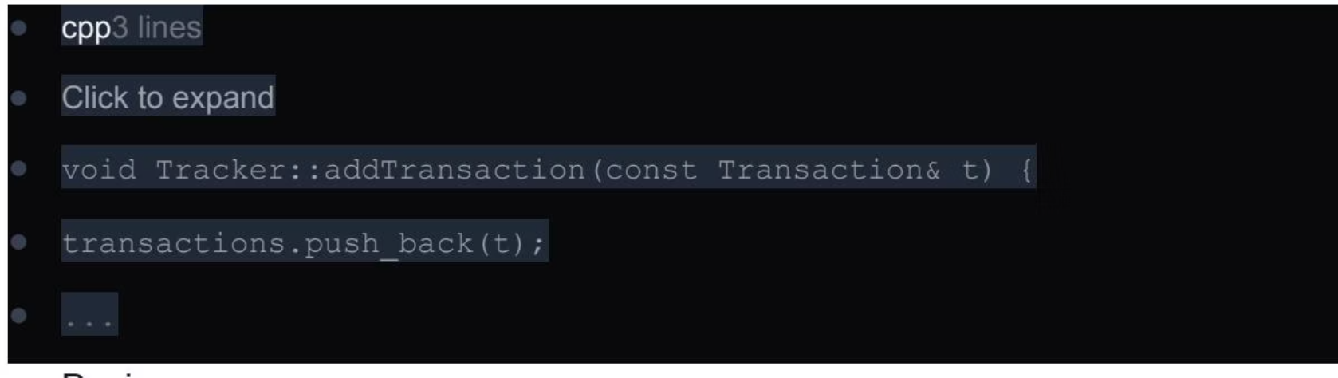
Adding a Transaction (Code Example)
How it Works
The process of adding a new transaction is designed to be user-friendly and straightforward. When a user opts to add a transaction, the application prompts them to input several key details.
User Input: The user is guided to enter the date, a brief description, the category, the amount, and to specify whether the transaction is an income or an expense.
Data Validation: (Future Improvement) While not fully implemented in the current version, future iterations will include robust input validation to ensure data integrity and prevent errors.
Vector Integration: Once all details are provided, a new Transaction object is created using the input data. This newly created object is then appended to the internal vector of Transaction objects managed by the Tracker class.
Persistence: The updated vector, now containing the new transaction, will be saved to the data.txt file when the application is closed, ensuring the transaction is permanently recorded.

Slide 7
Summary Report (Code Example)
How it Works
void Tracker::summaryReport() { double income = 0, expenses = 0; for (const auto& transaction : transactions) { if (transaction.isIncome) { income += transaction.amount; } else { expenses += transaction.amount; } } std::cout << "\n--- Summary Report ---\n"; std::cout << "Total Income: $" << income << std::fixed << std::setprecision(2) << "\n"; std::cout << "Total Expenses: $" << expenses << std::fixed << std::setprecision(2) << "\n"; std::cout << "Balance: $" << (income - expenses) << std::fixed << std::setprecision(2) << "\n"; std::cout << "----------------------\n";}
The summary report feature provides users with a quick and comprehensive overview of their financial status. This functionality is crucial for understanding overall income, expenses, and the resulting balance.
Calculation Logic: The application iterates through all stored Transaction objects within the internal vector. For each transaction, it checks the isIncome flag. If true, the amount is added to the total income; otherwise, it's added to the total expenses.
Balance Calculation: The net balance is then computed by subtracting the total expenses from the total income.
Display: Finally, the calculated total income, total expenses, and the net balance are clearly displayed to the user in a formatted output, providing an immediate financial snapshot.

Slide 8

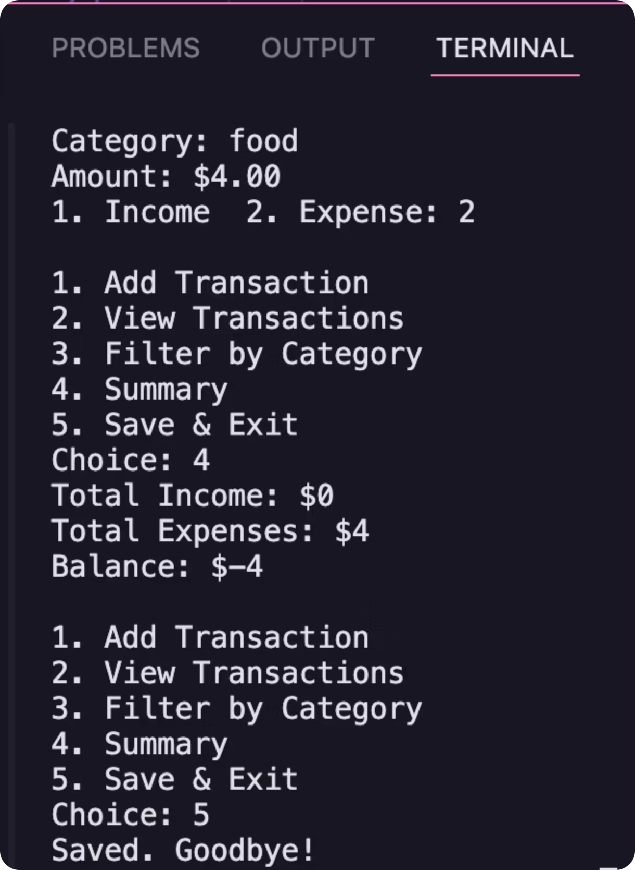
Demo Screenshot:

Slide 9
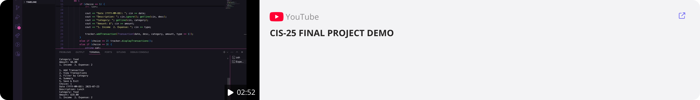
DEMO:

Slide 10




Future Improvements
Export to CSV
Implement functionality to export all transaction data into a CSV (Comma Separated Values) file. This will allow users to easily import their financial data into other spreadsheet software or accounting tools for further analysis or record-keeping.
Monthly/Category Analytics
Develop advanced analytical features to provide deeper insights into spending patterns. This includes generating reports that break down income and expenses by month and by specific categories, helping users identify trends and areas for financial adjustment.
GUI using Qt
Transition the command-line interface to a modern Graphical User Interface (GUI) using the Qt framework. A GUI will enhance user experience with visual elements, intuitive navigation, and a more interactive environment, making the application more accessible and user-friendly.
More Input Validation
Strengthen the input validation mechanisms to ensure that all user entries are accurate and in the correct format. This will prevent data corruption, improve the reliability of the application, and provide clear feedback to users on invalid inputs.

