Slide 1
Default Classification of Buy Now, Pay Later Clients
Elizabeth Esnard

Slide 2




BNPL is an emerging debt service

Slide 3
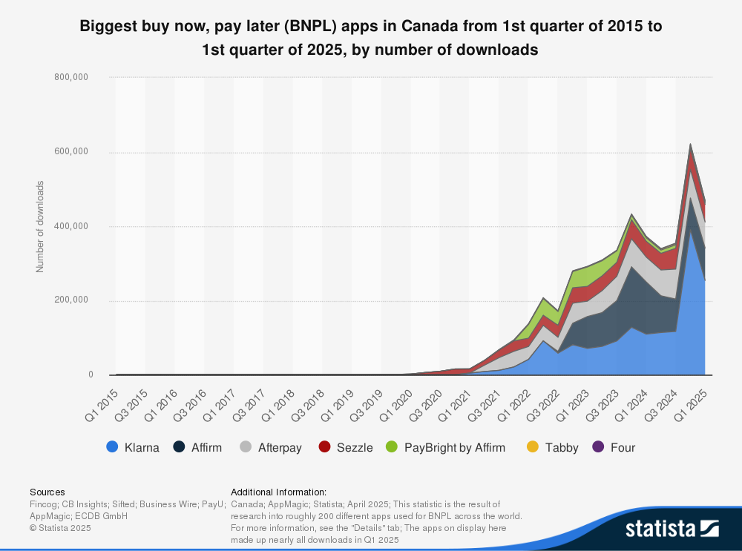
Over 389,000 active BNPL monthly users in Canada

Slide 4
Will credit card default prediction models translate to BNPL default prediction?

Slide 5
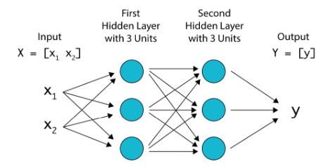
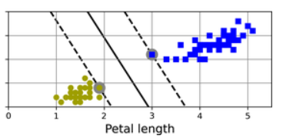
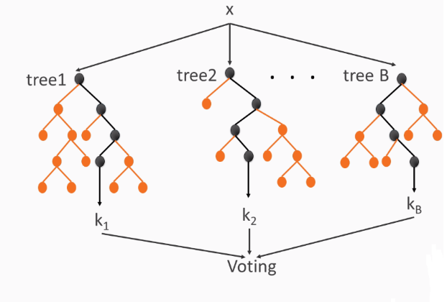
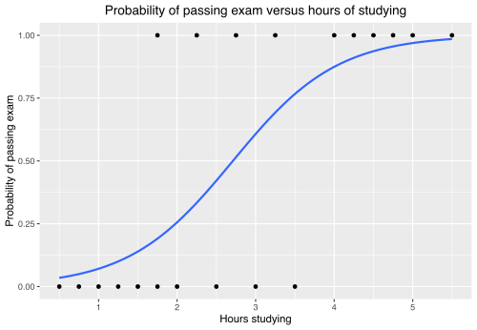
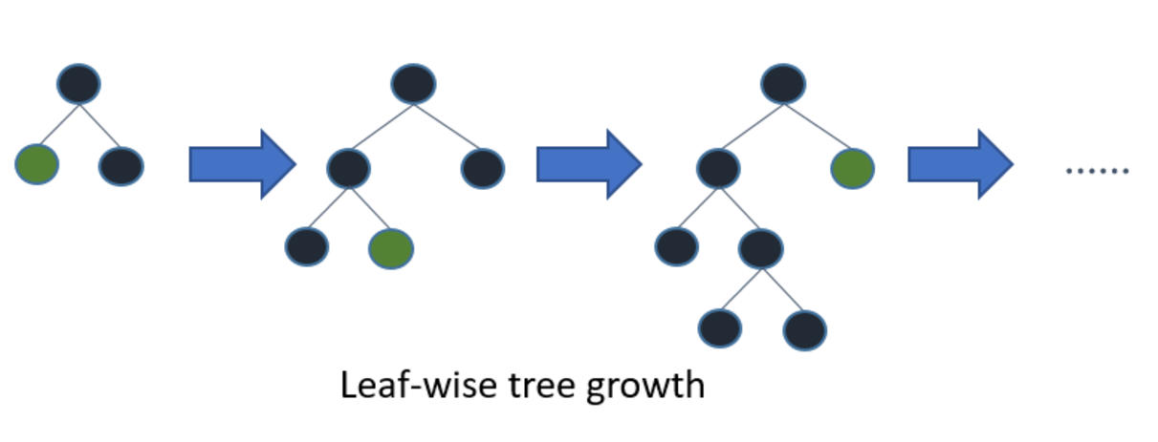
5 Models:
Logistic Regression
Random Forest
Support Vector Machine
LightGBM
Neural Network
Moocarme, M., So, A. V., & Maddalone, A. (2021)
Wikipedia contributors (n.d.)
Géron, A. (2022)
Eckroth, J. (2018).
Microsoft and LightGBM contributors. (n.d.)

Slide 6
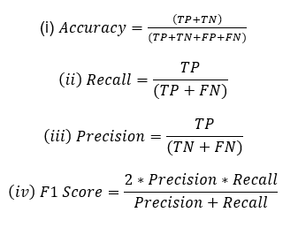
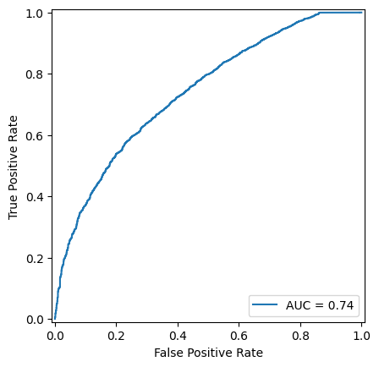
Evaluation Metrics
Accuracy
AUC Curve
Recall
Precision
F1 Score

Slide 7
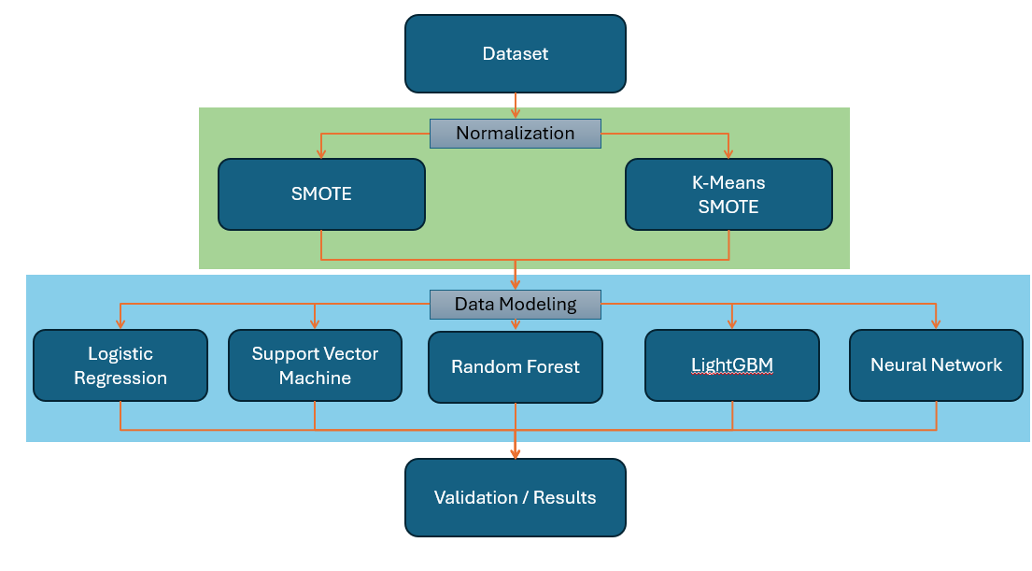
Methodology Visualization

Slide 8
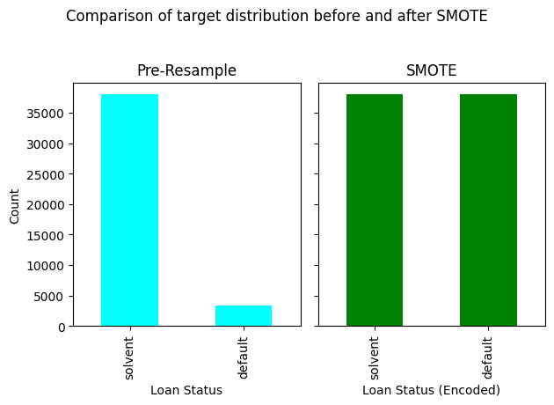

Preprocessing and Resampling
Filtered to <=$3500 loan
Target variable recategorized
Annual income capped
Missing values removed or replaced
One-hot encoding
Resampling
SMOTE
KMeans SMOTE

Slide 9
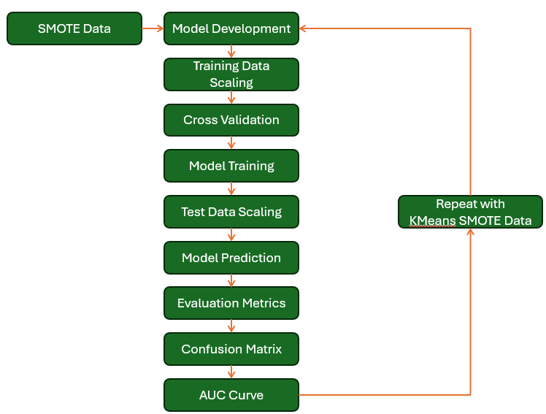
Methodology Visualization

Slide 10
Model Results
Visualizing Evaluation Metrics and Comparison of Models

Slide 11
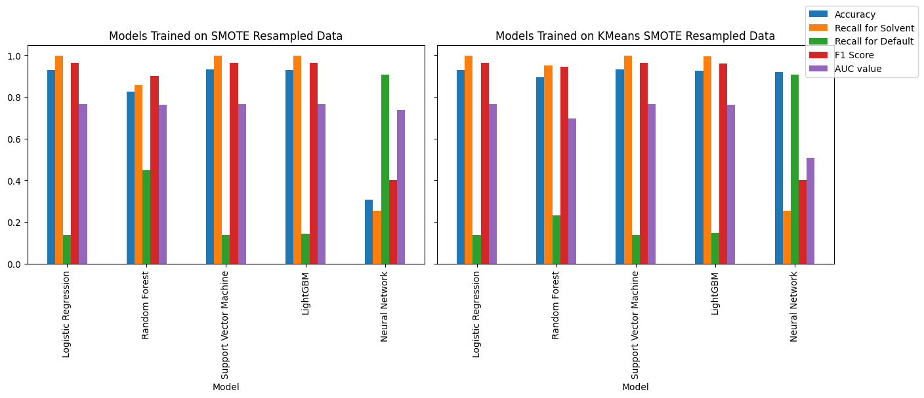
Evaluation Metrics Across Models and Sampling Methods

Slide 12
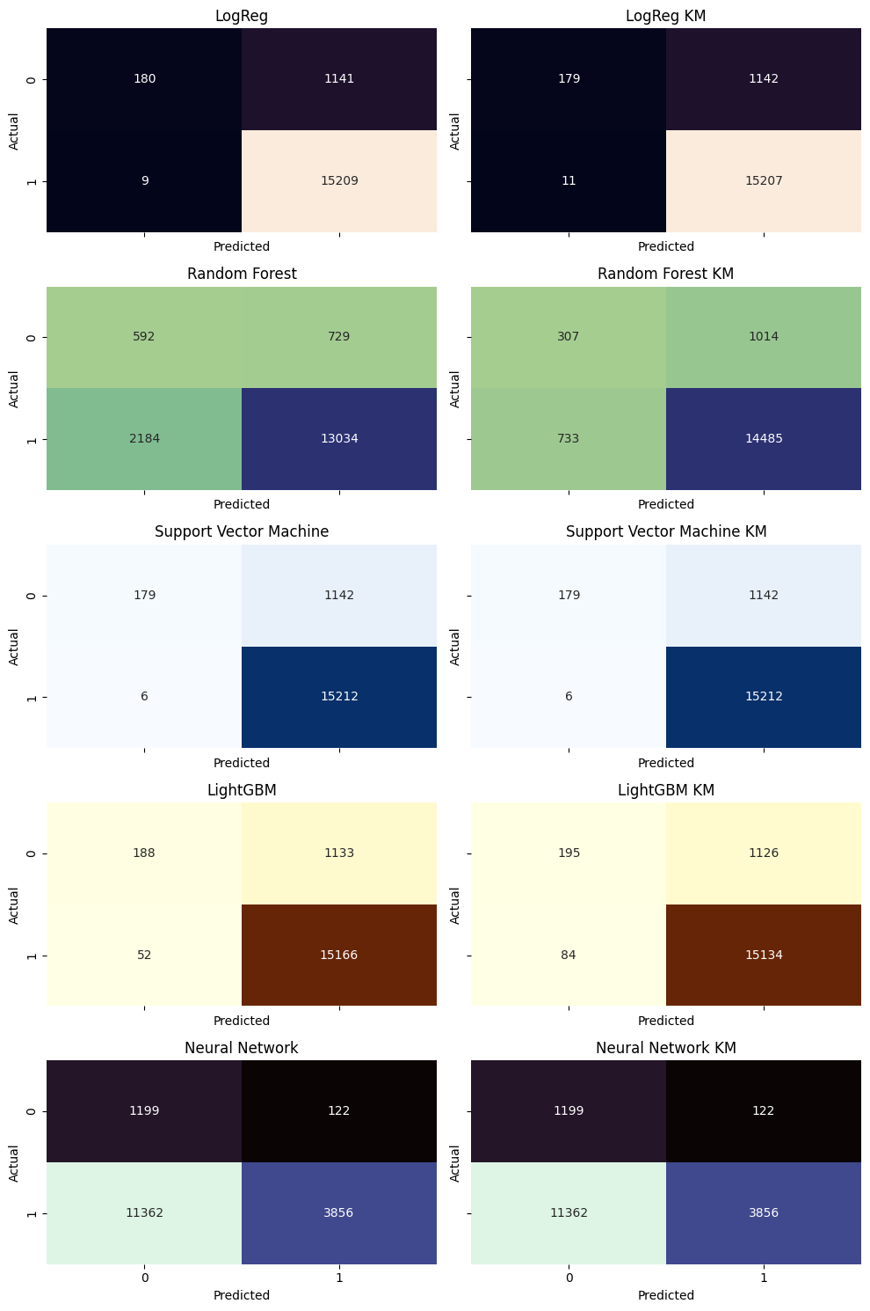
Logistic Regression:
Confusion Matrix Comparisons
Random Forest:
Support Vector Machine:
LightGBM:
Neural Network:

Slide 13
Logistic Regression Confusion Matrix
SMOTE Resampled Data
KMeans SMOTE Resampled Data

Slide 14
Random Forest Confusion Matrix
SMOTE Resampled Data
KMeans SMOTE Resampled Data

Slide 15
Support Vector Machine Confusion Matrix
SMOTE Resampled Data
KMeans SMOTE Resampled Data

Slide 16
Light GBM Confusion Matrix
SMOTE Resampled Data
KMeans SMOTE Resampled Data

Slide 17
Neural Network Confusion Matrix
SMOTE Resampled Data
KMeans SMOTE Resampled Data

Slide 18
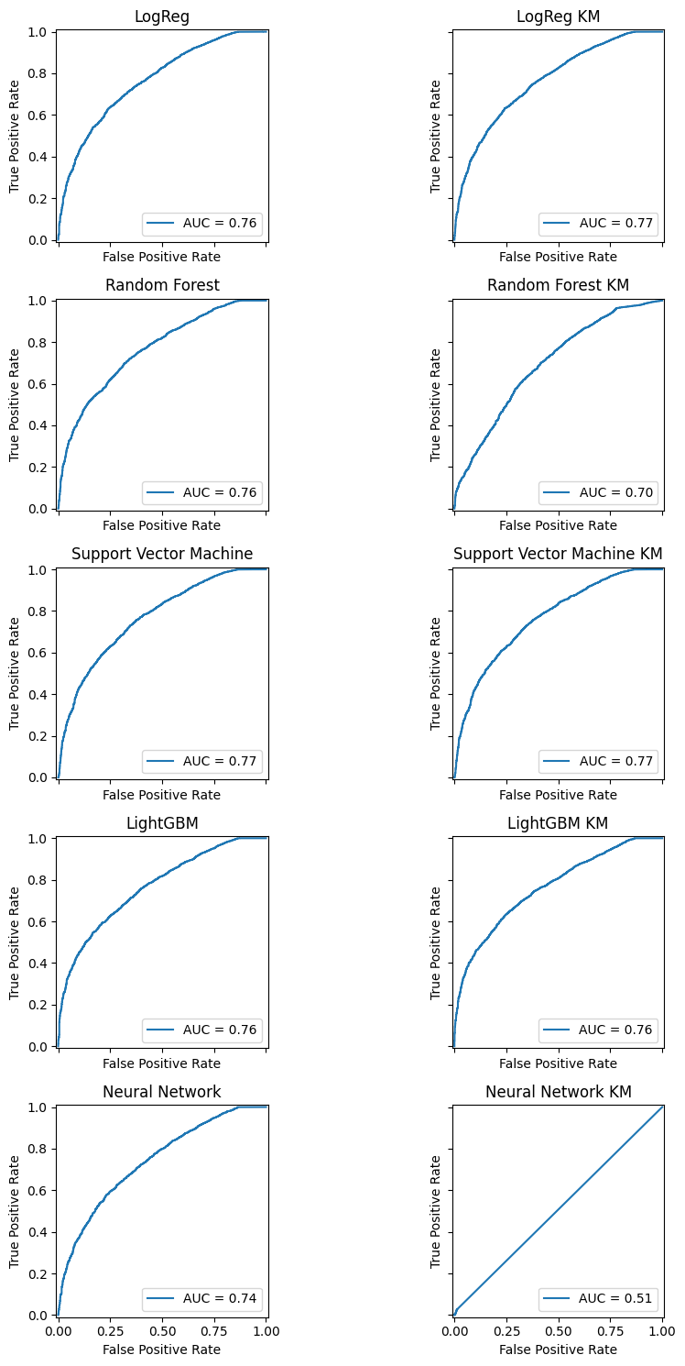
AUC Curve Comparisons
Logistic Regression:
Random Forest:
Support Vector Machine:
LightGBM:
Neural Network:

Slide 19
Logistic Regression AUC Curve
SMOTE Resampled Data
KMeans SMOTE Resampled Data

Slide 20
Random Forest AUC Curve
SMOTE Resampled Data
KMeans SMOTE Resampled Data

Slide 21
Support Vector Machine AUC Curve
SMOTE Resampled Data
KMeans SMOTE Resampled Data

Slide 22
LightGBM AUC Curve
SMOTE Resampled Data
KMeans SMOTE Resampled Data

Slide 23
Neural Network AUC Curve
SMOTE Resampled Data
KMeans SMOTE Resampled Data

Slide 24
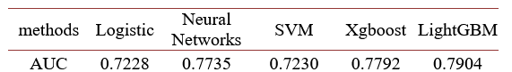
Comparison to Past Research
AUC Values from
Yang, S., & Zhang, H. (2018)
AUC Values of this project
Methods | LogReg | Random Forest | Support Vector Machine | LightGBM | Neural Network
SMOTE | 0.7644 | 0.7623 | 0.7664 | 0.7647 | 0.7386
KMeans SMOTE | 0.7650 | 0.6952 | 0.7664 | 0.762 | 0.5072

Slide 25
Model Evaluation Summary
Logistic Regression, SVM, and LightGBM:
strong accuracy ~90%
Fair AUC Curve Value ~0.76
Poor recall on default ~13.5%
Random Forest:
SMOTE, KM SMOTE accuracy: 82% and 89%
SMOTE, KM SMOTE AUC: 0.76 and 0.69
Neural Network SMOTE was worst performing model
30% accuracy
Neural Network had best recall value for default observations
90%

Slide 26
Conclusion
Machine learning models used to predict credit card default can be translated onto BNPL transactions and yield good accuracy.
The models developed need more training on default observations.
Neural networks need more fine-tuning to reproduce evaluation metrics.
The dataset used has limitations:
Further research must partner with private fintech companies.
Additional resampling methods should be tested to expand default target variable

Slide 27
Thank you.

Slide 28
References
Slide 2: Buy now, pay later downloads Canada 2015-2025: Biggest buy now, pay later (BNPL) apps in Canada from 1st quarter of 2015 to 1st quarter of 2025, by number of downloads. (2025). [Dataset]. Statista Ltd.
Slide 13: Yang, S., & Zhang, H. (2018). Comparison of several data mining methods in credit card default prediction. Intelligent Information Management, 10(05), 115.

Slide 29
Slide 5: Eckroth, J. (2018). Python artificial intelligence projects for beginners : get up and running with artificial intelligence using 8 smart and exciting AI applications (1st edition). Packt.
Slide 5: Géron, A. (2022). Hands-on machine learning with Scikit-Learn, Keras and TensorFlow : concepts, tools, and techniques to build intelligent systems (Third edition.). O’Reilly Media, Inc.
Slide 5: Microsoft and LightGBM contributors. (n.d.). Features [Software documentation]. LightGBM. https://lightgbm.readthedocs.io/en/latest/Features.html
Slide 5: Moocarme, M., So, A. V., & Maddalone, A. (2021). The tensorflow workshop : a hands-on guide to building deep learning models from scratch using real-world datasets (1st edition.). Packt.
Slide 5: Wikipedia contributors (n.d.) describe logistic regression as a model that predicts binary outcomes via the log‑odds of independent variables

