Slide 1
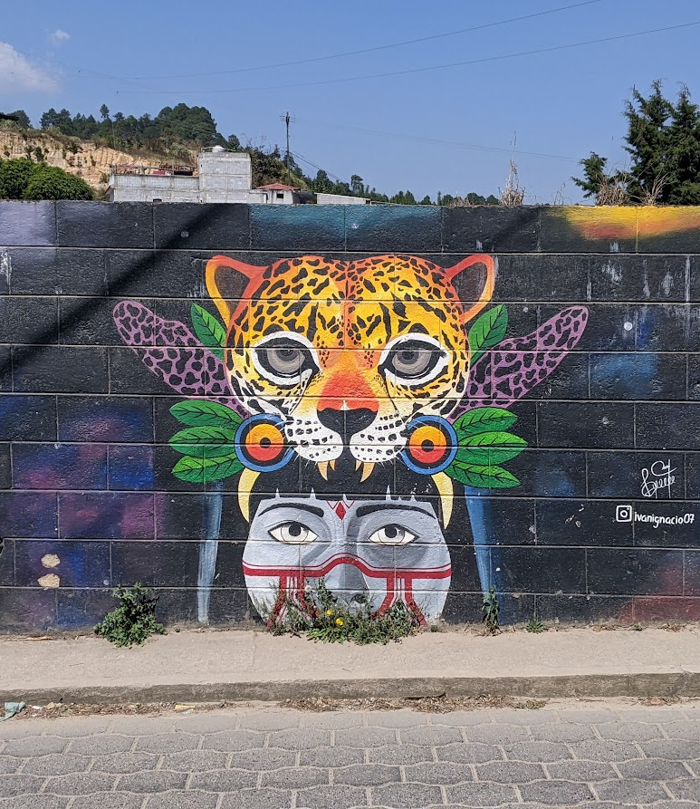
Status suffixes at the syntax-prosody interface: a corpus study of Chichicastenango K'iche'
Elizabeth Wood
elizabethwood@utexas.edu
CLS 59, 4/30/2023

Slide 2
Overview
Status suffixes and ‘phrase-final’ morphemes
A corpus study
The corpus
Categorization of syntactic and prosodic phrase position
Results
A possible analysis: a recursive prosodic structure

Slide 3
Status suffixes and Phrase-final morphemes

Slide 4
Marking phrase edges
Common across languages:
Final lengthening (Beckman & Edwards 1987)
Pauses (Krivokapić 2007)
Voice quality, phrase-final creak (Davidson 2021)
Tones (Katsika et al. 2014)
Pitch reset (Yang & Wang 2002)
The Mayan languages: phrase-final morphemes

Slide 5
Status suffixes as ‘phrase-final’ morphemes
(1) ʃ-in-aːtin-∅ iwiːɾ
cpl-b.1sg-bathe-ss.m yesterday
‘I bathed yesterday.’ (Larsen 1988)
(2) iwiːɾ ʃ-in-aːtin-ik
yesterday cpl-b.1sg-bathe-ss.f
‘Yesterday I bathed.’ (Larsen 1988)
Basic generalization:
‘Final’ suffix when verb is last element

Slide 6
Status suffixes as ‘phrase-final’ morphemes
(3) k-in-kuːn-ik k-in-ɓeː-k
incpl-b.1sg-be.able-ss.f incpl-b.1sg-go-ss.f
‘I am able to go.’ (Larsen 1988)
More data:
‘Final’ suffix when verb is last element of the clause
(Mondloch 1981; Larsen 1988; Can Pixabaj & Sis Iboy 2004; Barrett 2007)

Slide 7
Status suffixes as ‘phrase-final’ morphemes
Phrase-final forms also attested:
When sentence repeated slowly word by word (Henderson 2012)
Preceding a vocative (Henderson 2012)
Preceding certain clitics (Tyers & Henderson 2021)
Correlated with final high/rising pitch contours (boundary tones) (Henderson 2012; Royer 2021)
More data:
‘Final’ suffix when verb is last element of the Intonational Phrase
(Henderson 2012; Royer 2021; Tyers & Henderson 2021)

Slide 8
Elicited vs. Spontaneous speech
Previous work on this topic (mostly) based on elicited examples of specific constructions
Limited to contexts that have been of interest to researchers
Hard to identify patterns dependent on discourse/large context for grammaticality (Chelliah and De Reuse 2011)

Slide 9
A corpus study

Slide 10
Goals
Exploration of overall distribution of phrase-final and phrase-medial status suffixes in all environments present in the corpus, not restricted to contexts already identified as relevant
Test of whether clause position or IP position better predicts the alternation
(Effect of consonant clusters: stems ending in clusters do not alternate based on position)

Slide 11
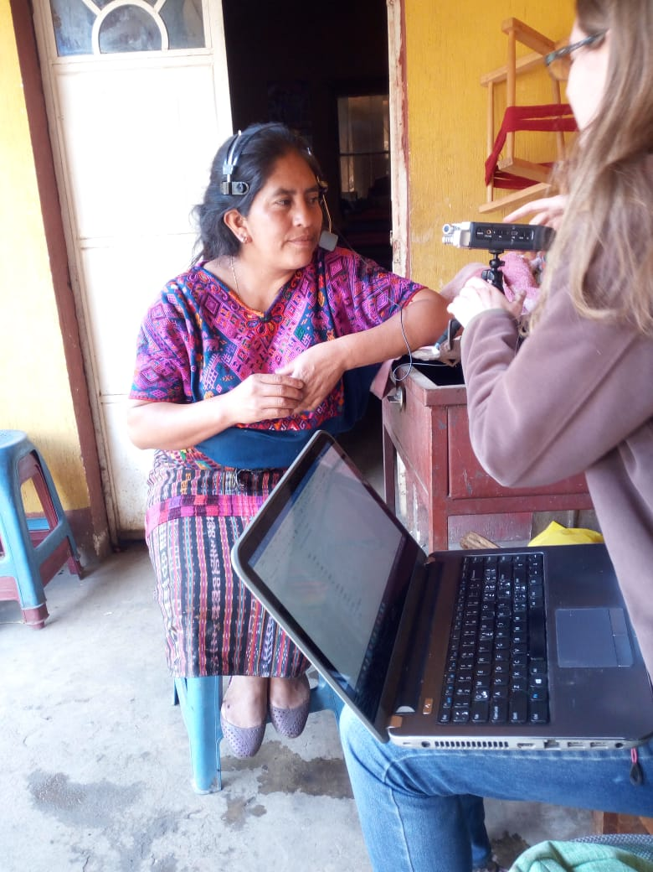
A corpus of Chichicastenango K’iche’
Spontaneous narrations (stories, history, recipes, discussion of local traditions)
Speakers of variety of ages, genders, and locations within Chichicastenango
Recorded 2018-2019
2 h 40 min total time
Transcribed in orthography with English and Spanish translations
If speaker gave permission, archived (audio and transcription) in AILLA (The K’iche’ collection of Elizabeth Wood, ailla.utexas.org)

Slide 12
Verbs in the corpus
Included all verbs with status suffixes that vary in form in medial and final contexts:
Excluded if restart/hesitation/unfinished
Also for the data discussed here, excluded all verbs ending in consonant clusters
Total of 2630 tokens

Slide 13
Categorization
Type of status suffix:
phrase-final: -ɪk, -ɔq, -ɔ/ʊ -aʔ/oʔ/uʔ
phrase-medial: ∅, -a/o/u

Slide 14
Categorization: syntactic position
Syntactic position: clause-final or clause-medial
Clause: finite verb/non-verbal predicate + all dependent arguments and modifiers
Clause-final: last element of clause and/or precedes a new clause
Clause-medial: all other verbs
Some questionable (but very infrequent) cases: ideophones, quotatives, vocatives, relational nouns

Slide 15
Categorization: prosodic position
Identifying Intonational Phrases (IP) in naturalistic data not a trivial task
Many works on K’iche’ and related languages, including those on status suffixes, discuss IP-final boundary tones (Nielsen 2005; Henderson 2012; Velleman 2014; Burdin et al. 2015): high/rising pitch contours
Looking for boundary tones:
Rise on final syllable of the verb that reached highest relative height in surrounding context
These tended to occur at the ends of topicalized phrases and the ends of sentences/clauses
Marked in examples as accent mark ´

Slide 16
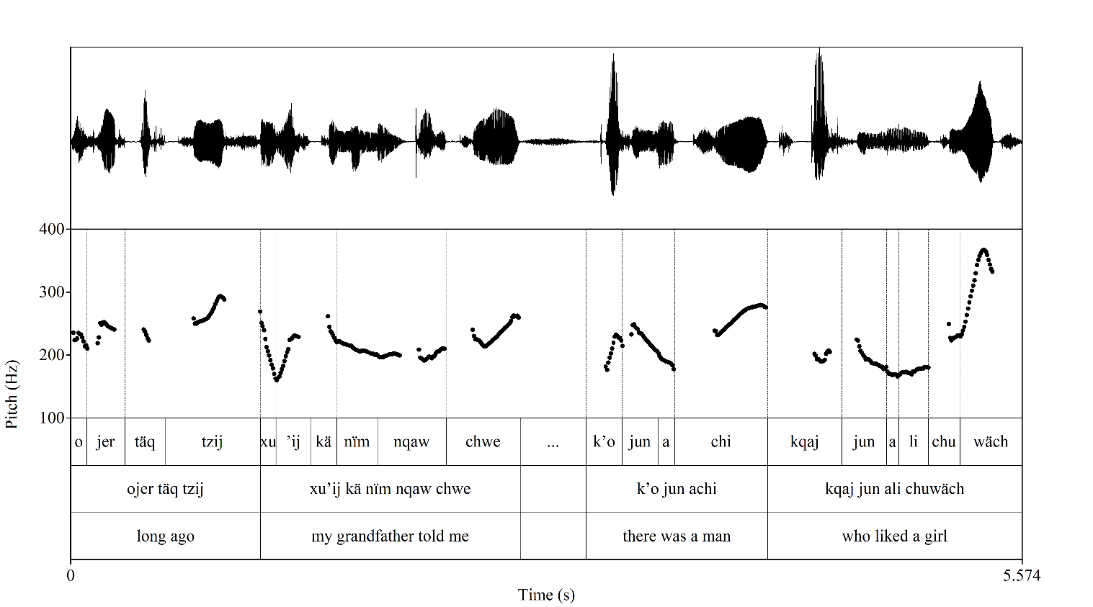

Slide 17
Results: clause position
Clause position | Total | Phrase-medial status suffix | Phrase-final status suffix
Medial | 2227 | 2090 (93.8%) | 137 (6.2%)
Final | 403 | 9 (2.2%) | 394 (97.8%)

Slide 18
Clause-medial verbs with phrase-final status suffixes
Contexts:
Followed by demonstrative pronouns
Followed by discourse particles
Followed by pause or speech filler
Other

Slide 19
Clause-medial verbs with phrase-final status suffixes
Followed by demonstrative pronouns
71 tokens
Uncertain analysis
Discourse functions: certainty, possibility, hope, response to request (López Ixcoy 1997; 1999; Sam Colop 1990)
Scoping over full proposition (Bliss & Wiltschko 2020 for Blackfoot) → outside of clause?
Some verbs followed by demonstrative pronouns have phrase-medial status suffixes
(4) sabado k-ɔχ-t͡ʃkʊn-ɪk ɾɪ́ʔ
Saturday incpl-b.1pl-work-ss.f dem
‘On Saturdays we work.’ (txt;talentos, 0:06:00)

Slide 20
Clause-medial verbs with phrase-final status suffixes
Followed by Spanish discourse particles
9 tokens
Similar to demonstrative discourse particles → outside of clause?
(5) kwando ja k-∅-q-ɪl-ɔ pwés
when already incpl-b.3s-a.1pl-see-ss.f then
‘When we already see it then...’ (txt;3recipes, 0:03:31)

Slide 21
Clause-medial verbs with phrase-final status suffixes
Followed by pause/speech filler
13 tokens
Additional material afterthought → outside of clause?
(6) ʃ-in-t͡ʃ(ə)kʊn-ɪ́k … ɾ-uk' ɾ n ɾ n-qáw
cpl-b.1sg-work-ss.f a.3sg-with det a.1sg det a.1sg-father
‘I worked … with my… my father.’ [txt;mr, 0:08:33]

Slide 22
Clause-medial verbs with phrase-final status suffixes
Other, unexplained
44 tokens
(7) kɛɓɾqən ʃ-∅-u-ʔun-ɔ q-uk' oχéɾ
earthquake cpl-b.3sg-a.3sg-do-ss.f a.1pl-with before
‘An earthquake that happened to us in the past.’ [txt;earthquake, 0:00:15]
(8) ɓəχt͡ʃéʔ k-∅-k’əm-ɔ k-ʃk’áj
early incpl-b.3sg-a.3pl-take-ss.f a.3pl-stick
‘Early they take their sticks.’ [txt;mushrooms, 0:07:12]

Slide 23
Clause-final verbs with phrase-medial status suffixes
9 tokens
Unexplainable under a syntactic analysis
Most verbs followed by embedded clause have phrase-final status suffixes
(9) χe ta ɾ k-∅-i-ʔən-∅ t͡ʃeɾ
like.that irr det incpl-b.3sg-a.2pl-do-ss.m comp
k-∅-it͡ʃəp-ɔ́
incpl-b.3sg-a.2pl-catch-ss.m
‘That is not how you catch them.’ (lit: ‘It’s not like that that you do it that you catch them.’) [txt;fishing, 0:05:23]

Slide 24
Results: IP position
With boundary tone | Total | Phrase-medial status suffix | Phrase-final status suffix
No | 2285 | 2079 (91.0%) | 206 (9.0%)
Yes | 345 | 20 (5.8%) | 325 (94.2%)

Slide 25
Verbs with boundary tones and phrase-medial status suffixes
20 tokens
Likely not boundary tones and no IP boundary – more research needed on K’iche’ intonation
(10) ʃ-∅-in-t͡ʃə́p-∅ χu laχ amló
cpl-b.3sg-a.1sg-catch-ss.m one little fly
‘I caught a little fly.’ [txt;mushrooms, 0:04:47]

Slide 26
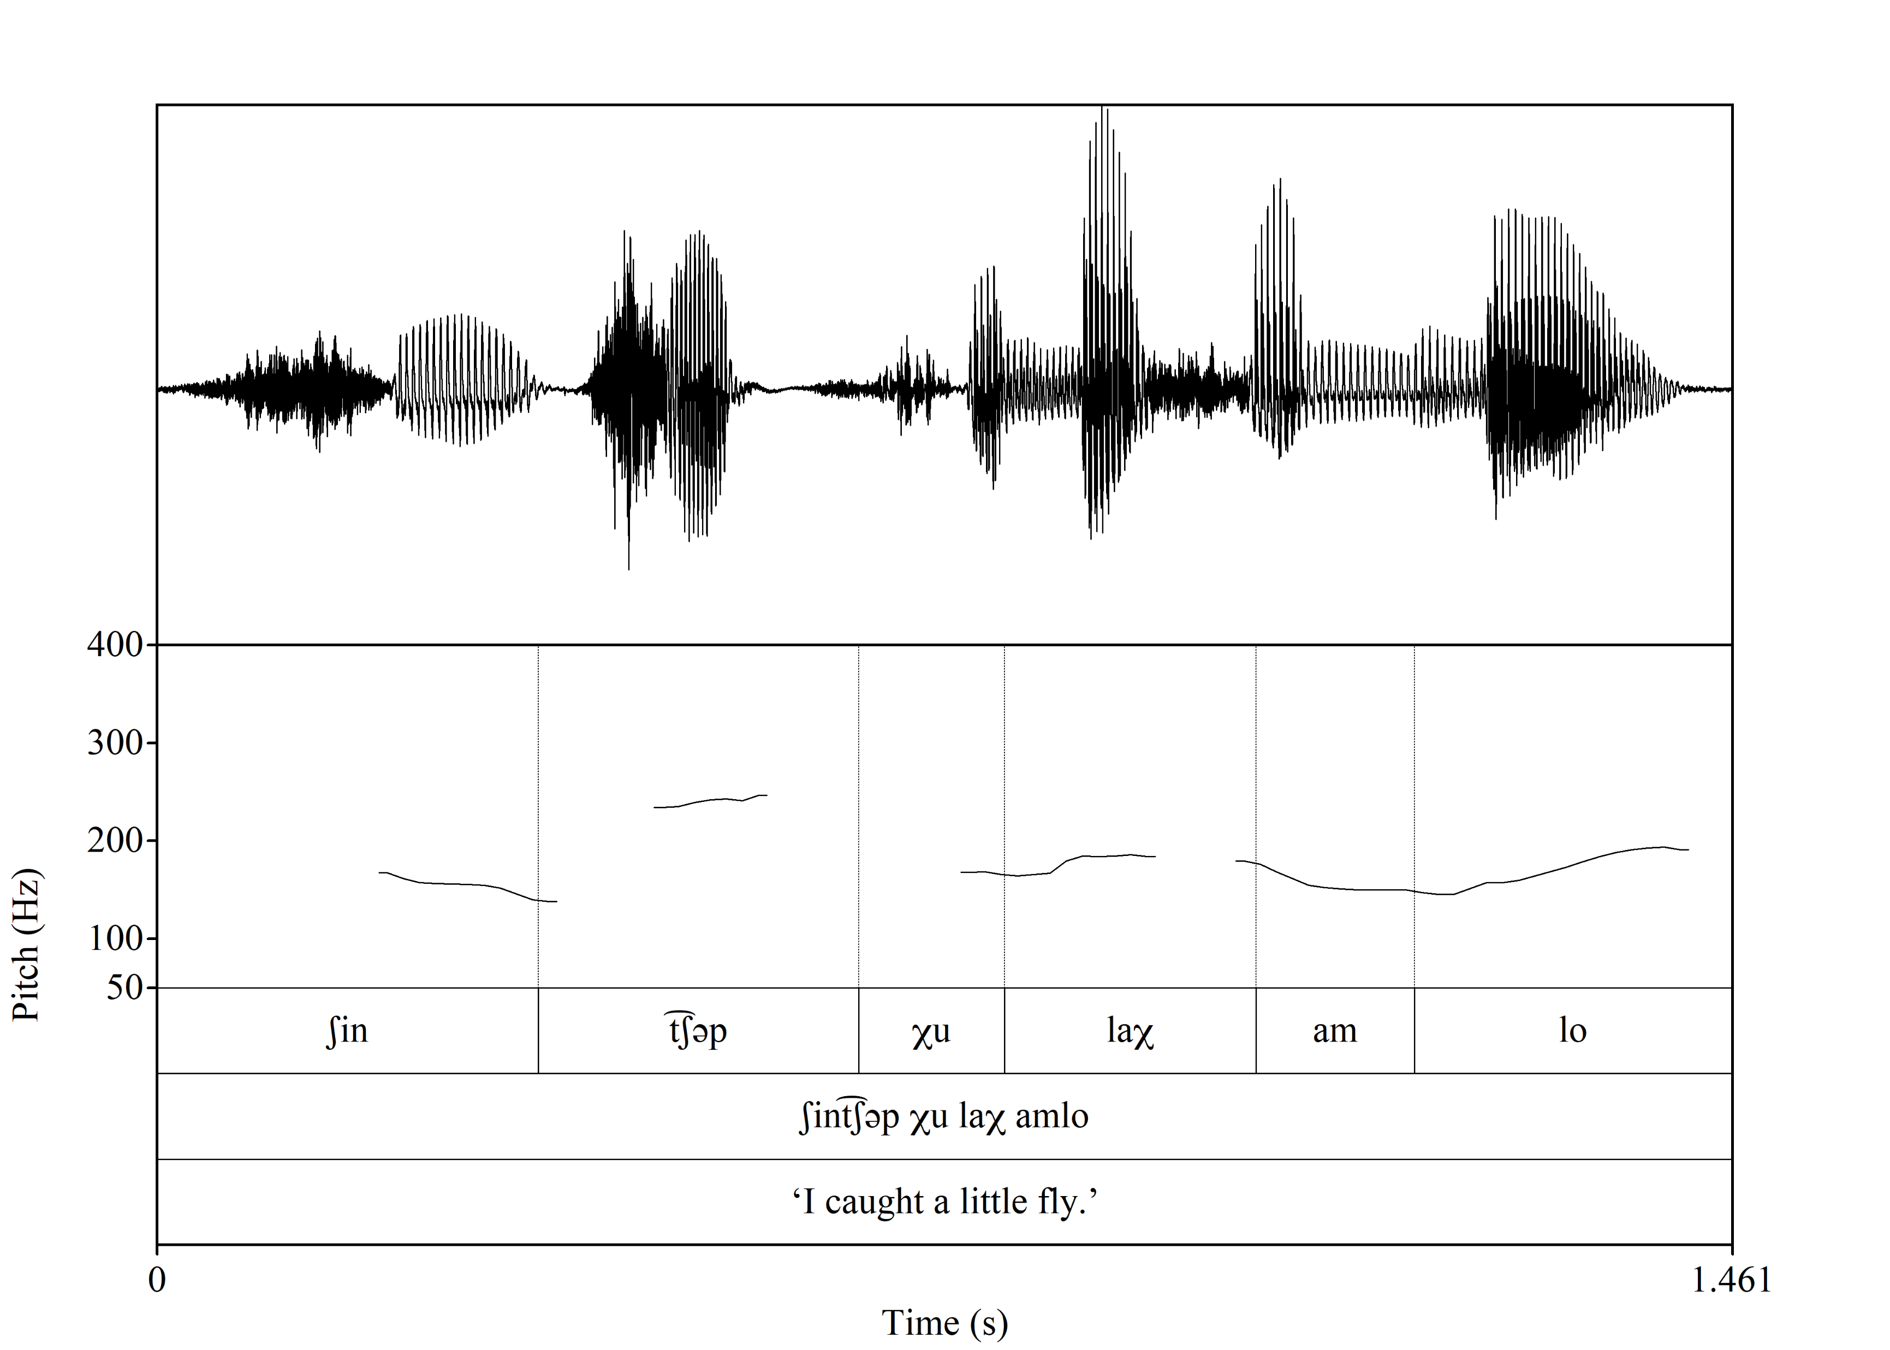

Slide 27
Verbs without boundary tones with phrase-final status suffixes
Contexts:
Followed by an embedded clause
Followed by a matrix clause (mostly quotative verbs)
Followed by an independent clause
Followed by an ideophone
Followed by a demonstrative pronoun
Followed by a discourse particle
Other

Slide 28
Verbs without boundary tones with phrase-final status suffixes
Followed by an embedded clause
32 tokens
Clause boundary → no IP boundary?
Some verbs followed by embedded clause have a boundary tone, some do not
(11) k-∅-q-ɪl-ɔ ja mq'ɪn t͡ʃ ɾ q-t'uʔj incpl-b.3sg-a.1pl-see-ss.f already hot again det a.1pl-pot
t͡ʃu q'áq’
prep fire
‘We see that our pot is now hot on the fire.’ [txt;3recipes, 0:03:11]

Slide 29
Verbs without boundary tones with phrase-final status suffixes
Followed by a matrix clause
8 tokens
Clause boundary → no IP boundary?
Some verbs followed by matrix clause have a boundary tone, some do not
(12) t͡siχ k-∅-kəm-ɪk ʃ-∅-u-ʔiχ aɾɛ́ʔ
true incpl-b.3s-die-ss.f cpl-b.3sg-a.3sg-say 3sg
‘… it is true that she will die, he said.’ [txt;owl, 0:02:00]

Slide 30
Verbs without boundary tones with phrase-final status suffixes
Followed by demonstrative pronoun or discourse particle
71 tokens
Clause boundary (?) → no IP boundary?
(13) sabado k-ɔχ-t͡ʃkʊn-ɪk ɾɪ́ʔ
Saturday incpl-b.1pl-work-ss.f dem
‘On Saturdays we work.’ (txt;talentos, 0:06:00)

Slide 31
Verbs without boundary tones with phrase-final status suffixes
Others, unexplained
38 tokens
(14) kɛɓɾqən ʃ-∅-u-ʔun-ɔ q-uk' oχéɾ
earthquake cpl-b.3sg-a.3sg-do-ss.f a.1pl-with before
‘An earthquake that happened to us in the past.’ [txt;earthquake, 0:00:15]
(15) ɓəχt͡ʃéʔ k-∅-k’əm-ɔ k-ʃk’áj
early incpl-b.3sg-a.3pl-take-ss.f a.3pl-stick
‘Early they take their sticks.’ [txt;mushrooms, 0:07:12]

Slide 32
Summary
Neither clause nor IP (as correlated with boundary tone) explain all of the cases
Biggest problem for syntactic analysis: medial suffixes at clause boundaries
Biggest problem for prosodic analysis: final suffixes without boundary tones

Slide 33
A possible analysis: recursive IP structure

Slide 34
A proposal
Not all IP boundaries marked with boundary tones
If we take phrase-final suffixes as diagnostic for IP boundary, and high/rising pitch contour as evidence for highest IP boundary in recursive structure, we can account for all of the variability in the data with different prosodic parsing of the same syntactic structures
This analysis relies on:
Recursive prosodic structure (Selkirk 2011; Ito & Mester 2012, Myrberg 2013), contradicting the Strict Layer Hypothesis (Selkirk 1984; Nespor & Vogel 1986)
Syntax-prosody mismatches & variable prosodic parsing of same syntactic structure (c.f. Royer 2021)

Slide 35
Verbs preceding demonstrative and discourse particles
Two attested structures:
Phrase-final status suffix on verb, boundary tone on particle
[ [ clause ]_{IP} particle ]_{IP}
[ [ sabado kɔχt͡ʃkʊn-ɪk ]_{IP} ɾɪ́ʔ ]_{IP}
Phrase-medial status suffix on verb, boundary tone on particle
[ clause particle ]_{IP}
[ xeqaχ-∅ ɾɪ́ʔ ]_{IP}

Slide 36
Verbs preceding embedded clauses
Three attested structures:
Phrase-final status suffix and boundary tone on matrix verb
[ matrix-clause ]_{IP} [ embedded-clause ]_{IP}
[ kawɪl-ɔ́ ]_{IP} [ su ɾ kuja ɾ χaʔ ]_{IP}
Phrase-final status suffix on matrix verb, boundary tone on embedded clause
[ [ matrix-clause ]_{IP} [ embedded-clause ]_{IP} ]_{IP}
[ [ kqɪl-ɔ ]_{IP} [ ja mq’ɪn t͡ʃ ɾ q-t’uʔj t͡ʃu q'áq']_{IP} ]_{IP}
Phrase-medial status suffix on matrix verb, boundary tone on embedded clause
[ matrix-clause embedded-clause ]_{IP} / [matrix-clause [ embedded-clause ]_{IP} ]_{IP}
[kiʔin-∅ t͡ʃeɾ kit͡ʃəpɔ]_{IP} / [kiʔin-∅ [͡ʃeɾ kit͡ʃəpɔ ]_{IP} ]_{IP}

Slide 37
Summary
In a corpus of spontaneous narratives, phrase-final status suffixes do not occur perfectly correlated with either clause boundaries nor high/rising pitch contours (boundary tones)
A clause-based analysis is impossible due to some phrase-medial suffixes in positions that are clearly clause-final
An IP-based analysis is possible by reconsidering distribution of boundary tones: phrase-final suffixes at all IP boundaries and boundary tones only at the highest IP
This analysis includes:
Recursive IPs
Mismatches between clause and IP boundaries

Slide 38
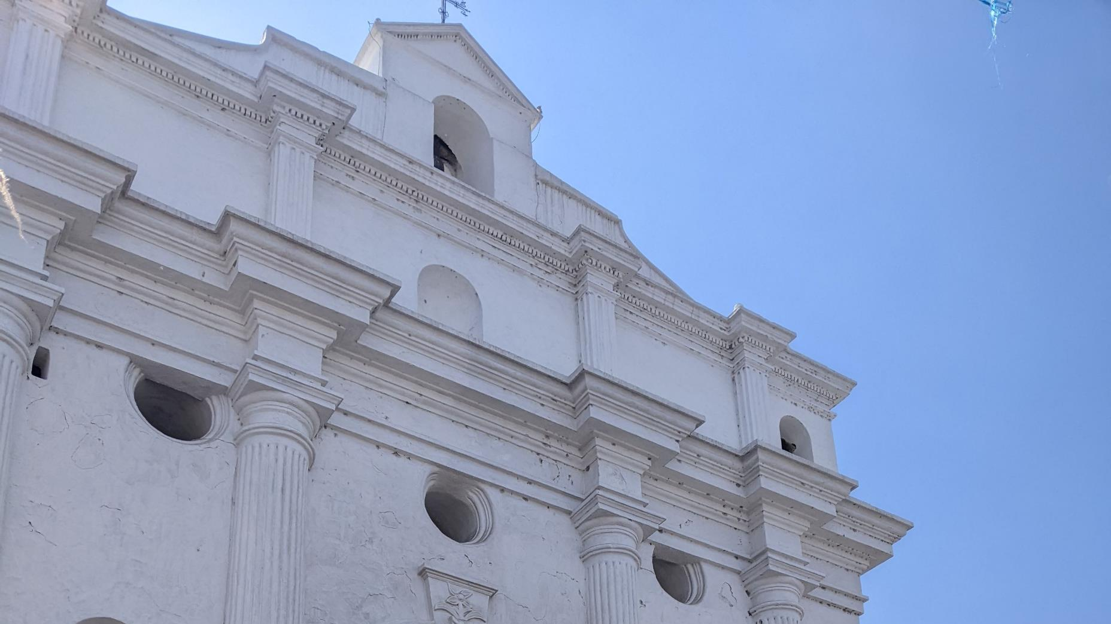
Thank you/Maltyox!
Questions/comments?
elizabethwood@utexas.edu

Slide 39
Acknowledgments
I would like to thank all of the K'iche' speakers who are represented in the corpus, without whom this work would have been impossible. I would also like to thank Scott Myers, Ryan Bennett, Megan Crowhurst and the members of the UT Austin Research in Phonetics and Phonology and Research in Documentary, Descriptive and Historical Linguistics research groups for helpful feedback on this project.
This material is based upon work supported by the National Science Foundation Graduate Research Fellowship Program under Grant No. 000392968. Any opinions, findings, and conclusions or recommendations expressed in this material are those of the author and do not necessarily reflect the views of the National Science Foundation.

Slide 40
References
Barrett, Rusty. 2007. The evolutionary phonology of glottal stops in K’ichean. Proceedings of the Annual Meeting of the Berkeley Linguistics Society 33 (1):19–29.
Beckman, Mary E and Jan Edwards. 1987. The phonological domains of final lengthening. The Journal of the Acoustical Society of America 81 (S1): S67.
Bliss, Heather, and Martina Wiltschko. 2020. Stsíkiistsi ki stsíkiistsi: The ubiquity of Blackfoot demonstratives in discourse. Demonstratives in Discourse, ed. Ashild Naess, Anna Margetts and Yvonne Treis, pp. 123-147. Berlin: Language Science Press.
Burdin, Rachel Steindel, Sara Phillips-Bourass, Rory Turnbull, Murat Yasavul, Cynthia G Clopper, and Judith Tonhauser. 2015. Variation in the prosody of focus in head- and head/edge-prominence languages. Lingua 165:254–276.
Can Pixabaj, Telma, and Nikté María Juliana Sis Iboy. 2004. Contextualizando posicionales. Lengua y mantenimiento cultural en Mesoamérica: Un simposio. Oxlajuuj Keej Maya Ajtz’iib’.
Chelliah, Shobhana L., and Willem J. De Reuse. 2010. Semantics, pragmatics, and text collection. Handbook of Descriptive Linguistic Fieldwork, pp. 413-448. Dordrecht: Springer.
Davidson, Lisa. 2021. The versatility of creaky phonation: Segmental, prosodic, and sociolinguistic uses in the world's languages. Wiley Interdisciplinary Reviews: Cognitive Science 12(3): e1547.
Henderson, Robert. 2012. Morphological alternations at the intonational phrase edge: The case of K’ichee’. Natural Language & Linguistic Theory 30 (3):741–787.
Ito, Junko, and Armin Mester. 2012. Recursive prosodic phrasing in Japanese. Prosody Matters: Essays in Honor of Elisabeth Selkirk, ed. Toni Borowsky, Shigeto Kawahara, Mariko Sugahara and Takahito Shinya, pp. 280-303. Elsevier.
Katsika, Argyro, Jelena Krivokapić, Christine Mooshammer, Mark Tiede, and Louis Goldstein. 2014. The coordination of boundary tones and its interaction with prominence. Journal of Phonetics 44: 62-82.
Krivokapić, Jelena. 2007. Prosodic planning: Effects of phrasal length and complexity on pause duration. Journal of phonetics 35 (2): 162-179.
Larsen, Thomas Walter. 1988. Manifestations of ergativity in Quiché grammar. Ph.D. dissertation, University of California, Berkeley.
Law, Danny. 2017. Language contacts with(in) Mayan. The Mayan Languages, ed. Judith Aissen, Nora C. England and Roberto Zavala Maldonado, pp. 112-127. London: Routledge Ltd.

Slide 41
References
López Ixcoy, Candelaria Dominga. 1997. Gramática K’ichee’. Guatemala: Fundación Cholsamaj.
López Ixcoy, Candelaria Dominga. 1999. Los demostrativos en k’ichee’. Undergraduate thesis, Universidad Rafael Landívar.
Mondloch, James Lorin. 1981. Voice in Quiche-Maya. Ph.D. dissertation, State University of New York at Albany.
Myrberg, Sara. 2013. Sisterhood in prosodic branching. Phonology 30 (1):73-124.
Nespor, Marina, and Irene Vogel. 1986. Prosodic Phonology. Dordrecht: Foris.
Nielsen, Kuniko. 2005. Kiche intonation. UCLA Working Papers in Phonetics 104: 45– 60.
Royer, Justin. 2021. Prosody as syntactic evidence: The view from Mayan. Natural Language & Linguistic Theory 40 (1):1–46.
Sam Colop, Luis Enrique. 1990. Bosquejo de algunos temas de la gramática K’iche’. Lecturas sobre la lingüística maya, ed. Nora C. England and Stephen R. Elliott, pp. 127–144. Centro de Investigaciones Regionales de Mesoamérica.
Selkirk, Elisabeth. 1984. Phonology and Syntax: The relation between sound and structure. Cambridge, MA: MIT Press.
Selkirk, Elisabeth. 2011. The Syntax-Phonology Interface. The handbook of phonological theory, pp. 435-501.
Tyers, Francis and Robert Henderson. 2021. A corpus of K’iche’ annotated for morphosyntactic structure. Proceedings of the First Workshop on Natural Language Processing for Indigenous Languages of the Americas, pp. 10–20.
Velleman, Leah Bridges. 2014. Focus and movement in a variety of K’ichee’. Ph.D. dissertation, University of Texas at Austin.
Wood, Elizabeth. The K’iche’ Collection of Elizabeth Wood. The Archive of the Indigenous Languages of Latin America, ailla.utexas.org, 2019-, access: public, PID ailla: 271517.
Yang, Yufang, and Bei Wang. 2002. Acoustic correlates of hierarchical prosodic boundary in Mandarin. Speech prosody 2002, international conference.

Slide 42
The status suffixes of Chichicastenango K’iche’
 |  | Phrase-medial | Phrase-final
Intransitive | Plain | ∅ | -ɪk
 | Dependent | ∅ | -ɔq
Root transitive | Plain | ∅ | -ɔ/ʊ
 | Dependent | -o/u/a | -oʔ/uʔ/aʔ

