Slide 1

Academic-Administrative Management System for Postgraduate Studies at the Centro Universitario de los Valles (CUValles). Specific case: Master's in Software Engineering
Software Configuration Management
Elizabeth Baños Arias
Ameca, Jalisco
2025

Slide 2

Objectives
Develop a web system for the academic and administrative management of the postgraduate program in Software Engineering at CUValles, for the management of students, professors, and academic procedures.
2

Slide 3

Functional requirements
RF_1 Authenticate User RF_2 Recover Password RF_3 Register User RF_4 Edit User RF_5 Delete User RF_6 Search User RF_7 View User RF_8 Register Student RF_9 Edit Student RF_10 Delete Student RF_11 Search Student RF_12 View Student
RF_13 Register Teacher RF_14 Edit Teacher RF_15 Delete Teacher RF_16 Search Teacher RF_17 View Teacher RF_18 Register Procedure RF_19 Edit Procedure RF_20 Delete Procedure RF_21 Search Procedure RF_22 View Procedure RF_23 Export Procedure
3

Slide 4
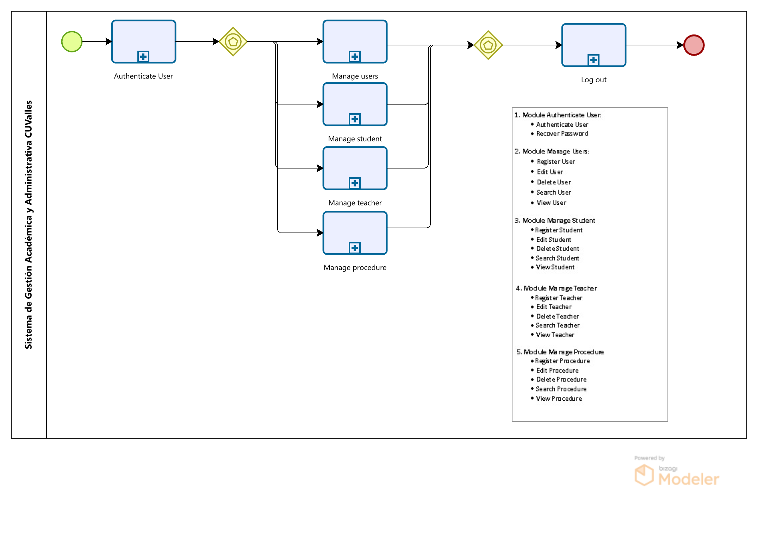
Modules
Acceptance letter
Travel permit
Scholarship commitment letter
Thesis
Mobility credits
Documents
4

Slide 5
Non-functional requirements
1. Performance • The system must authenticate users within a maximum of 2 seconds.
2. Usability • The interface must be intuitive. • Registration, editing, and deletion forms must have real-time validation (e.g., required fields).
3. Security • Password recovery must be done via a secure email and a single-use token.
4. Compatibility • The system must be accessible from modern browsers (Chrome, Firefox, Edge). • It must be adaptable to different devices (PC, tablet, mobile).
5

Slide 6
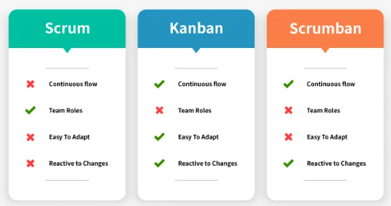
Methodology
Scrumban combines Scrum and Kanban practices to improve organization and workflow. It uses a visual board to track tasks, allowing tasks to be adjusted as needed without affecting the final product. As for meetings, it maintains the Scrum ones, although shorter and held when necessary: planning meetings for updates, daily meetings for coordination, sprint reviews, and retrospectives
6

Slide 7
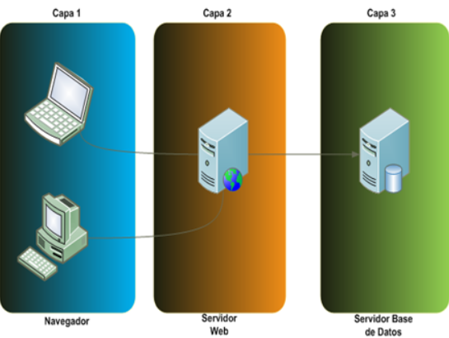
Layered Architecture
Layer 1
Layer 2
Layer 3
1-Presentation Layer (Frontend) • It is responsible for show information and receiving data entered by the user. • Example: forms for registering users, students, teachers, login.
7
Browser
Fronted
Web server
Backend
Database server

Slide 8
Layered Architecture
Layer 1
Layer 2
Layer 3
2-Business Logic Layer (Backend / Application) • This defines business rules: who can access, how data is validated, how permissions are managed. • It communicates with the database to read and write information. • Example: manages authentication and data validation.
7
Browser
Fronted
Web server
Backend
Database server

Slide 9
Layered Architecture
Layer 1
Layer 2
Layer 3
3-Data Layer (Database) • This is where system data. • Example: tables for users, students, teachers
7
Browser
Fronted
Web server
Backend
Database server

Slide 10
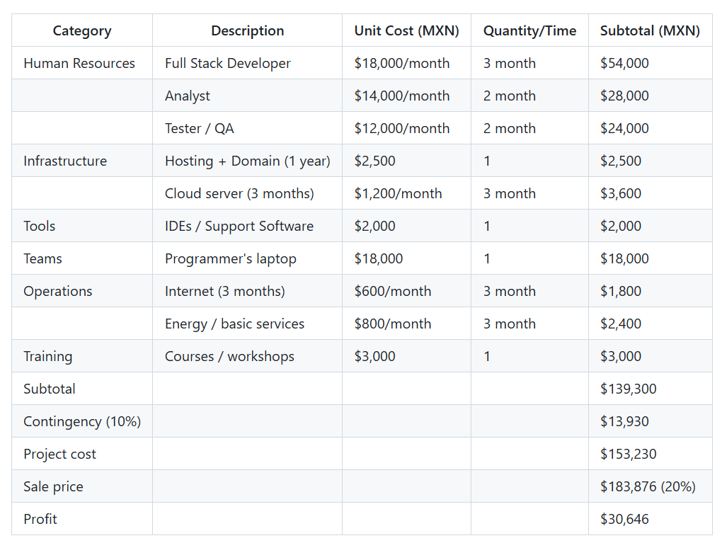
Project Expense Estimate (3 months)
8

Slide 11
Academic and Administrative Management System for Graduate Studies at the Centro Universitario de los Valles (CUValles). Specific case: Master's in Software Engineering.
Software Configuration Management
Elizabeth Baños Arias
Ameca, Jalisco
2025

