Slide 1

Local system for sales in a store
Software Configuration Management
Elizabeth Baños Arias
Ameca, Jalisco
2025

Slide 2

Understanding the Request
The project involves expanding the current sales system, which currently operates only locally in the store, to an online model. This requires implementing an e-commerce website, integrating digital payments, and ensuring real-time inventory synchronization between the physical store and the web platform.
2

Slide 3
Affected Modules
1. Cashier
Reason: Currently, the cashier manages local sales with physical payment. The website must process online payments and generate digital receipts.
Impact:
Integration with electronic payment gateways (cards, transfers, PayPal, etc.).
Generation of electronic receipts and automatic registration in the database.
3

Slide 4
Affected Modules
2. Vendor
Reason: Vendor supply products to the store. Managing their information ensures timely replenishment and accurate inventory.
Impact:
Database integration to track deliveries and product availability.
Automatic updating of stock levels upon receipt of new products.
4

Slide 5
Affected Modules
3. Products
Reason: The product catalog must be available in both the physical store and the website.
Impact:
Any updates to prices, descriptions, or images must be automatically reflected in both environments.
An API or synchronization service is required.
5

Slide 6
Affected Modules
4. Stock
Reason: Stock control must be updated the moment a sale occurs, whether physical or online.
Impact:
Prevents the sale of out-of-stock products.
Involves implementing blocking mechanisms and simultaneous inventory updates for multiple users.
6

Slide 7
List of risks
Risk of security breaches.
Higher maintenance and hosting costs.
System overload if not properly designed.
Possible incompatibility between the local system and the new web platform.
Dependence on internet connectivity and external servers (if the network fails, the online system will not work).
7

Slide 8
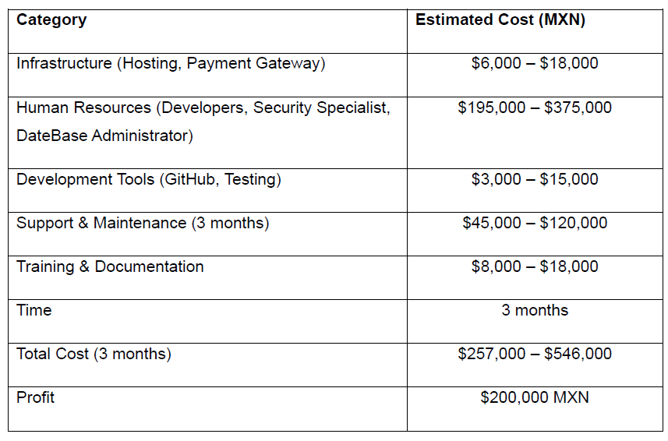
Resource estimation
8

Slide 9
Local system for sales in a store
Software Configuration Management
Elizabeth Baños Arias
Ameca, Jalisco
2025

