Slide 1
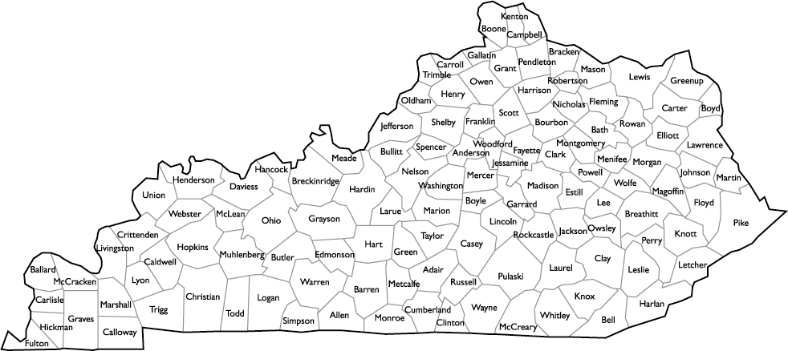
Predicting Kentucky’s Failing Schools
Elizabeth Miller
BrainStation - Data Science
Notes:
Good morning, everyone! As you all are aware, I’ve spent the last decade teaching math, and I plan to somehow merge data with education moving forwards.

Slide 2
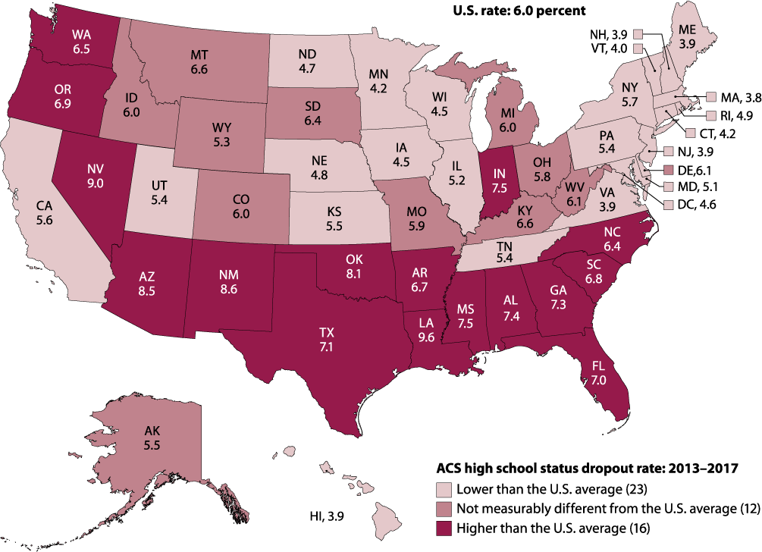
Introduction
The purpose of this research is to provide the state of Kentucky with some guidelines moving forward in order to reduce drop out rates. First by building a model to predict dropout rates then by using these models to determine which features help or hinder the most.
Notes:
Kentucky ranks 45th in the nation in uneducated population-- only 5 states have a worse education system. The average state dropout rate is 6.5%. The purpose of this research is to provide the state of Kentucky with some guidelines moving forward in order to reduce drop out rates. First by building a model to predict dropout rates then by using these models to determine which features help or hinder the most.

Slide 3
Cleaning
Data collected via the KDE School Report Card and Kids Count Data Center from 2011-2017:
1. Assessment Data
2. Learning Environment Data
3. School Safety
4. Comprehensive county demographic data on children
Notes:
To begin this project I pulled data from 4 sources. I got assessment data, learning environment data, and school safety data from the Kentucky department of Education’s own report card and pulled comprehensive county demographic data on children in KY from Kids Count, a non-profit organization. All data is from 2011 to 2017. This took a lot of time to wrangle and clean.

Slide 4
Cleaning
About 60% of the project was data wrangling. Started with 33 csv files and ~18 million data points and ended up at 71,815.
Each row represents each high school for each of the 6 years.

Slide 5
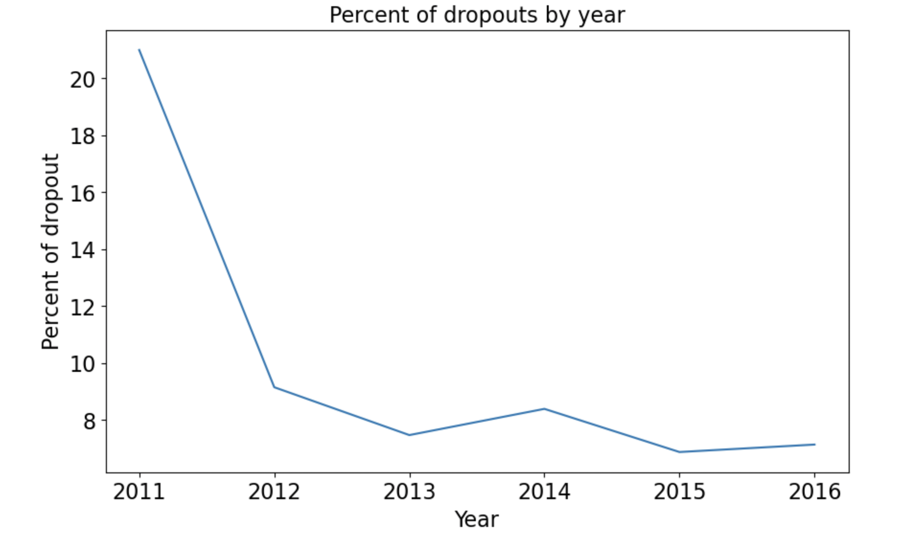
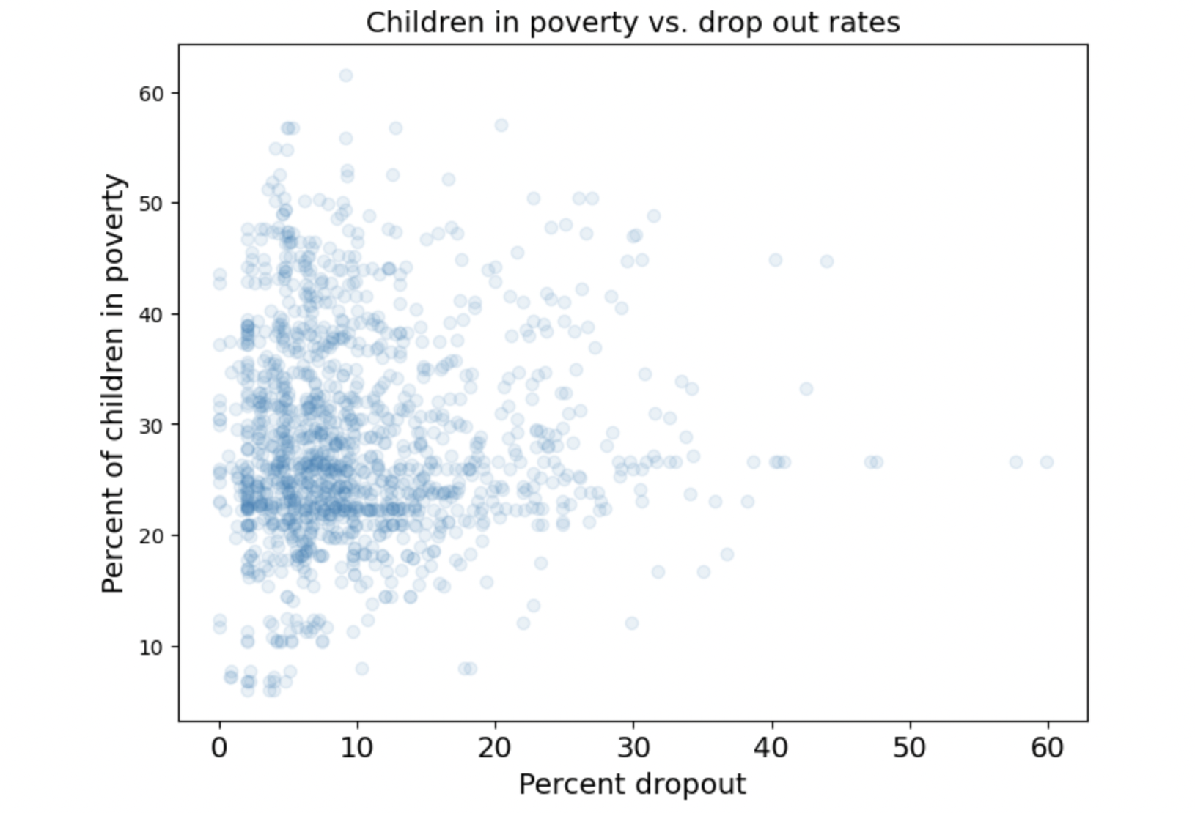
EDA
Notes:
The target variable for this project is percent of dropouts so I first looked at how these average values have changed over time. We can see that after 2011 there was a sharp drop in drop outs. This is due to a new law that took place. In 2011 high school students could drop out at age 16, but in 2012 the age was moved to 18. I think this graph illustrates the change quite well.
Next, in education, there is a lot of blame shifting where a lot of issues are blamed on poverty so I wanted to compare drop out to poverty and see if a relationship does exist. At least from this data used, there actually isn’t a clear relationship!

Slide 6
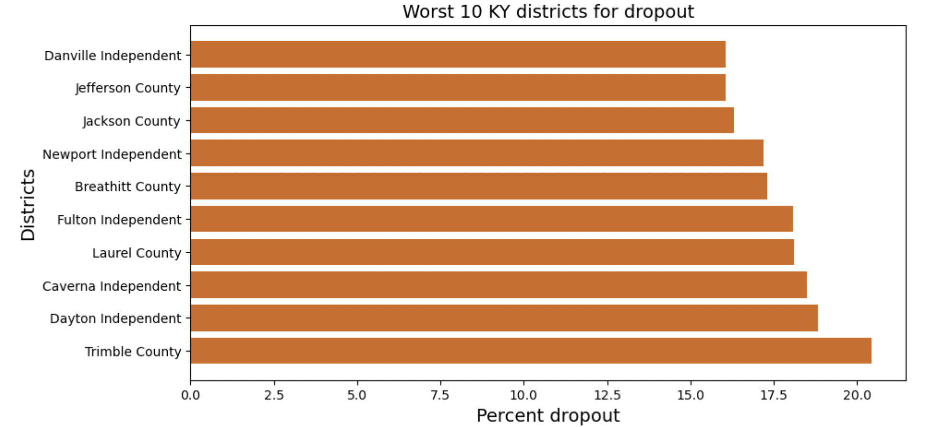
Notes:
Then I also analyzed which 10 districts were the worst in the state, notice that the percents range from 16-20%! The highest was a high school in Louisville in 2011 with 60% dropout!

Slide 7
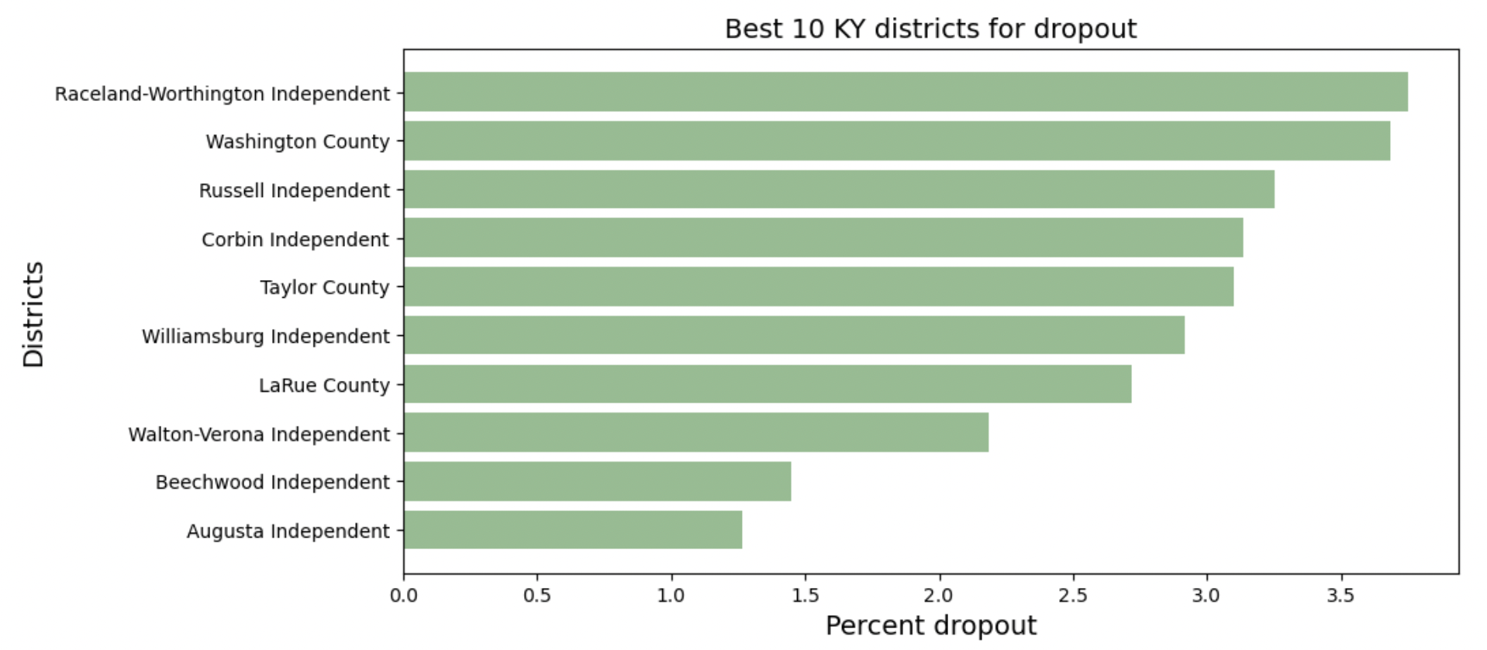
Notes:
For the 10 best districts we see it’s from 1-4% dropout.

Slide 8
Modeling
Algorithm Used | Best R2 | Best RMSE
Linear Regression | 50% | 5.9
KNearest Neighbor Regressor | 53% | 5.8
Decision Tree Regressor | 65% | 5.3
Random Forest Regressor | 72% | 4.5
Notes:
For this project I used 4 different regression models: linear regression, KNN, decision trees, and random forests. To evaluate the best model I used rsquared and Root Mean Squared Error. Both indicated that Random Forest was the best model with 72% rsquared value and a RMSE value of 4.5.

Slide 9
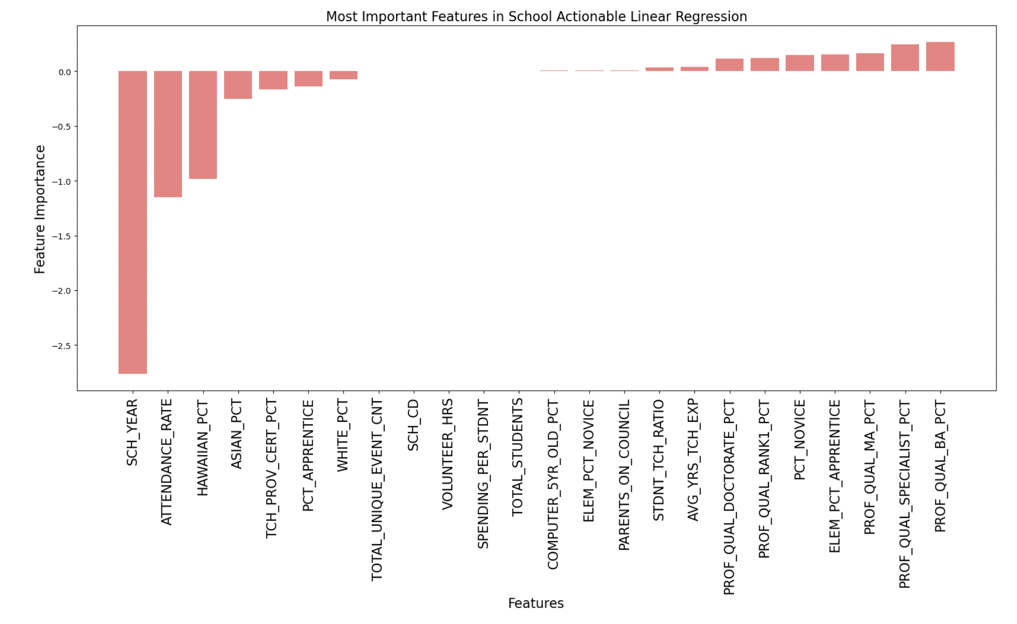
Notes:
Next, I looked at what features lead to the most and the least drop outs. I did this with my linear regression, decision tree and random forest. This is the linear graph. I didn’t want to include them all. Key positive indicators were highly qualified teachers with multiple degrees and and high standardized test scores. Negative indicators were low attendance rates, number of school suspensions, and low student diversity.

Slide 10
Findings for KDE
Jefferson County has the highest and lowest dropout rates in the state and as such should be a major focus.
Accurately report the average dropout rate at 10%!

Slide 11
Findings for Districts
Increase teacher quality
Improve attendance rate
Reduce behavior incidences
Improve novice test scores
Improve diversity of schools (both race and household income)
Focus less on technology for dropout purposes
Notes:
I found 6 items that districts should focus on:
-Increasing teacher quality: We saw that schools with better dropout rates had teachers with higher degrees and more years of teaching experience. Districts should provide more incentives to attract more qualified teaching candidates
-Improving attendance rate: Schools and districts should work on increasing daily attendance. Perhaps by rewarding high attendance, students might attend more.
-Reducing behavior incidences: The latter models showed that having more suspensions in schools resulted in more dropouts. Perhaps a school wide behavior policy changes should be looked into.
-Reducing novices on state testing: Districts focus on test scores every year, this should continue to be a major focus.
-Improving diversity among all schools in the district: There is some political issues with this one but schools should have roughly equal diversity amongst the race and household incomes of their students.
-Focus less on technology: Kentucky has been pushing for increased technology lately, but none of the models showed that technology effects drop out rates. This isn’t to say it doesn’t effect student outcomes of achievement… that wasn’t the focus of this research.

Slide 12
Thank you for your time! Any Questions?

