Slide 1
MA 252 | FINAL COURSE PROJECT
Analysis of College
Major Salaries
What predicts earnings after graduation?
Kayla Waweru & Elizabeth Menjivar
May 4, 2026

Slide 2
Research Question & Dataset
RESEARCH QUESTION
THE DATASET
Which factors best explain variation in median salary across 172 college majors?
Specifically:
• Does gender composition (ShareWomen) predict earnings?
• Does unemployment rate matter?
• How much does field of study (Major Category) drive salary differences?
172 academic majors
Key Variables:
• Median Salary (response)
• ShareWomen (proportion female)
• Unemployment Rate
• Major Category (16 categories)
n = 173 complete observations after removing NAs
K

Slide 3
Methods Overview
01
02
Simple Linear Regression
Multiple Linear Regression
Baseline model: Median salary predicted by ShareWomen alone. Establishes the bivariate relationship before adding complexity.
Expanded model adding Unemployment Rate and Major Category (as factor). Allows us to control for field of study and other variables.
03
04
Stepwise Model Selection
Model Assumptions
Bidirectional stepwise procedure (AIC-based) to identify the best combination of predictors from all available variables.
Residuals vs. Fitted, Q-Q plot, Scale-Location, Cook's Distance, and VIF analysis to validate assumptions and check for multicollinearity.
K

Slide 4
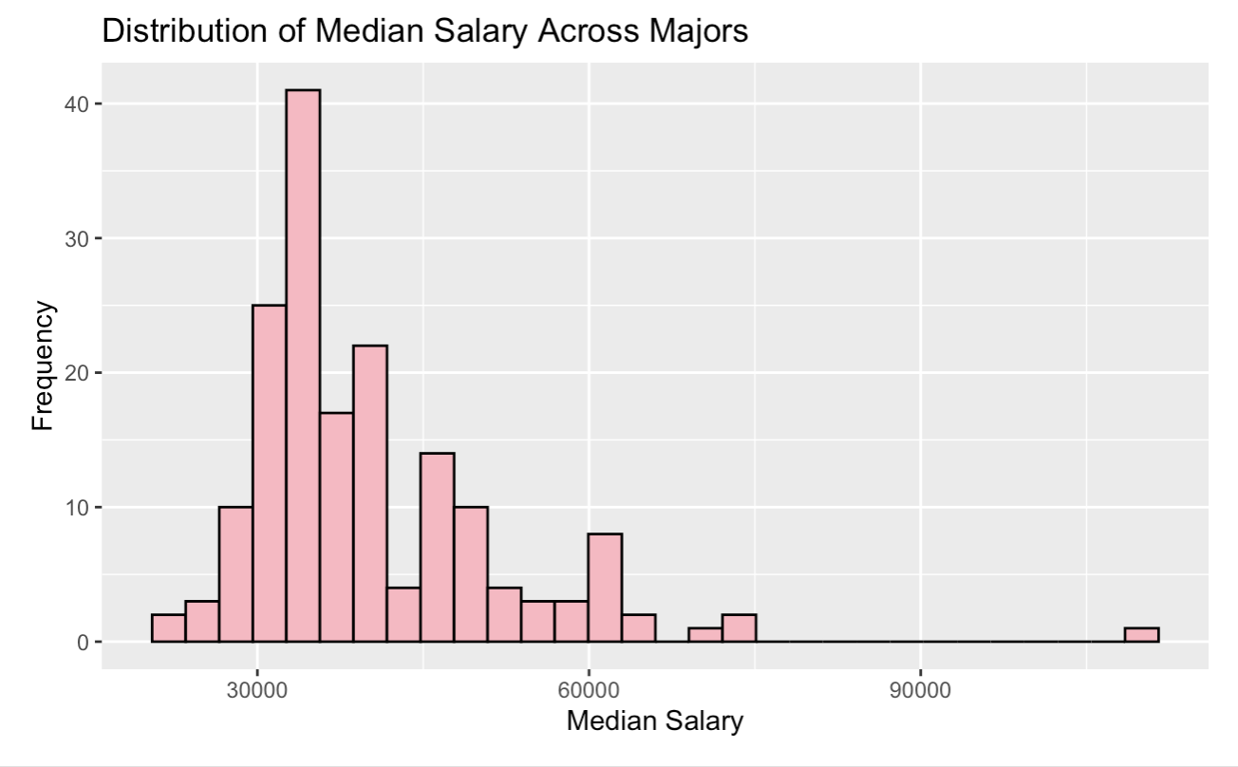
Exploratory Data Analysis
Mean Salary
Avg. Share Women
Avg. Unemployment
$40,077
52%
7%
Median: $36,000
Range: 0% – 97%
Range: 0% – 18%
Distribution of Median Salary
Right-skewed distribution — most majors fall between $30K–$50K,
but a few high-earning fields pull the mean above the median.
The interquartile range spans $33K–$45K, meaning half of all majors fall
within a ~$12K salary band.
Salary range: $22,000 (minimum) to $110,000 (maximum) — a nearly 5×
spread across majors.
K

Slide 5
Salary Differs Dramatically by Field
HIGH EARNERS
Engineering majors earn ~$57K median — nearly double Education fields
LOWER EARNERS
Psychology, Education & Humanities cluster below $33K median
KEY TAKEAWAY
Major category is the number one predictor of salary — confirmed by all three models
K

Slide 6
Regression Models: Equations
MODEL 1 — Simple Linear Regression
Median Salary = β₀ − β₁(ShareWomen)
Median Salary = 56,093 − 30,670 × ShareWomen
R² = 0.383 | p < 2e-16 | ShareWomen alone explains 38% of salary variation
MODEL 2 — Multiple Linear Regression (Stepwise Final Model)
Median Salary = β₀ + β₁(ShareWomen) + β₂(UnemploymentRate) + Σ β₃ₖ(MajorCategoryₖ)
where MajorCategoryᵢₖ = 1 if major i is in category k, 0 otherwise
R² = 0.622 | Adjusted R² = 0.580 | F(17, 154) = 14.9, p < 2.2e-16
K

Slide 7
Model 1: Simple Linear Regression and Interpretations
Median Salary = 56,093 − 30,670 × ShareWomen
β₀
β1
$56,093
−$30,670
Predicted salary for a major with 0% women
Each 1-unit increase in ShareWomen → salary drops by $30,670
R²
p-value
0.383
2e-16 < α
ShareWomen alone explains 38% of salary variation
Relationship is highly statistically significant since less than 0.05 (alpha)
K

Slide 8
Model 2: Multiple Linear Regression
Median Salary = β₀ + β₁(ShareWomen) + β₂(UnemploymentRate) + Σ β₃ₖ(MajorCategoryₖ)
ShareWomen
Unemployment Rate
Major Category
−$15,238
−$30,091
★ Strongest
• Significant (p = 0.0004)
• NOT significant (p = 0.16)
• Engineering: +$20,083 (p < 0.001)
• Effect shrinks from −$30,670 in simple model
• Does not meaningfully predict salary
• Business: +$10,194 (p = 0.002)
• Gender gap persists even after controlling for field
• Once major category is controlled for
• Computers & Math: +$7,186 (p = 0.04)
R² improved from 0.383 (simple model) → 0.622 (full model) | Model now explains 62% of salary variation
E

Slide 9
Stepwise Model Selection & VIF
How the stepwise algorithm (bidirectional, AIC-based) built the final model:
Step 1
Step 2
Step 3
Excluded
Major Category
+ ShareWomen
+ Unemployment
Rate
✕ Total
Graduates
AIC: 3096
AIC: 3083
AIC: 3083
No AIC gain
Biggest AIC drop — strongest predictor
Meaningful gain — included
Marginal gain — included
Not selected — no improvement
Multicollinearity Check (VIF) — All values well below cutoff of 5
Predictor
GVIF
Adjusted VIF
Concern?
Major Category
3.75
1.045
✓ None
ShareWomen
2.93
1.713
✓ None
Unemployment Rate
1.30
1.139
✓ None
E

Slide 10
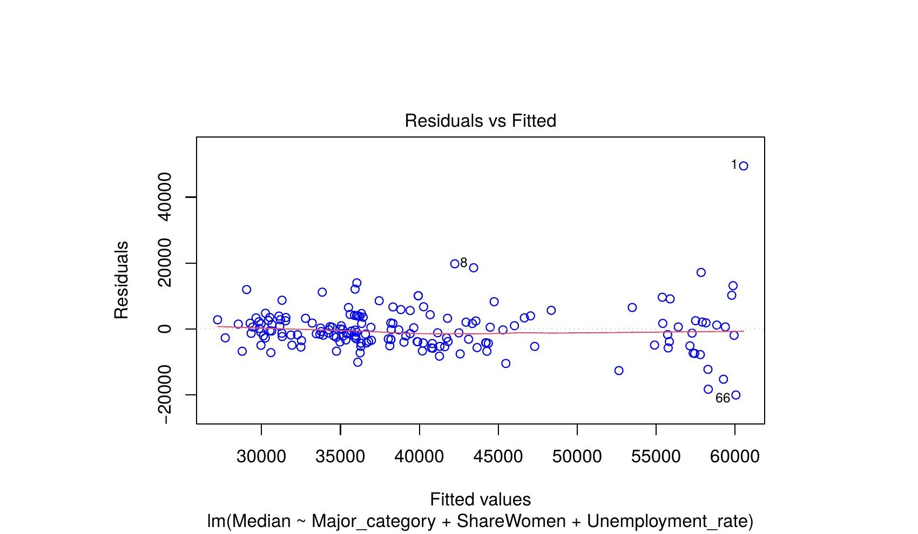
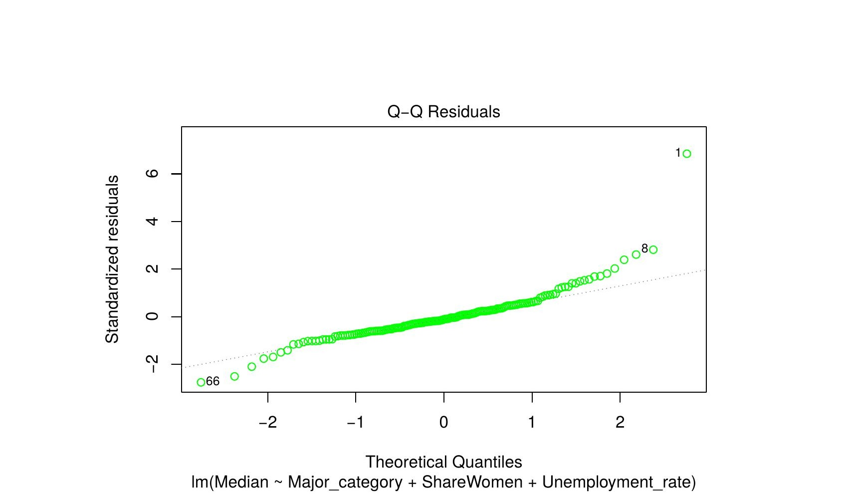
Model Diagnostics: Residual Plots
Residuals vs. Fitted
Normal Q-Q Plot
✓ Linearity met
Residuals scatter evenly around zero with no strong curvature. Slight variance increase at higher fitted values — mild heteroscedasticity, not severe.
✓ Normality approximately met
Most points follow the reference line. Some deviation in the upper tail (obs. 1, 8) from high-earning outliers, but normality assumption holds overall.
E

Slide 11
Model Comparison: Is the Full Model Better?
Nested ANOVA: F(16, 154) = 6.09, p = 2.82 × 10⁻¹⁰ → Full model is significantly better ✓
WHAT THIS MEANS
62% explained vs 38% in the simple model
Adding Major Category and Unemployment Rate captured an extra 24% of salary variation.
The ANOVA confirms this improvement is statistically significant — not due to chance.
E

Slide 12
Conclusion
What We Found
• Major category is the strongest driver of salary differences across fields — Engineering, CS, and Business earn significantly more.
• Gender composition (ShareWomen) remains a significant negative predictor (p = 0.0004) even after controlling for field — suggesting a within-field gender earnings gap.
• Unemployment rate adds little explanatory power once major category is accounted for (p = 0.16).
• Our final model explains 62% of salary variation — a major improvement over 38% with gender alone.
Why It Matters
Future Directions
Choosing a major has lasting financial consequences. Understanding which factors drive salary — and which don't — helps students and advisors make better decisions.
• Explore interaction terms (e.g., gender × field)
• Include region or cost-of-living adjustments
• Examine graduate-level vs. recent-grad data
E

Slide 13
Key Takeaways
01
Major Category is the #1 Predictor
02
Gender Gap Persists Across Fields
Field of study dominates salary outcomes. Engineering, Business, and CS majors earn significantly more — effect is large and highly significant.
ShareWomen stays significant (p = 0.0004) even after controlling for major — suggesting a within-field gender earnings gap.
03
Unemployment Rate Adds Little
04
Full Model Explains 62% of Variation
Not significant once major category is included (p = 0.16) — field of study absorbs most of its explanatory power.
Major improvement over the simple model (R² = 0.383 → 0.622), confirmed by nested ANOVA (F = 6.09, p < 0.001).
Data: FiveThirtyEight recent-grads dataset | Kayla Waweru & Elizabeth Menjivar | MA 252
E

Slide 14
References
DATA SOURCE
FiveThirtyEight. (2014). Recent College Graduates Dataset [recent-grads.csv].
Retrieved from: https://github.com/fivethirtyeight/data/tree/master/college-majors
R PACKAGES
Wickham, H. et al. (2023). tidyverse: Easily install and load the Tidyverse. R package version 2.0.0.
Fox, J. & Weisberg, S. (2019). car: Companion to Applied Regression. R package version 3.1-2.
Robinson, D. & Hayes, A. (2023). moderndive: Statistical inference via data science. R package version 0.5.4.
Waring, E. et al. (2022). skimr: Compact and Flexible Summaries of Data. R package version 2.1.5.
COURSE MATERIAL
MA 252 course notes and lectures — Normal Regression, model selection, and diagnostics.
E

