Slide 1
Barriers & Challenges to Implementing a Just Culture
Liz Hinz CSD380-A339: DevOps

Slide 2
Just Culture
Staff not punished for actions, omissions, suggestions, or decisions taken

Slide 3
Conceptual Barriers
Achieving a common culture is difficult
Relies on shared beliefs, values, practices, & assumptions

Slide 4
Societal Barriers
Systems can fail on a large scale
Accepting & placing blame can be complex
Can lead to scapegoats

Slide 5
Professional & Organisational Barriers
Companies & professions have varying ideas on mistakes
Professional standards are different

Slide 6
Historical Barriers
Organizations have a history
Honesty from employees may vary based on previous consequences

Slide 7
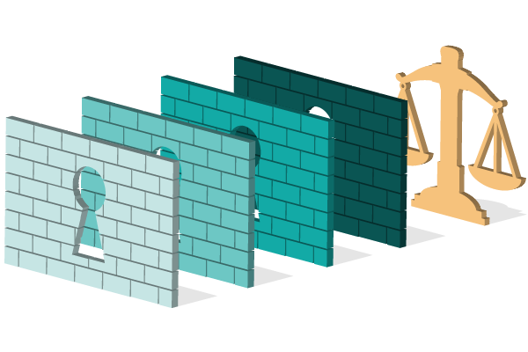
Legal & Judicial Barriers
Some mistakes may cross legal boundaries
Laws need to be followed during business conduct

Slide 8
Evolutionary Barriers
Justice in situations varies
Evolution is linked back to betrayal over actions

Slide 9
References
Bock, S. (2021, March 25). 4 Barriers Blocking Access to Justice | Blog. Relativity. https://www.relativity.com/blog/4-barriers-blocking-access-to-justice-and-how-to-break-them/
Shorrock, S. (2023, October 18). Why Is It Just So Difficult? Barriers to “Just Culture” in the Real World. Humanistic Systems. https://humanisticsystems.com/2023/10/18/why-is-it-just-so-difficult-barriers-to-just-culture-in-the-real-world/

Slide 10
THANK YOU FOR WATCHING!

