Slide 1
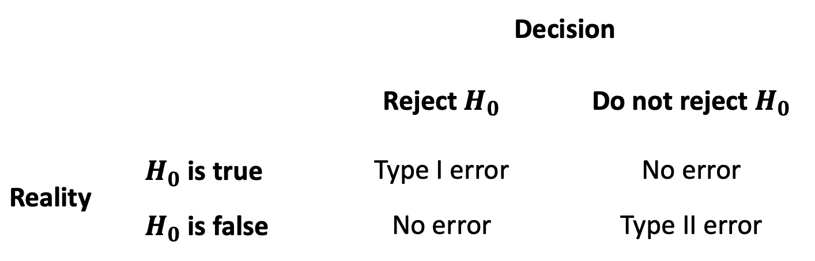
 |  | Decision
 |  | Reject $H_{0}$ | Do not reject $H_{0}$
Reality | $H_{0}$ is true | Type I error | No error
 | $H_{0}$ is false | No error | Type II error

Slide 2
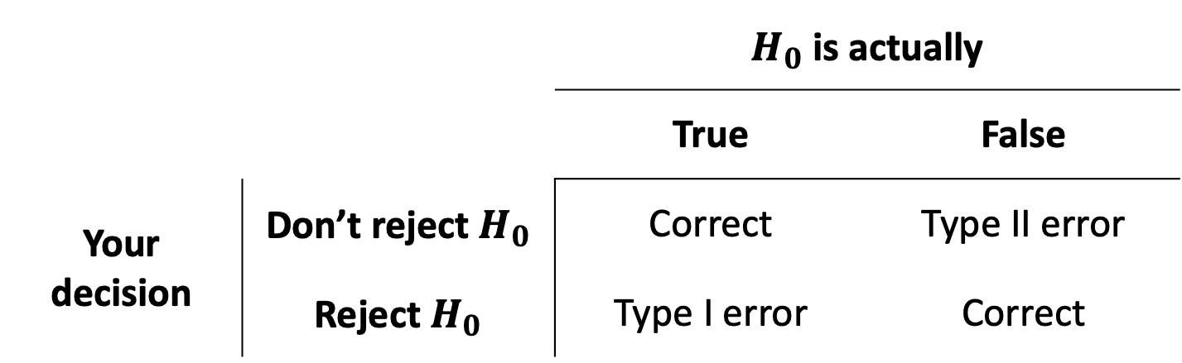
 |  | Defendant is actually
 |  | Innocent | Guilty
Court decision | Not guilty | Correct | Error
 | Guilty | Worse error | Correct
 |  | $H_{0}$ is actually
 |  | True | False
Your decision | Don’t reject $H_{0}$ | Correct | Type II error
 | Reject $H_{0}$ | Type I error | Correct

Slide 3
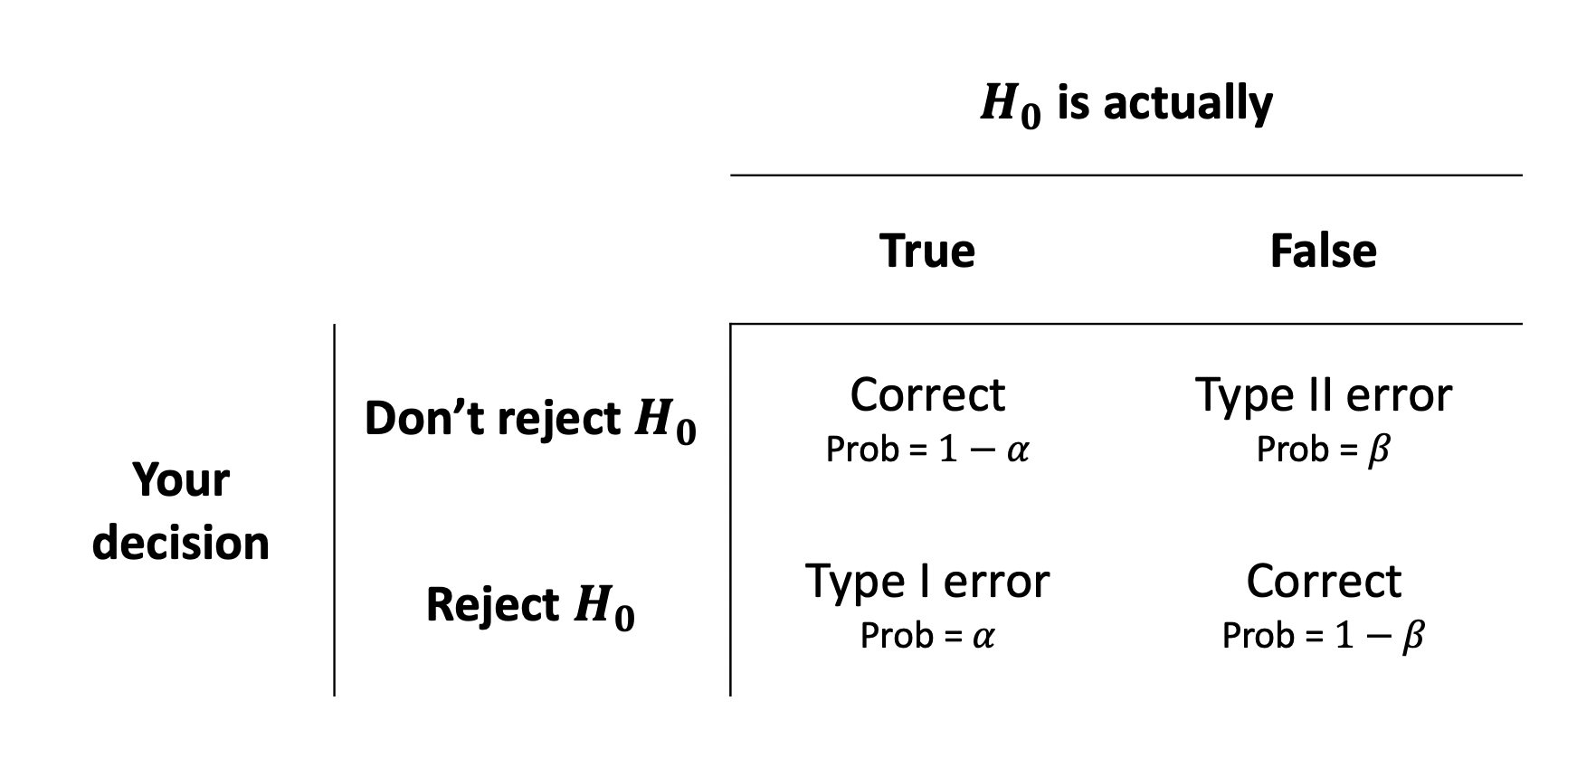
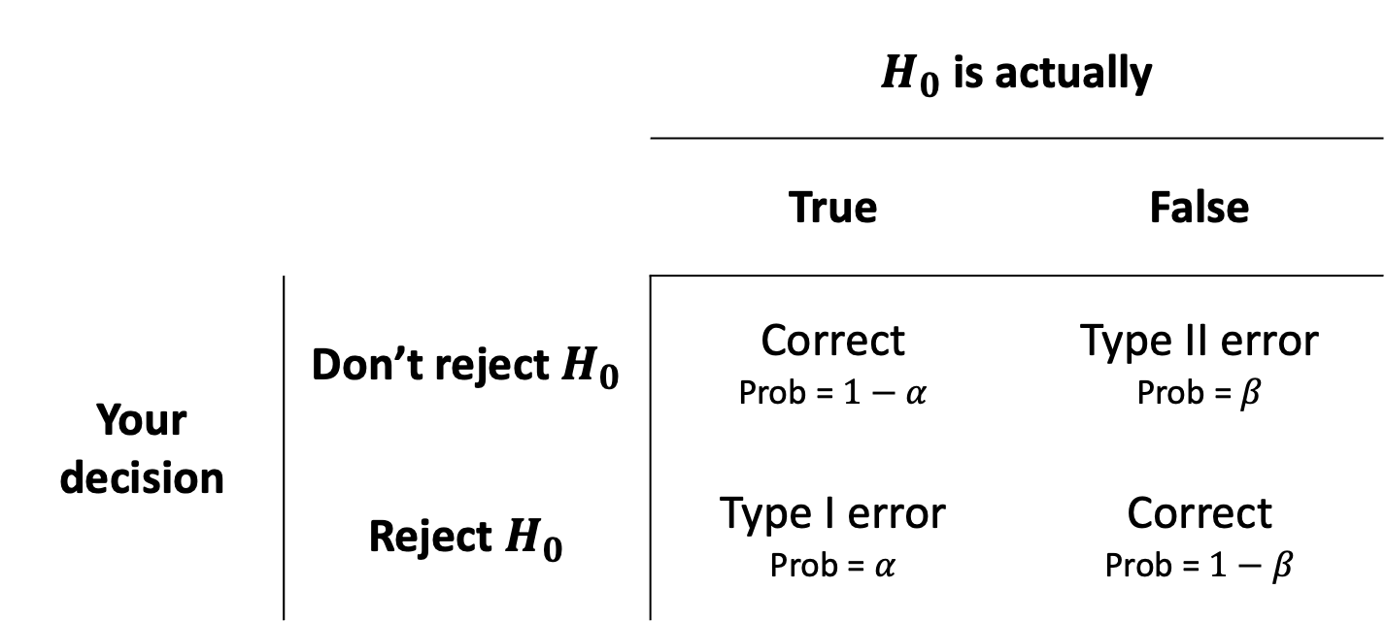
 |  | $H_{0}$ is actually
 |  | True | False
Your decision | Don’t reject $H_{0}$ | Correct Prob = $1−α$ | Type II error Prob = $β$
 | Reject $H_{0}$ | Type I error Prob = $α$ | Correct Prob = $1−β$

Slide 4
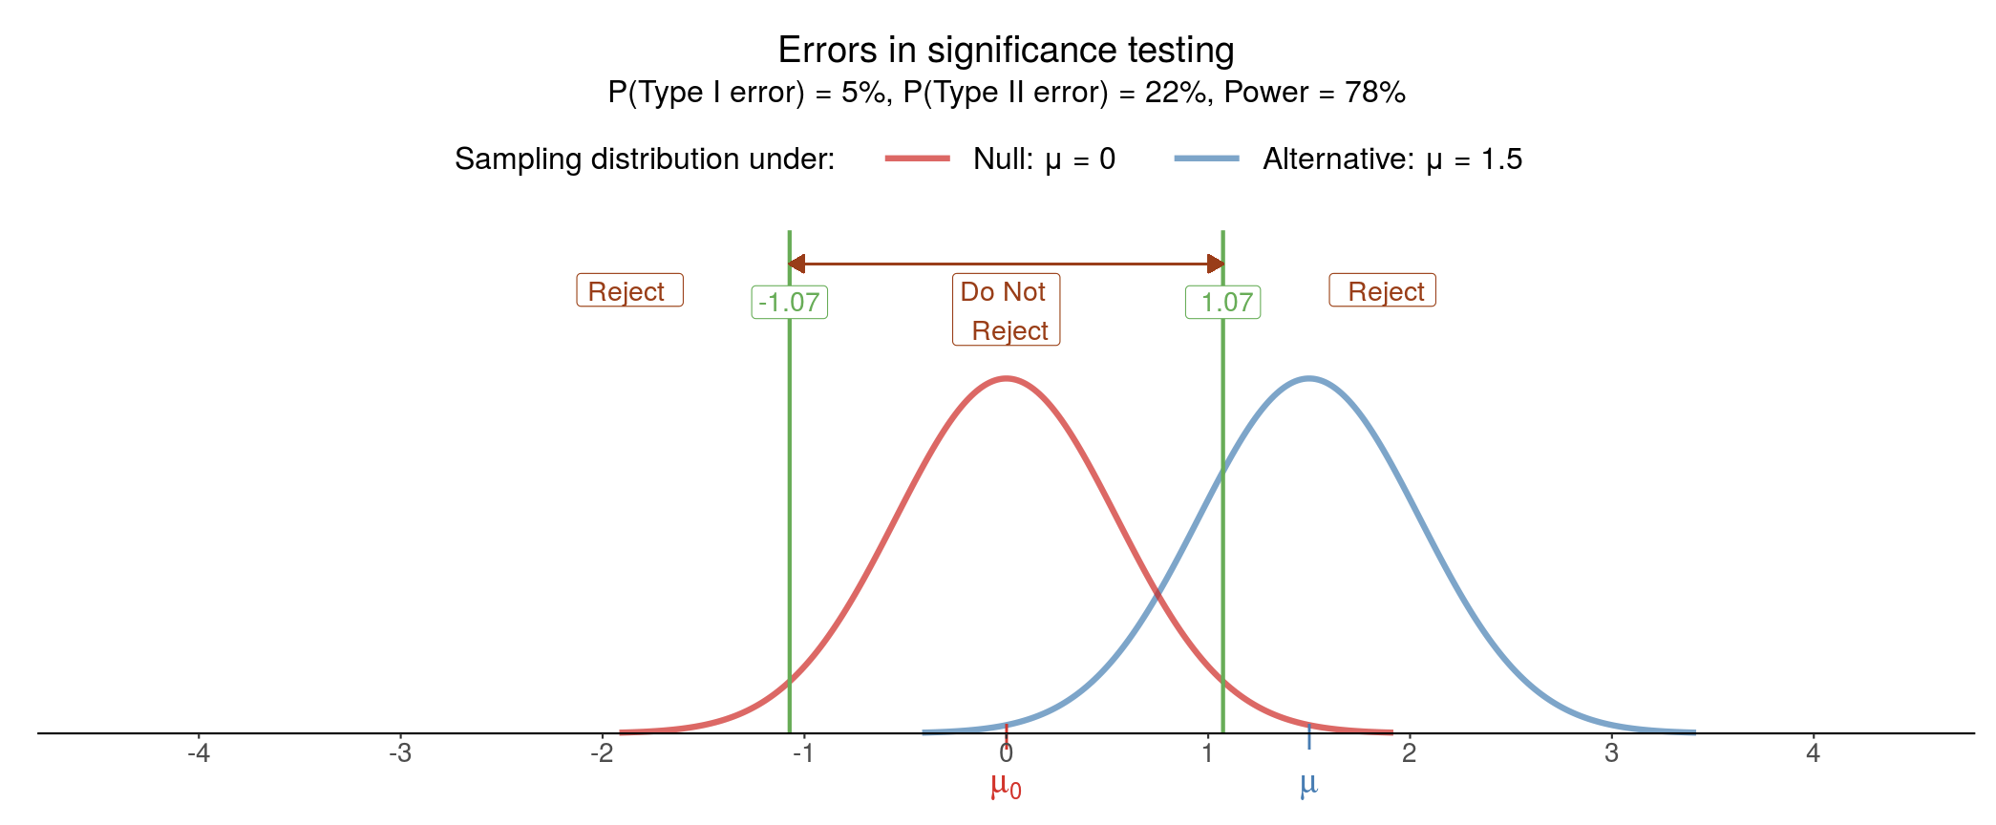

Slide 5
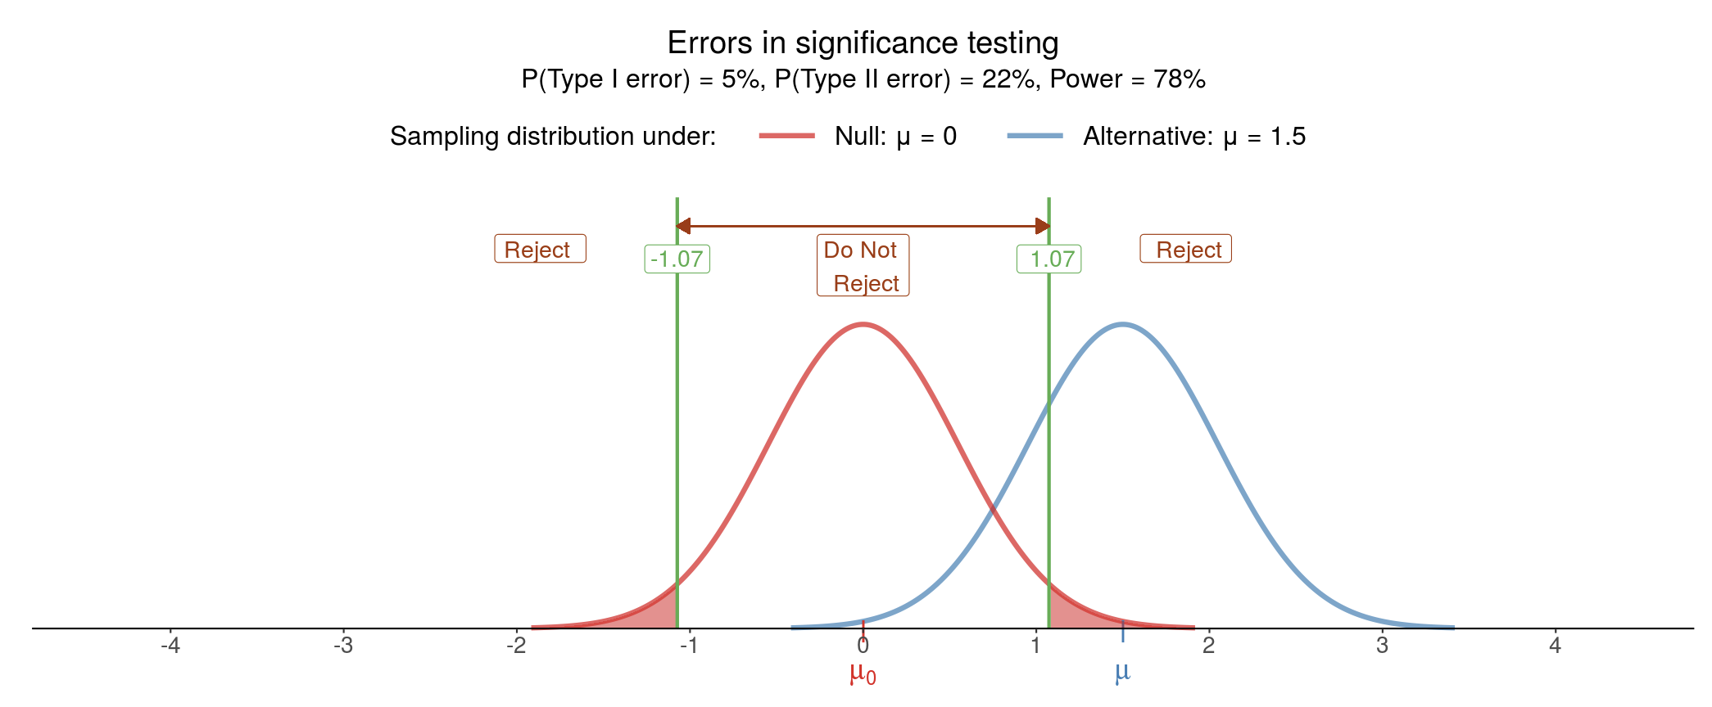

Slide 6
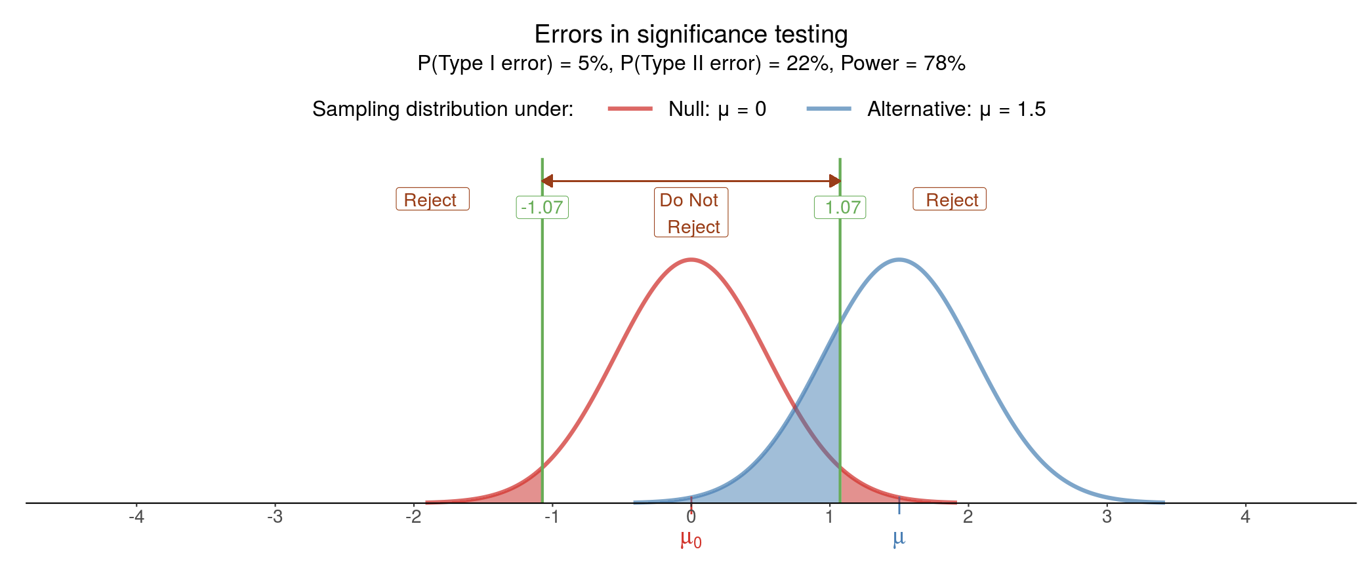

Slide 7
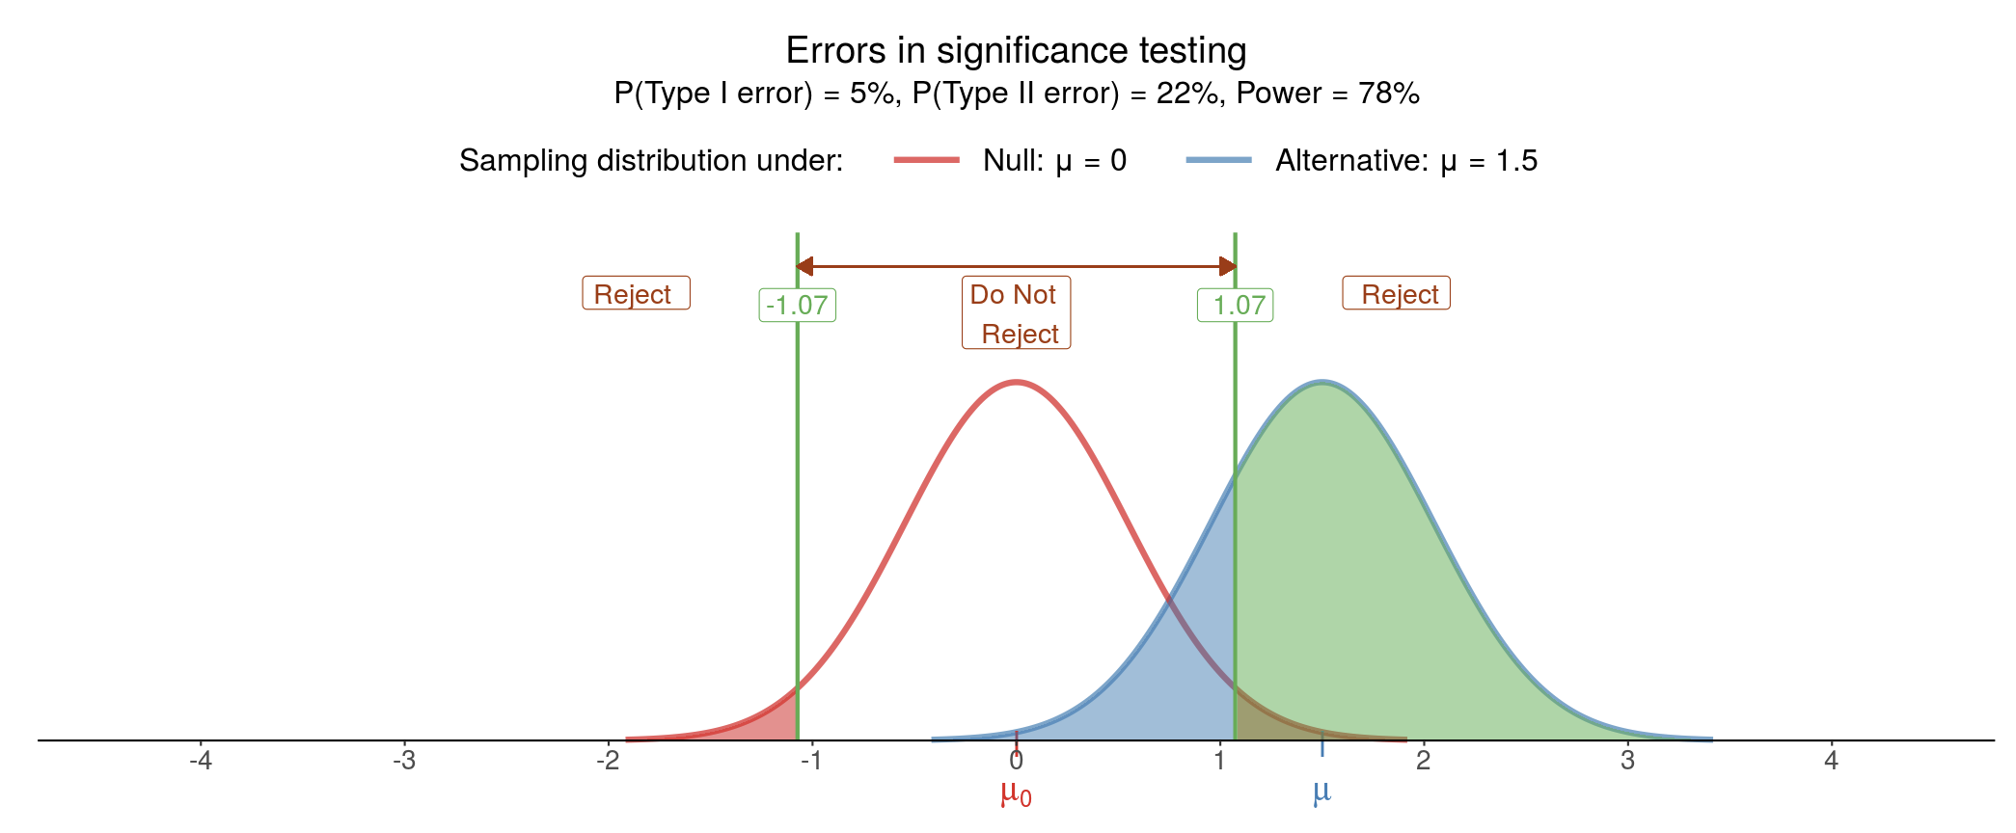

Slide 8
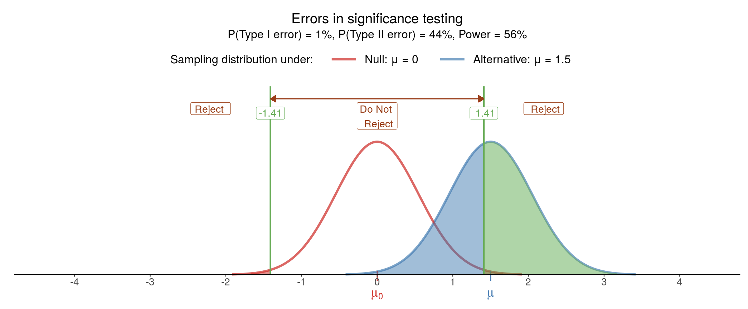

Slide 9
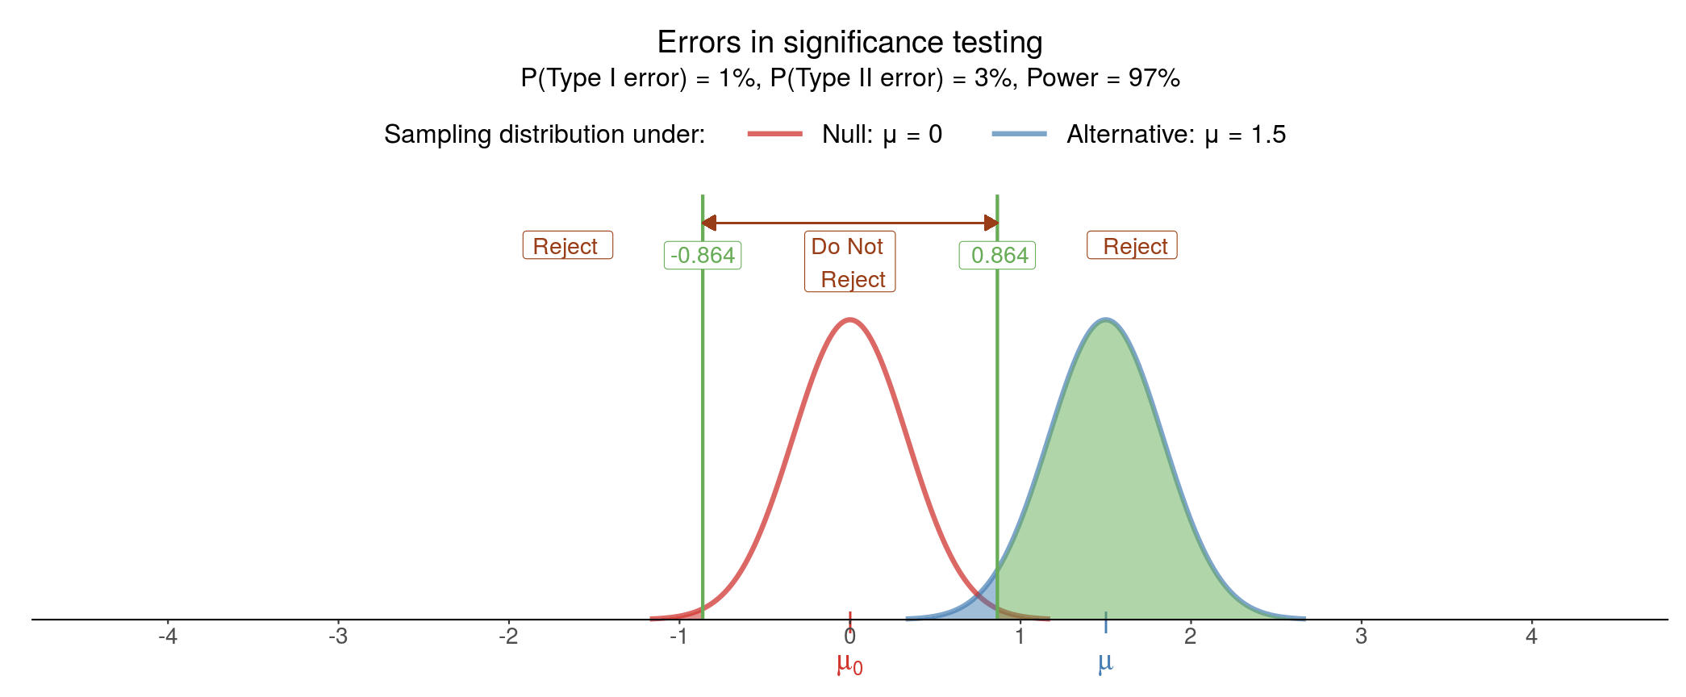

Slide 11
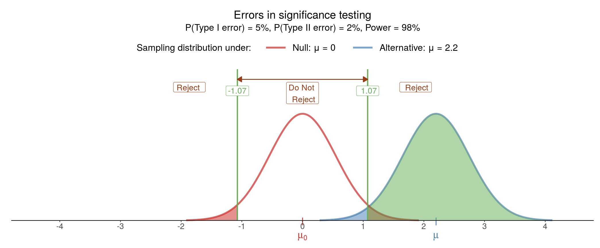

Slide 12

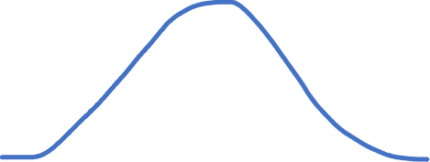


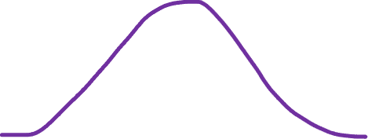

BGL for nondiabetics
$$H_{0}$$
Blood glucose level
$$C=6.5 \text{mmol}\text{/}\text{L}$$
BGL for diabetics
$$H_{1}$$
$$C=6.5 \text{mmol}\text{/}\text{L}$$

Slide 13

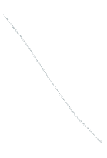



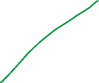



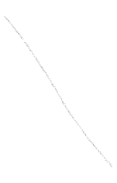



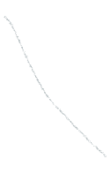

BGL for nondiabetics
$$H_{0}$$
Blood glucose level
$$C=6.5 \text{mmol}\text{/}\text{L}$$
BGL for diabetics
$$H_{1}$$
$$C=6.5 \text{mmol}\text{/}\text{L}$$

Slide 14




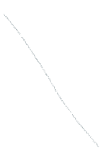



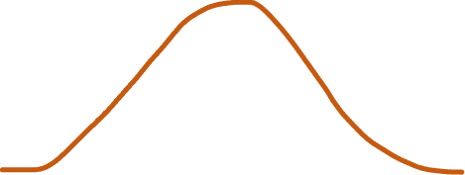

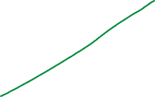
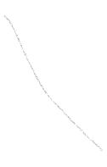




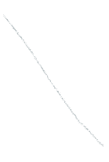





BGL for nondiabetics
$$H_{0}$$
FALSE POSITIVES
Blood glucose level
$$C=6.5 \text{mmol}\text{/}\text{L}$$
BGL for diabetics
TRUE NEGATIVES
$$H_{1}$$
TRUE POSITIVES
FALSE NEGATIVES
$$C=6.5 \text{mmol}\text{/}\text{L}$$

Slide 15







BGL for nondiabetics
Prob = $α$
$$H_{0}$$
FALSE POSITIVES
Blood glucose level
$$C=6.5 \text{mmol}\text{/}\text{L}$$
Prob = $1−α$
BGL for diabetics
TRUE NEGATIVES
$$H_{1}$$
TRUE POSITIVES
FALSE NEGATIVES
Prob = $1−β$
Prob = $β$
$$C=6.5 \text{mmol}\text{/}\text{L}$$

Slide 16
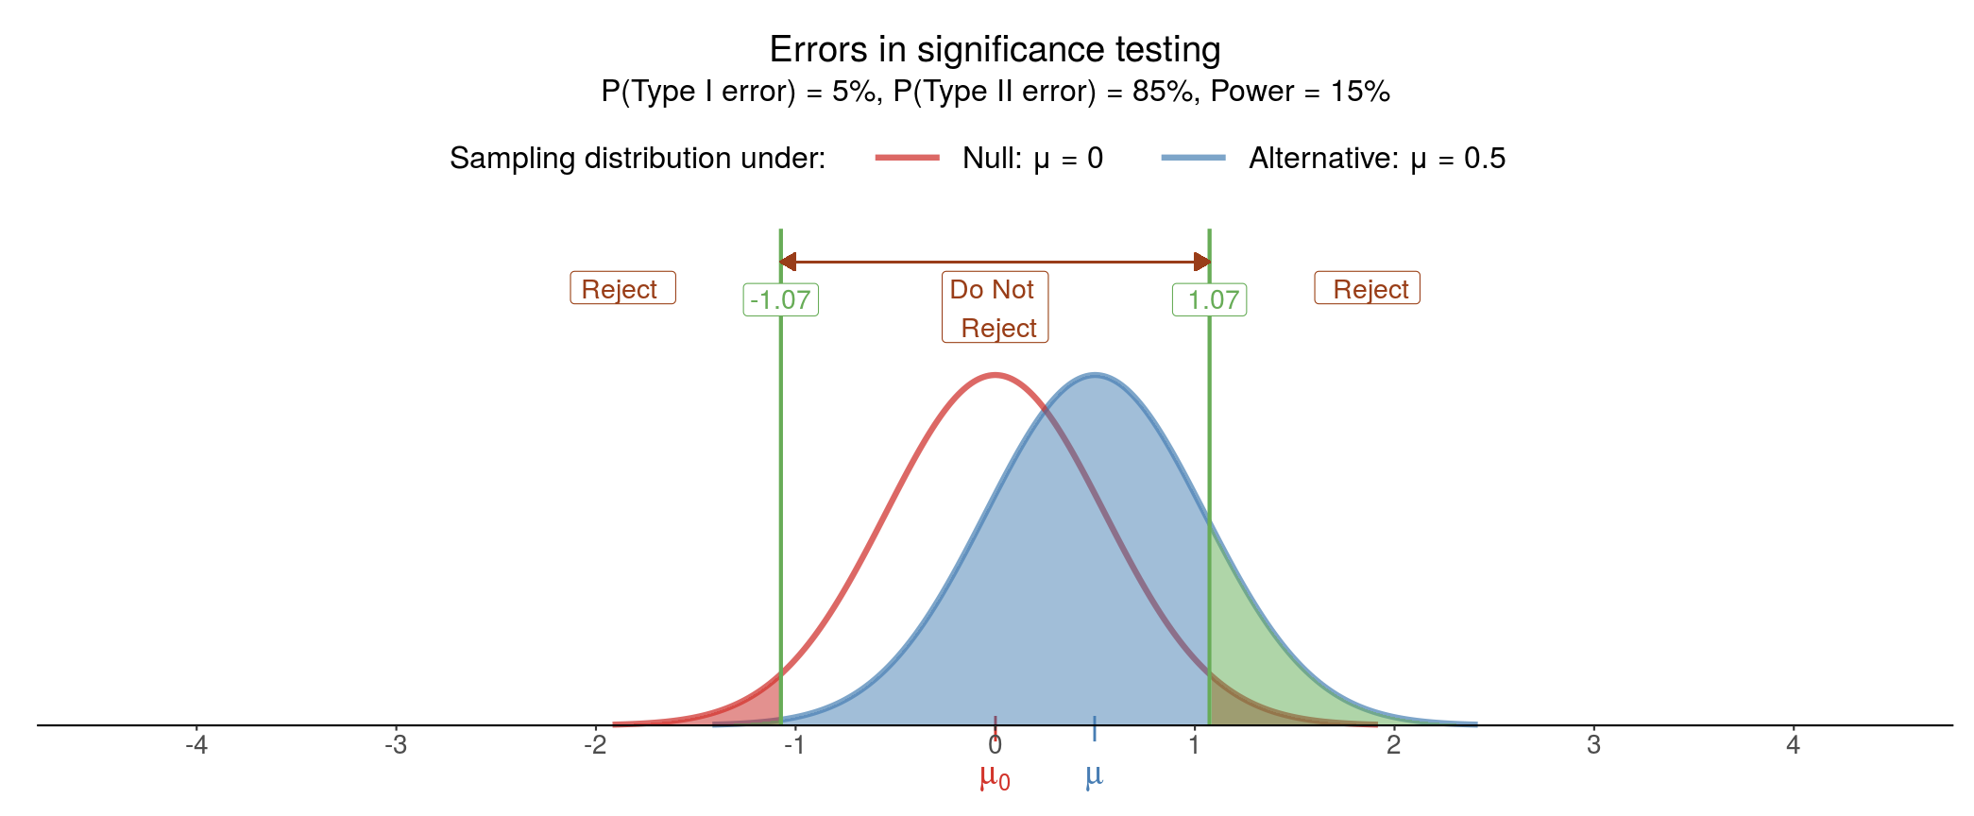

Slide 17
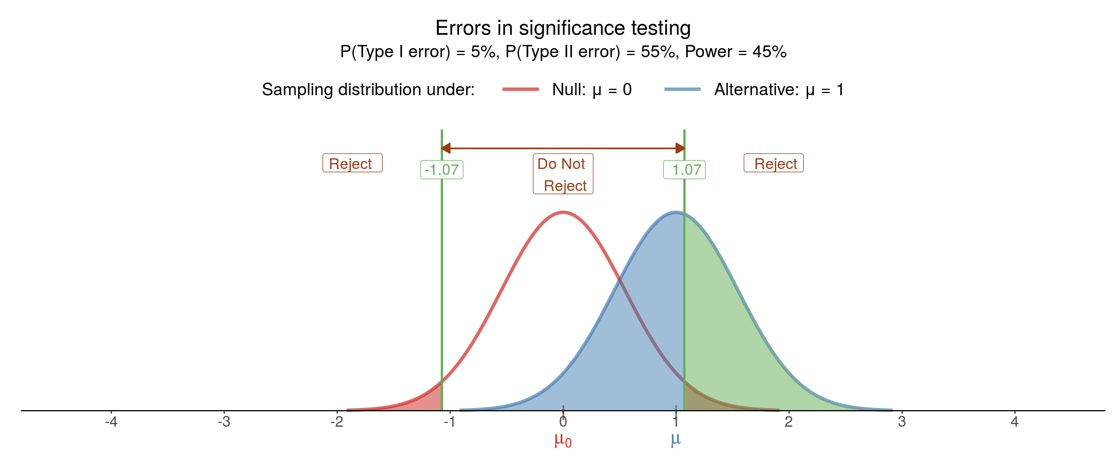

Slide 18


Slide 19
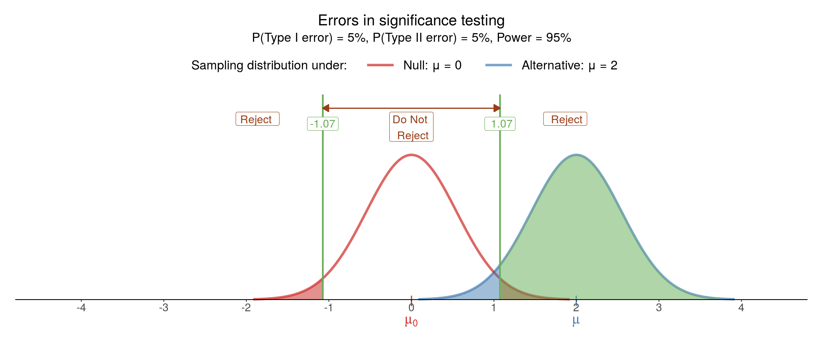

Slide 20
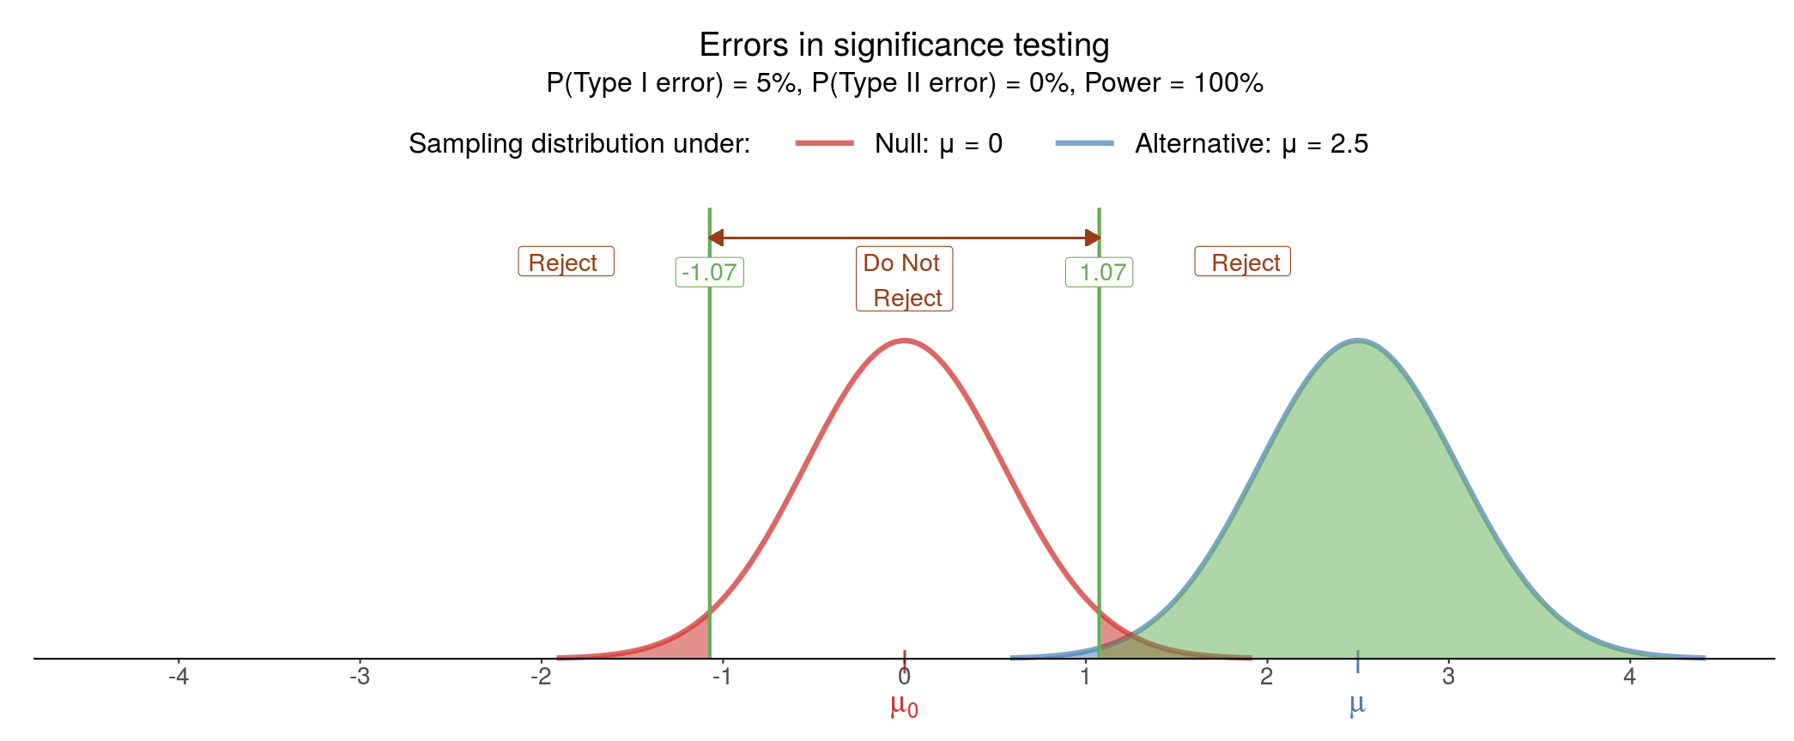

Slide 21
