Slide 1
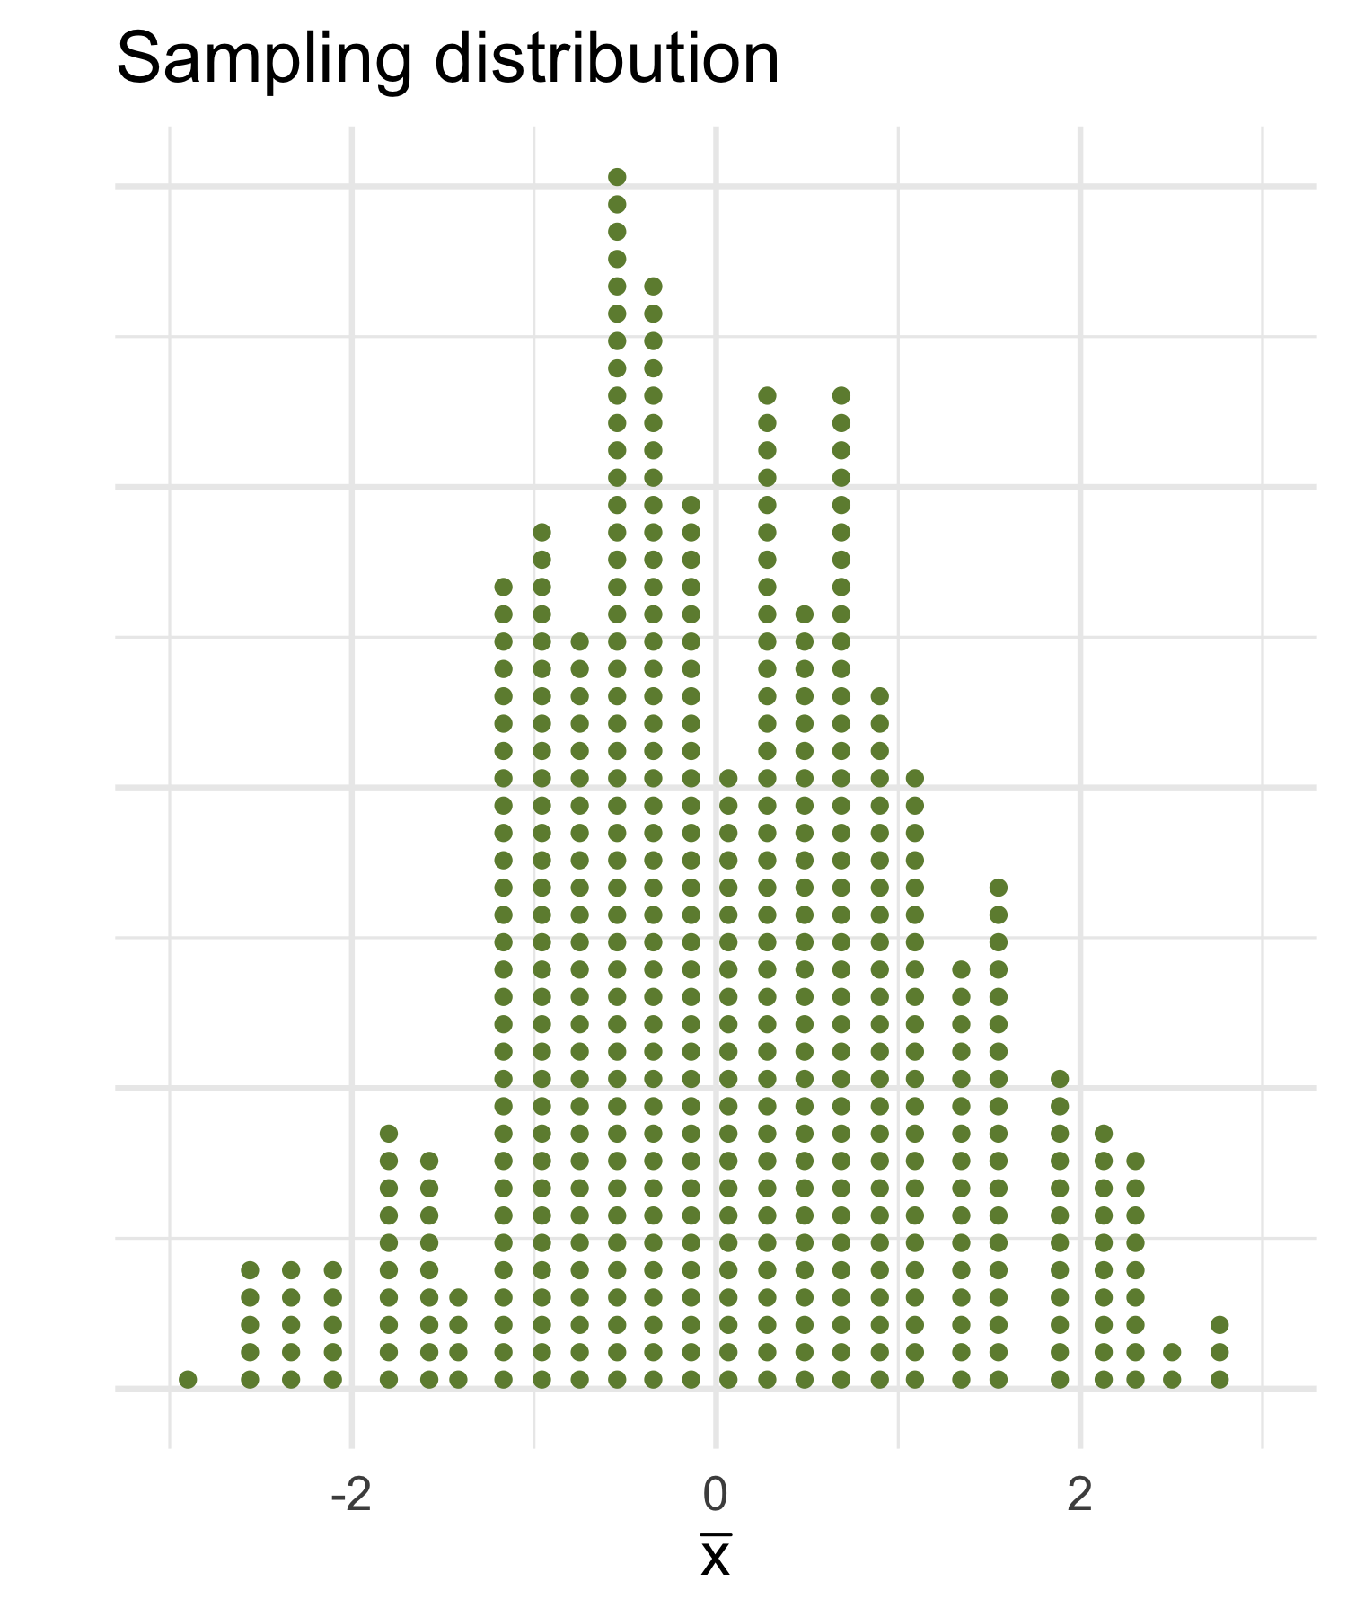
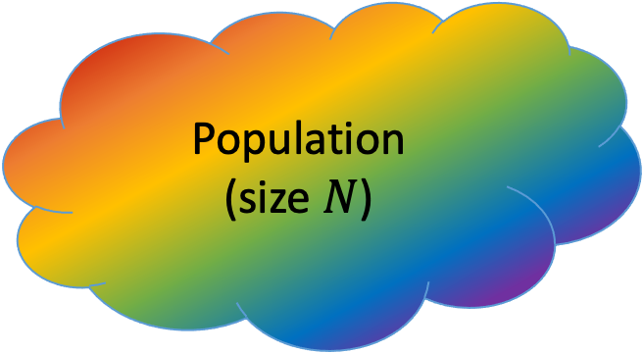
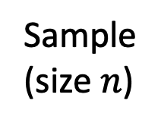
Population (size $N$)
Sample
(size $n$)
Compute a statistic,
e.g. the sample mean

Slide 2
Population (size $N$)
???
Sample
(size $n$)
Compute a statistic,
e.g. the sample mean

Slide 3
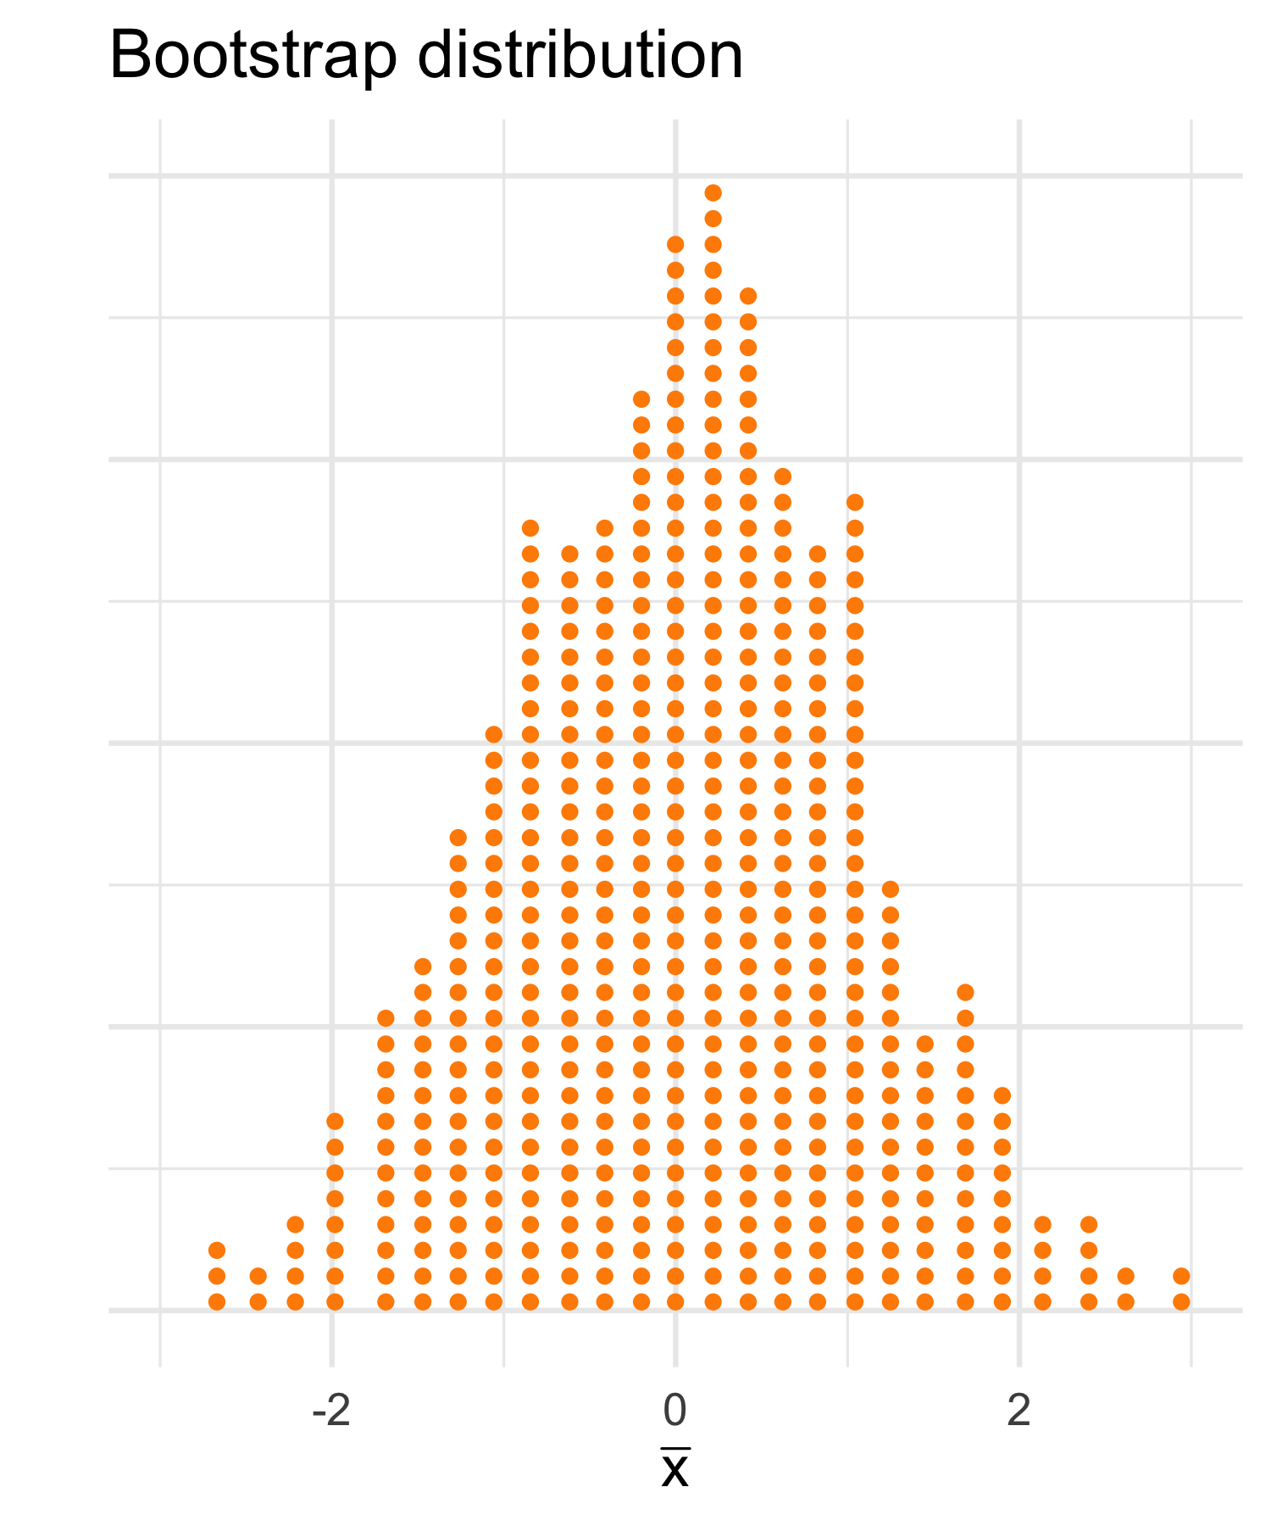
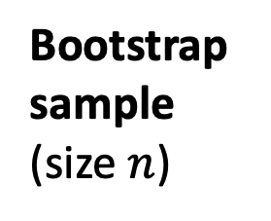
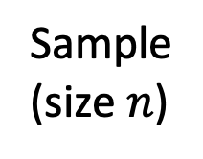
Sample
(size $n$)
Sample WITH REPLACEMENT
using the same sample size
Bootstrap sample
(size $n$)
Compute a bootstrap statistic,
e.g. the sample mean

Slide 4
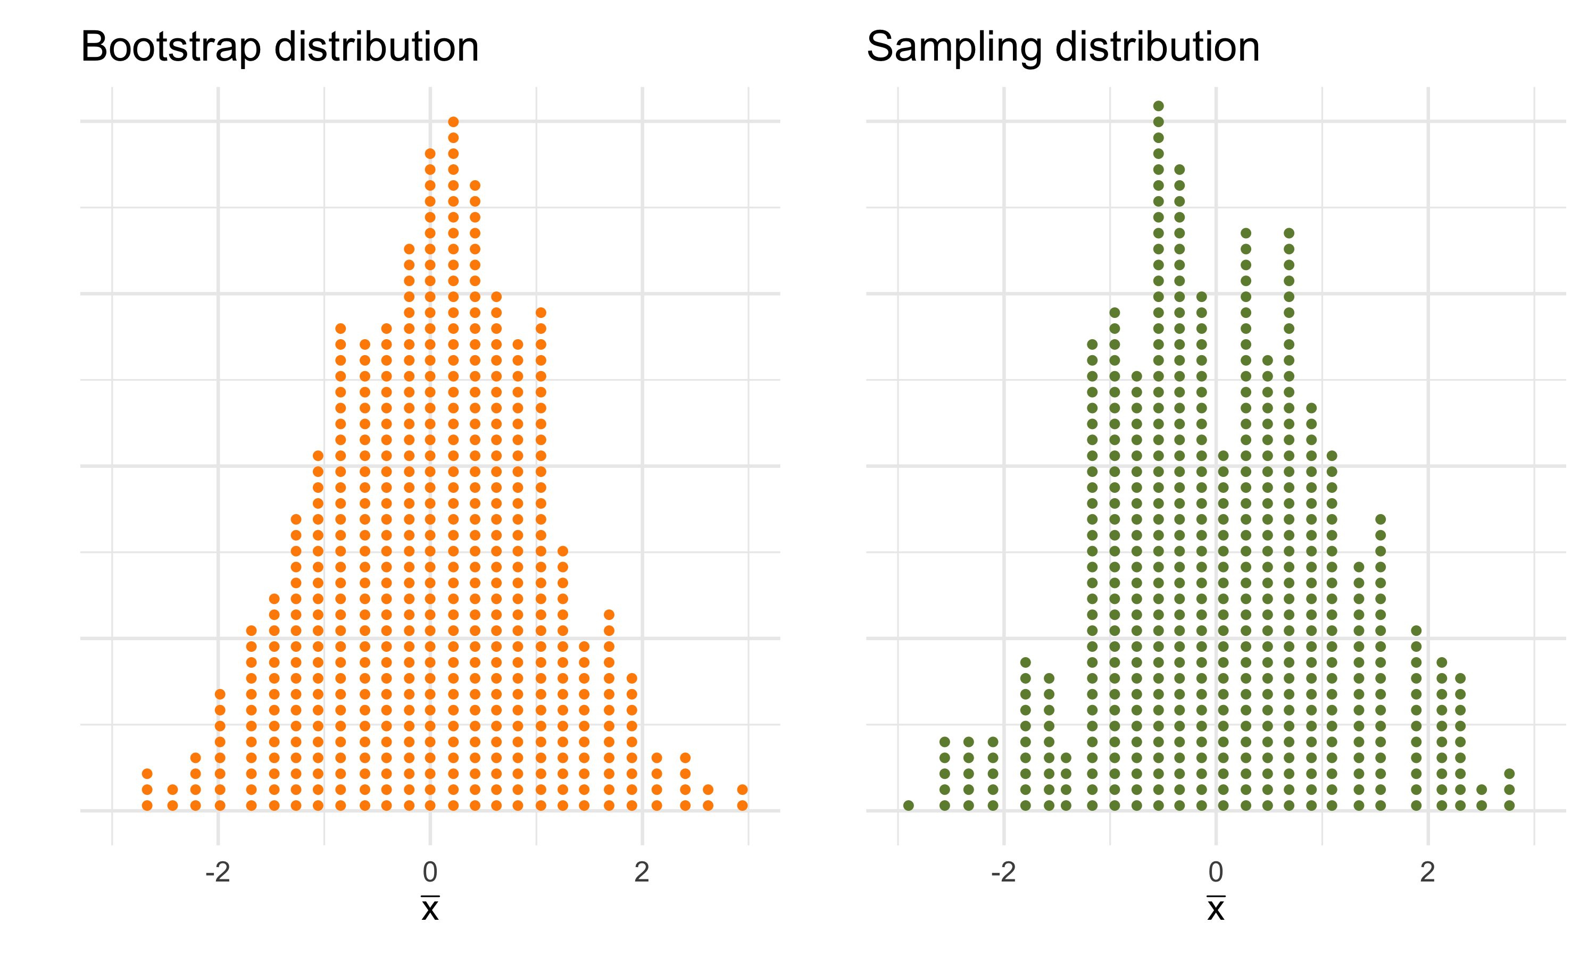
approximates the unknown
Bootstrap SE
SE

Slide 5
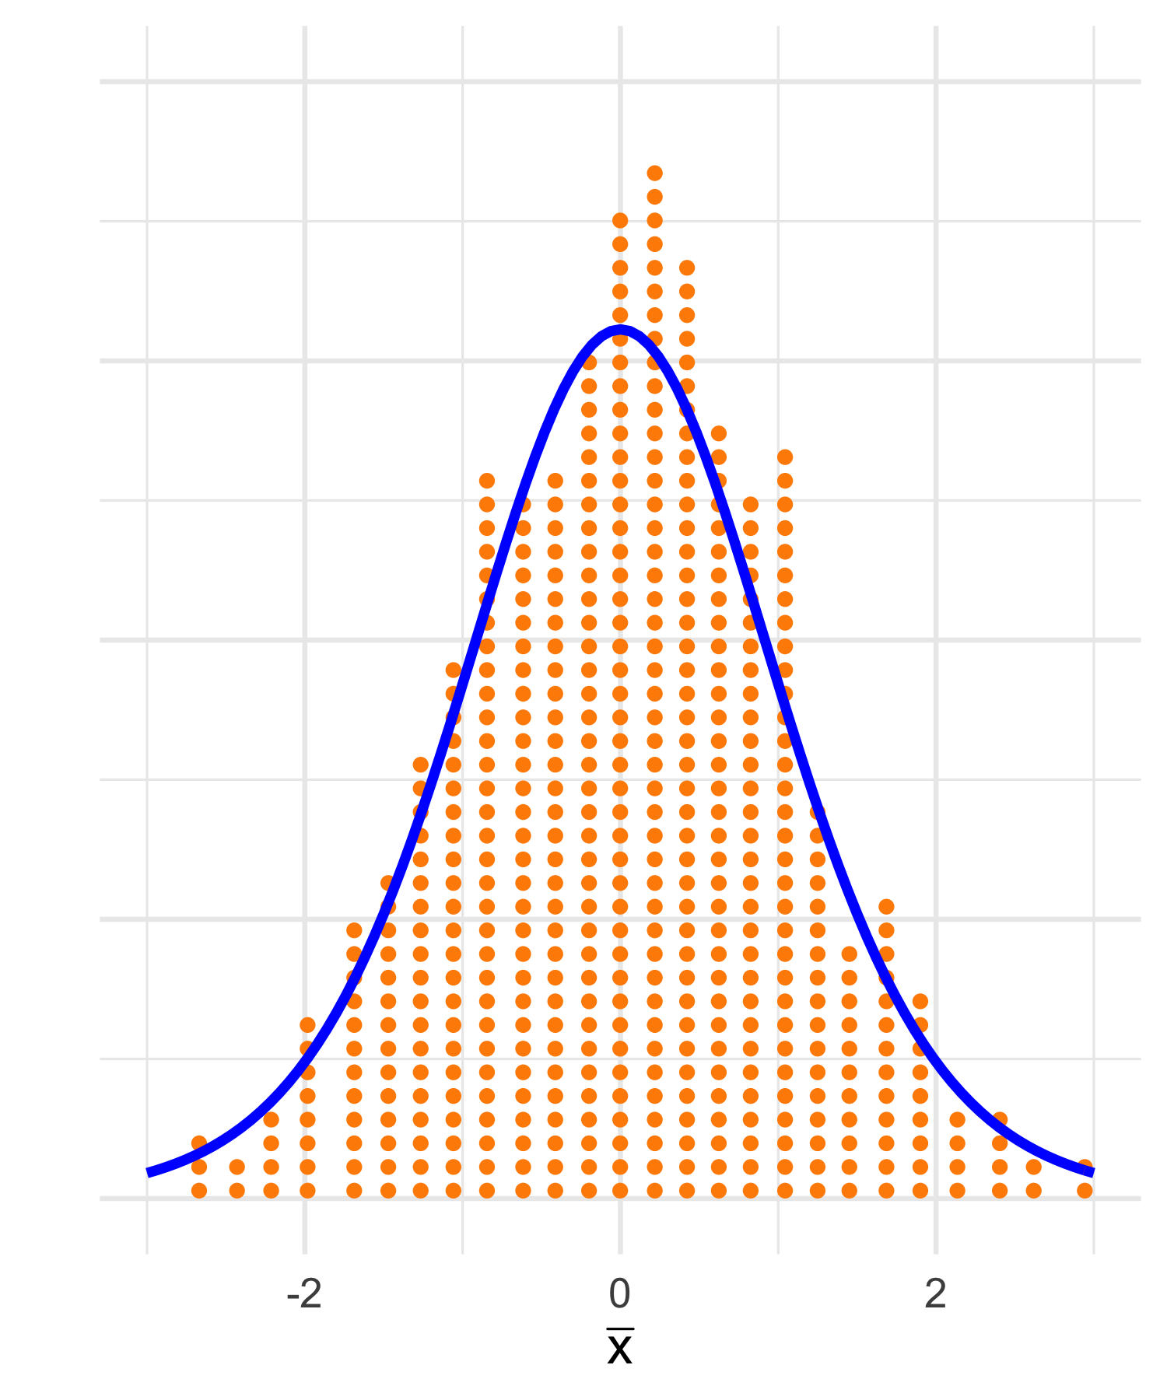

Slide 6
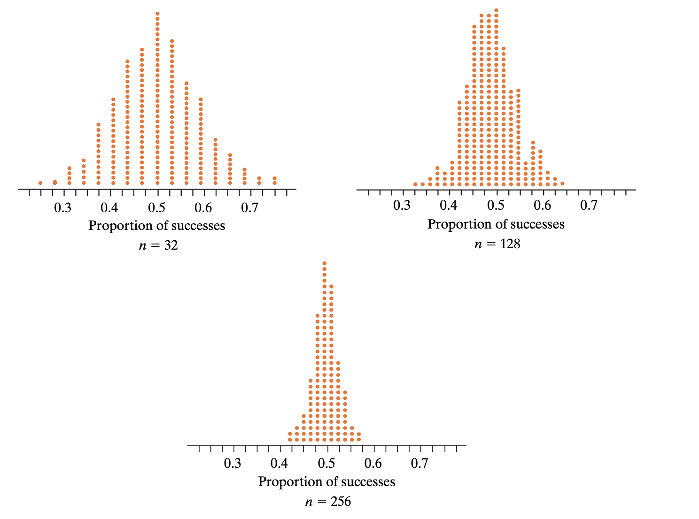

Slide 7
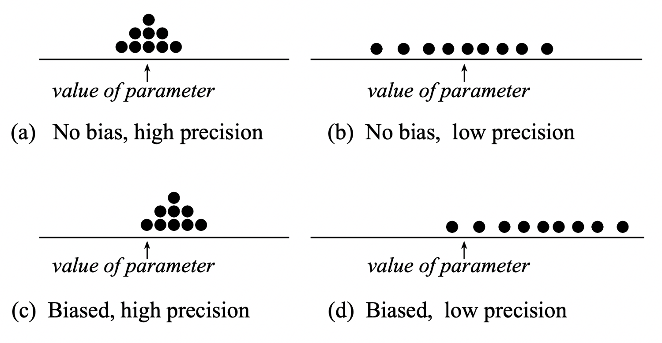

Slide 8
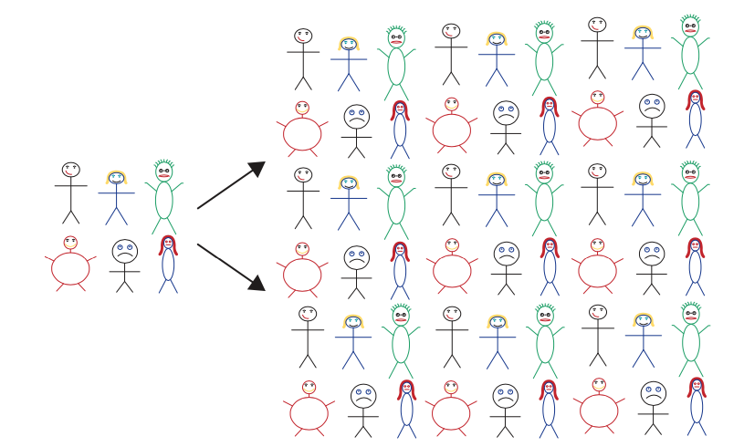
Many copies of the original sample
Original sample

