Slide 1




Sampling distribution under:
Errors in significance testing
P(Type I error) = 5%
P(Type II error) = 22%
Power = 78%
$$H_{0}:μ=0$$
$$H_{1}:μ=1.5$$
Reject
Do Not Reject
Reject
-1.07
1.07
-4
-3
-2
-1
0
1
$$μ$$
2
3
4
$$μ_{0}$$

Slide 2
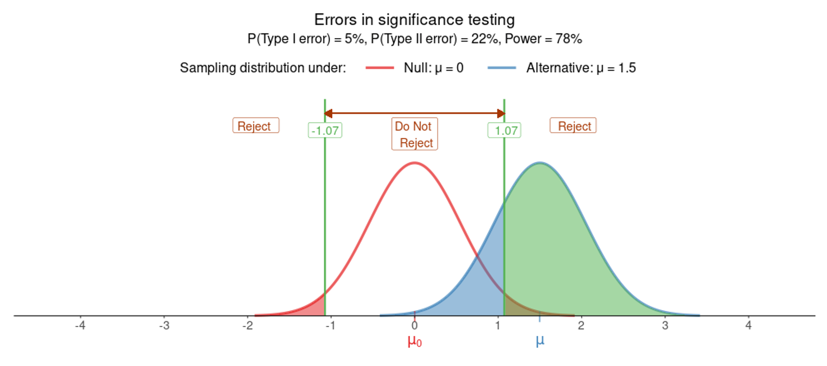


Sampling distribution under:
$$H_{0}:μ=0$$
$$H_{1}:μ=1.5$$
Errors in significance testing
P(Type I error) = 5%
P(Type II error) = 22%
Power = 78%
Reject
Do Not Reject
Reject
-4
-3
-2
-1
0
1
$$μ$$
2
3
4
$$μ_{0}$$

Slide 4
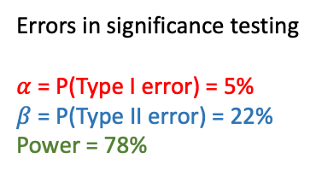




Sampling distribution under:
Errors in significance testing
$α$ = P(Type I error) = 5%
$β$ = P(Type II error) = 22%
Power = 78%
$$H_{0}:μ=0$$
$$H_{1}:μ=1.5$$
Reject
Do Not Reject
Reject
-1.07
1.07
$H_{0}$ true
$H_{0}$ false
-4
-3
-2
-1
0
1
$$μ$$
2
3
4
$$μ_{0}$$

Slide 5

Sampling distribution under:
Errors in significance testing
$α$ = P(Type I error) = 5%
$β$ = P(Type II error) = 22%
Power = 78%
$$H_{0}:μ=0$$
$$H_{1}:μ=1.5$$
Reject
Do Not Reject
Reject
-1.07
1.07
$H_{0}$ true
$H_{0}$ false
-4
-3
-2
-1
0
1
$$μ$$
2
3
4
$$μ_{0}$$
$$α$$

Slide 6

Sampling distribution under:
Errors in significance testing
$α$ = P(Type I error) = 5%
$β$ = P(Type II error) = 22%
Power = 78%
$$H_{0}:μ=0$$
$$H_{1}:μ=1.5$$
Reject
Do Not Reject
Reject
-1.07
1.07
$H_{0}$ true
$H_{0}$ false
-4
-3
-2
-1
0
1
$$μ$$
2
3
4
$$μ_{0}$$
$$β$$

Slide 7
Sampling distribution under:
Errors in significance testing
$α$ = P(Type I error) = 5%
$β$ = P(Type II error) = 22%
Power = 78%
$$H_{0}:μ=0$$
$$H_{1}:μ=1.5$$
Reject
Do Not Reject
Reject
-1.07
1.07
$H_{0}$ true
$H_{0}$ false
-4
-3
-2
-1
0
1
$$μ$$
2
3
4
$$μ_{0}$$
Power

Slide 8
Sampling distribution under:
Errors in significance testing
$α$ = P(Type I error) = 5%
$β$ = P(Type II error) = 22%
Power = 78%
$$H_{0}:μ=0$$
$$H_{1}:μ=1.5$$
Reject
Do Not Reject
Reject
-1.07
1.07
$H_{0}$ true
$H_{0}$ false
-4
-3
-2
-1
0
1
$$μ$$
2
3
4
$$μ_{0}$$

