Slide 1
The Bootstrap and Confidence Intervals
Dr Umberto Noe
Data Analysis for Psychology in R 1
Department of Psychology
The University of Edinburgh

Slide 2
Part A Recap of estimation

Slide 3
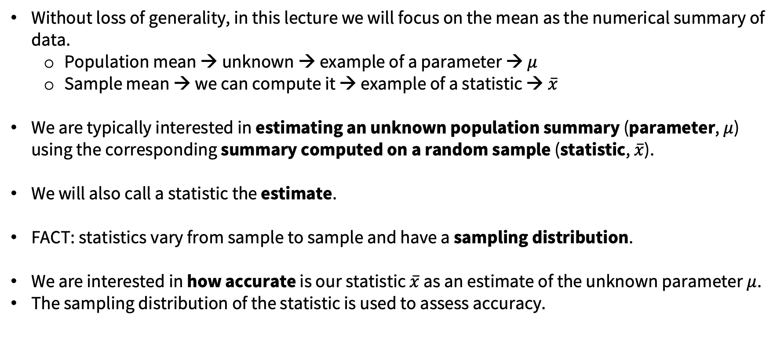
Statistics to estimate parameters
Without loss of generality, in this lecture we will focus on the mean as the numerical summary of data.
Population mean → unknown → example of a parameter → $μ$
Sample mean → we can compute it → example of a statistic → $\overline{x}$
We are typically interested in estimating an unknown population summary (parameter, $μ$) using the corresponding summary computed on a random sample (statistic, $\overline{x}$).
We will also call a statistic the estimate.
FACT: statistics vary from sample to sample and have a sampling distribution.
We are interested in how accurate is our statistic $\overline{x}$ as an estimate of the unknown parameter $μ$.
The sampling distribution of the statistic is used to assess accuracy.

Slide 4
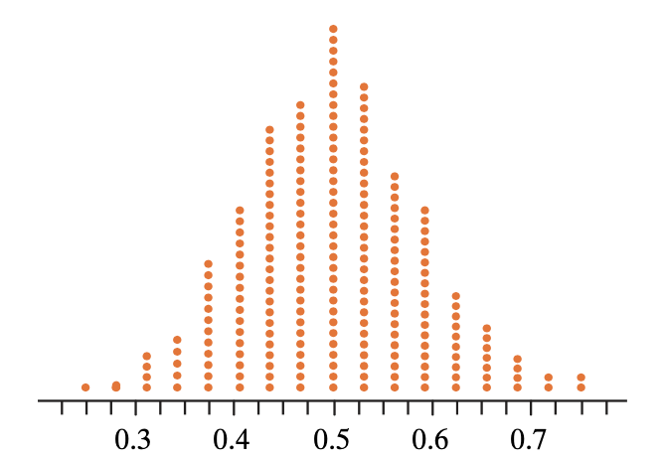
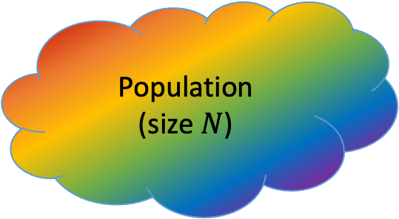
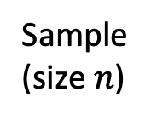
Sampling distribution
Sampling distribution
Population (size $N$)
Sample
(size $n$)
Compute a statistic,
e.g. the sample mean

Slide 5
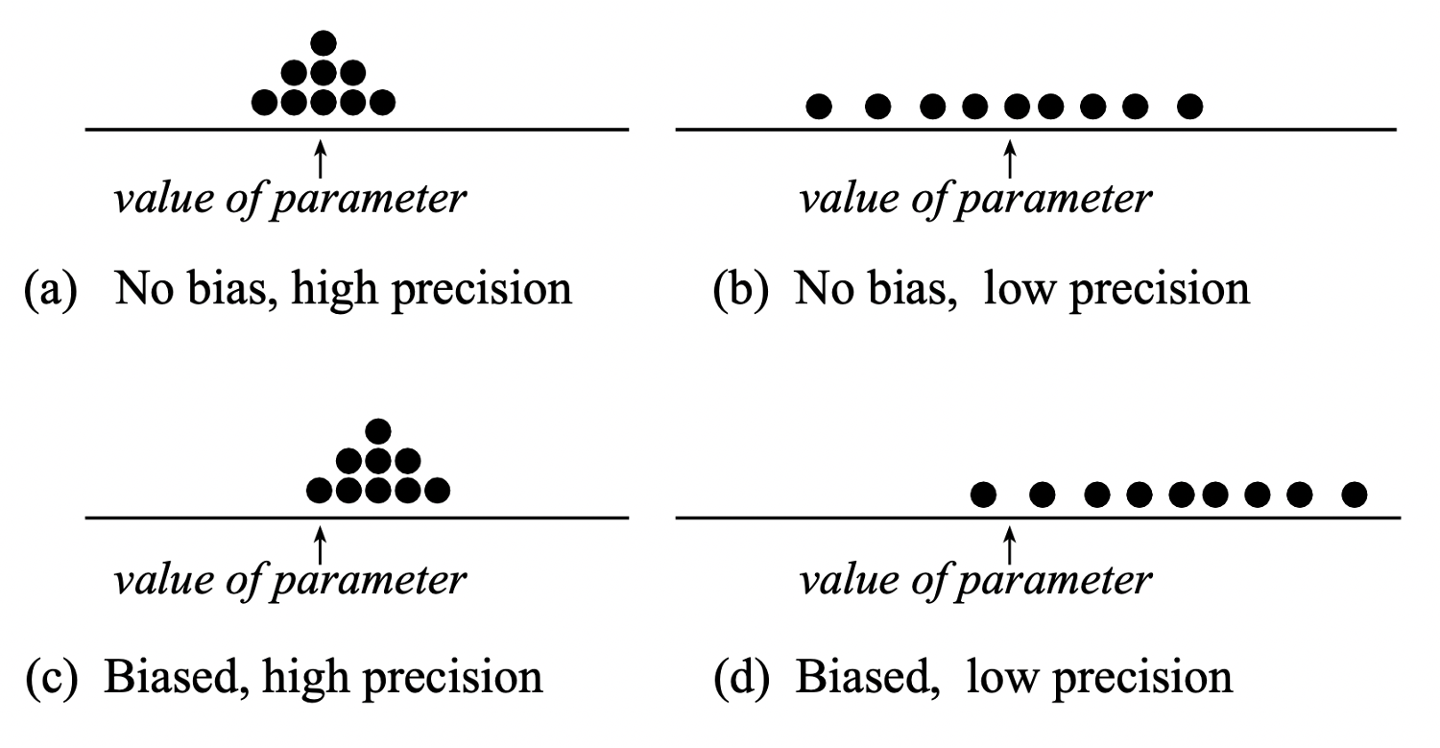
Accuracy of a statistic
We investigate the accuracy of a statistic by looking at its bias and precision

Slide 6
Accuracy of a statistic: Precision and Bias
We aim for a statistic to be precise and not biased.
Bias is avoided if you select samples at random from the population. You have bias when your samples systematically do not include a part of the population.
Precision relates to the variability of the sampling distribution, and the Standard Error (SE) is used to quantify precision.
Notes:
BIAS
Bias is related to the centre of the sampling distribution, and you have bias when the statistics on average tend to be systematically “off” from the true value, meaning that we don’t have good guesses of the true parameter.
Example: True IQ is 100, but the average of the statistics is 120. We are very off, we may not have captured specific parts of the population in our samples.
PRECISION
The lower the SE, the lower is the typical “estimation error”, and hence the higher is the precision. If the SE is high, the precision is low, and this means that we don’t have reliable estimates as they vary too much from one sample to another.
Example 1: One sample gives an estimate of 70, another sample of 115. They are very different, which one do we trust? Would you trust 70 to be a good guess? And 115?
Example 2: One sample gives an estimate of 95, another sample of 101. Do you trust the values more now?

Slide 7
Part B The Bootstrap

Slide 8

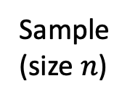
Sampling distribution???
Sampling distribution
Population (size $N$)
???
Sample
(size $n$)
Compute a statistic,
e.g. the sample mean

Slide 9
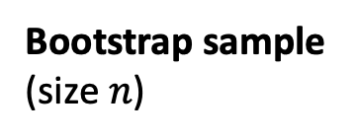
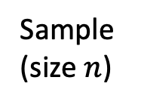
Bootstrap to the rescue
Bootstrap distribution
Sample
(size $n$)
Sample WITH REPLACEMENT
using the same sample size
Bootstrap sample
(size $n$)
Compute a bootstrap statistic,
e.g. the sample mean

Slide 10
Bootstrap distribution vs Sampling distribution
The bootstrap distribution approximates the sampling distribution.
The bootstrap SE approximates the SE from the sampling distribution.
z
z
Bootstrap distribution
Sampling distribution
approximates the unknown
Bootstrap SE
SE

