Slide 1
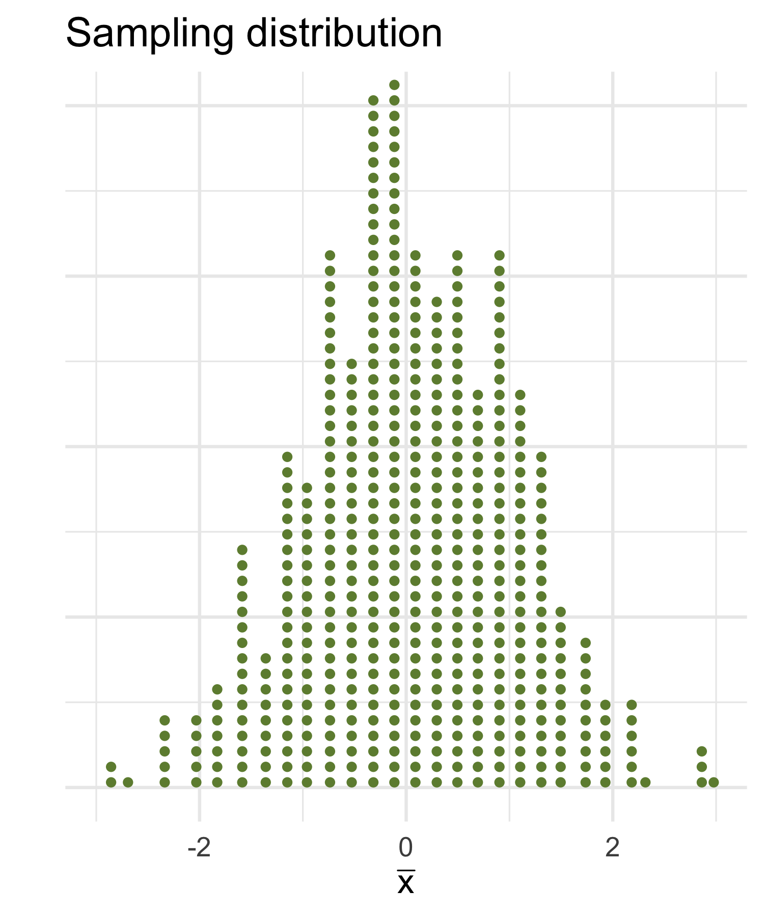
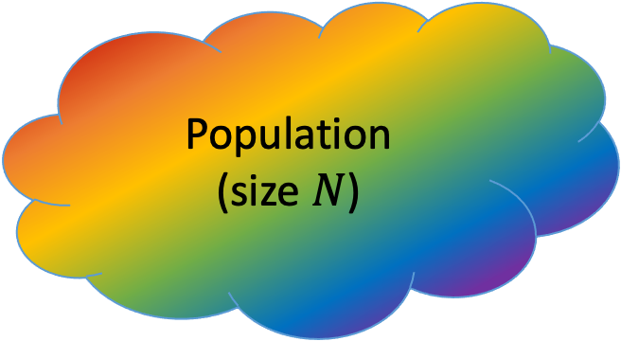
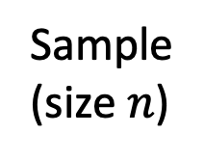
Population (size $N$)
Sample
(size $n$)
Compute a statistic,
e.g. the sample mean

Slide 2
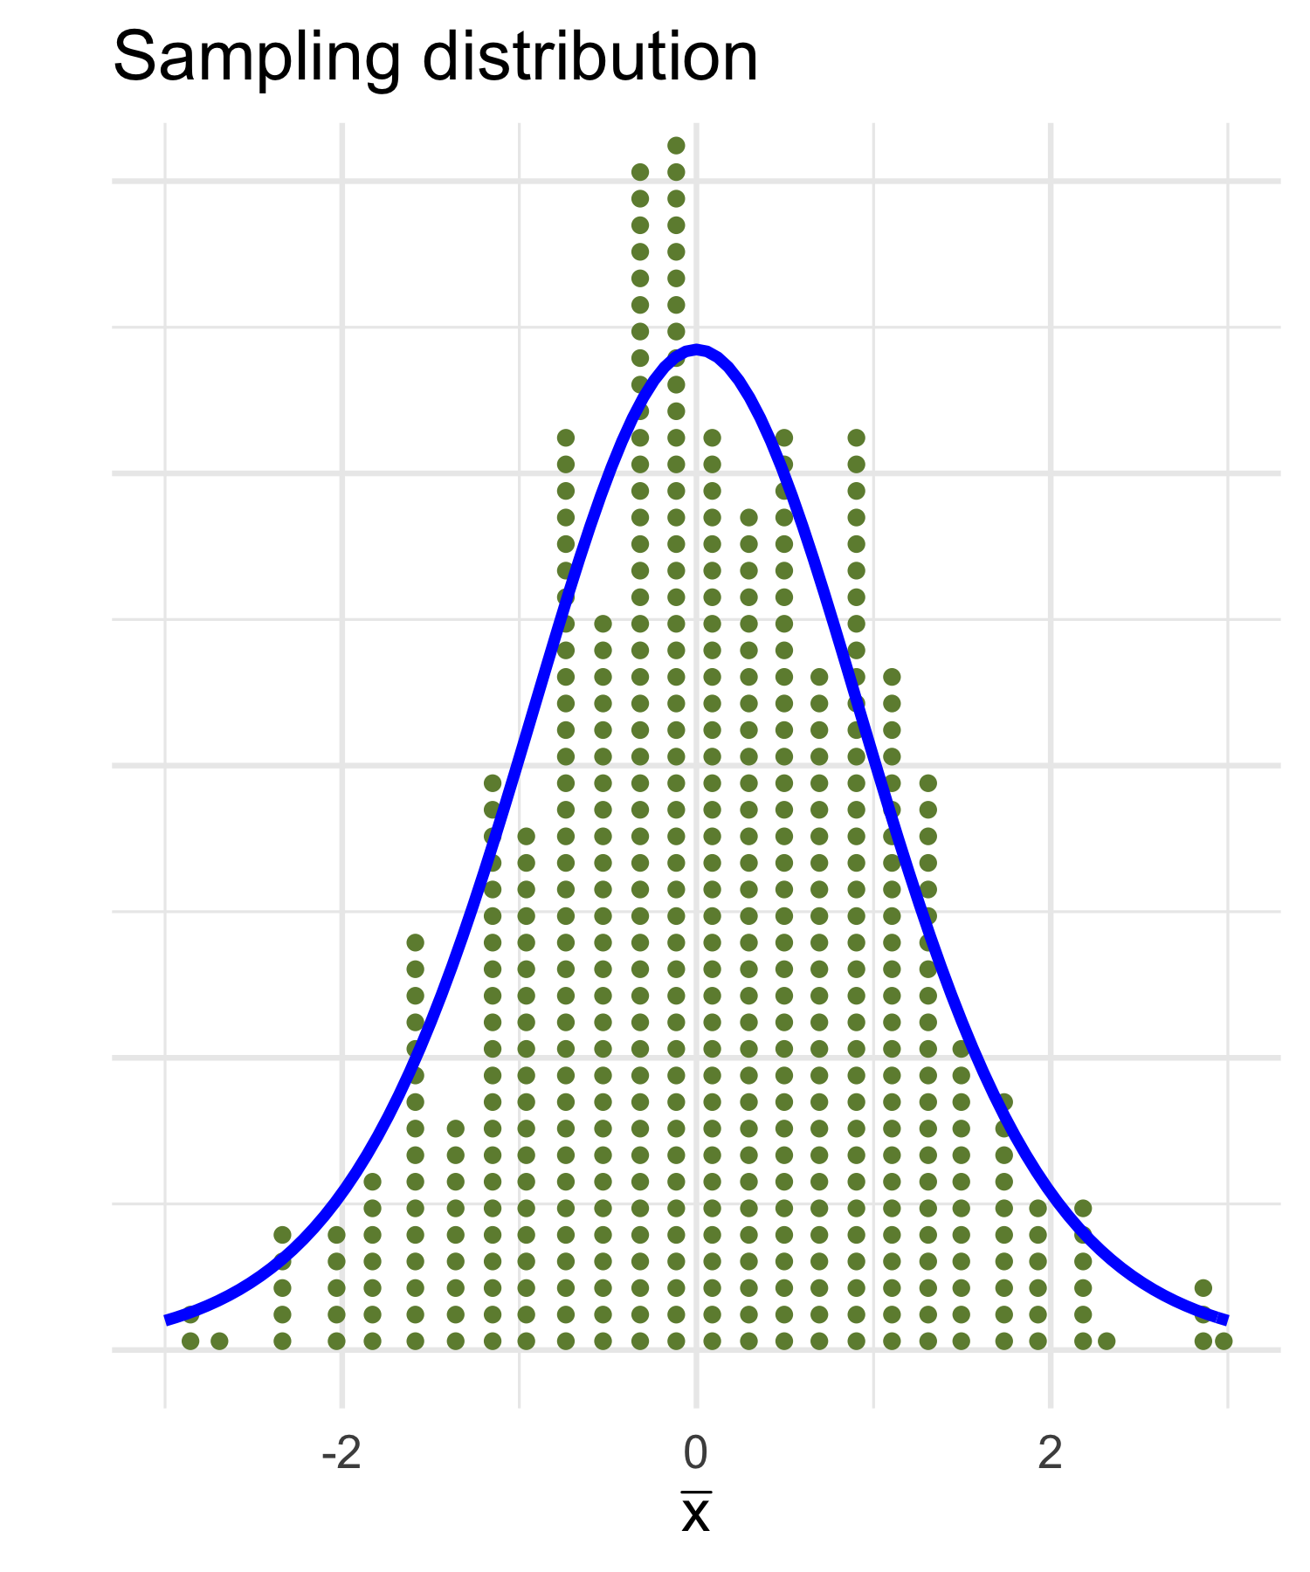
Population (size $N$)
SE
Sample
(size $n$)
Compute a statistic,
e.g. the sample mean

Slide 3
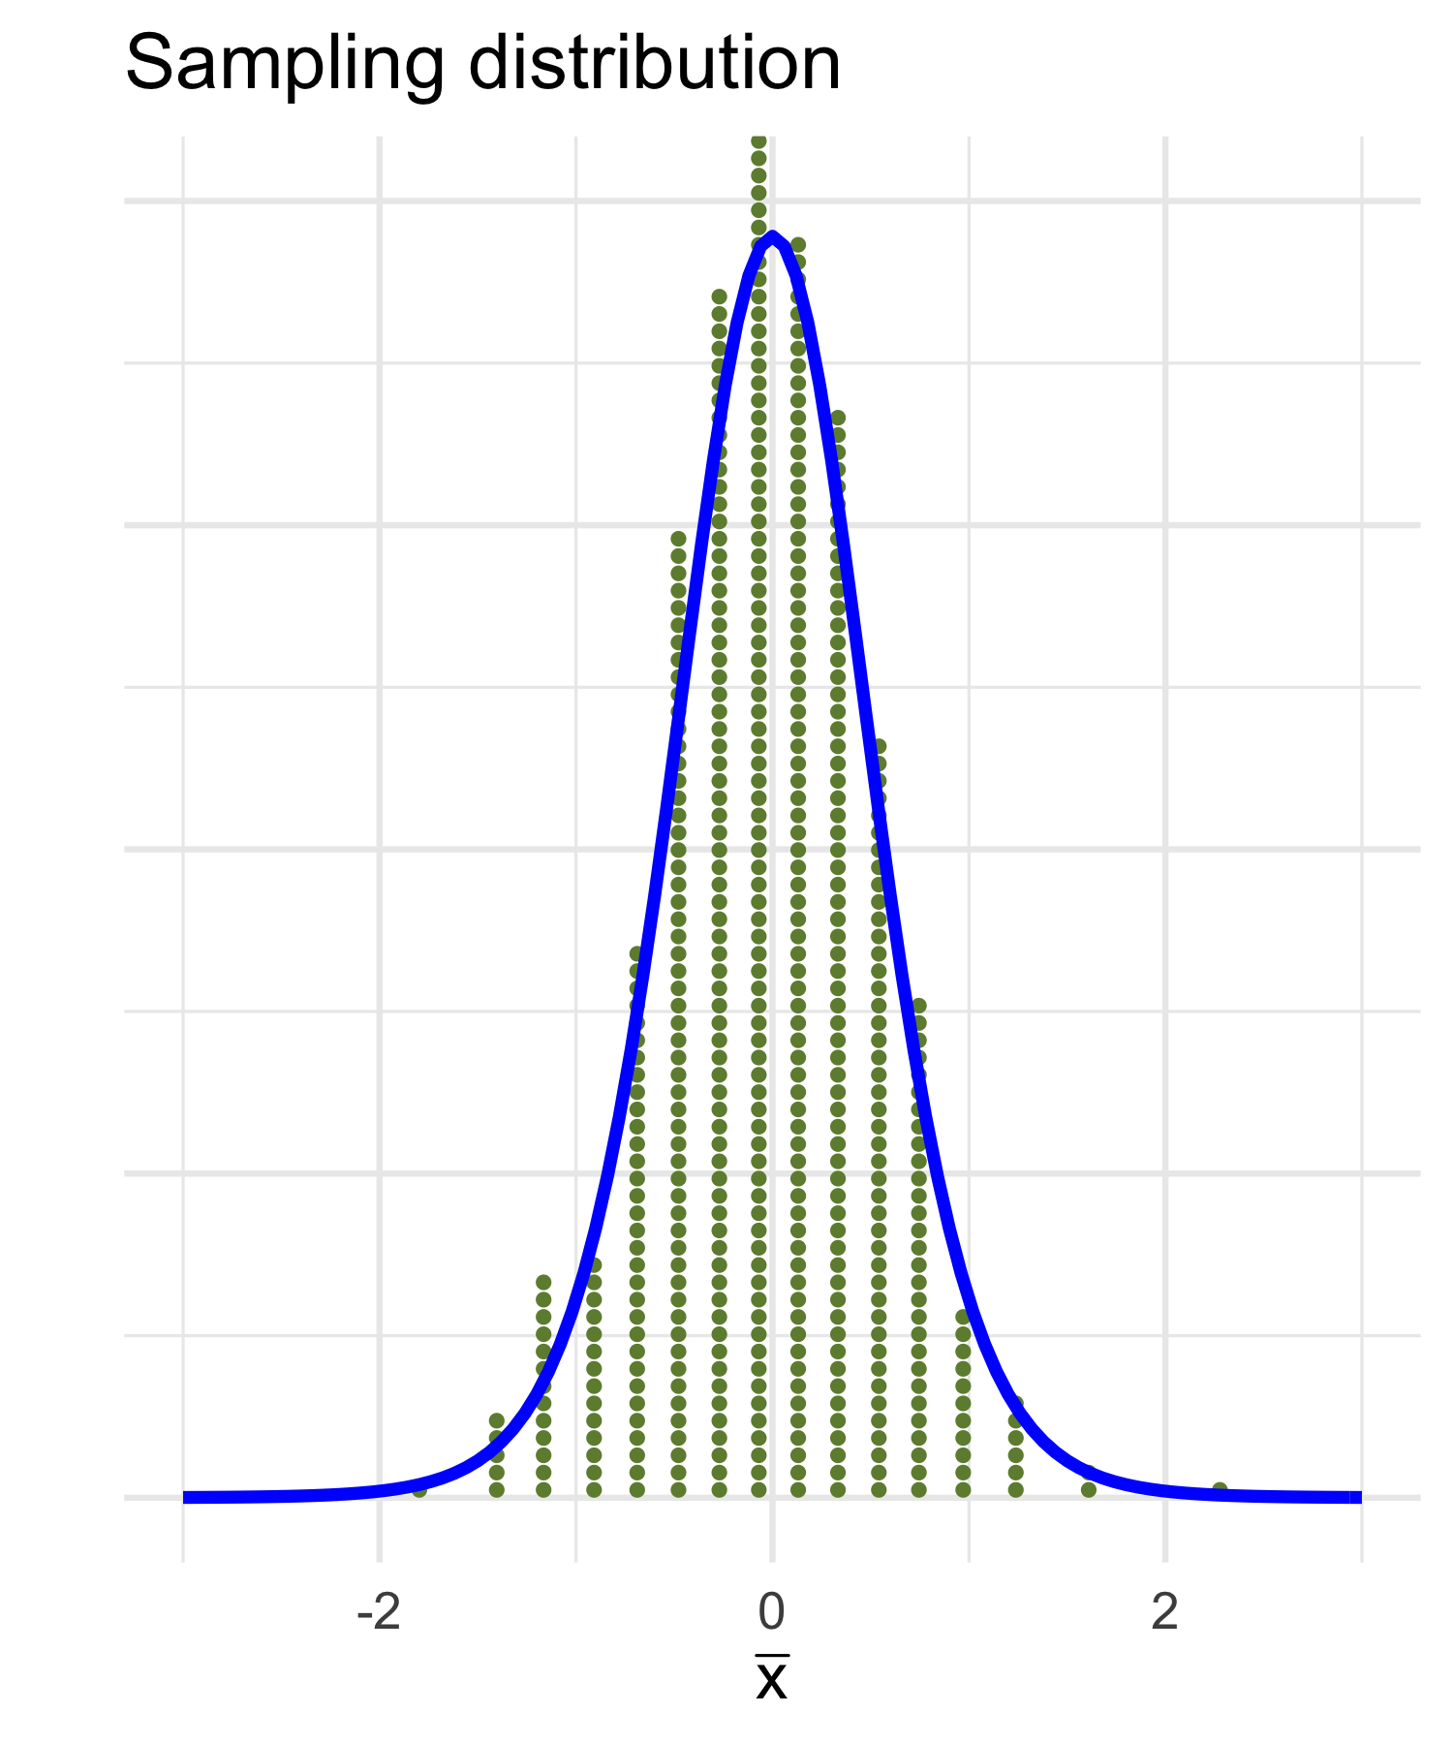
Population (size $N$)
Sample
(size $n$)
Compute a statistic,
e.g. the sample mean

Slide 4
Population (size $N$)
???
SE
Sample
(size $n$)
Compute a statistic,
e.g. the sample mean

Slide 5
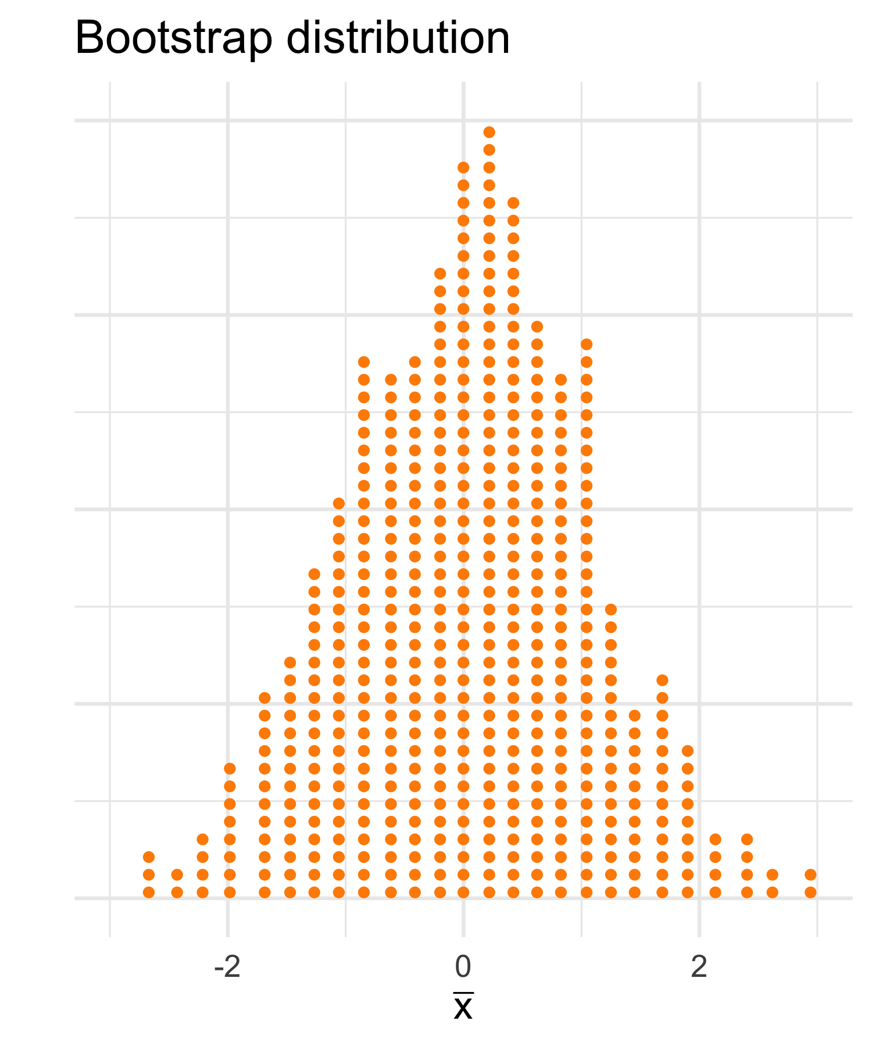
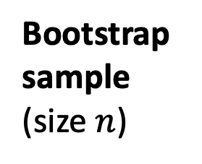
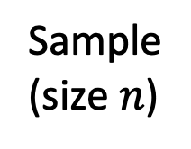
Sample
(size $n$)
Sample WITH REPLACEMENT
using the same sample size
Bootstrap sample
(size $n$)
Compute a bootstrap statistic,
e.g. the sample mean

Slide 6
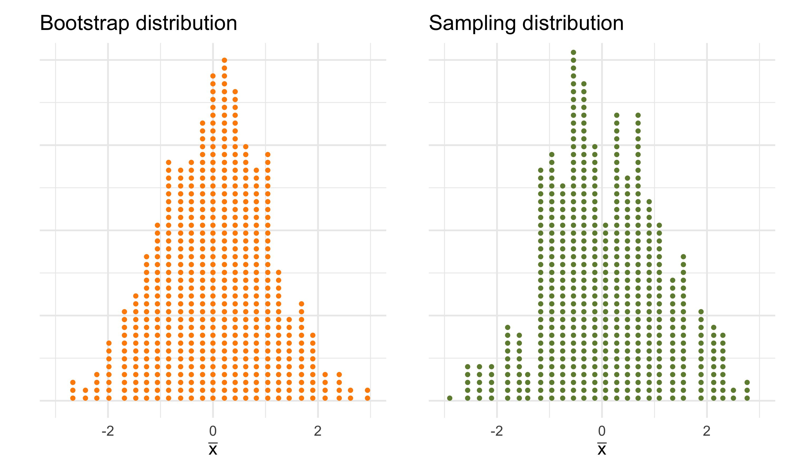
approximates the unknown
Bootstrap SE
SE

Slide 7
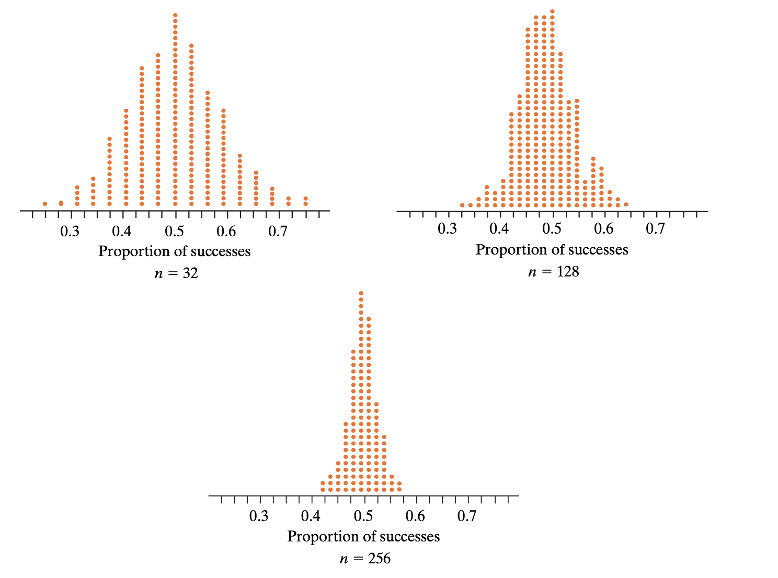

Slide 8
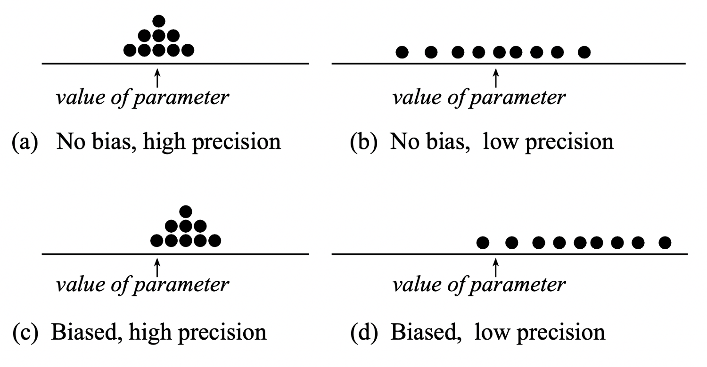

Slide 9
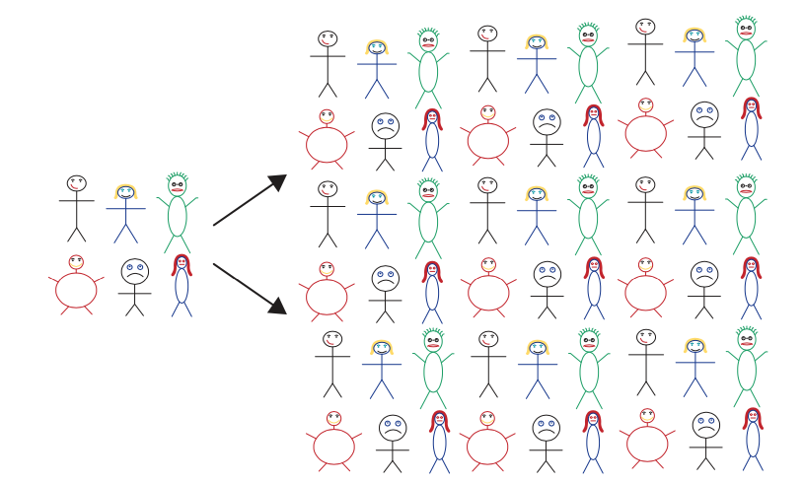
Many copies of the original sample
Original sample

Slide 10


$$\overline{x}$$
$$μ$$

Slide 11
$$\overline{x}$$
$$μ$$

