Slide 1
Review of p-value computation

Slide 2
What if the observed t-statistic is positive?

Slide 3
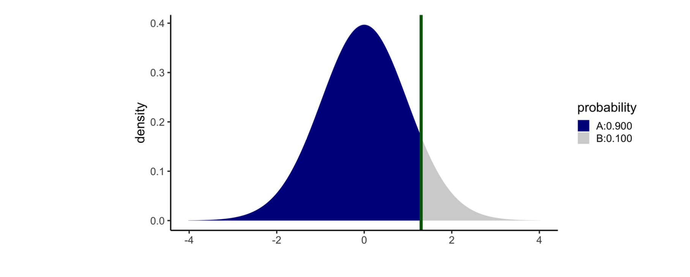
If $H_{1}: μ<μ_{0}$ and tobs = $t=+1.3$, pvalue = A
pt(tobs, df = n-1, lower.tail = TRUE)

Slide 4
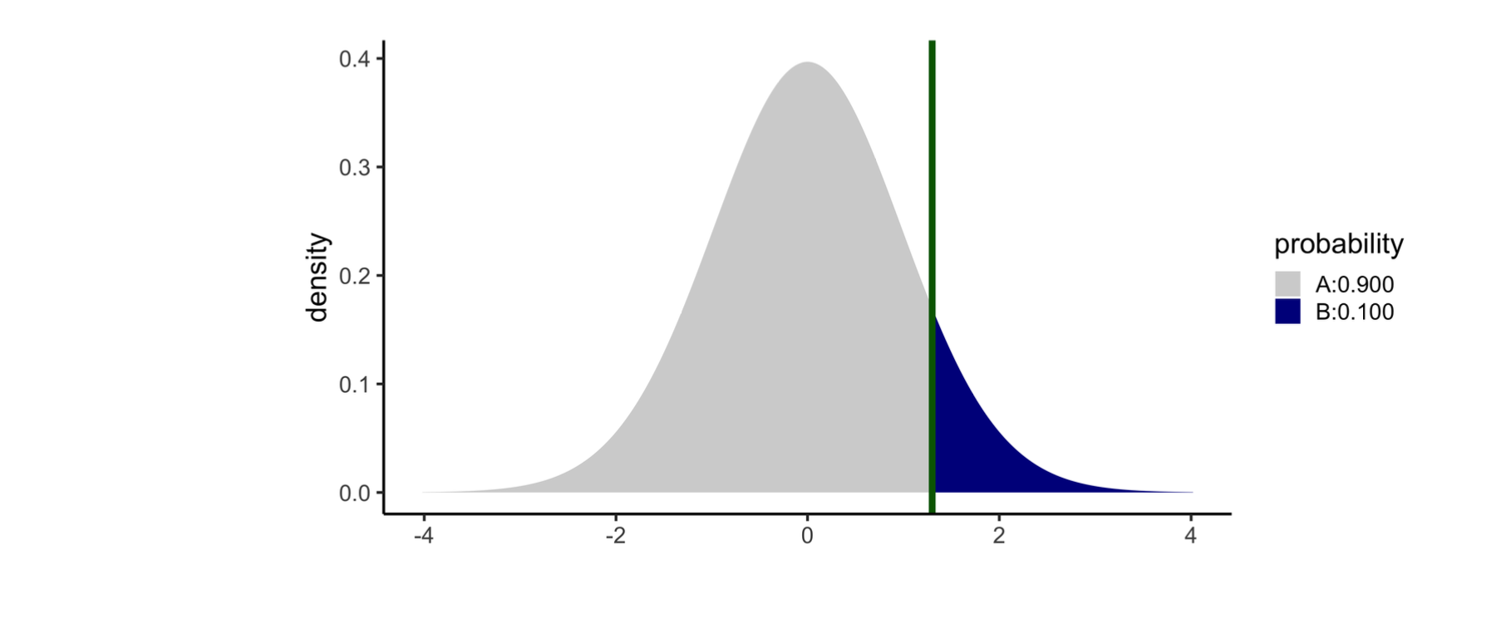
If $H_{1}: μ>μ_{0}$ and tobs = $t=+1.3$, pvalue = B
pt(tobs, df = n-1, lower.tail = FALSE)

Slide 5
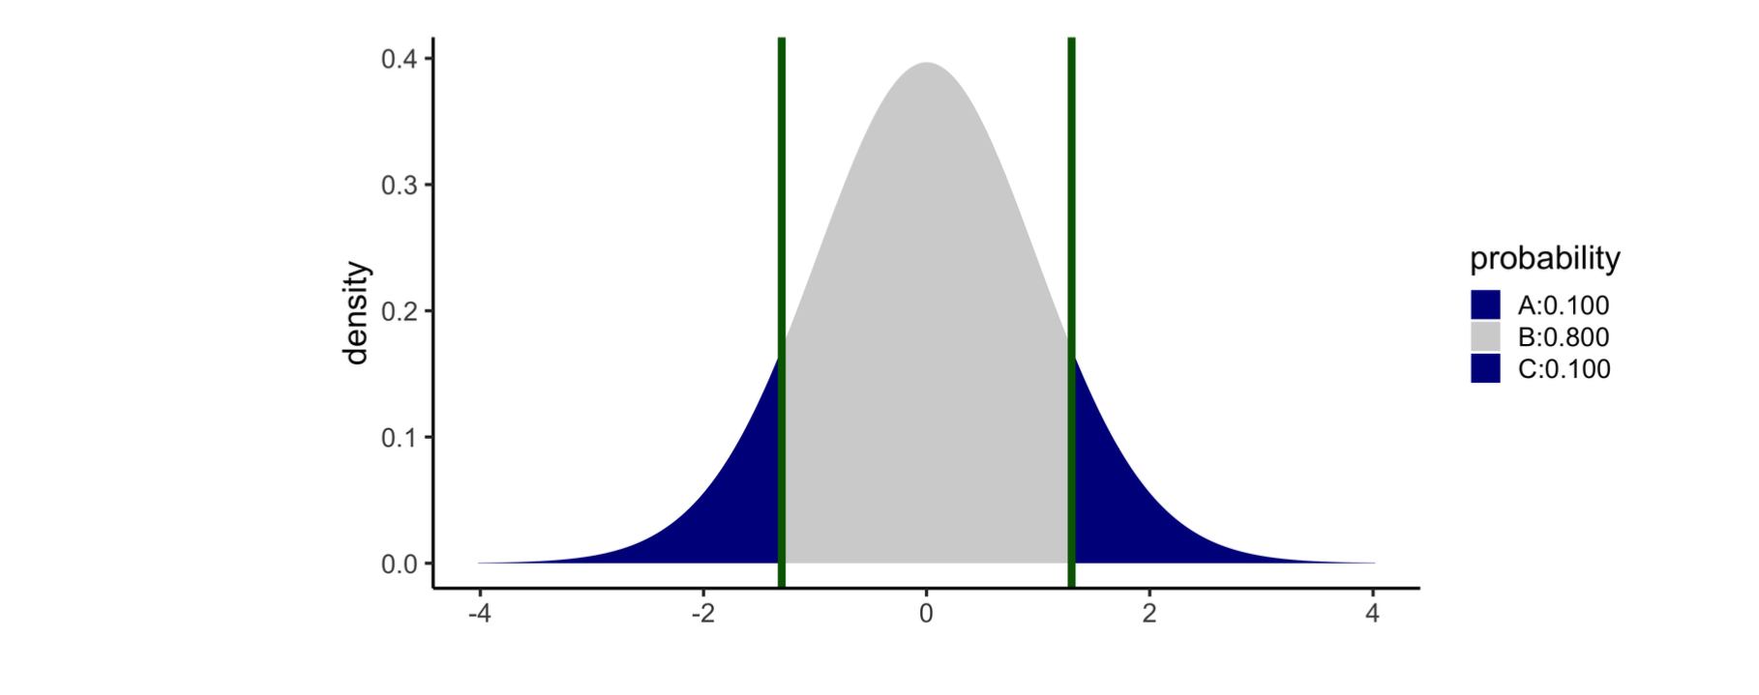
If $H_{1}: μ≠μ_{0}$ and tobs = $t=+1.3,$ pvalue = A + C
2 * pt(abs(tobs), df = n-1, lower.tail = FALSE)

Slide 6
What if the observed t-statistic is negative?

Slide 7
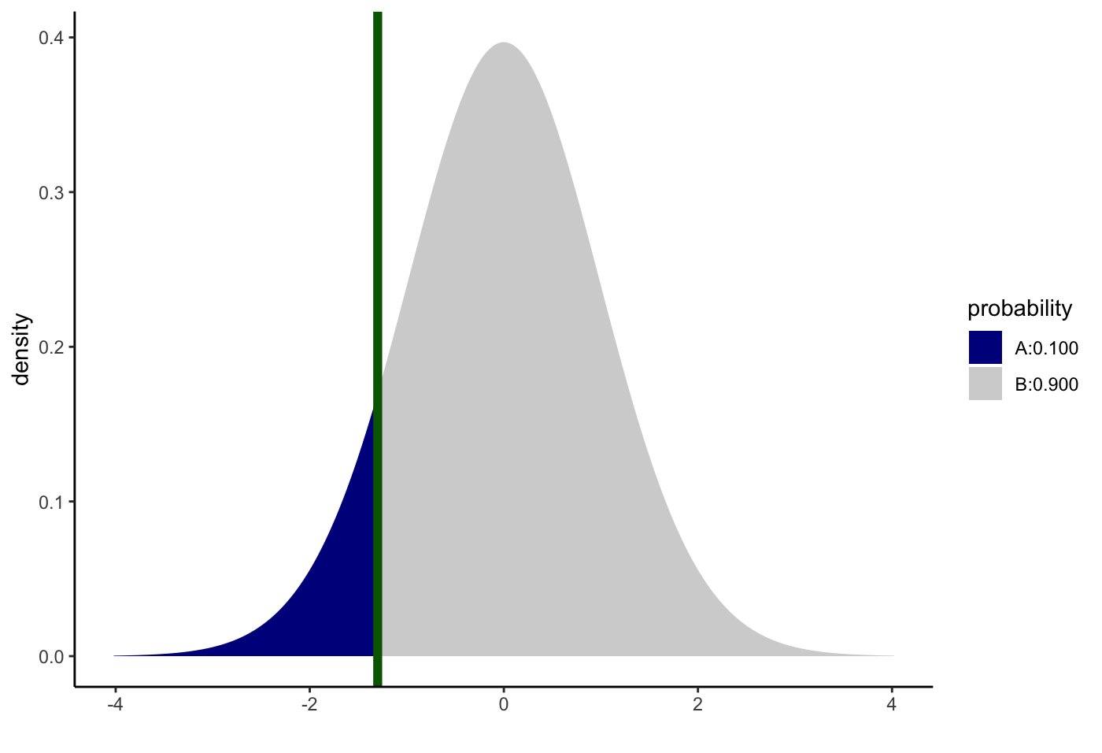
If $H_{1}: μ<μ_{0}$ and tobs = $t=−1.3$, pvalue = A
pt(tobs, df = n-1, lower.tail = TRUE)

Slide 8
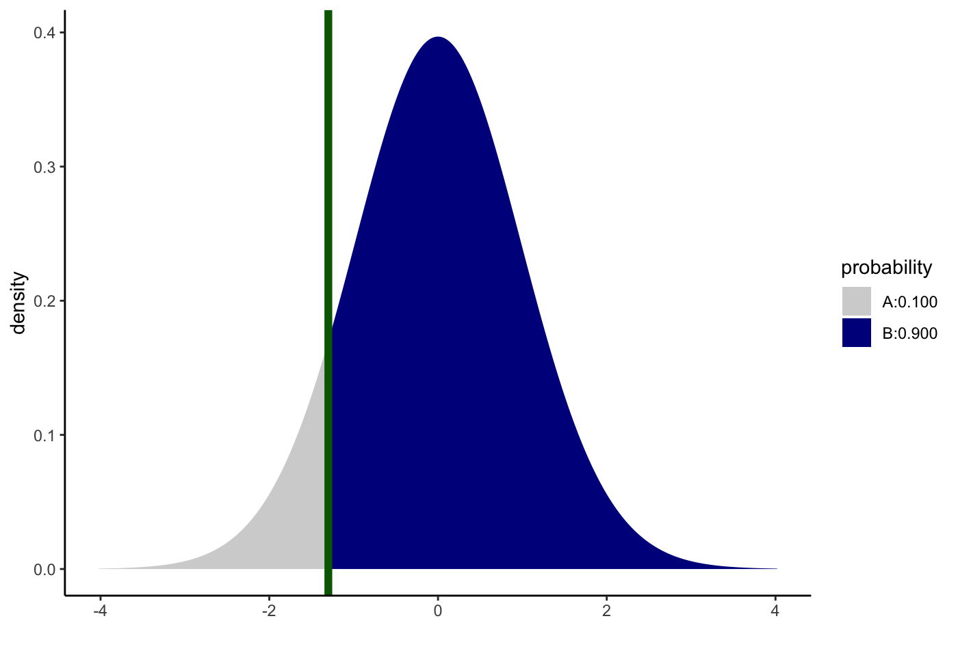
If $H_{1}: μ>μ_{0}$ and tobs = $t=−1.3$, pvalue = B
pt(tobs, df = n-1, lower.tail = FALSE)

Slide 9
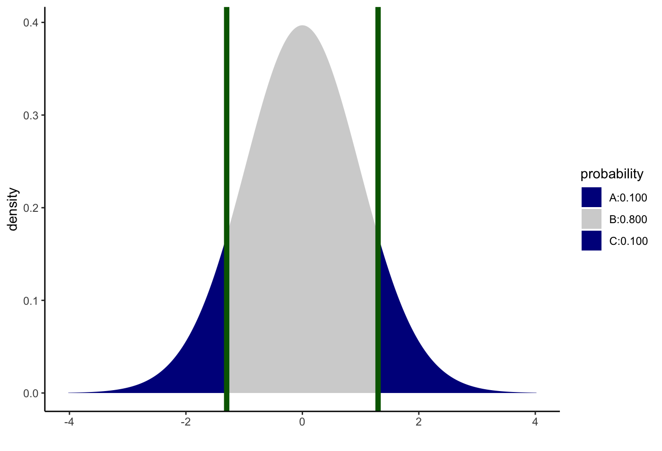
If $H_{1}: μ≠μ_{0}$ and tobs = $t=−1.3$, pvalue = A+C
2 * pt(abs(tobs), df = n-1, lower.tail = FALSE)

