Slide 1
 |  | Defendant is actually
 |  | Not guilty | Guilty
Court decision | Not guilty | Correct | Error
 | Guilty | Error | Correct
 |  | Defendant is actually
 |  | Not guilty | Guilty
Court decision | Not guilty | Correct | Error
 | Guilty | Worse Error | Correct
 |  | H₀ is actually
 |  | True | False
Your decision | Do not reject H₀ | Correct | Type II error
 | Reject H₀ | Type I error | Correct

Slide 2
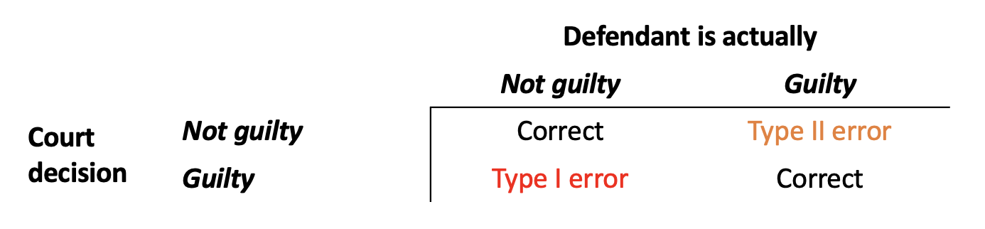
 |  | Defendant is actually
 |  | Not guilty | Guilty
Court decision | Not guilty | Correct | Type II error
 | Guilty | Type I error | Correct

Slide 3

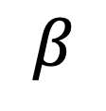

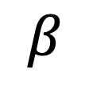

$$β$$
$$α$$
$$α$$
$$β$$

Slide 4
 |  | Person is actually
 |  | Non-diabetic | Diabetic
Test result | Non-diabetic | Correct | Worse Error Type II error
 | Diabetic | Error Type I error | Correct

Slide 6
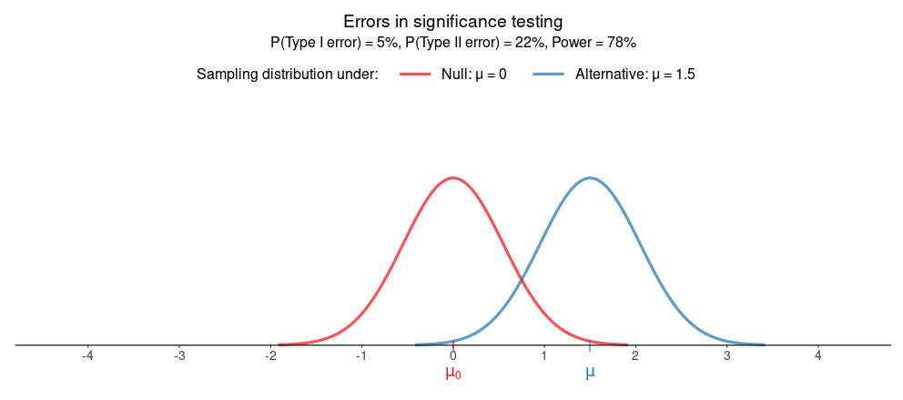

Slide 7
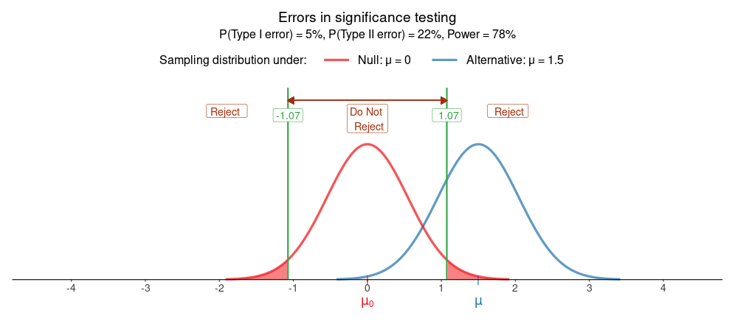

Slide 8
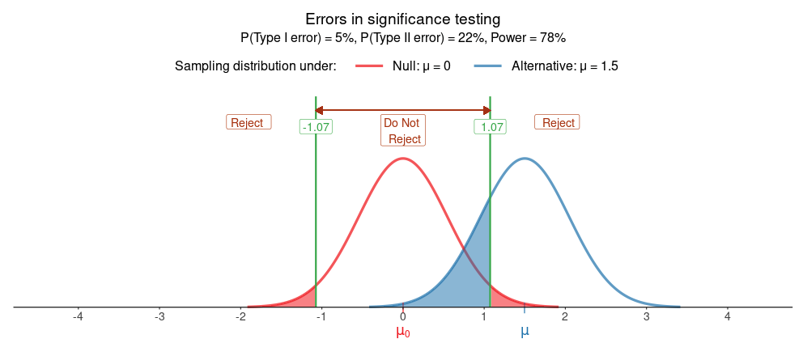

Slide 9
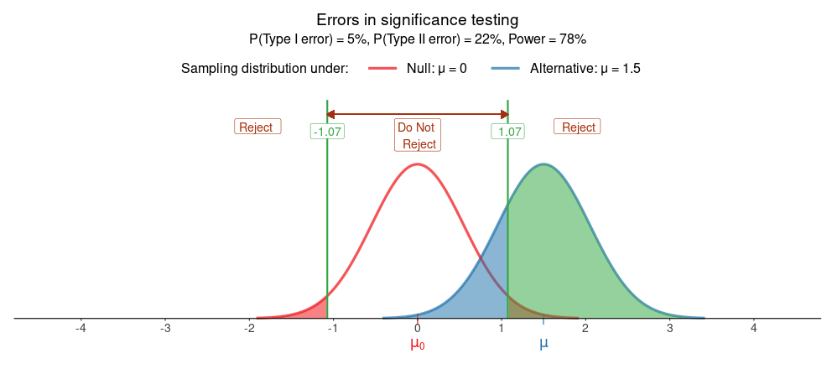

Slide 10
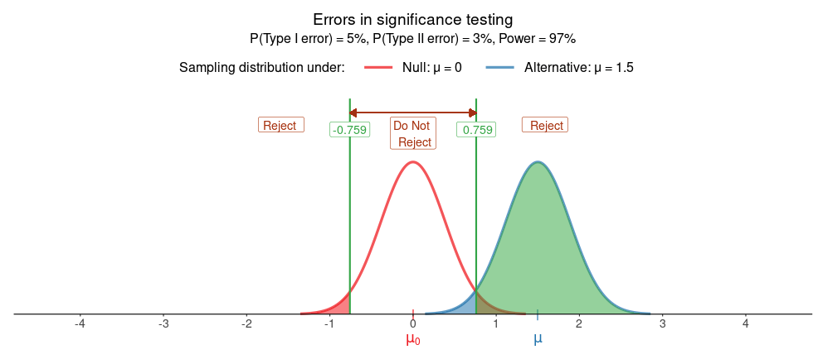
N=60=2*30

Slide 12
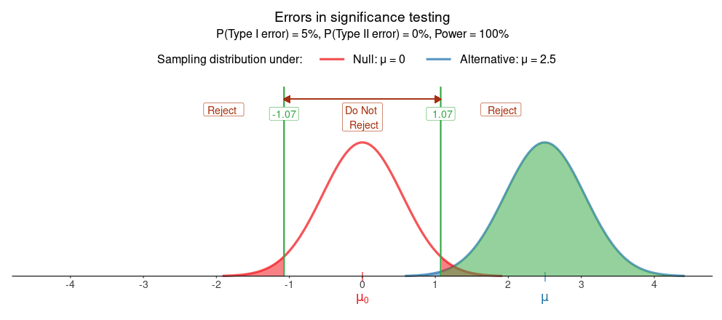

Slide 14
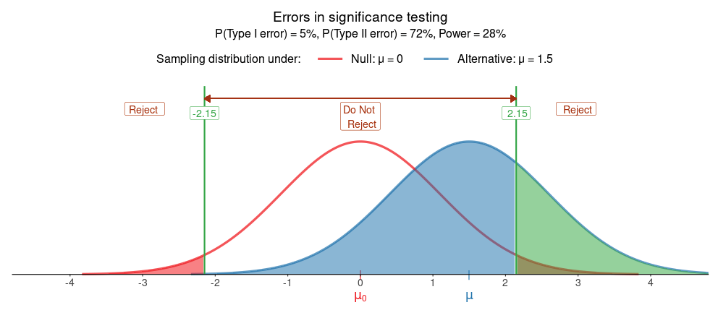
Sigma = 3 * 2 = 6

Slide 15

Sigma = 3/2 = 1.5

Slide 16
