Slide 1
Magnetic Field Driven Instabilities of Chiral Phonons
Elizabeth Scheuermann

Slide 2
Outline
Background
  Experimental Evidence for Zeeman Splitting
Model Hamiltonians
Results
  Phase Diagrams
  Magnetic Susceptibility
  Phonon Dynamics

Slide 3
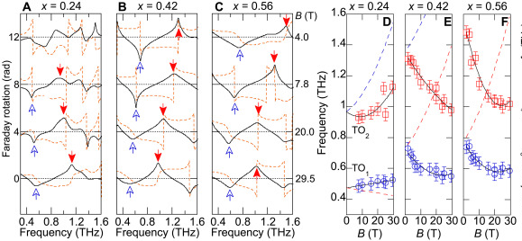
Background
There has been recent evidence for Zeeman-like splitting in chiral phonons
Whether or not this can lead to vanishing phonon frequencies is unclear

Slide 4
Model Hamiltonians
Harmonic Phonons do not work!
Anharmonic Phonons do!

Slide 5
Model Hamiltonians
4 Site Clock Model with Ferroelectric interactions

