Slide 1
Visual Lean
An accessible interface for Lean 4 proofwriting
Autumn Mapes
Conducted under Timothy Gowers, Miles Cranmer, and Matthew Colbrook in the Cambridge Faculty of Mathematics

Slide 2
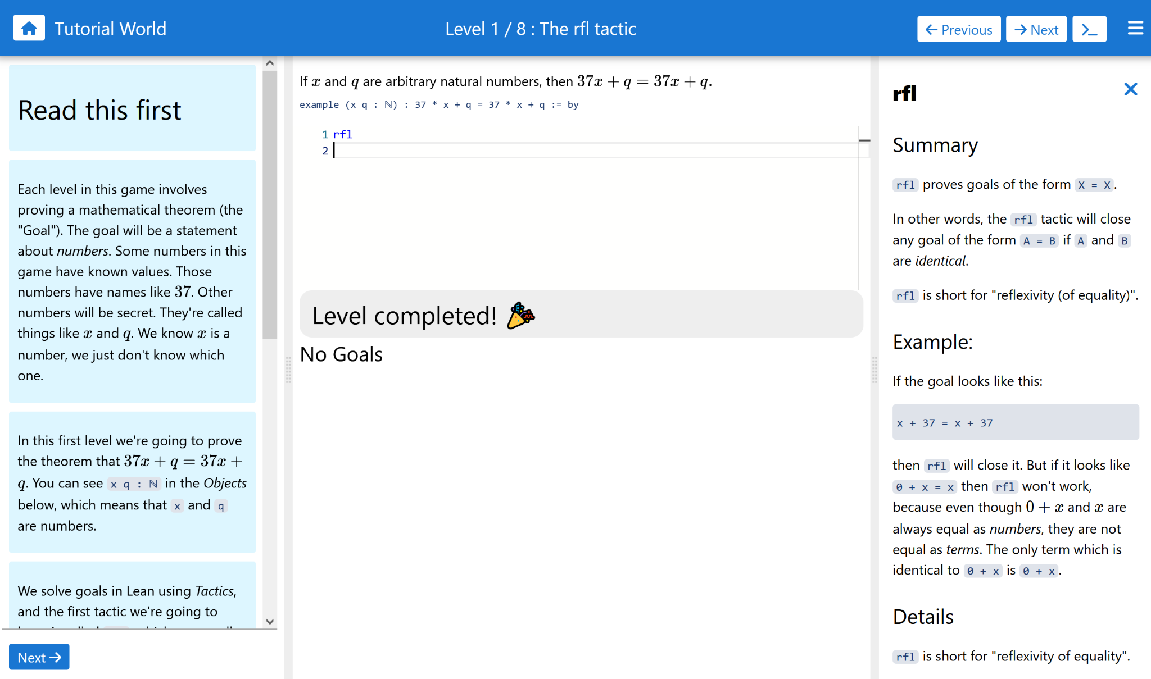
The Natural Numbers ‘Game’ remains quite technical…
Can we do better?

Slide 3
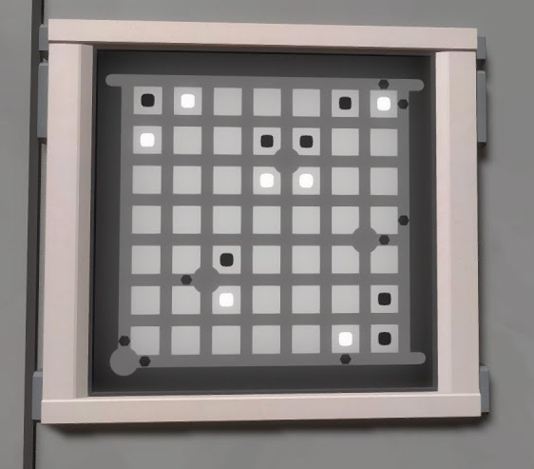
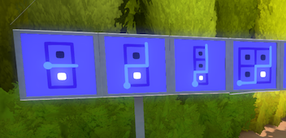
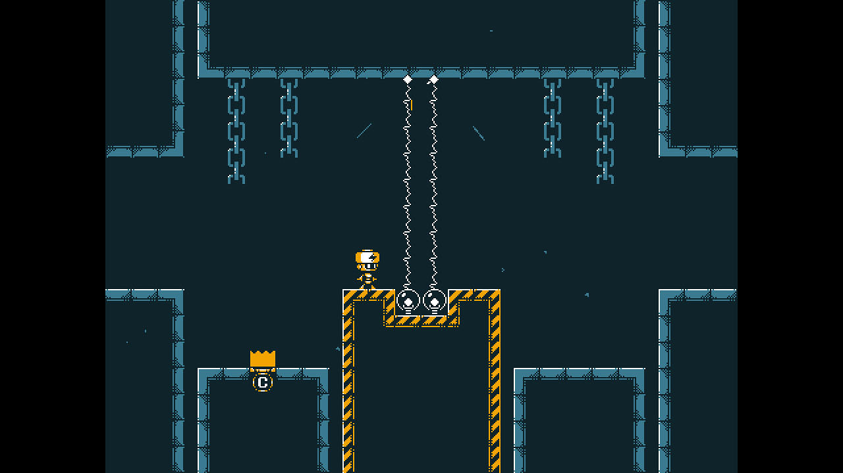
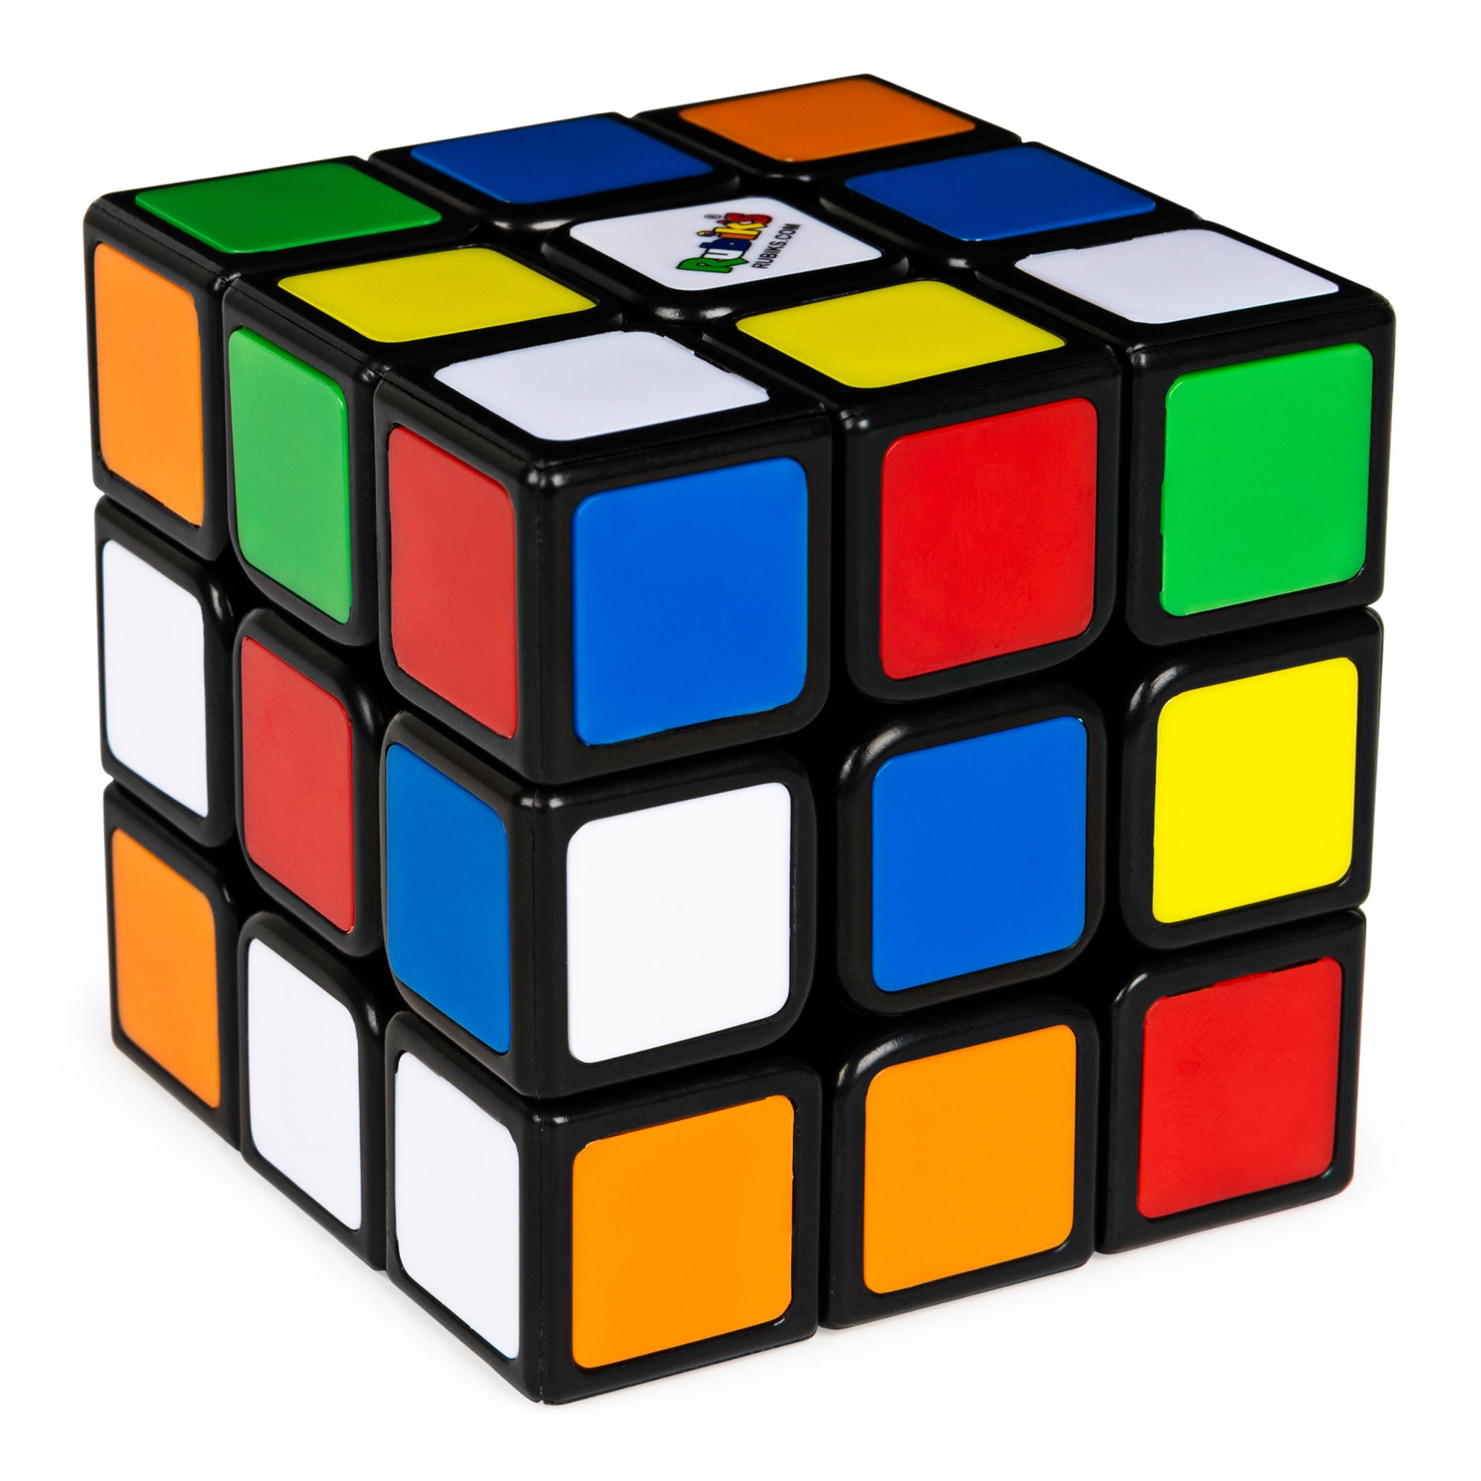
Learn from game design?
The Witness
Elec-Head
Rubik’s Cube

Slide 4
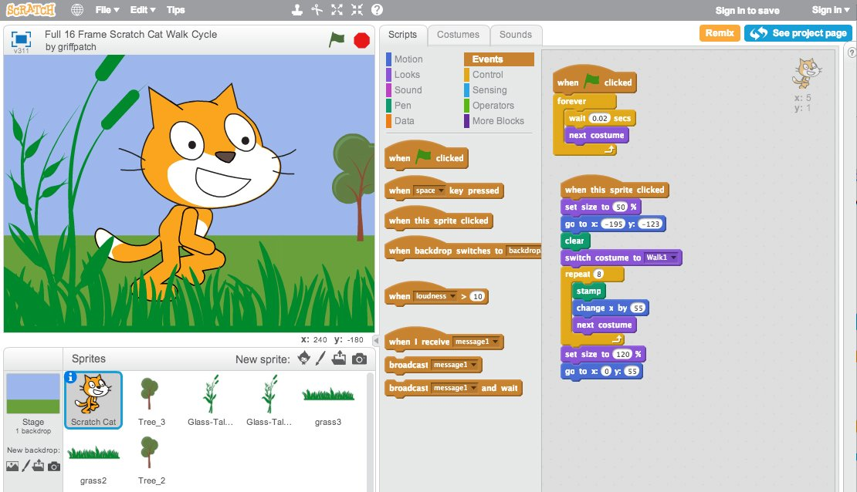
You can teach programming this way, why not math?

Slide 5
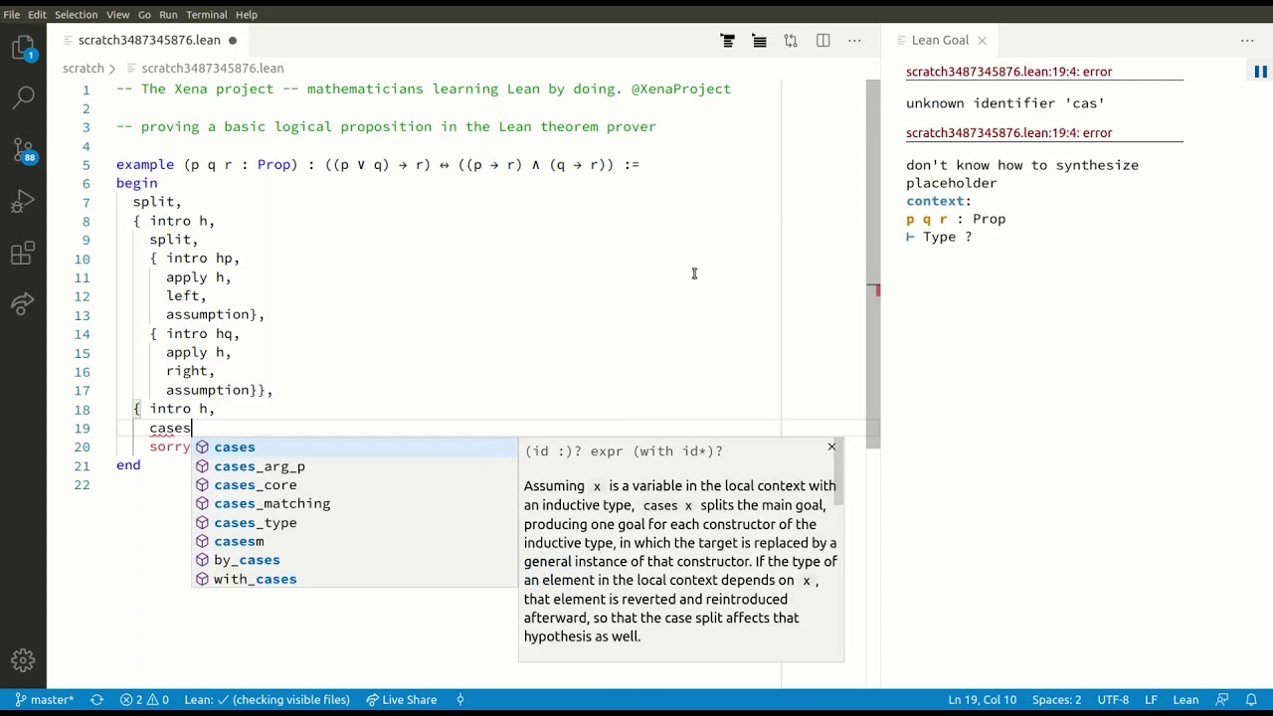
Automatic theorem provers are uniquely suited to this!

Slide 6
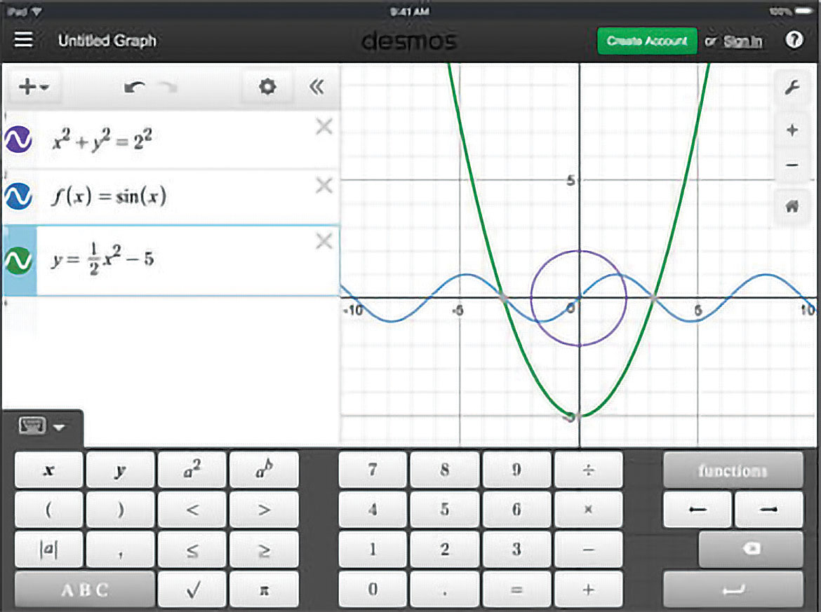
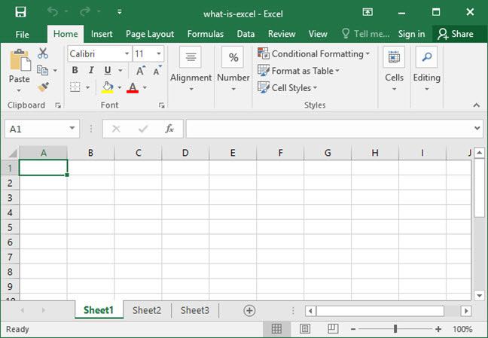
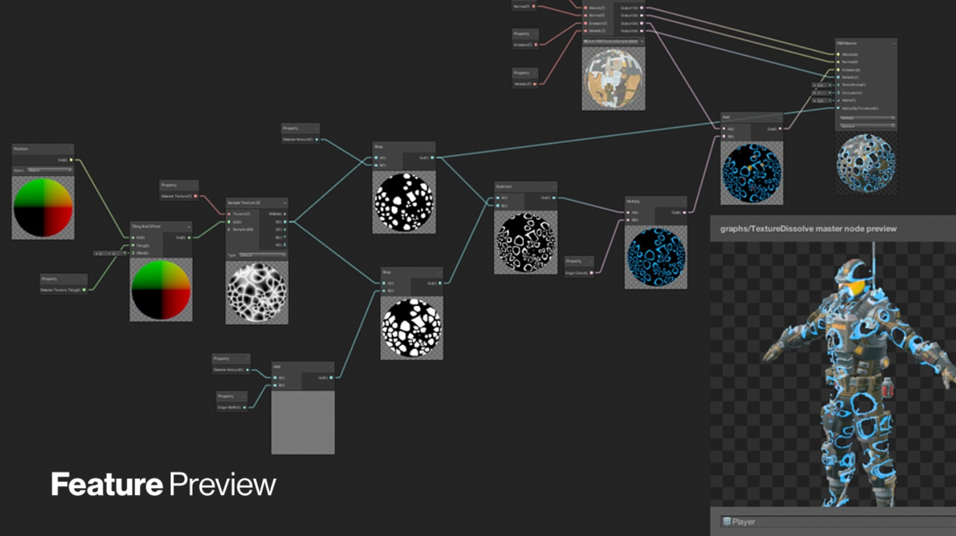
It’s not just about education…

Slide 7
Live demo

Slide 8
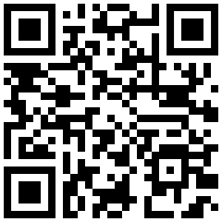
Try it for yourself! leangame.io

Slide 9

Survey

