Slide 1
Post-Match Analysis Report
2:0
Prakrida
SBFC
Team
All
Analysis Type
All
Match Performance
Match Performance
Players
Possession
Shots
Prakrida
Prakrida
FH
On Target
40%
Conversion Rate
14
SH
4
30%
SBFC
SBFC
FH
14
80%
6
60%
SH

Slide 2
Passes
Prakrida
FH
Accuracy
Key passes
73
10
40%
SH
Team
SBFC
FH
42
5
20%
Analysis Type
SH
Players
Defensive Action
Set Pieces
Discipline
Tackles
Corners
Fouls
Prakrida
40
40
2
20
20
0
SBFC

Slide 3
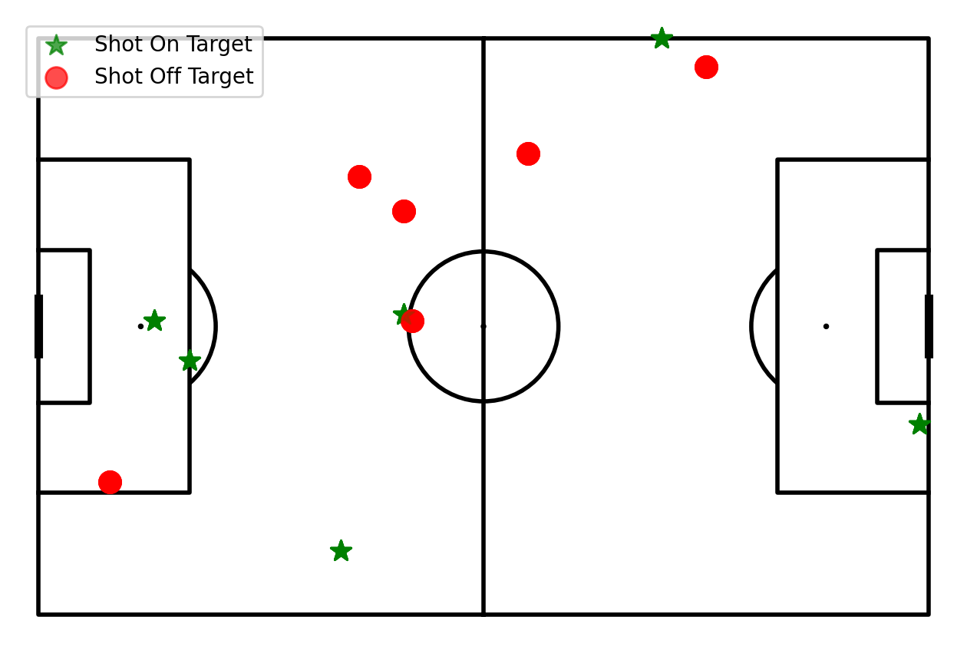
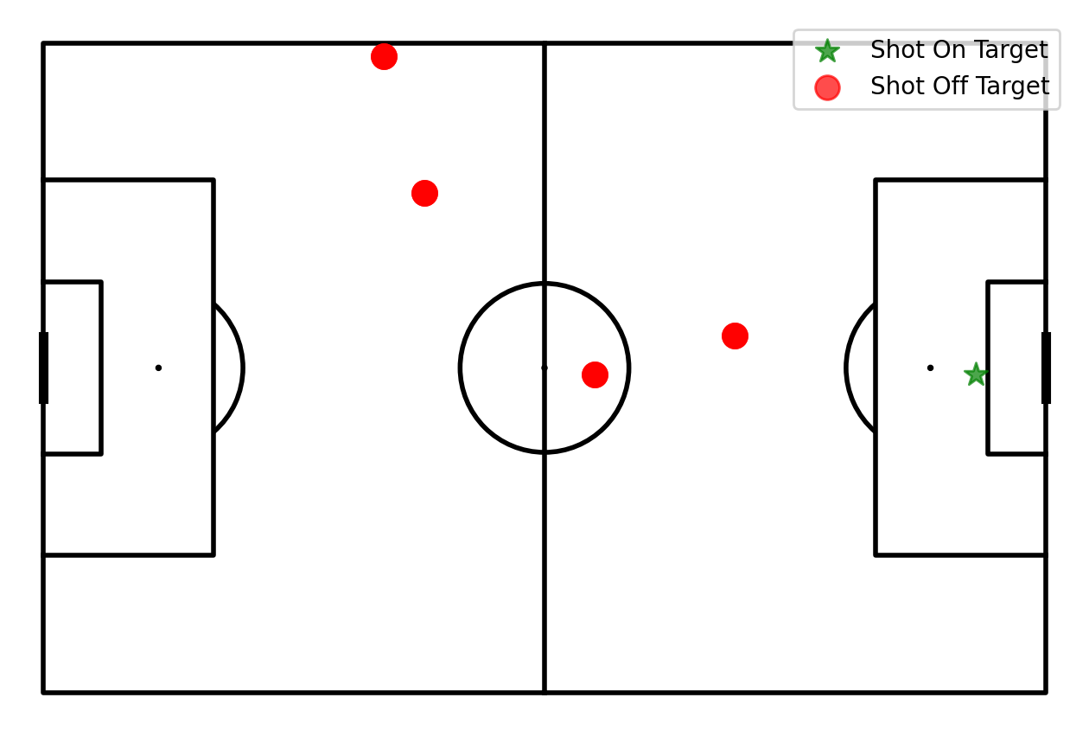
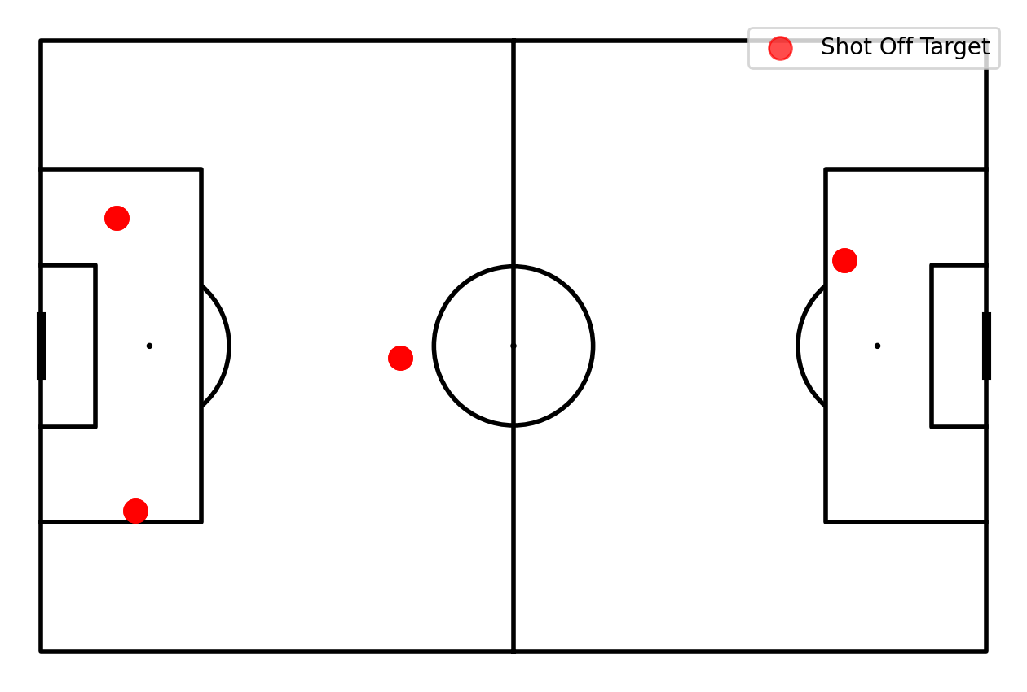
Team Performance
Prakrida
Shots
SBFC
FH
FH
Team
Analysis Type
Players
SH
SH

Slide 4
Team
Analysis Type
Players

Slide 5
Team
Analysis Type
Players

