Slide 1
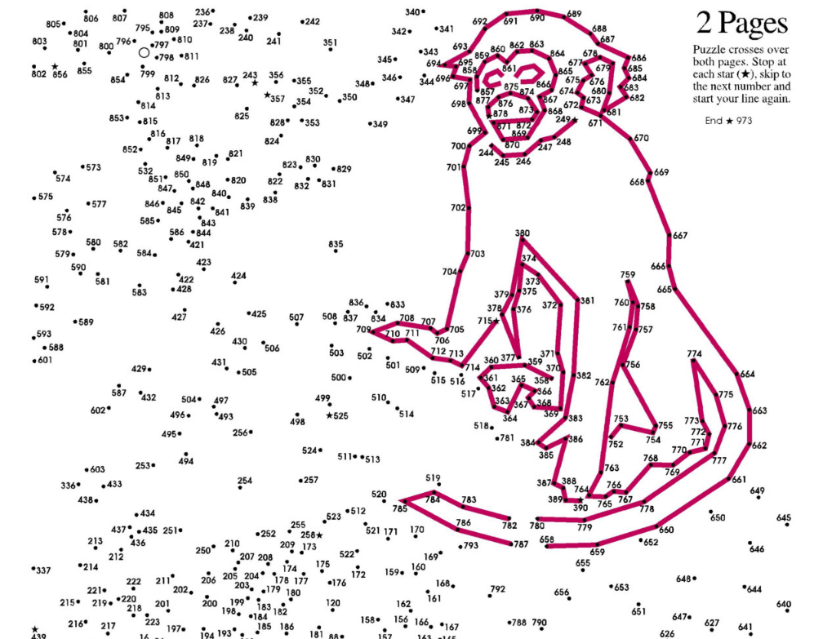
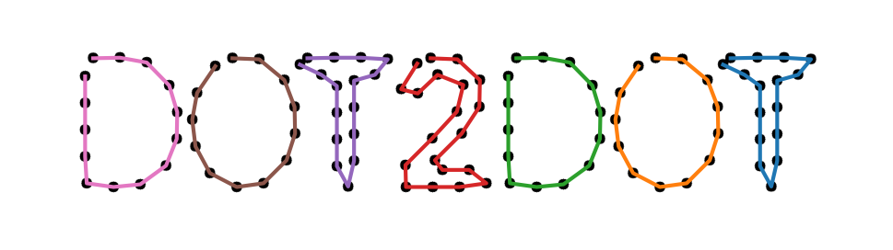
Project by
Makhneva Liza

Slide 2
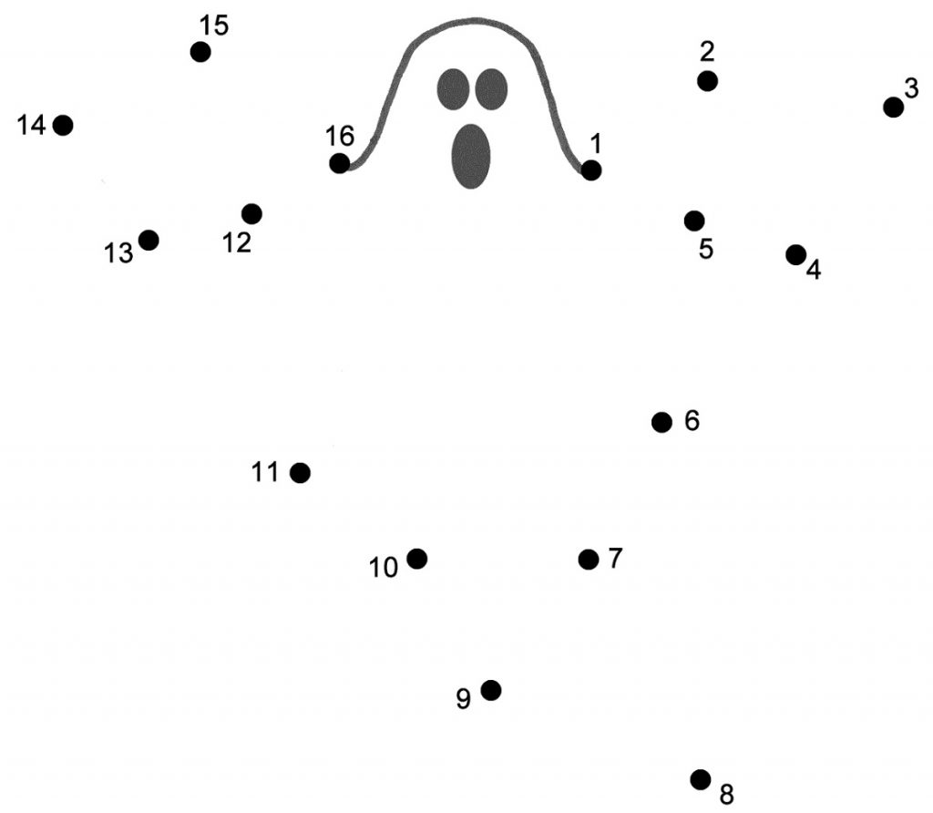
Problem description
CV algorithm
Results
Future steps
Problem: connect dots in correct order
Numbers are close to points, can contain several digits
There can be any amount of points

Slide 3
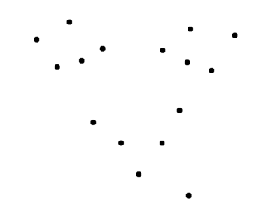
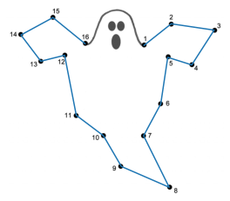
Problem description
CV algorithm
Results
Future steps
[4, 1]
14
Step 1. Find dots
Step 2. Find digits
Step 3. Recognize and order digits
Step 4. Order and connect dots

Slide 4
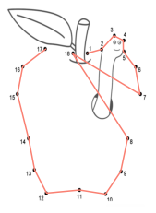
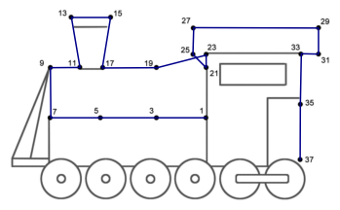
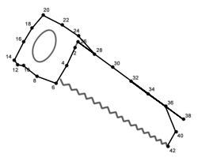
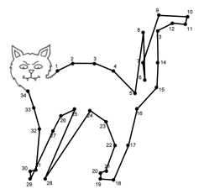
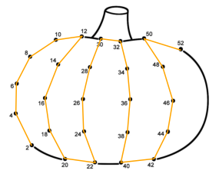
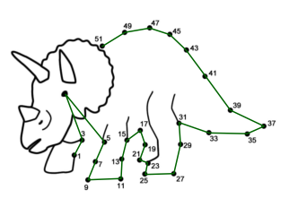
Problem description
CV algorithm
Results
Future steps
Q = # correct connections / (# dots - 1)
Train
Test
Q = 1.0
Q = 0.88
Q = 0.88
Q = 0.67
Q = 0.81
Q = 1.0
Q = 0.92
*correct connections - connections between consecutive numbers

Slide 5
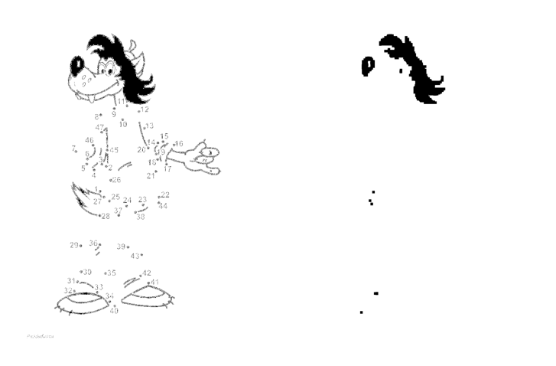
Problem description
CV algorithm
Results
Future steps
Step 1. Find dots
for any dot width
for any color of lines
for any color of dots
Step 2. Find digits
for any picture
Step 3. Recognize and order digits
for any font
Step 4. Order and connect dots
it’s perfect

Slide 6
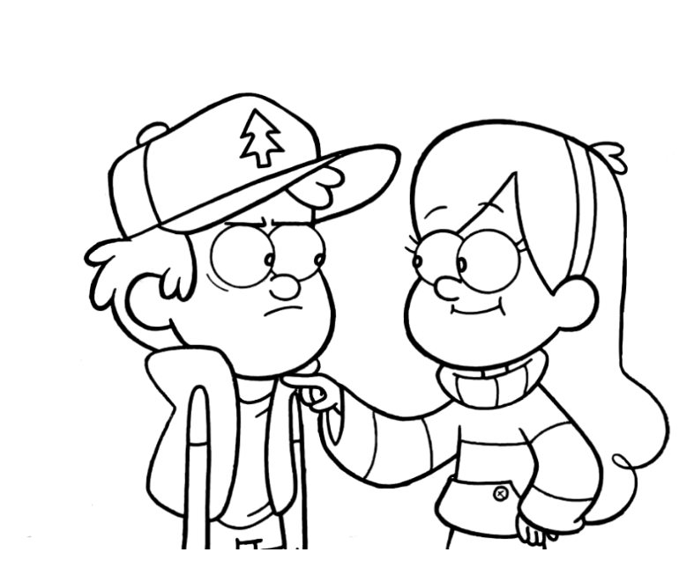
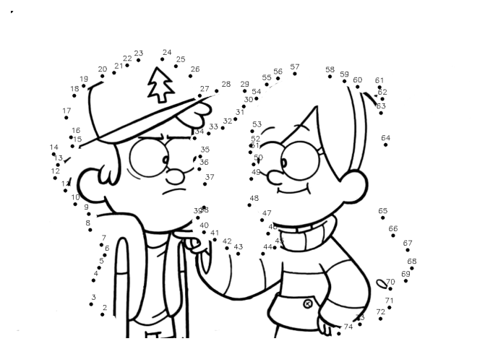
Bonus
Picture2Dots

