Slide 1
Programming Mirobot with Python
Elizaveta Semenova, 19th November 2017

Slide 2
Why learn python?
Python is great for
data analysis (statistics, Machine Learning, Deep Learning, Artificial Intelligence),
backend web development,
scientific computing,
games,
desktop apps.
Isn’t it motivating enough?

Slide 3
Resources
There are plenty of resources on the internet to get you started, such as
https://tutorial.djangogirls.org/en/python_introduction/
or online interactive python tutorials, such as
https://www.learnpython.org/
And many more.

Slide 4
Main concepts to grasp (For programming in general)
Variable
Conditional
statement
Loop
Function
Once those cornerstones are clear, you are already set for a lot of programming adventures.

Slide 5
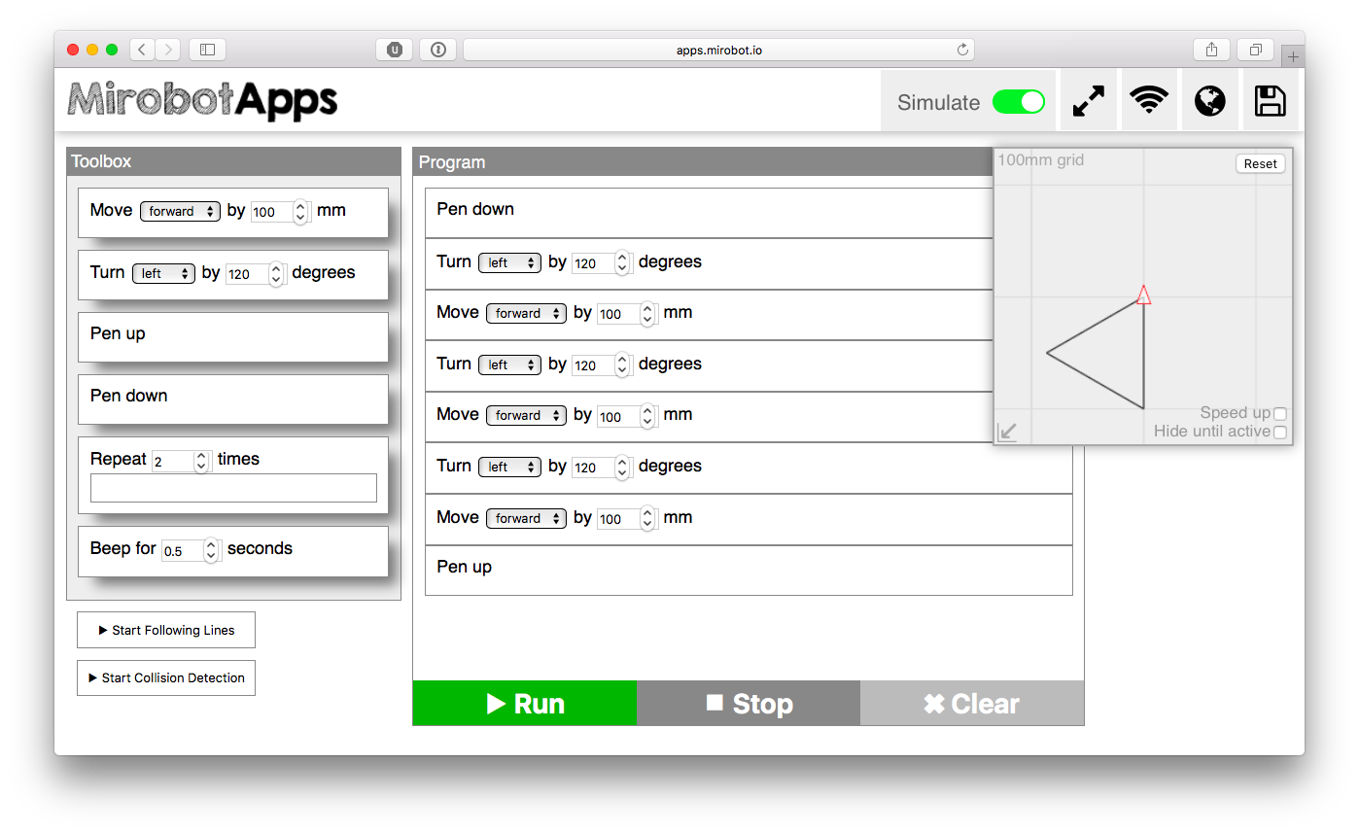
Programming mirobot: Drag-and-drop

Slide 6
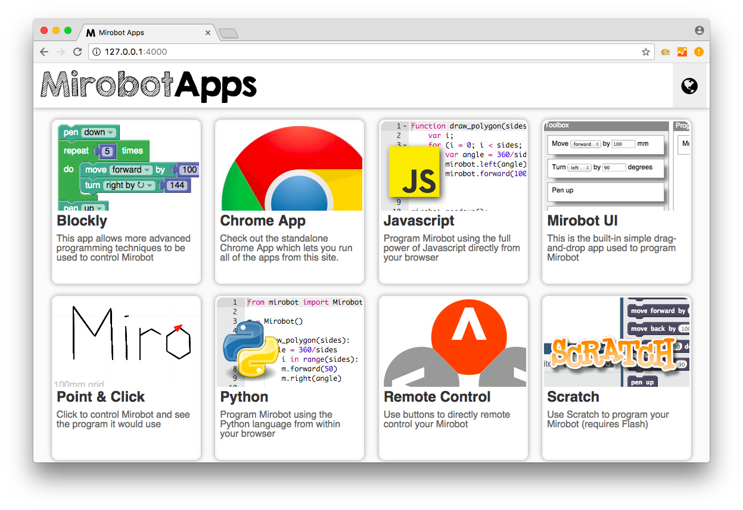
Mirobot apps

Slide 7
Overall workflow
Define the logic first
What is it that you want to draw?
Can you express consequent actions in words, if the pool of actions is ‘pen down’, ‘pen up’, ‘move forward X mm’, ‘turn X degrees left’, ‘turn X degrees right’
Test in the simulation mode
Test with the robot

Slide 8
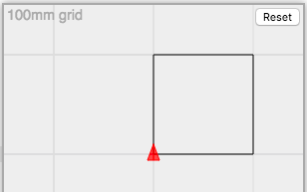
Draw a square
START
put pen down
move forward by 100mm
turn right by 90 degrees
move forward by 100mm
turn right by 90 degrees
move forward by 100mm
turn right by 90 degrees
move forward by 100mm
put pen up
END

Slide 9
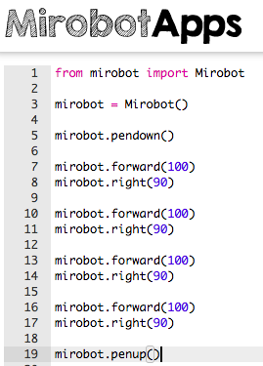
Draw a square in python
START
put pen down
move forward by 100mm
turn right by 90 degrees
move forward by 100mm
turn right by 90 degrees
move forward by 100mm
turn right by 90 degrees
move forward by 100mm
put pen up
END

Slide 10
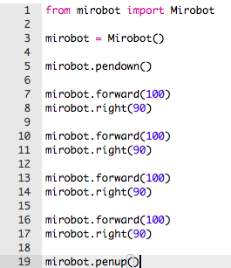
Optimize your python code
Identify, where it would help to use
Variables
Loops
Functions

Slide 11
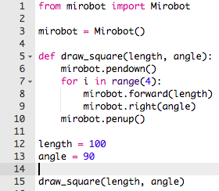
Optimize your python code

Slide 12
Tasks to be working on
Write a function to draw an equilateral triangle
Call : draw_triangle(length)
Input: length – side length
2. Write a function to draw an equiangular polygon
Call: draw_polygon(length, num)
Input: length – side length, num– number of sides
3. Write your own name
4. Write a function to write any letter of the alphabet
Call: alphabet(letter, height)
Input: letter – a letter of an alphabet, height– height of a letter

Slide 13
Tasks to be working on
The code of some examples is available at
https://github.com/elizavetasemenova/Mirobot

