Slide 1
Applied Machine Learning & Data Analytics
Resampling and Model Selection
Prof. Rustamov Samir
Eljan Mahammadli & Sokrat Bashirov
16/04/2024

Slide 2
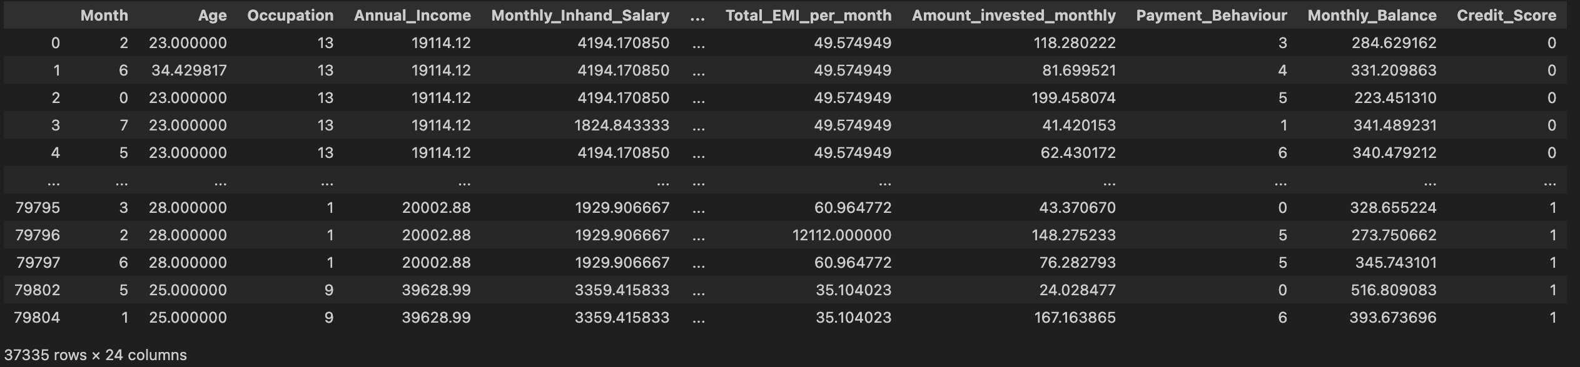
Classification Dataset
Credit Scoring
Task: Given a person’s credit-related information, build a machine learning model that can classify the credit score.
Number of samples: 37K
Number of features: 23
Target: Credit Score (good, bad or standard)

Slide 3
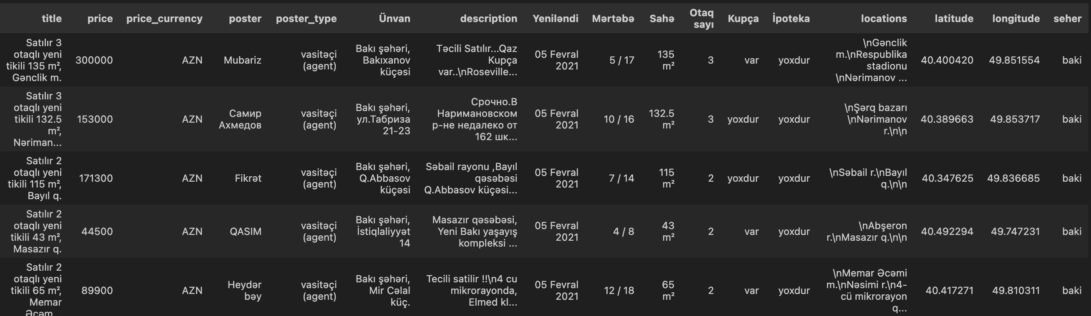
Regression Dataset
Scraped ~60K data points from bina.az with 17 fields.

Slide 4
Base models
Classification metrics
Regression metrics
Model | Precision | Recall | F1 | AUC
LR | 90 | 84 | 87 | 92
LDA | 92 | 81 | 86 | 91
QDA | 92 | 81 | 86 | 90
NB | 94 | 79 | 86 | 89
Model | RSS | RMSE | R-Squared
LR | 5.7e+11 | 33595 | 0.74
Poly | 6.3e+11 | 34810 | 0.77
Interac | 6.4e+11 | 35149 | 0.76

Slide 5
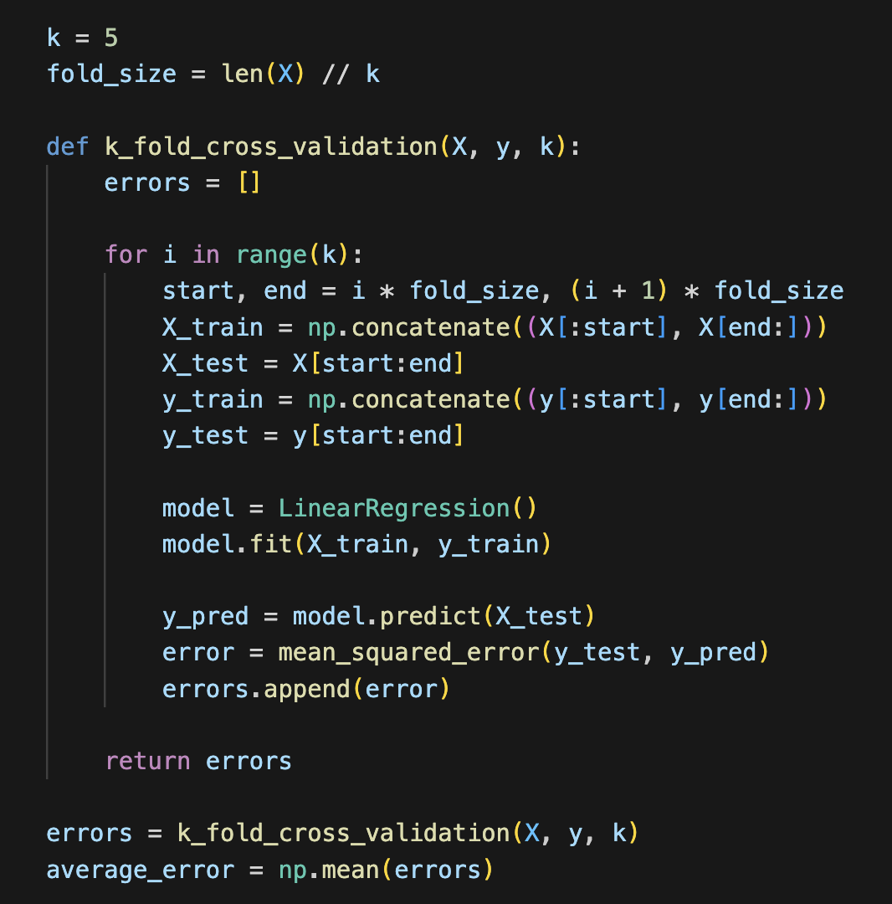
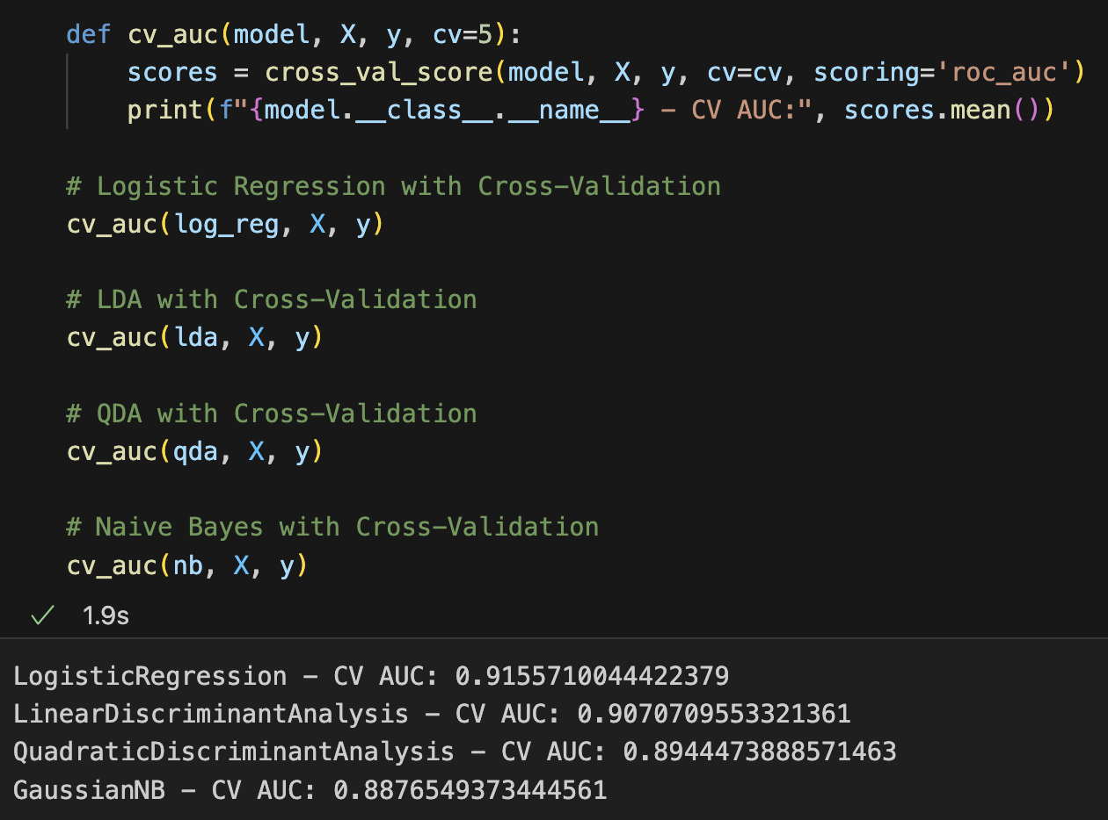
Cross-Validation
Evaluate model performance to generalize on unseen data.
Types of Cross-Validation
K-Fold: Splits data into 'k' parts; train on 'k-1', test on 1, rotate.
Leave-One-Out (LOOCV): Each sample is a test set once, rest are training.
Stratified K-Fold: Preserves percentage of samples for each class.
Implementation Steps
Data Partitioning: Randomly divide data into equal 'k' subsets.
Training and Testing: Rotate training and testing subsets through all data.
Evaluate Performance: Measure accuracy, precision, recall, F1-score.
Advantages and Disadvantages
Advantages: Reduces overfitting risk, better model evaluation.
Disadvantages: Higher computational cost, less suitable for small datasets.

Slide 6
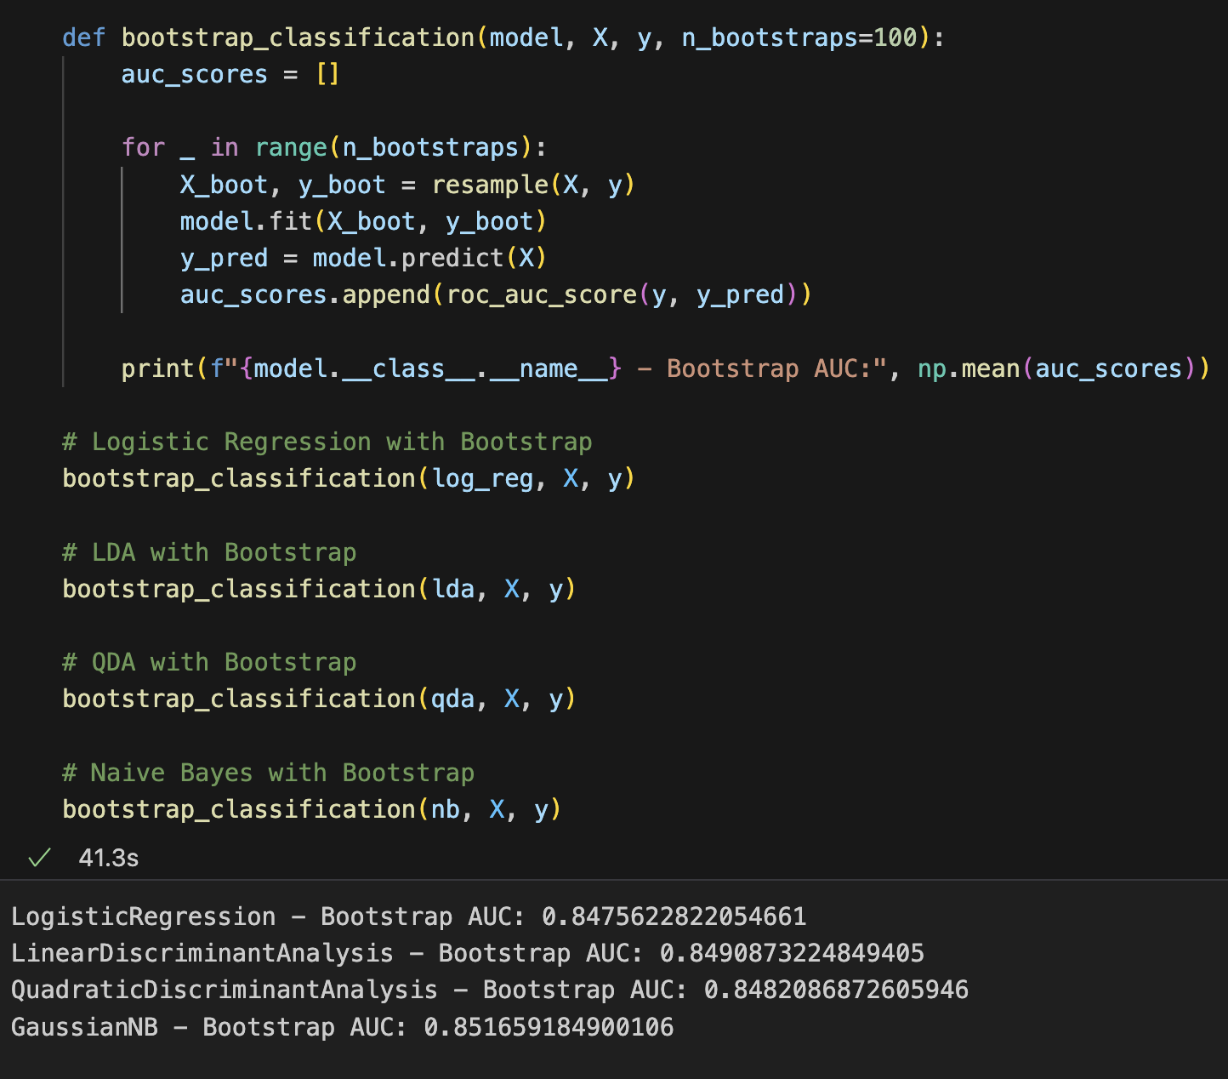
Bootstrap Sampling
Estimate the variability and robustness of statistical estimates or predictive models by repeatedly sampling with replacement from the original dataset to form multiple "bootstrap" samples.
Steps
Draw samples with replacement from the original dataset to create multiple bootstrap samples.
Fit the model on each bootstrap sample to simulate training on different possible subsets of the data.
Performance Evaluation: Assess the model's performance on the original dataset after each fit.
Advantages of Bootstrap Sampling
Distribution Assumption-Free: Does not require assumptions about the data’s underlying distribution.
Estimates Variability: Provides a measure of how estimated model parameters or performance metrics might vary across different samples.
Improves Model Robustness: Helps in understanding model performance across diverse scenarios, enhancing reliability.
Helps in determining which model performs consistently across different resampled datasets. Essential for testing how stable and reliable a model is when faced with different subsets of data.

Slide 7
AIC and BIC
AIC (Akaike Information Criterion)
Aims to select the model that best explains the data with minimal information loss.
AIC = 2k - 2ln(L), where k is the number of parameters in the model and L is the likelihood of the model given the data.
Lower AIC values indicate a model that better fits the data without unnecessary complexity.
BIC (Bayesian Information Criterion)
Similar to AIC but includes a penalty term for the number of parameters to avoid overfitting.
Defined as BIC= ln(n)k− 2ln(L), where n is the number of observations.
Like AIC, a lower BIC value is preferable, but BIC is stricter regarding model complexity due to its heavier penalty on the number of parameters.

Slide 8
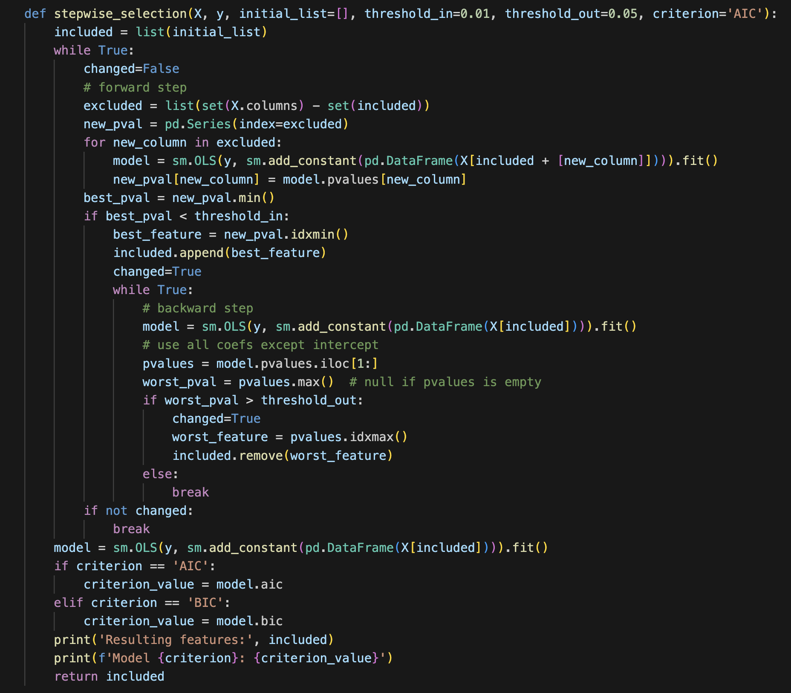
Stepwise AIC or BIC
Initial Setup: Start with an optional initial feature set.
Forward Selection:
Add features with p-values below the inclusion threshold.
Backward Elimination:
Remove features with p-values above the exclusion threshold.
Iteration: Repeat addition and removal until no further changes.
Model Evaluation:
Assess final model using AIC or BIC.
Output: List optimal features and criterion value.

Slide 9
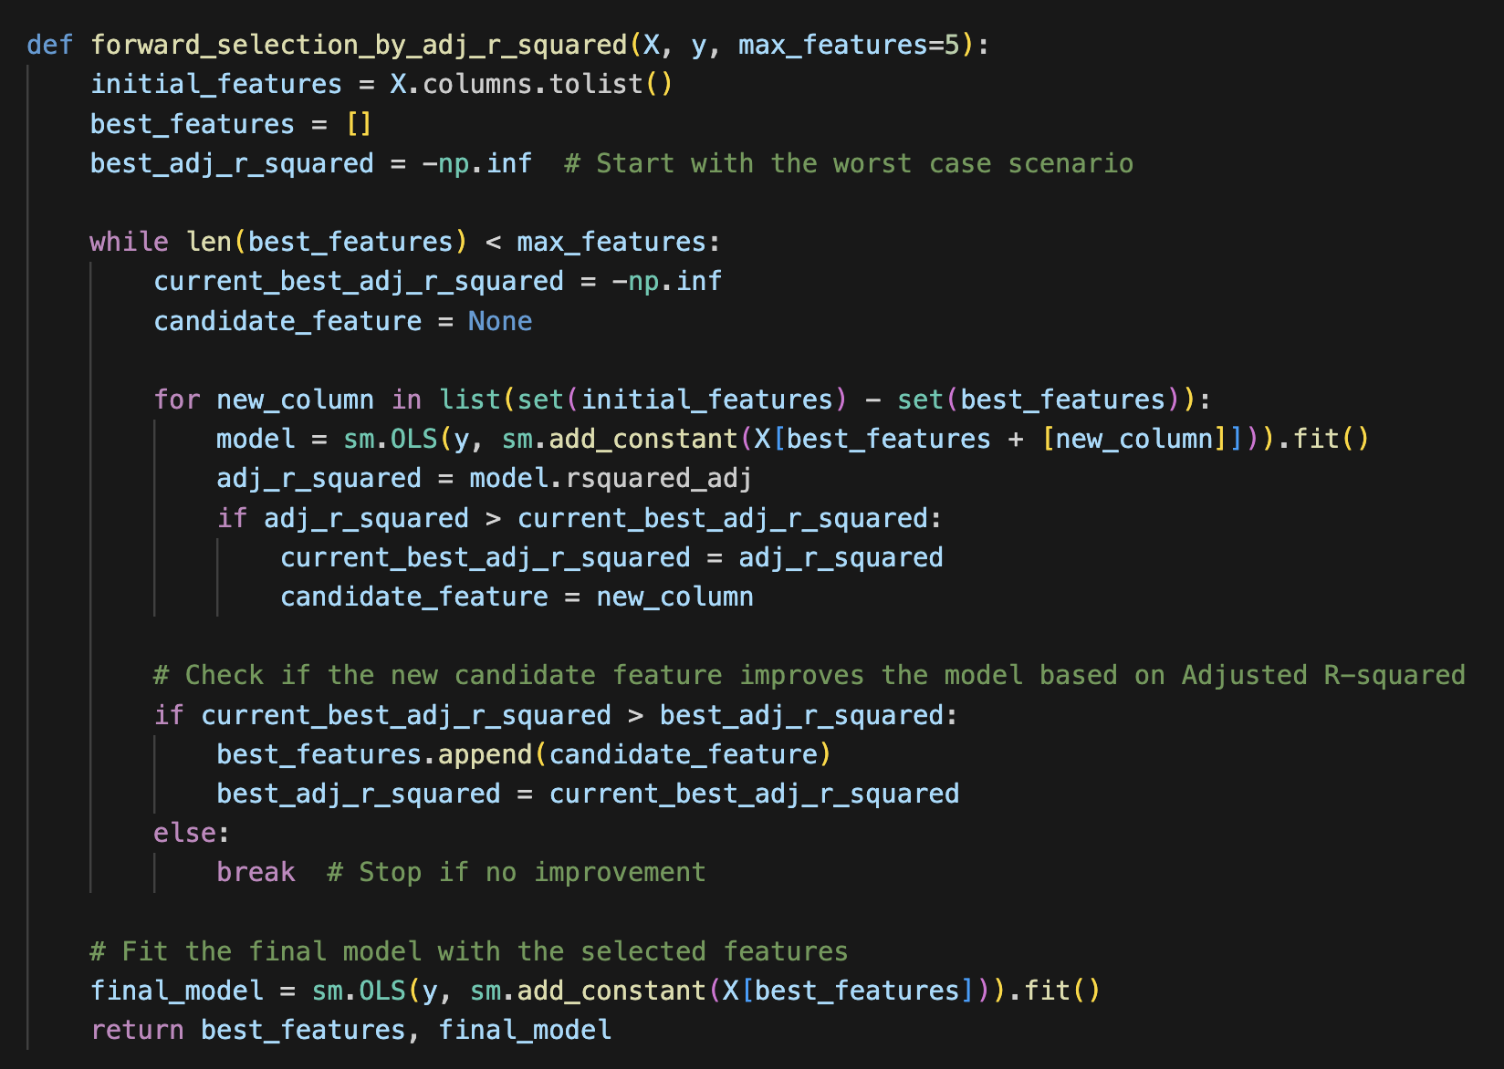
Adjusted R2
Forward Selection
Initial Setup: Start with all available features and no best features selected.
Selection Criteria: Use the adjusted R-squared value to evaluate models.
Loop Until Max Features:
Iteratively test each remaining feature to see if it improves the adjusted R-squared.
Update the best feature set if a feature increases the adjusted R-squared.
Evaluate Improvements:
Select the feature that provides the highest increase in adjusted R-squared from the remaining features.
Add this feature to the best feature list if it improves model performance.
End Condition:
Stop the process if adding new features does not improve the adjusted R-squared.
Final Model: Fit the final model with the selected features.
Return Values: Output the list of best features and the final fitted model.

Slide 10
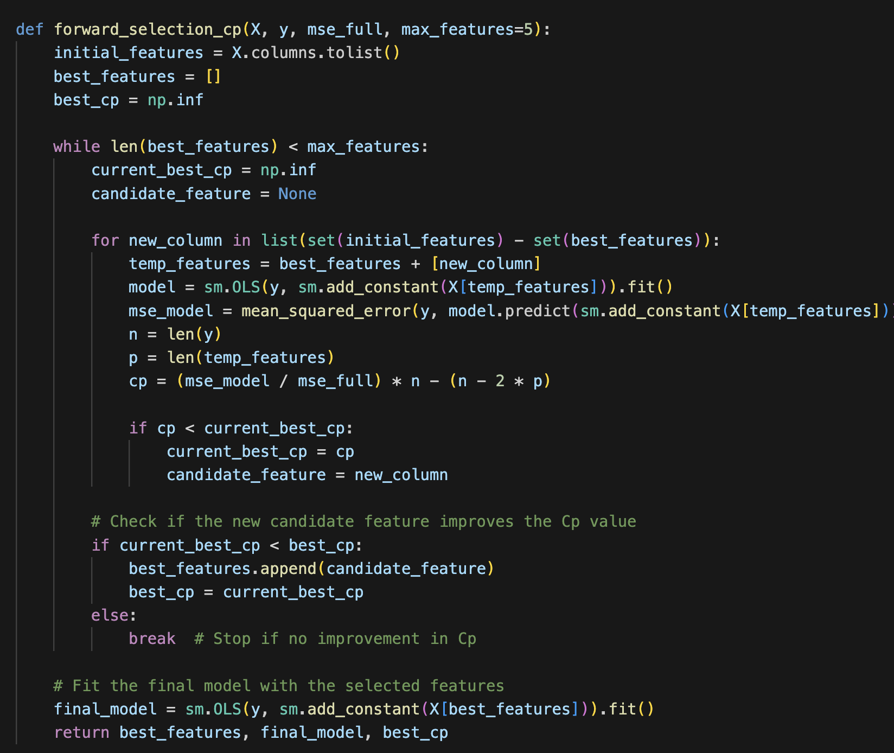
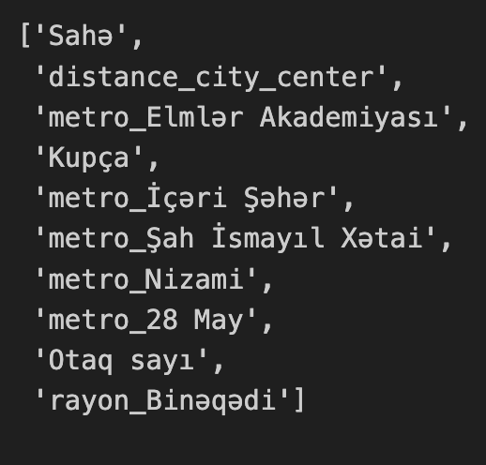
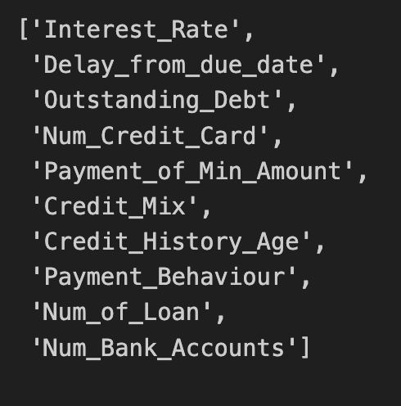
Mallows' Cp
Forward selection
Initial Setup: Begin with an empty set of best features and a list of all possible features.
Selection Criteria: Use Mallows' Cp to evaluate the addition of each feature.
Cp Calculation Details:
Cp aims to identify subsets of features that balance between fit and complexity.
Calculate Cp using: (MSE of model / MSE full model) × n − (n − 2 × p), where n is the sample size and p is the number of features in the model.
Feature Selection Loop:
For each feature not already in the best set, fit a model including the feature and calculate its Cp.
Select the feature with the lowest Cp that improves upon the current best Cp.
Update Best Features:
Add the feature with the best Cp improvement to the set of best features.
Stop Condition:
Cease the selection process if adding a new feature does not improve the Cp value.
Final Model Fit:
Fit a final OLS model using the selected features.
Return Values
Return the set of selected features, the final model, and the best Cp value achieved.

Slide 11
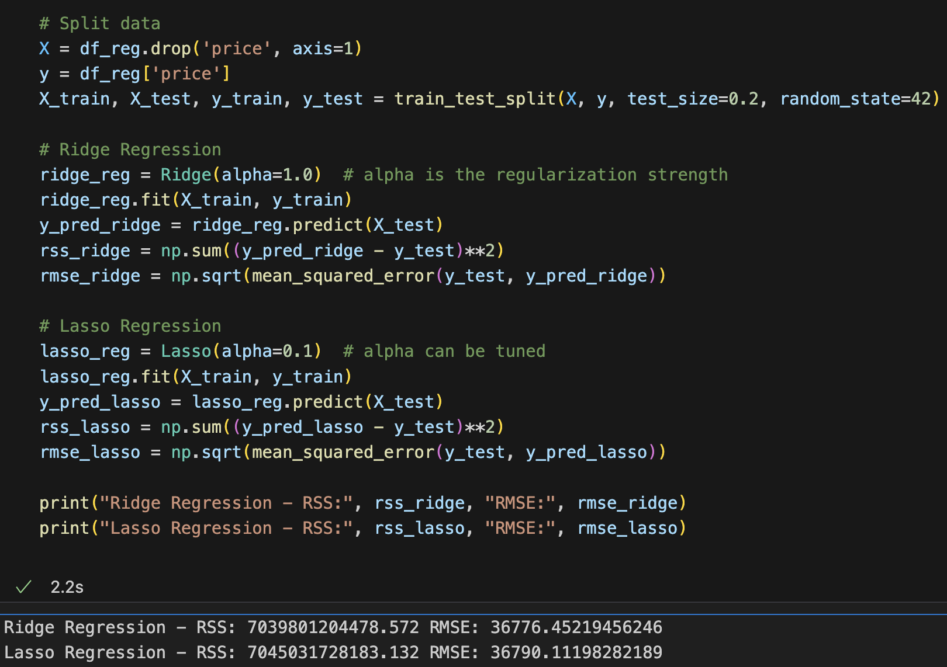
Ridge and Lasso shrinkage
Ridge Regression (L2 Regularization)
Penalty on Magnitude: Adds a penalty equal to the square of the magnitude of coefficients; minimizes the sum of the square of coefficients.
Objective Function: Minimizes the sum of squared residuals + λ(sum of squared coefficients), where λ is a complexity parameter.
Effect on Coefficients: Tends to shrink the coefficients evenly but generally does not reduce them to zero.
Usage: Best used when most features are relevant or when there are many small/medium-sized effects.
Lasso Regression (L1 Regularization)
Penalty on Magnitude: Adds a penalty equal to the absolute value of the magnitude of coefficients; minimizes the sum of the absolute values of coefficients.
Objective Function: Minimizes the sum of squared residuals + λ(sum of absolute values of coefficients).
Effect on Coefficients: Can shrink some coefficients to zero, effectively performing variable selection.
Usage: Useful when trying to reduce the number of variables, as it can indicate which features are most important.

Slide 12
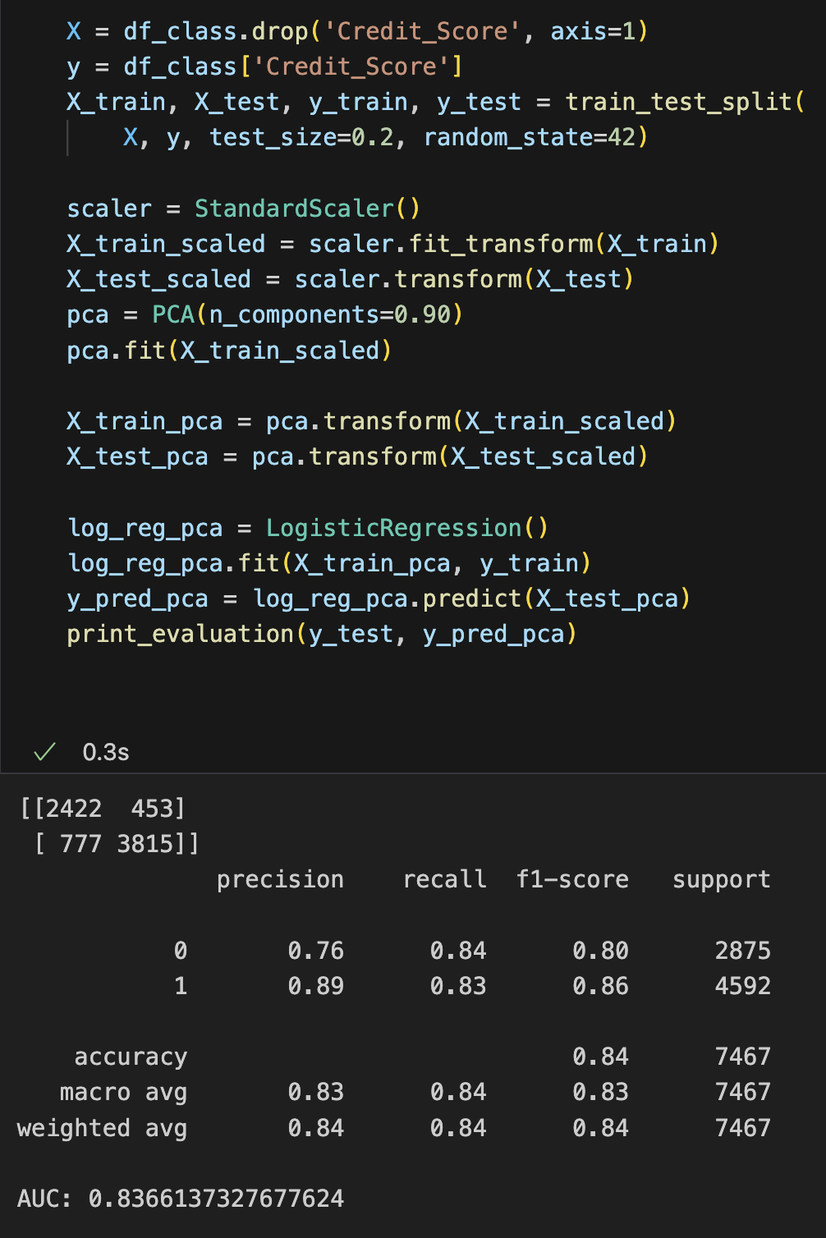
PCA
Principal Component Analysis (PCA)
Purpose: Reduces the dimensionality of data by transforming to a new set of variables (principal components), which are linear combinations of the original variables.
Data Preprocessing: Standardizes the data (mean = 0 and variance = 1) across features before applying PCA, as it is sensitive to the variances of the initial variables.
Variance Capturing: Principal components are selected to maximize the variance captured from the data.
Components:
The first principal component has the maximum variance.
Each succeeding component has the highest variance possible under the constraint that it is orthogonal to the preceding components.
Computation:
Calculate the covariance matrix of the data.
Compute the eigenvalues and eigenvectors of this covariance matrix.
Sort eigenvalues in descending order and choose the eigenvectors that correspond to the largest eigenvalues to maintain most of the data's variability.
Dimension Reduction: Projects the original data onto a smaller space using the selected eigenvectors (principal components).
Usage: Often used to simplify data, improve algorithms’ performance, or identify hidden patterns.

Slide 13
Results
Classification
Regression
Model | AUC
LR | 92
LDA | 91
QDA | 90
NB | 89
LR Cross-val | 91
LDA Cross-val | 90
QDA Cross-val | 89
NB Cross-val | 88
LR Bootstrap (100 iters) | 84
LR PCA (90% n_components) | 83
Cp (10 features) | 84
Adjusted R2 | 83
Model | RMSE
LR | 33595
Poly | 34810
Interac | 35149
Cross-val | 36908
Bootstrap sampling (100 iters) | 36835
Cp (10 features) | 37509
BIC (19 features) | 36365
AIC (18 features) | 36994
Adjusted R2 | 36615
PCA (90% n_components) | 38522

Slide 14
Thank you!

