Slide 1
Applied Machine Learning & Data Analytics
Non Linearity, Tree Based classification, SVM
Prof. Rustamov Samir
Eljan Mahammadli & Sokrat Bashirov
23/04/2024

Slide 2
ToC
1) Use non-linearity for regression task
a) polynomials
b) step functions
c) splines
d) local regression
e) generalized additive models
2) Tree-based methods for classification task
a) bagging
b) random forests
c) boosting
3) Apply SVM for classification with different kernels.

Slide 3
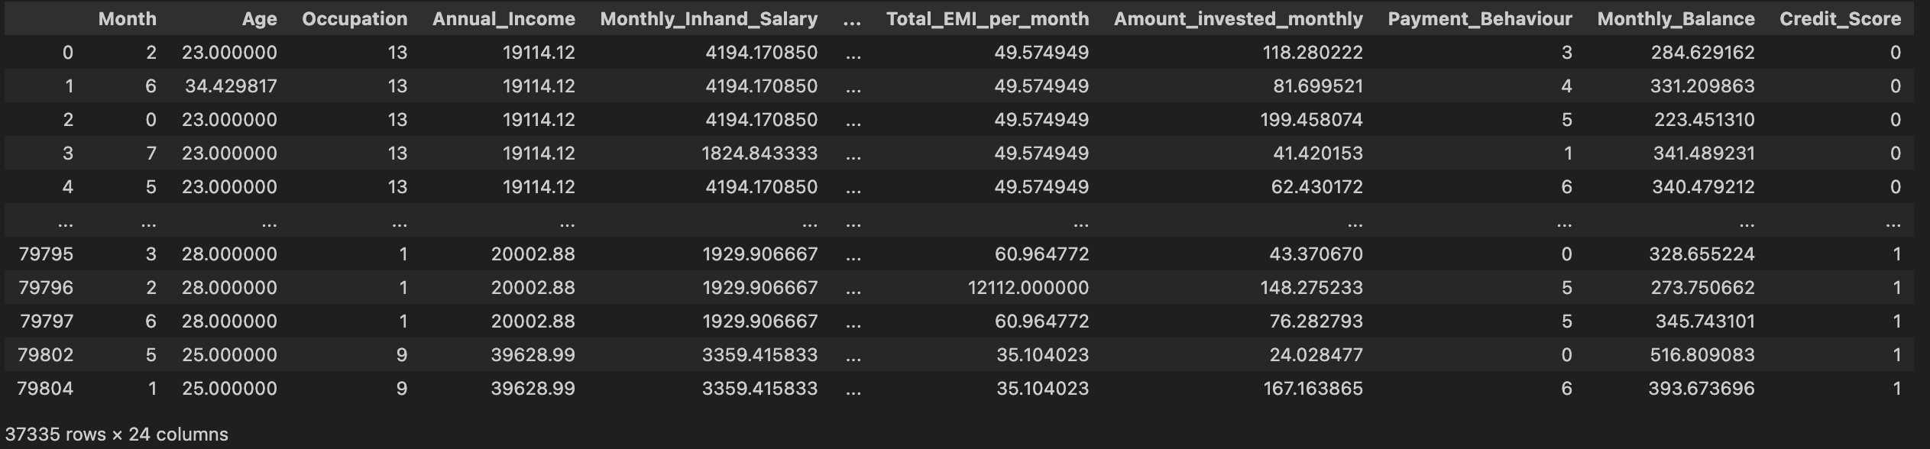
Classification Dataset
Credit Scoring
Task: Given a person’s credit-related information, build a machine learning model that can classify the credit score.
Number of samples: 37K
Number of features: 23
Target: Credit Score (good, bad or standard)

Slide 4
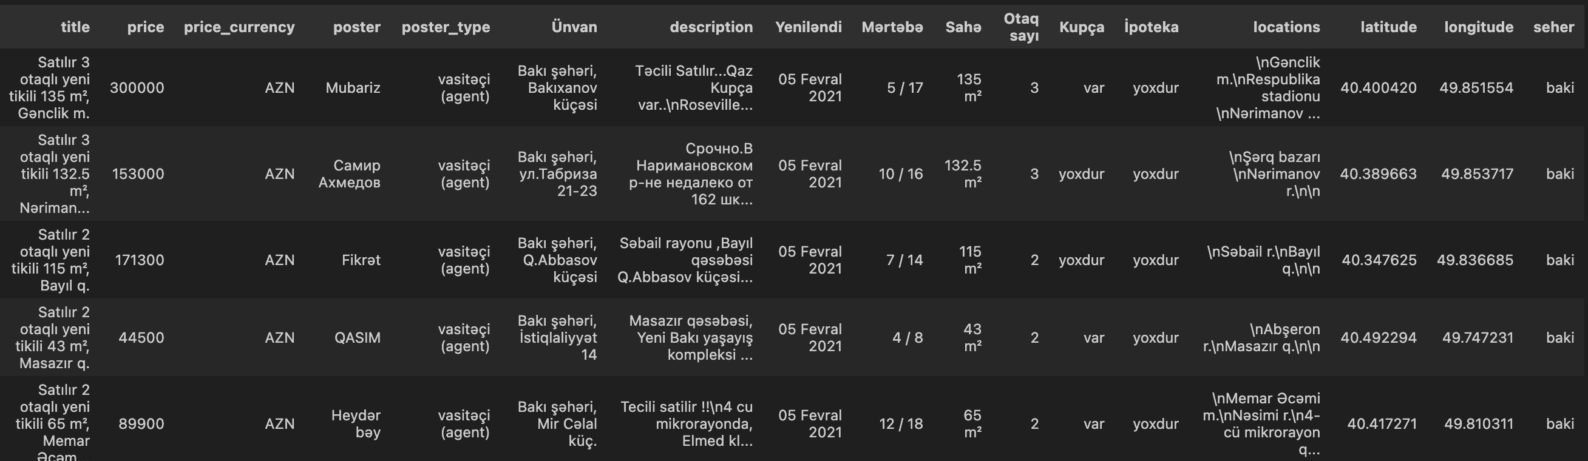
Regression Dataset
Scraped ~60K data points from bina.az with 17 fields.

Slide 5
non-linearity for regression task

Slide 6
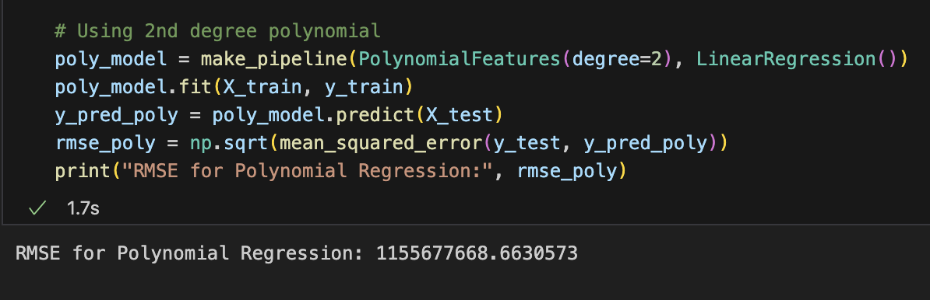
polynomials
Polynomial regression models are an extension of linear regression models that allow for polynomial terms of the predictors.
Enables the model to fit a wider range of data shapes by including squared, cubed, and higher-power terms of the predictors.
2nd degree polynomial

Slide 7
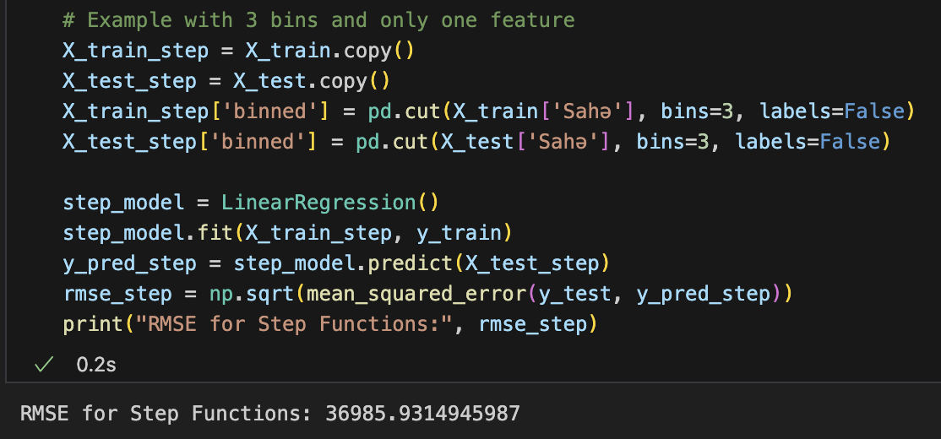
step functions
Step functions divide the range of a variable into k intervals, creating a new categorical variable with distinct levels.
This allows the model to fit different constants for different intervals in the data, essentially fitting piecewise constant models.

Slide 8
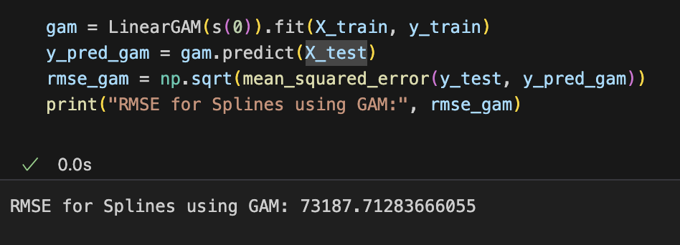
splines
Splines provide a way to fit flexible, smooth curves to data without needing to use high-degree polynomials, which can lead to overfitting.
They work by fitting simple polynomials in different sections of the data range, with constraints that ensure the sections join smoothly.

Slide 9
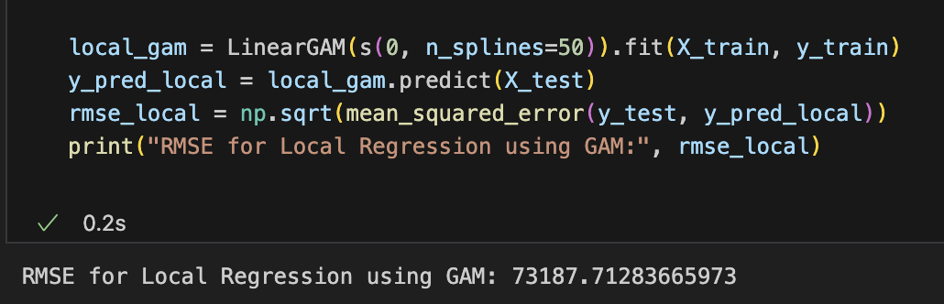
local regression
Local regression, or LOESS/LOWESS (Locally Estimated Scatterplot Smoothing), is a non-parametric method that fits multiple regressions in local neighborhoods of each data point. The weight of the data points decreases with distance from the point being estimated, providing a smooth curve that closely follows the data.
n_splines = 50

Slide 10
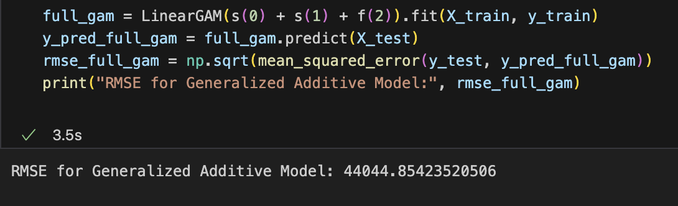
generalized additive models (GAM)
Generalized Additive Models extend linear models by allowing non-linear functions of each of the variables, while maintaining additivity.
Like linear models, GAMs are fitted to data using the method of least squares.

Slide 11
tree-based methods for classification task

Slide 12
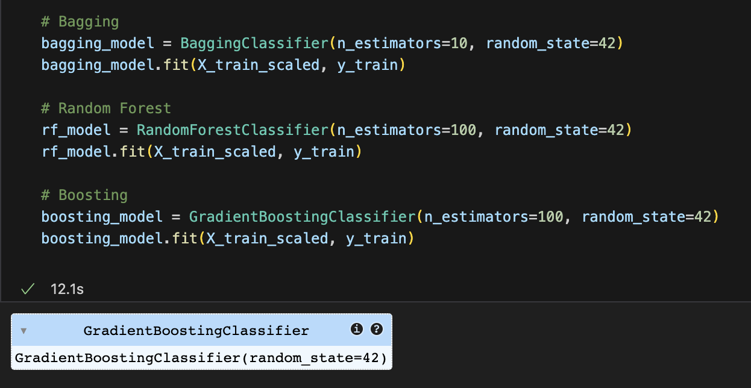
bagging, random forests, boosting
Bagging (Bootstrap Aggregating) uses multiple models (usually of the same type), each trained on random subsets of the training data. It reduces variance and helps to avoid overfitting.
Random Forest is an extension of bagging, applied specifically to decision trees. This method also uses a combination of learning models to increase accuracy. It not only samples the data points but also the features when building trees
Boosting is a sequential technique which works on the principle of correcting the errors of a previous model with the next model in the sequence. Each new model incrementally improves upon the previous one, typically leading to a powerful combined model.

Slide 13
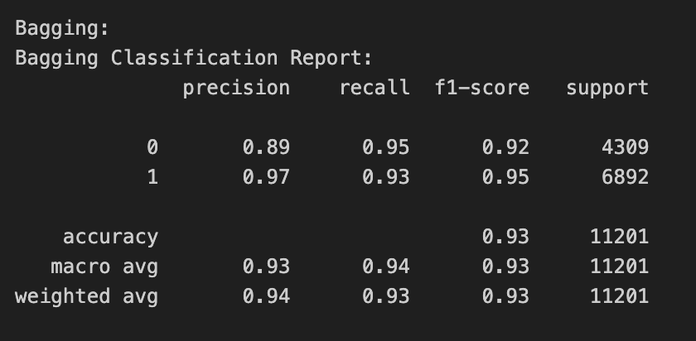
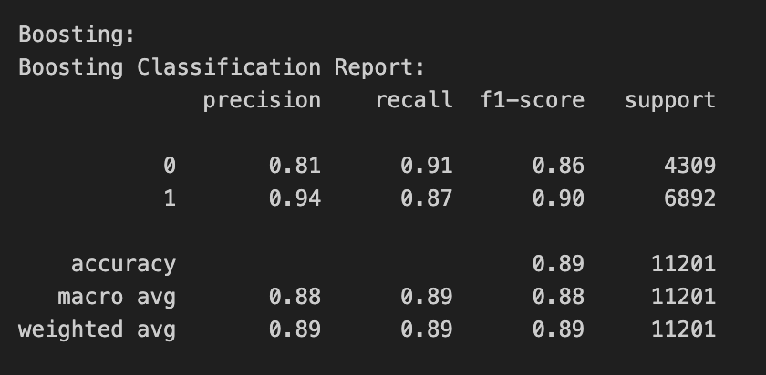
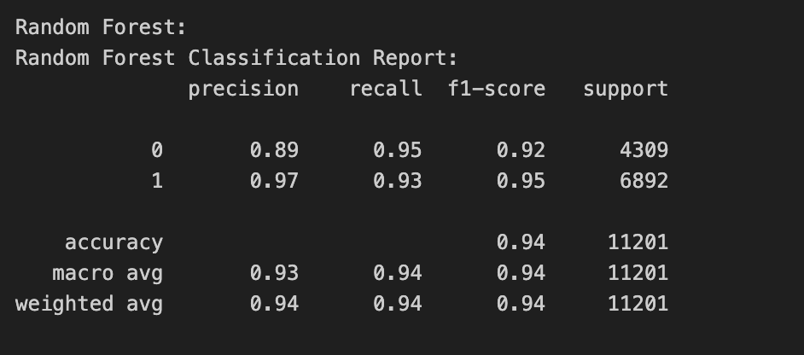
Bagging
Boosting
Random Forest

Slide 14
SVM for classification with different kernels

Slide 15
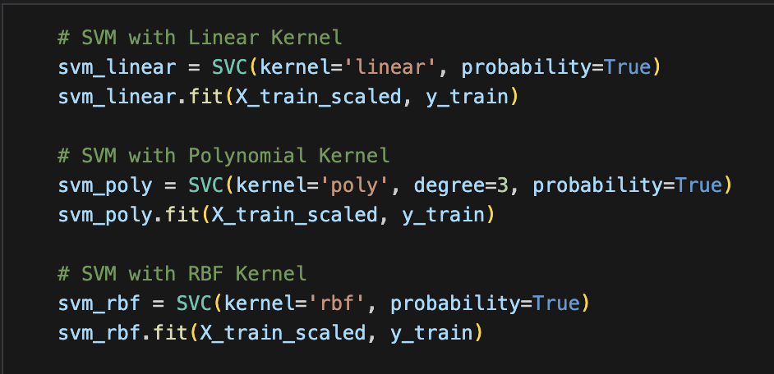
Suppor Vestor Classifier
Support Vector Machine (SVM) with a linear kernel is a type of linear classifier that finds the hyperplane that best separates two classes in the feature space with the maximum margin.
SVM using a polynomial kernel is a non-linear classifier that represents the dot product between vectors in a feature space over polynomials of the original data, allowing it to fit non-linear relationships.
The Radial Basis Function (RBF) kernel is a popular SVM kernel that can map data into higher dimensions to handle cases where the relationship between class labels and attributes is nonlinear.

Slide 16
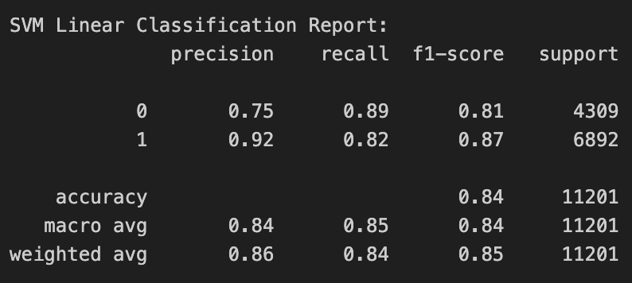
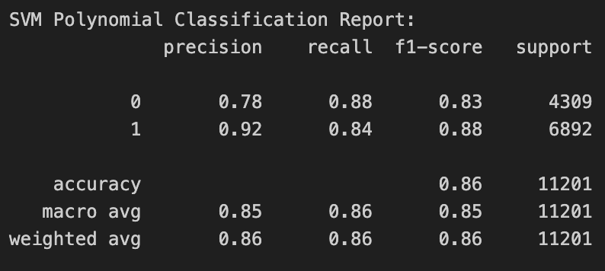
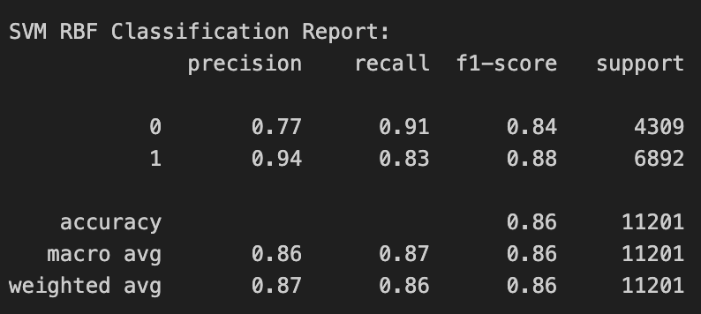
SVM Linear
SVM Polynomial
SVM RBF

Slide 17
Thank you!

