Slide 1
Applied Machine Learning & Data Analytics
Classification
Prof. Rustamov Samir
Eljan Mahammadli & Sokrat Bashirov
09/04/2024

Slide 2
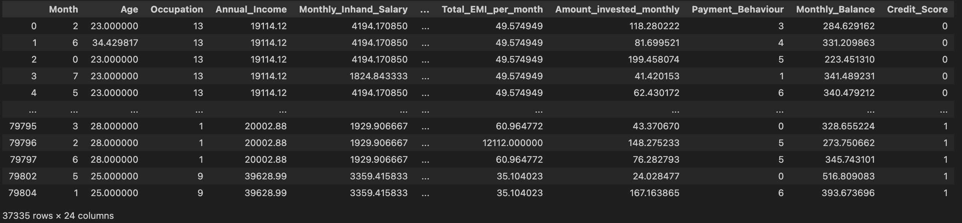
Dataset
Credit Scoring
Task: Given a person’s credit-related information, build a machine learning model that can classify the credit score.
Number of samples: 37K
Number of features: 23
Target: Credit Score (good, bad or standard)

Slide 3
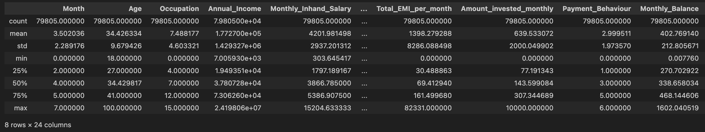
Basic Stats

Slide 4
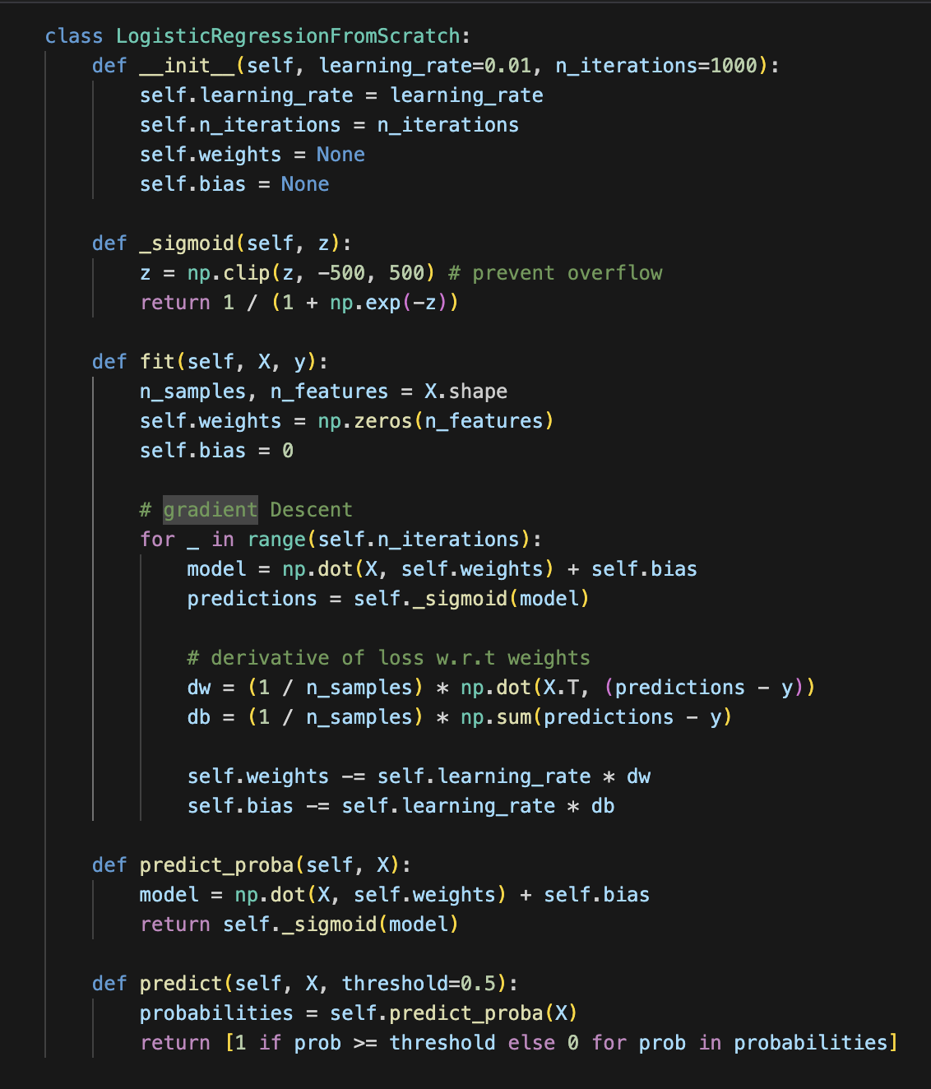
Logistic Regression
From scratch
This class trains by iteratively adjusting weights and bias to minimize error using gradient descent on the training data.
Main hyperparameters:
learning_rate
n_iterations
we can also add regularization

Slide 5
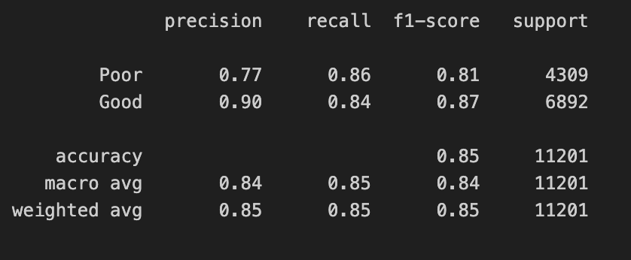
Logistic Regression
Evaluation

Slide 6
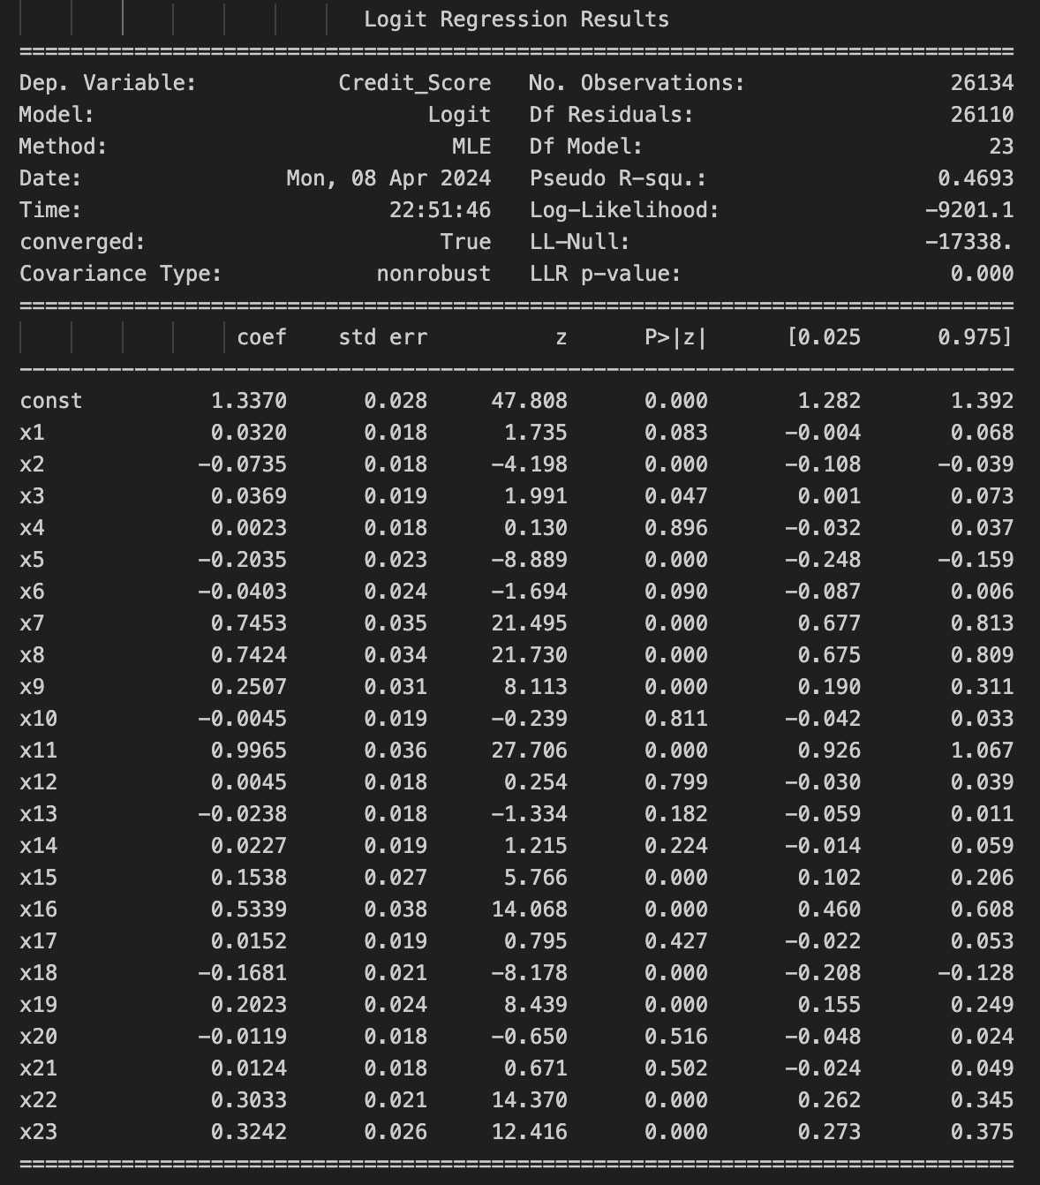
Standard error, Z-statistic and p-value
for each coefficient
Standard Error: The SE measures the precision of an estimate, specifically how much the estimate of the coefficient varies across samples.
Z-statistic: This is the coefficient divided by its standard error. It measures the number of standard deviations the coefficient is from 0.
P-value: The p-value indicates the probability of observing the data assuming the null hypothesis is true, which usually states that the feature has no effect.

Slide 7
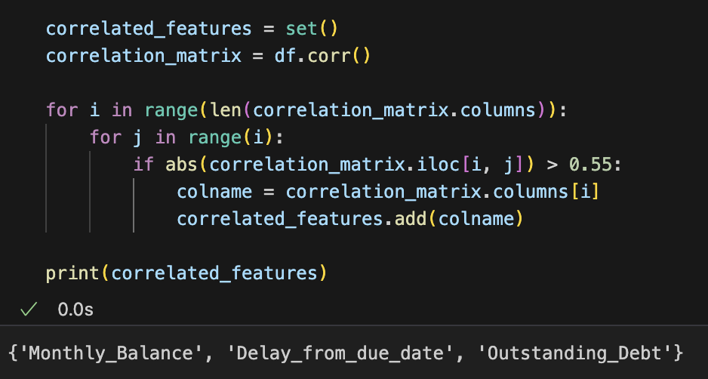
Confounding variable
A confounding variable is an external factor that influences both the dependent and independent variables, potentially distorting the perceived relationship between them.

Slide 8
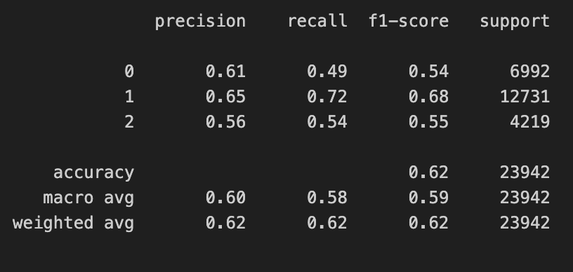
Logistic regression
with more than two classes
Since we have 3 classes in the target column we can train Logistic Regression using all classes.
We did not get good result on this and could not investigate the reason of this further.

Slide 9
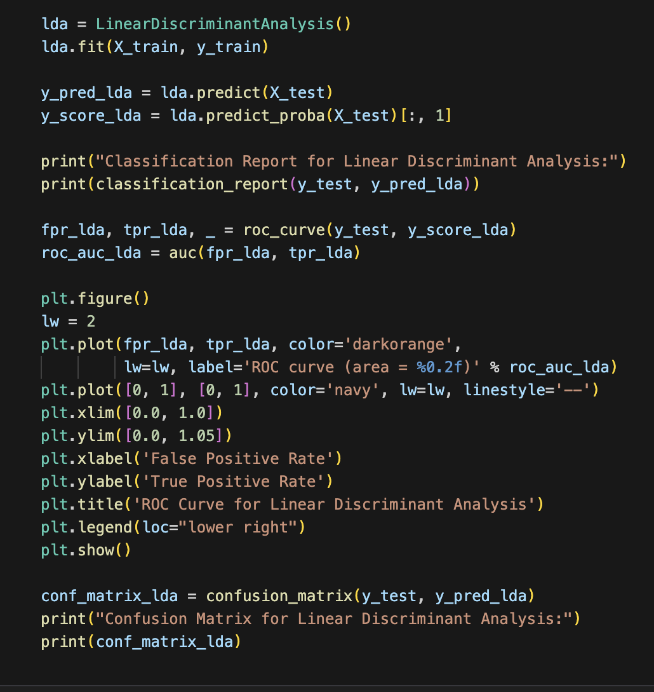
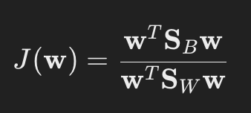
Linear Discriminant Analysis
Linear Discriminant Analysis (LDA) is a supervised learning algorithm that projects high-dimensional data onto a lower-dimensional space to maximize class separability for classification purposes.
We use scikit-learn for LDA
J(w) is the criterion to be maximized
w is the vector of weights that defines the projection direction,
SB is the between-class scatter matrix, reflecting the separation between the different classes,
SW is the within-class scatter matrix, reflecting the variance within each class.

Slide 10
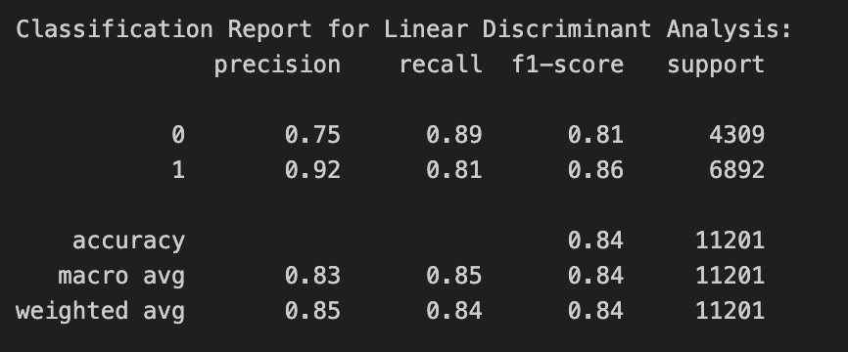
LDA Evaluation

Slide 11
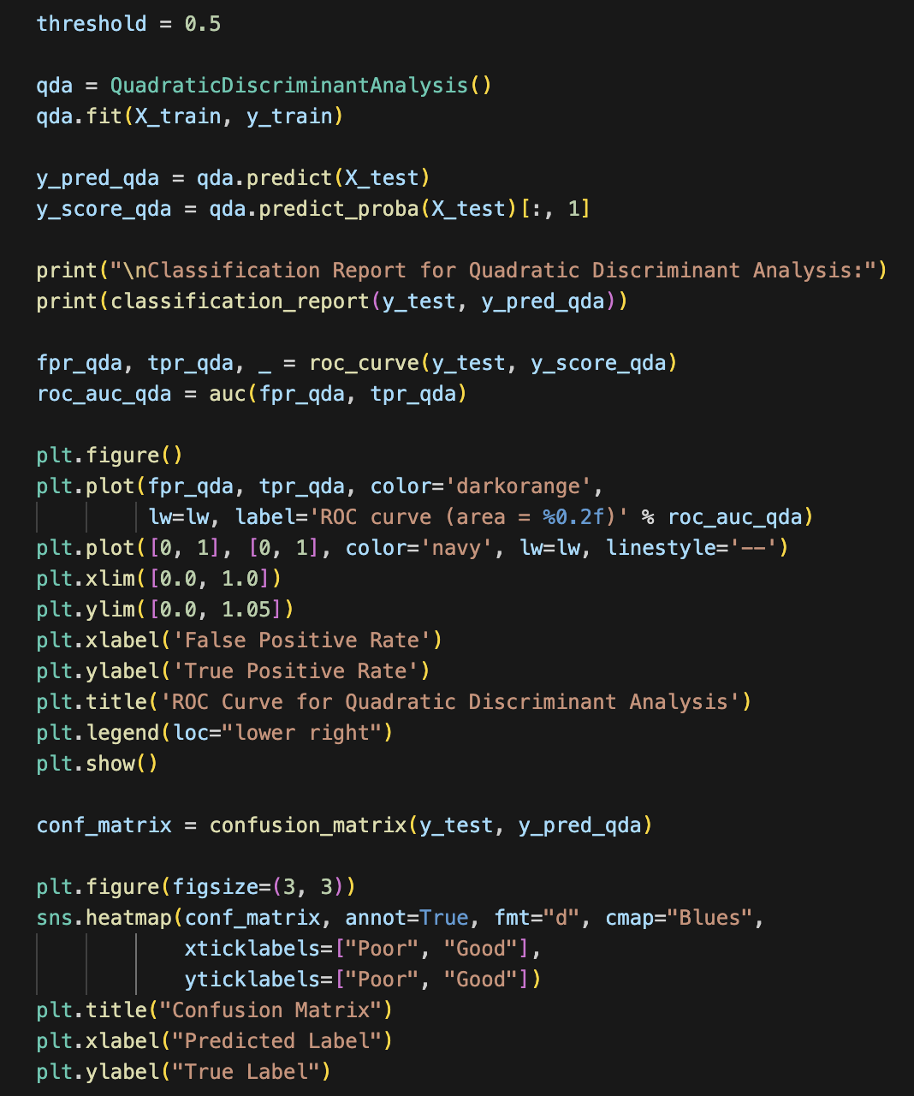
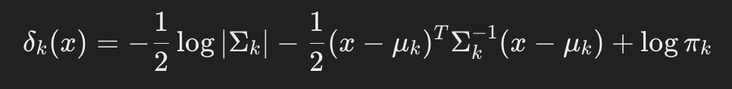
Quadratic Discriminant Analysis
It is a classification technique that generalizes LDA by allowing for non-linear decision boundaries, accommodating different covariance structures across classes.

Slide 12
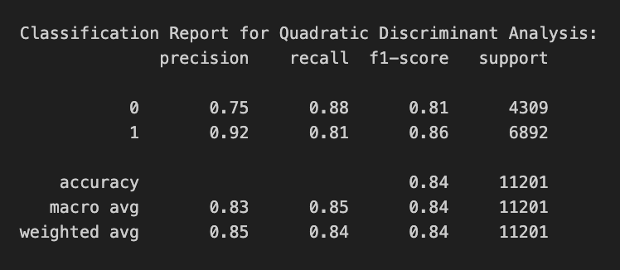
QDA Evaluation

Slide 13
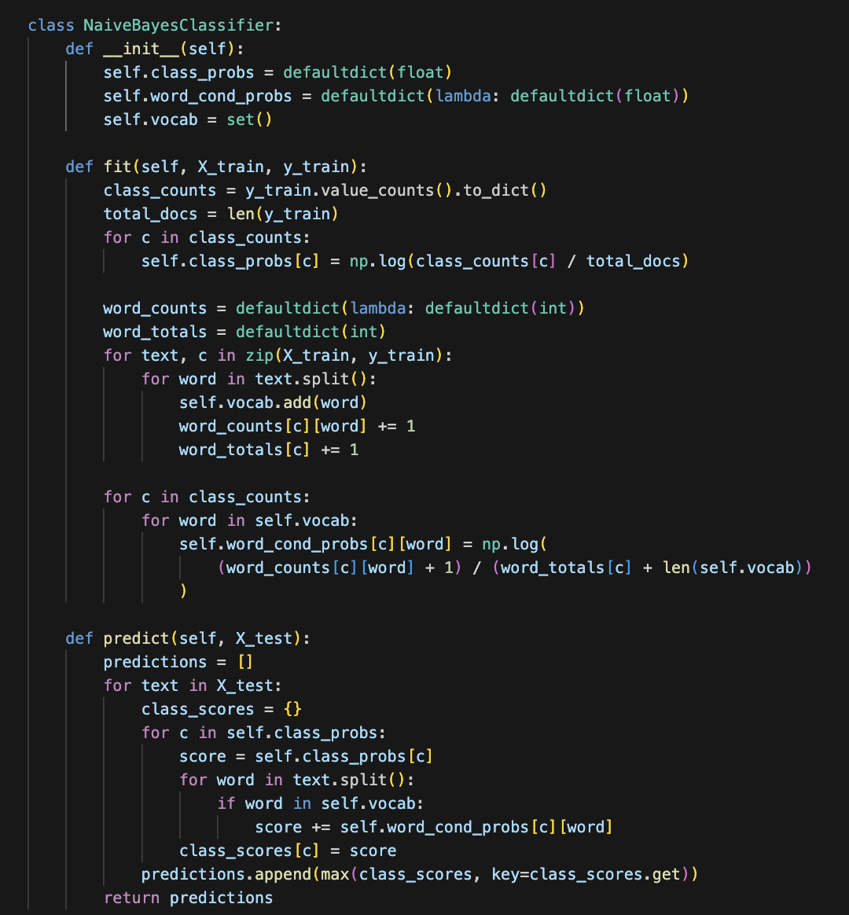
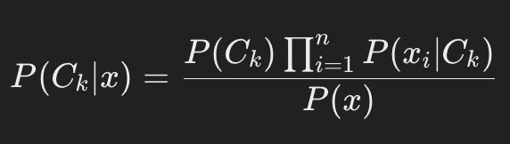
Naïve Bayes
It is a probabilistic classifier that applies Bayes' theorem with strong independence assumptions between the features.

Slide 14
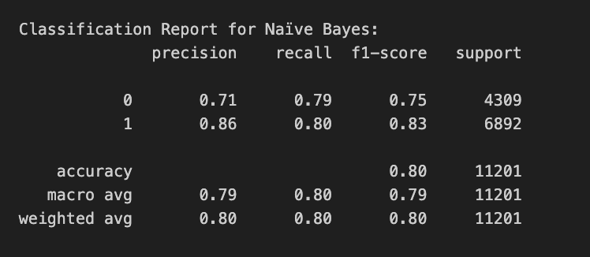
NB Evaluation

Slide 15
Comparison of eval results
We can see that the performace LR, LDA and QDA are very identical.
Naive Bayes seems to have the worse result.
Otherwise, there does not seem to have too much difference
Model | Precision | Recall | F1 | AUC
LR | 90 | 84 | 87 | 92
LDA | 92 | 81 | 86 | 91
QDA | 92 | 81 | 86 | 90
NB | 94 | 79 | 86 | 89

Slide 16
Thank you!

