Slide 1
Applied Machine Learning & Data Analytics
Linear Regression
Prof. Rustamov Samir
Eljan Mahammadli & Sokrat Bashirov
02/04/2024

Slide 2
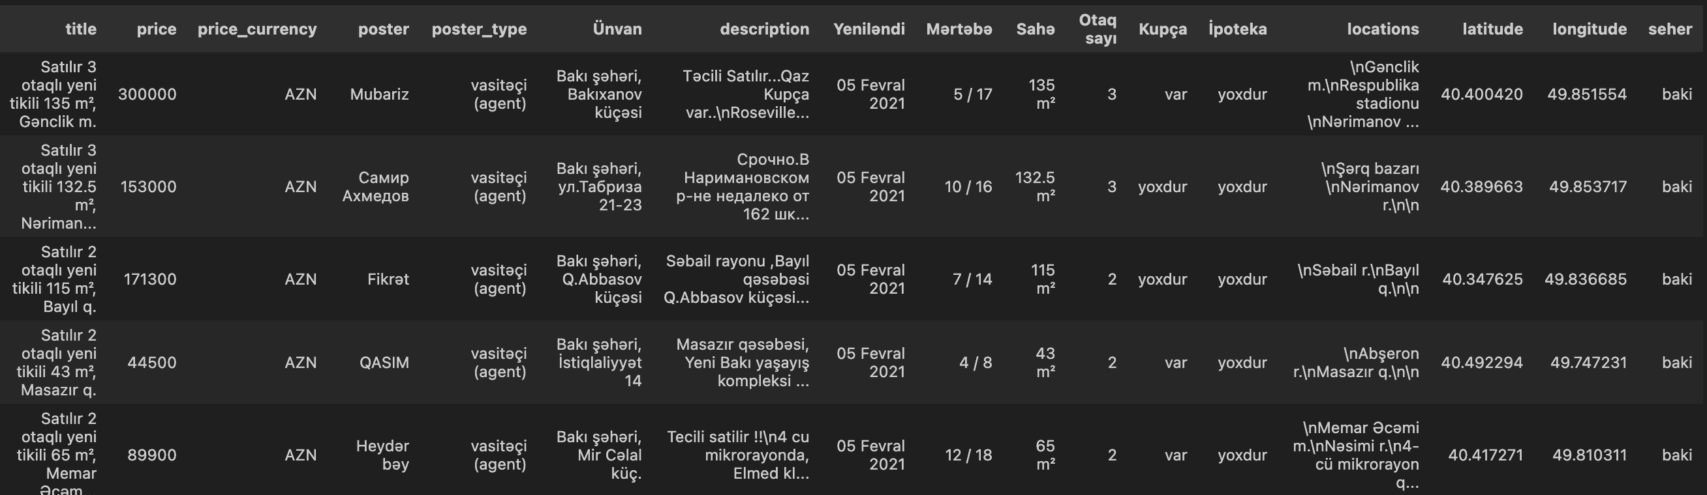
Raw Data
Scraped ~60K data points from bina.az with 17 fields.

Slide 3
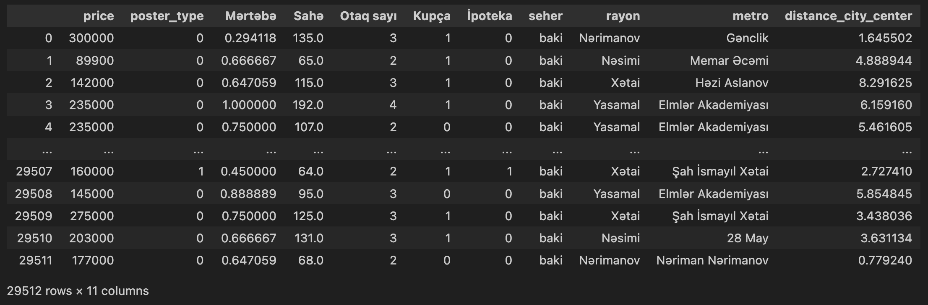
Preprocessing & Feature Engineering
Generated following features:
Distance from the city center using “latitude" and “longitude”.
Floor ratio
Parsed metro station and region from the location
Cleaned and filtered some data points
Parsing numeric values from the strings
Dropping unnecessary columns
Removing NaNs
Removing outliers using IQR method
Normalizing columns
…

Slide 4
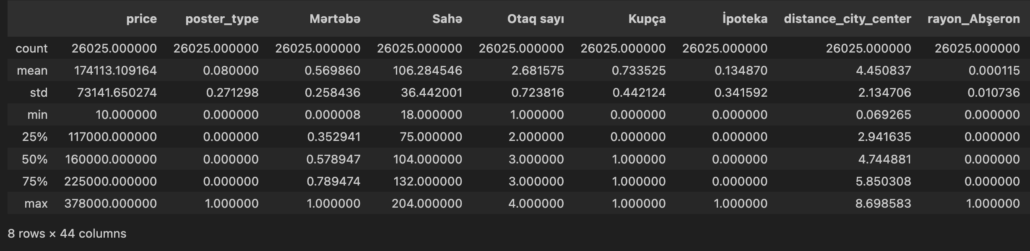
Stats

Slide 5
Correlations

Slide 6
Linear Regression with single predictor
We use Area as a single predictor as it seems like there is linear correlation between that and the target price.

Slide 7
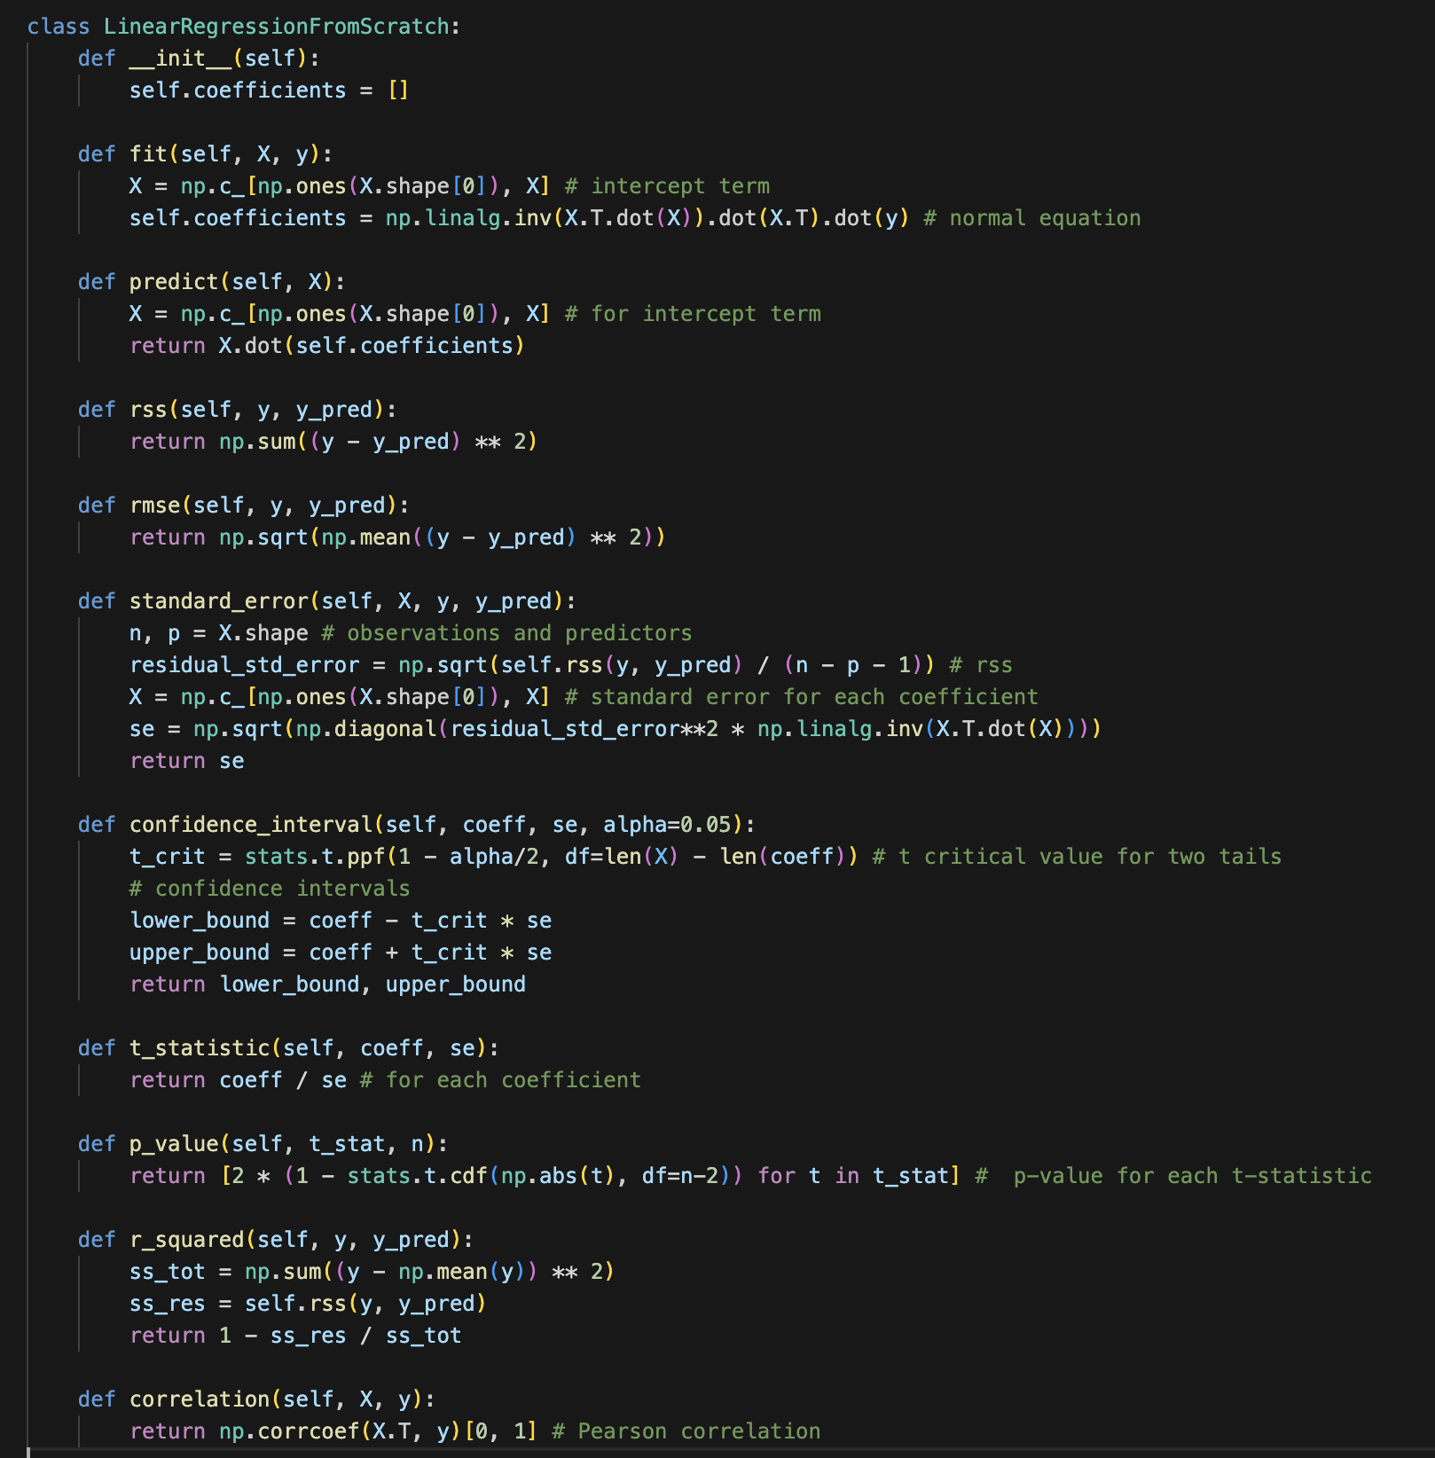
Linear Regression
from scratch
Coefficients: [12900.08058656 1497.74171075]
RSS: 8874116200072.938
RMSE: 41890.55157510048
Standard Error: [1854.33381657 16.90824291]
Confidence Interval: (array([9265.47907907, 1464.60057693]), array([16534.68209405, 1530.88284457]))
T-Statistic: [ 6.9567197 88.58056505]
P-Value: [3.9261927042844036e-12, 0.0]
R-Squared: 0.6053647528558667
Correlation: 0.7780673527578185

Slide 8
Linear Regression
with multiple predictors
Simple Linear Regression:
RSS: 5707670242808.45
RMSE: 33595.64
R-squared: 0.74
Polynomial features:
RSS: 6307179433659.83
RMSE: 34810.25
R-Squared: 0.77
Interactions:
RSS: 6430645388941.551
RMSE: 35149.31
R-Squared: 0.76

Slide 9
Useful features
Feature with p-value lower than 0.05 we accept as useful feature:
27 out of 44 features are below 0.05
Some of them are:
'price', 'area', ‘num_rooms’, 'kupça', ‘ipoteka
Model does not seem to capture the data very well as we have lower R-Suared value and high RMSE

Slide 10
Backward Elimination
to get the subset of features
finding subset of the predictors using backward elimination method

Slide 11
Thank you!

